Slide 1

Davis Instruments Corporation
DriveRight®
First look at DriveRight 600e ,Fleet & FMS Software

Slide 2
DriveRight 600
Davis Instruments’ flagship safety product

Slide 3
DriveRight 600 Features
Driver ID entry
Trip details: High and average speed, start and end times, accelerations and decelerations
LCD interface, with audible alarms for instant driver feedback
And more…

Slide 4
DriveRight 600 Advances
Now GPS compatible
600 trips, with GPS location marks
“20+20” accident reporting, with GPS location marks
GPS pinging (“bread crumbing”) during vehicle motion, and marks for all stops
Digital input tracking

Slide 5

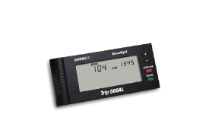
DriveRight 600 - Memory Capacity
Driving 5 trips/day = 120 days
Driving 10 trips/day = 60 days
Driving 15 trips/day = 40 days
Driving 20 trips/day = 30 days
Notes:
This helps to determine how long a Trip 500AL can stay in a car before older trips are written over. Days without any trips do not count against the total storage capability.

Slide 6
20+20 Accident Reporting
Captures the vehicle speed readings each second for 20 seconds leading to and after a sudden deceleration
With GPS option, each Accident Log is tagged with the location of the event

Slide 7
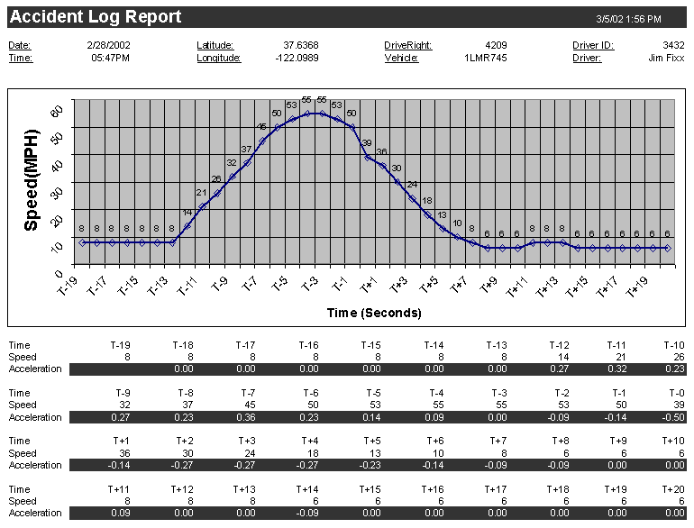
20+20 (Enlarged)

Slide 8
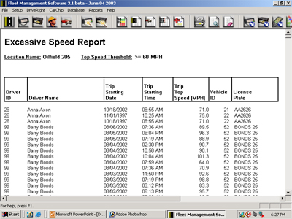
Fleet Management Software
Powerful Tools for the safety manager

Slide 9
DriveRight FMS 3.1 Highlights
Interface and reporting designed for the manager
Database flexibility
Smart data handling and archiving
Multiple data transfer options
Strong suite of summary reports
Emailing capabilities

Slide 10
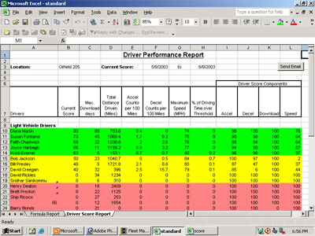
Driver Safety Score Report
One-line summary of all safety-related driving for each driver

Slide 11
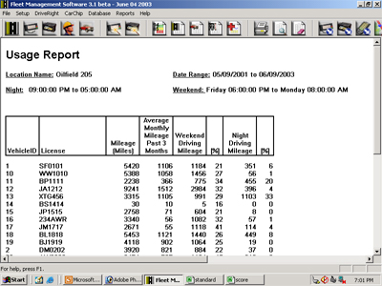
Usage Report
Quick summary of vehicle use, including night and weekend vehicle use

Slide 12
Exception Reporting
Filters to check for excessive speed, night driving, and hard accelerations and decelerations

Slide 13
New Database Flexibility
New ODBC (Open Database Connectivity) compliant design lets users decide upon preferred database platform
Supports Microsoft Access, Oracle 9i, MySQL, and MS SQL Server, with ability to add others

