Slide 1
Temme
Shi Feichao
https://github.com/shinima/temme

Slide 2
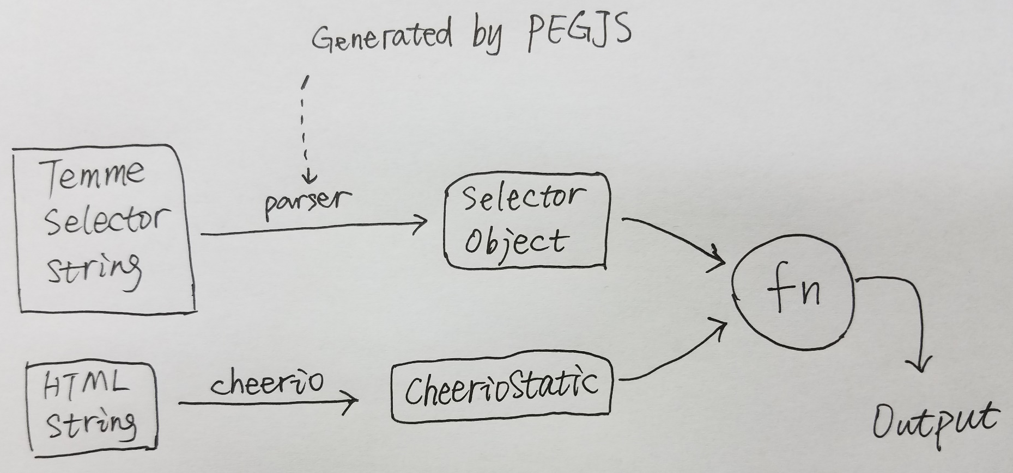
Inspired by emmet, built on top of cheerio
Fast, flexible, and lean implementation of core jQuery designed specifically for the server. -- cheerio
The essential toolkit for web-developers. -- emmet
Better selector on top of CSS selector for node crawler.(暂定) -- temme

Slide 3

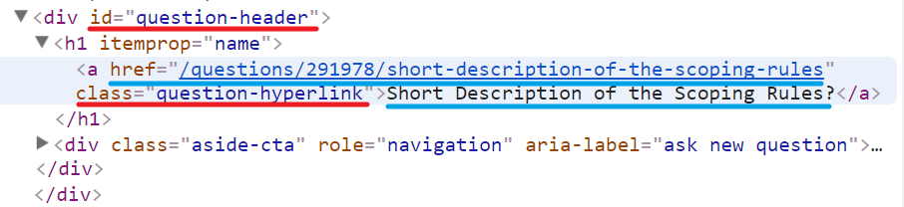
Basic Example
Every Question has a name and a url.

Slide 4
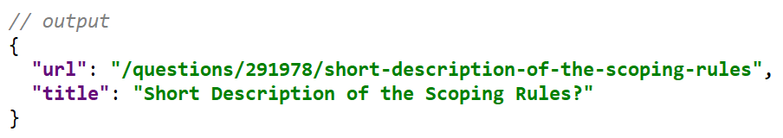


Use $xxx to capture what you need.
Or use $ to make a default capture.

Slide 5
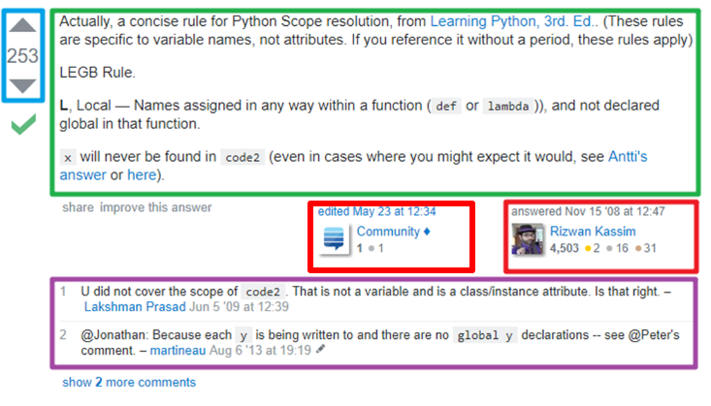
Capture an array of items.
There are several answers in this question.
Vote
Answer
Authors
Comments

Slide 6
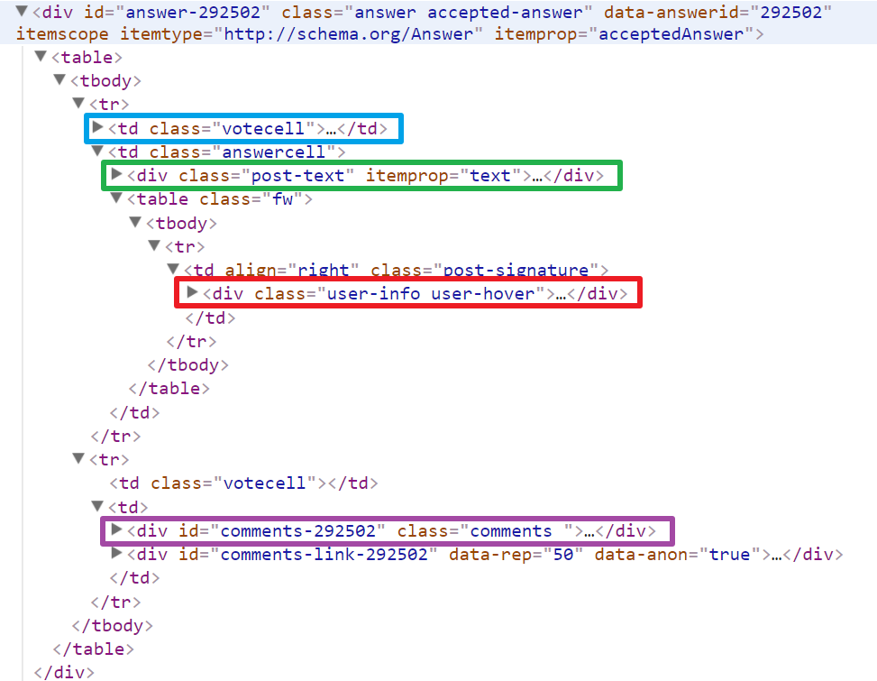
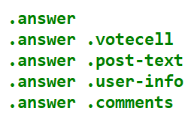
Capture an array of items.

Slide 7

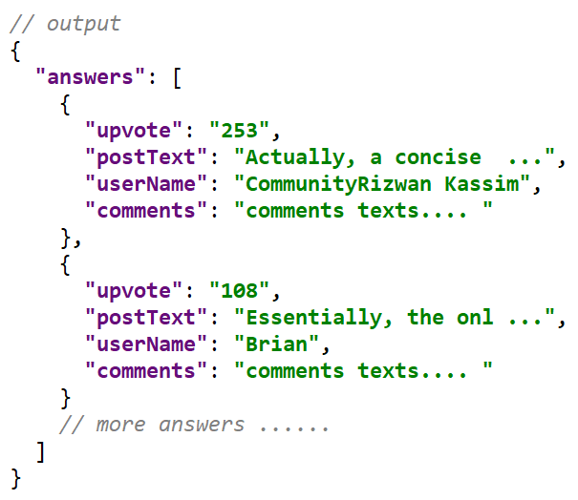
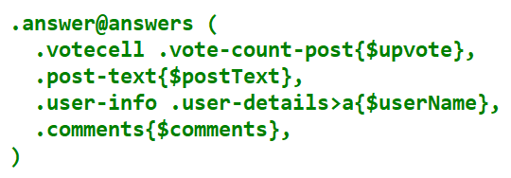
Use @xxx to generate an array of captures.

Slide 8
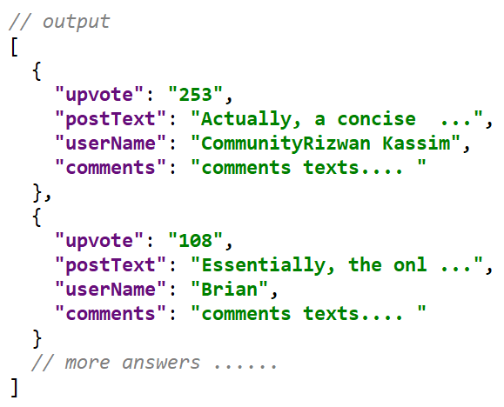
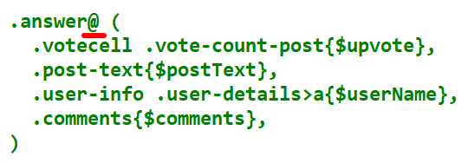
Or use @ to make a default capture.

Slide 9
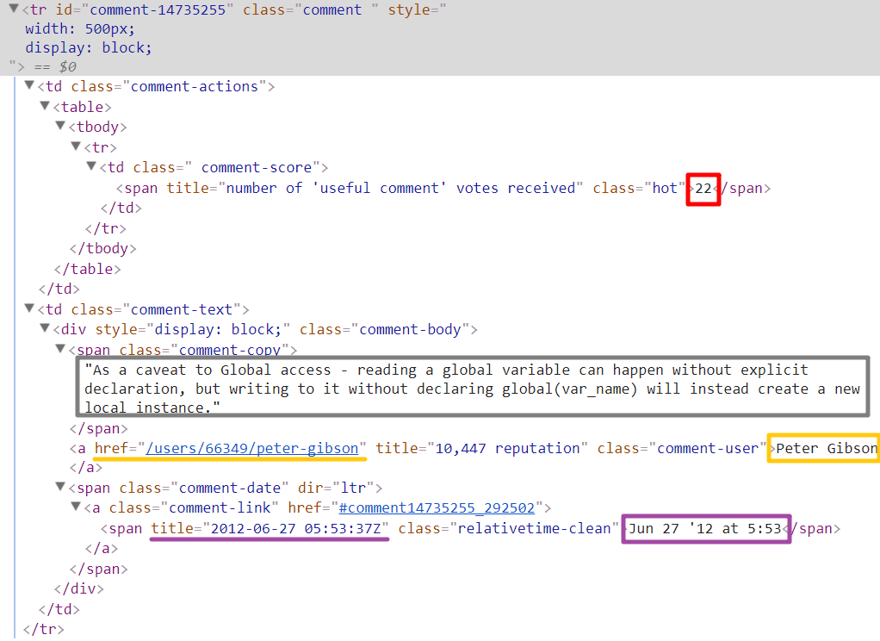
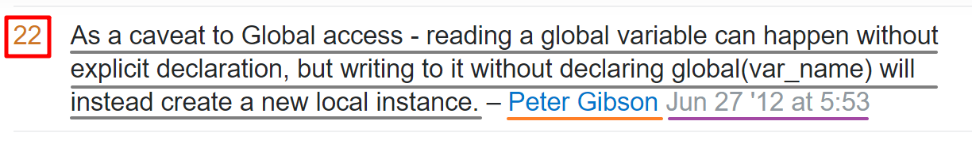
Capture an array of arrays of items.
One question has several answers.
Each answer has several comments.
Score
Text
User name
Date

Slide 10
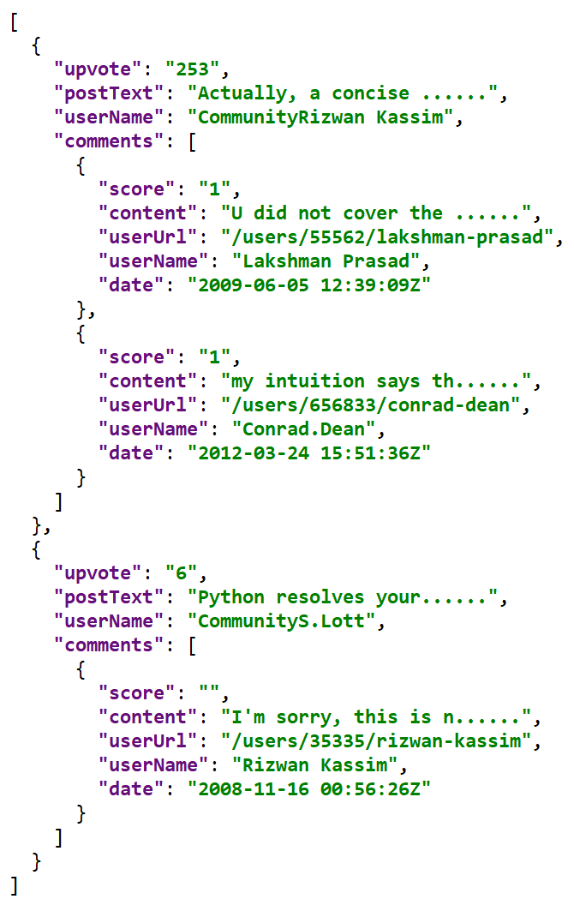
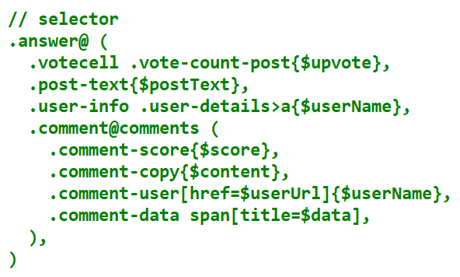
Capture an array of arrays of items.

Slide 11
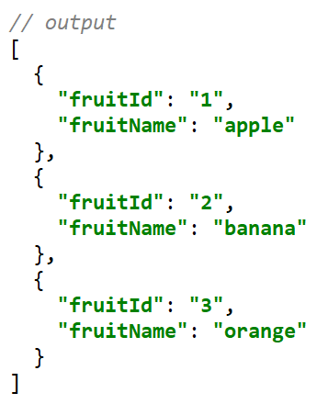
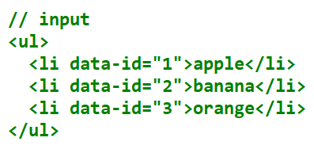
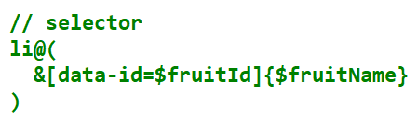
Parent Reference operator: &
Same as stylus parent reference operator.
Use & to reference parent in the child selector.
& is required when you want to capture data in the parent element.

Slide 12


Capture filters(post-processors)
Built-in filters
pack
splitComma
splitBlanks
Boolean
Number
String
Date
firstLine
Trim
asWords
json
(This list may change over time).
Every time variable x is captured, it will be processed like x = bar(foo(x)) .
A filter is a simple function that receives a single parameter and returns a single value.
Use defineFilter to add customized filters.
Some examples:
Cohere to Moment
Use regular expression to extract url from a complex string.

Slide 13
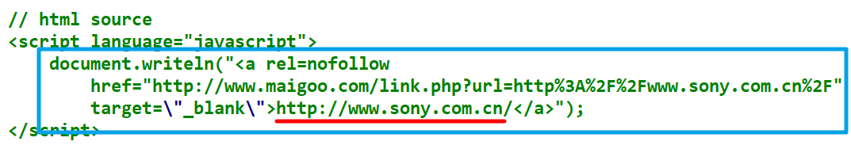


Filter example: Use regular expression to extract url from a complex string
// define filter defineFilter('extractUrl', function (s: string) { const r = s.match(/>(.+)<\/a>/) return r && r[1] })

Slide 14
Content functions
By default, ul@(li{$name}) will capture text content of element into variable name.
We could use other functions to capture html or cheerio-node.
Four built-in content functions:
text($var) captures the text content of element (default behavior).
html($var) captures the inner-html of element into var.
node($var) captures the cheerio-node into var.
contains('xxx') checks whether text content contains 'xxx' and captures nothing.
Content functions accept multiple arguments:
e.x text($name, ':', $value)
text/html function supports string matching.
The above selector will try to match string of form 'foo:bar' and capture part foo into name, part value into value.
Using multiple content functions in a single curly brace
x{func1, func2, func3}

Slide 15

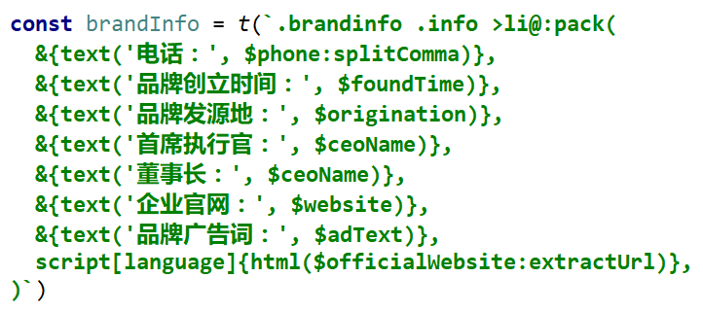
More examples

Slide 16
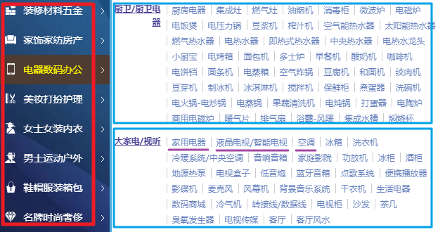
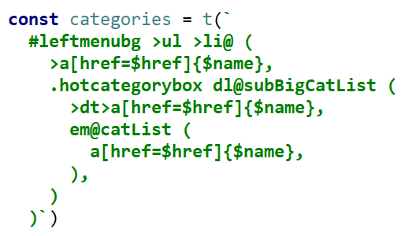
More examples

