Slide 1

Using an API for Services

Slide 2

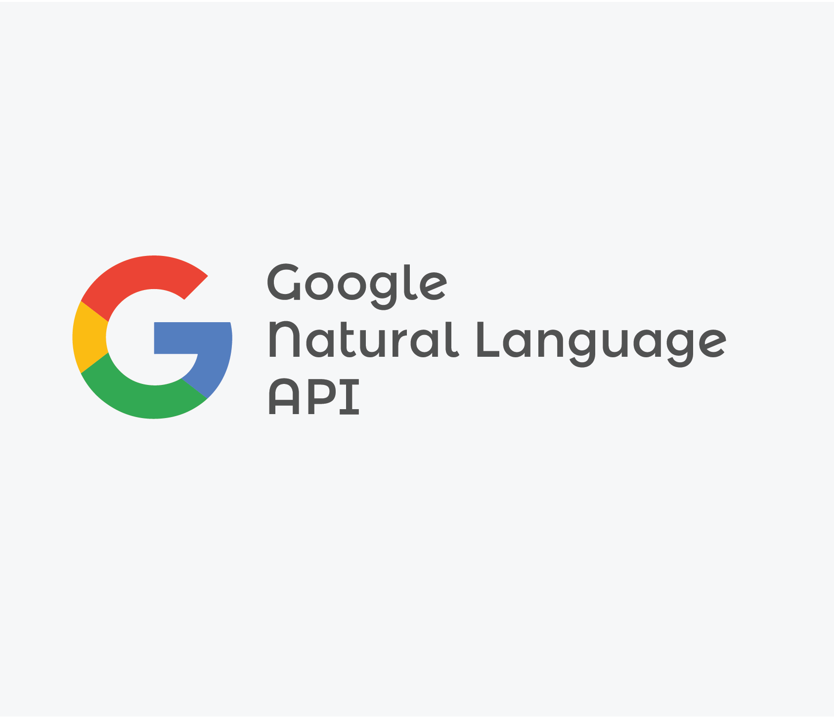

library(googleLanguageR)
R will make NLP requests to Google Services.

Slide 3


How does Speech to Text Work?
Phonetic Indexing & Speech Transcription
Phoneme Indexing & Speech Transcription
“The phonetic indexing and search technology works in two phases: indexing and searching. During the indexing phase it builds an index of the speech content using a phoneme-based speech recognition system. The speech content is transformed into phoneme lattices, which are compact probabilistic representations of the possibly uttered sentences. Special lookup trees are then built for these lattices in order to reduce look-up time during queries.”
Statistically weighted language model to the sequences of phonemes to derive the most likely combination of phonemes into words (the sounds “Z” and “K” are rarely heard in that order) and sentences of what was actually being said (to solve for the acoustic confusion of “recognize speech” versus “wreck a nice beach”). This is similar to how the human brain applies context to reason out what is being said in a noisy environment (if you are in a loud doctor’s office, the nurse most likely said “Wait Here”, not “Weight Hear”).
Audio is matched to a huge library of audio dictionary (100Ks of entries), those dictionary entries match known text transcriptions
Audio is matched to a small library of phonemes(44 in English), the sequences are probabilistically determined

Slide 4
Open H_GoogleAPI_NLP_Services.R
-Slow
-Computationally Expensive
+Accurate
-Fast
+Low Computation Cost
-Less Accurate
Speed
Cost
Accuracy
Like many business decisions you get 1 or 2, and have to prioritize the other attributes.

