Slide 1
Biomarker Analysis Strategies:
Some Case Studies
Abraham Apfel
May 21, 2019
Notes:
1

Slide 2
Pharmacodynamic Analysis

Slide 3
Analysis Goals
Analyze blood RNA-Seq data (141 samples from 18 patients with selected advanced solid tumors and haematological malignancies) for 18,591 genes to help inform dose and schedule selection.
Identify top genes with changes in expression over time that are consistent across dosing schedule

Slide 4
Sample Collections
Subjects and doses split over multiple batches – needed to account for subject and batch variation in model
D14 Dose
C1D1 Dose
Schedule 1
Cycle 1
Washout
Cycle 2
GEP samples
0h
(pre)
4h
8h
24h
0h
(pre)
4h
8h
24h
C1D1 Dose
D7 Dose
Schedule 2
Cycle 1
Washout
Cycle 2
GEP samples
0h
(pre)
4h
8h
24h
0h
(pre)
4h
8h
24h

Slide 5
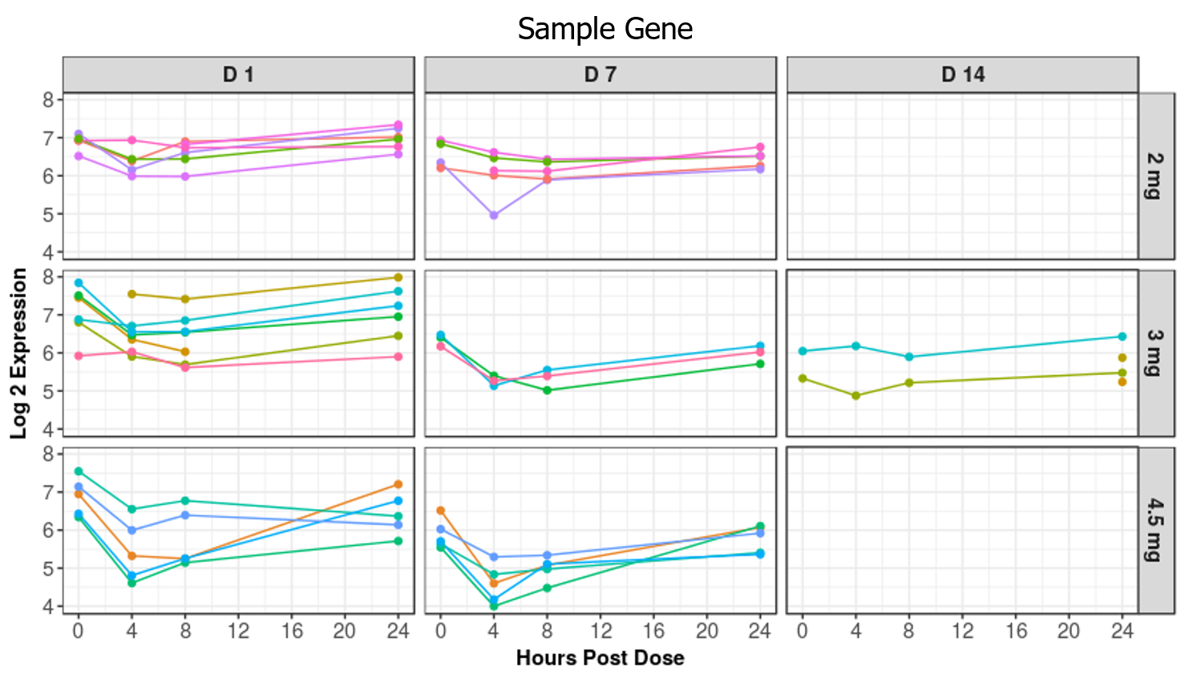
Sample Collections

Slide 6
Analysis Challenges
Batch Effects
Subject-subject and batch variability
Bridge samples
Dose*Day (schedule)*Time (hours post-dose) interaction
Anticipated non-linear relationships between gene expression and time
Over 4,500 genes were found to have Benjamini-Hochberg adjusted p-values < 0.05
Looking for expression patterns that are consistent across dose levels and cycle day

Slide 7
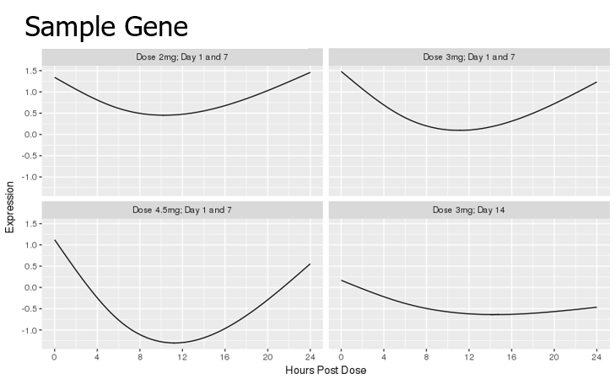
Gene Selection
Ran Linear Mixed Models to test for and estimate the relationship between gene expression and time
Averaged time effects across C1D1 and C2D7 for each dose level to identify genes with changes consistent across days
Did not test for relationship in C2D14 samples due to small number of samples
Removed genes that had a B-H adjusted p-value > 0.05
~ 4,500 genes remained, out of 18,591 total

Slide 8
Gene Expression Model
Linear mixed effects model (using R lmer function)
Response variable: Log2(gene expression)
Fixed Effects Portion of Model
Expression = Factor + CS + Factor*CS
Factor Levels (combination of Dose and Day):
2mg C1D1 & C2D7
3mg C1D1 & C2D7
4.5mg C1D1 & C2D7
3mg C2D14
CS represents two cubic spline basis functions for hours post dose, with one knot at 6 hours post dose.
Random Effects Portion of Model
Batch: Random intercept
Subject: Random intercept and random slope based on time as a continuous variable across both cycles, which imposed a decreasing correlation over time within each subject

Slide 9
Hypothesis Testing
H₀: Coefficient for each CS function (main effect or any interaction, excluding the interaction with curve representing C2D14) = 0
Interpretation: No time effect at any dose
H₁: Time effect at one or more doses
Likelihood Ratio Test, using bootstrap to get empirical p-values (via “pbkrtest” package in R)

Slide 10
Models
 | Fixed Effects
Factor | Full Model | Reduced Model
2mg C1D1 & C2D7 | μ + τ₁ + τ₂ | μ
3mg C1D1 & C2D7 | μ + β₂ + τ₁ + τ₂ + i₂₁ + i₂₂ | μ + β₂
4.5mg C1D1 & C2D7 | μ + β₃ + τ₁ + τ₂ + i₃₁ + i₃₂ | μ + β₃
3mg C2D14 | μ + β₄ + τ₁ + τ₂ + i₄₁ + i₄₂ | μ + β₄ + i₄₁ + i₄₂
μ: Intercept
β_{i}: Main effect factor coefficient
τ_{i}: Main effect basis function for cubic spline coefficient
i_{ij}: Interaction coefficient between basis function and factor

Slide 11
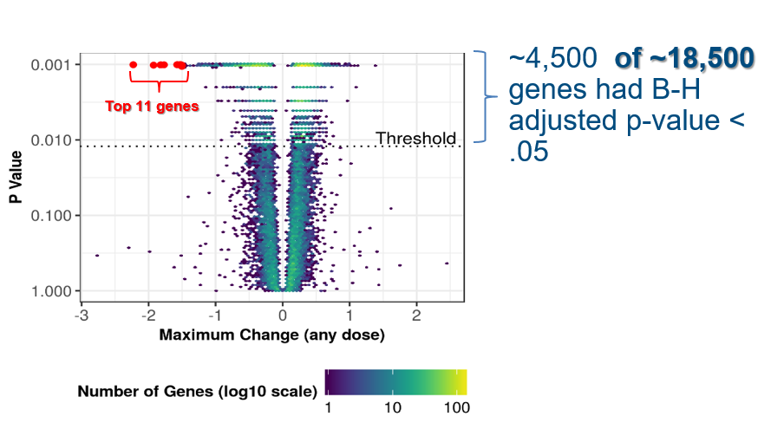
Gene Rankings
Calculated maximum change from baseline for each of the four curves described above within each gene
Selected curve with maximum absolute change (excluding the curve representing Cycle Day 14) for each gene
Ranked genes according to their respective selected maximum absolute change
Reported top 11 ranked genes
Adjusted P-value

Slide 12
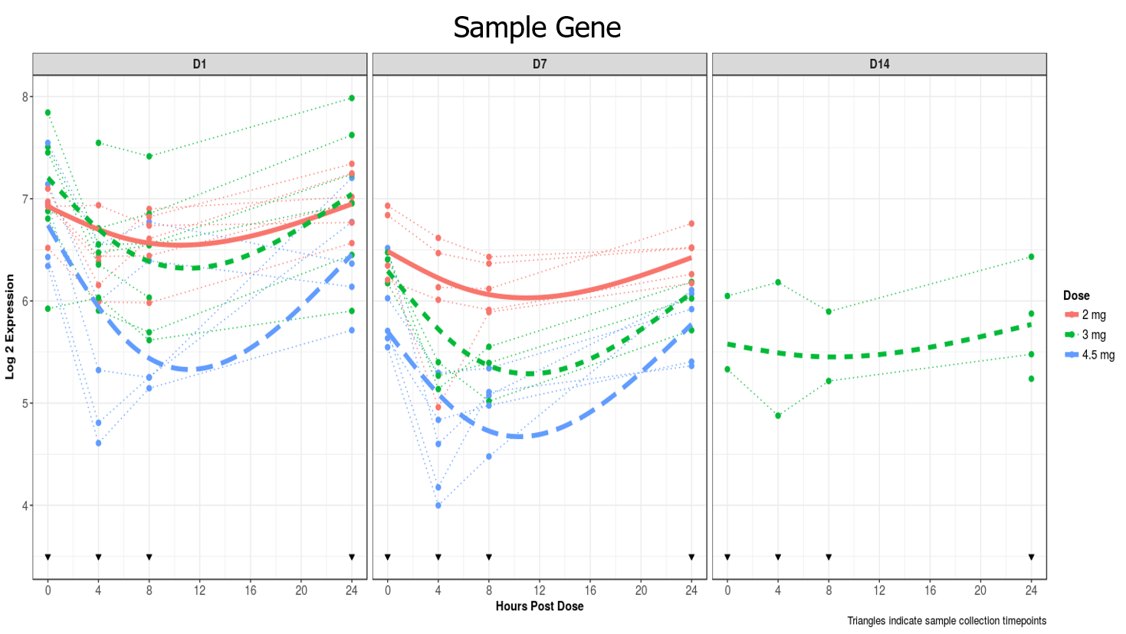
Visual Summary of Example Gene

Slide 13
Composite Biomarker Analysis

Slide 14
Summary of Analysis Methods
Efficacy measures: BOR (Best Overall Response), PFS, OS
Predictors: 3 continuous biomarkers (A, B, and C) and treatment arm
Analysis population: 183 subjects
Model-building approaches:
2 machine learning (ML) methods: MARS (earth package) and Grouped Lasso (glinternet package)
Both methods allow for possible interactions among predictor variables
MARS allows also for potential non-linear effects of predictor variables
Generalized Linear Models (GLM), with interaction terms and all effects linear
Logistic Regression for BOR
Cox Proportional-Hazards Models for PFS and OS
Model performance assessment:
Performance metrics: ROC, C-index, PPV and NPV
Metrics estimated by repeated, nested (for ML methods) cross-validation
Visualization by effect-estimate plots

Slide 15
Summary of Analysis Methods
Efficacy measures: BOR (Best Overall Response), PFS, OS
Predictors: 3 continuous biomarkers (A, B, and C) and treatment arm
Analysis population: 183 subjects
Model-building approaches:
2 machine learning (ML) methods: MARS (earth package) and Grouped Lasso (glinternet package)
Both methods allow for possible interactions among predictor variables
MARS allows also for potential non-linear effects of predictor variables
Generalized Linear Models (GLM), with interaction terms and all effects linear
Logistic Regression for BOR
Cox Proportional-Hazards Models for PFS and OS
Model performance assessment:
Performance metrics: ROC, C-index, PPV and NPV
Metrics estimated by repeated, nested (for ML methods) cross-validation
Visualization by effect-estimate plots

Slide 16
Outline
Investigated 7 models
3 Single Biomarker models
3 Pairwise Biomarker models
1 3-way Biomarker model
Model Assessments
Effect Size Estimates
Prediction Matrix Plots
Performance Metrics
Hypothesis Testing

Slide 17
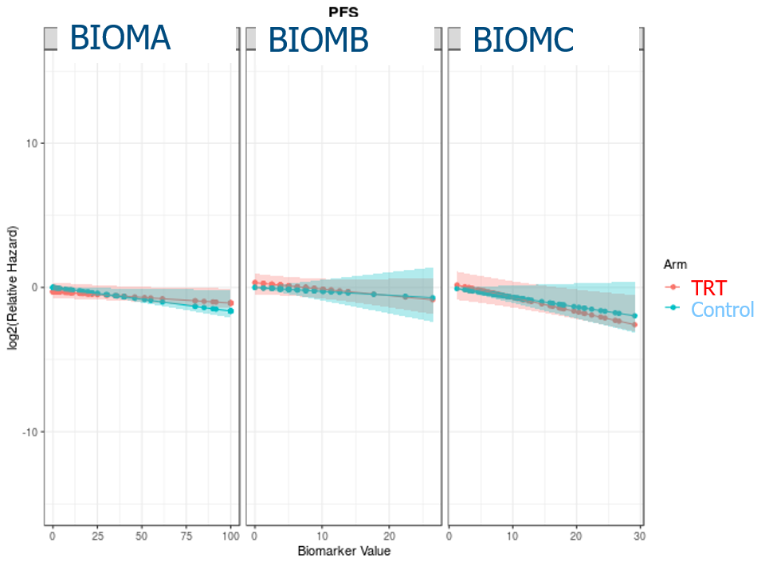
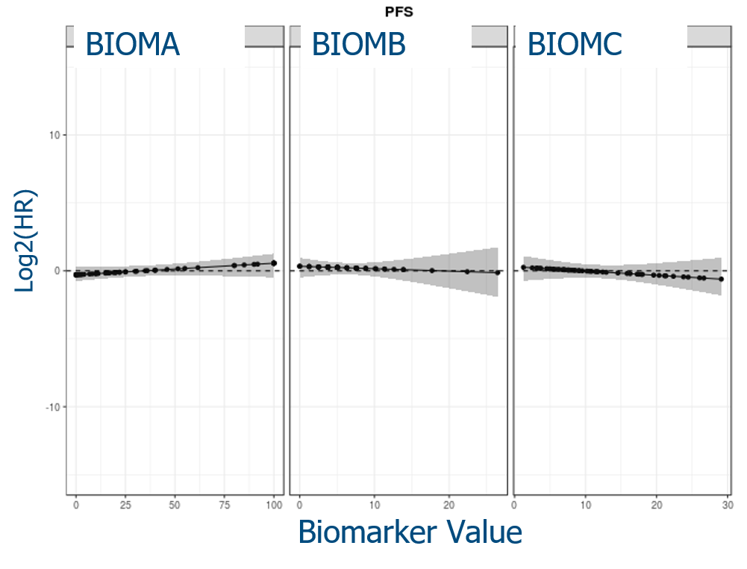
PFS, Individual Biomarkers (BM)
No noticeable interaction with treatment
Effect of BM on Relative Hazard
Effect of BM on Hazard Ratio (HR) of TRT vs Control
Log2(Relative Hazard
Biomarker Value

Slide 18
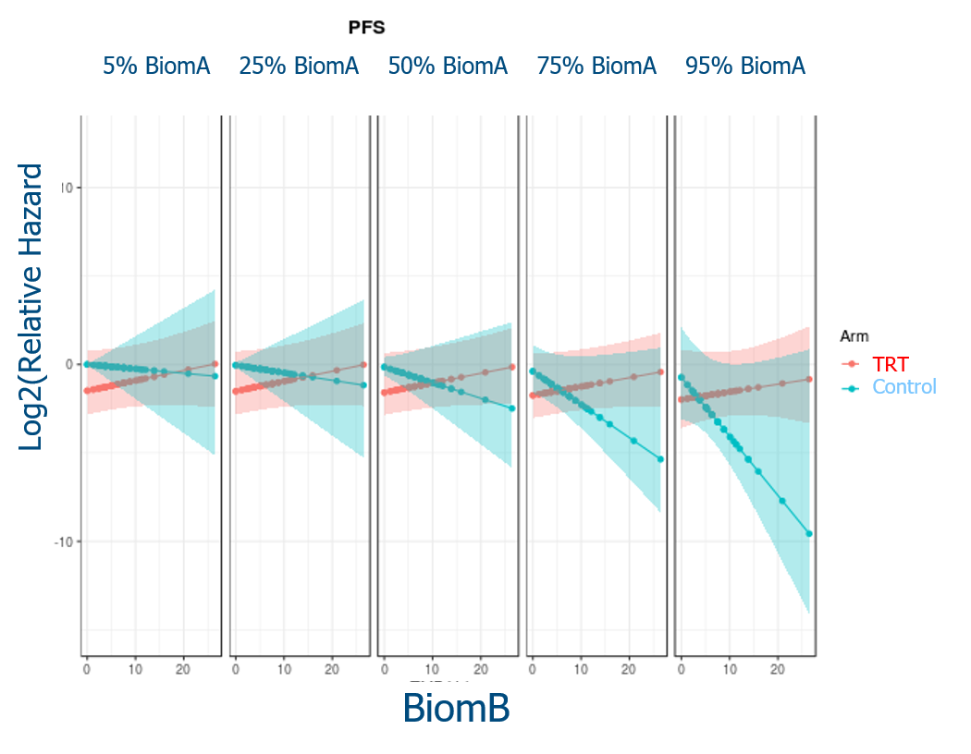
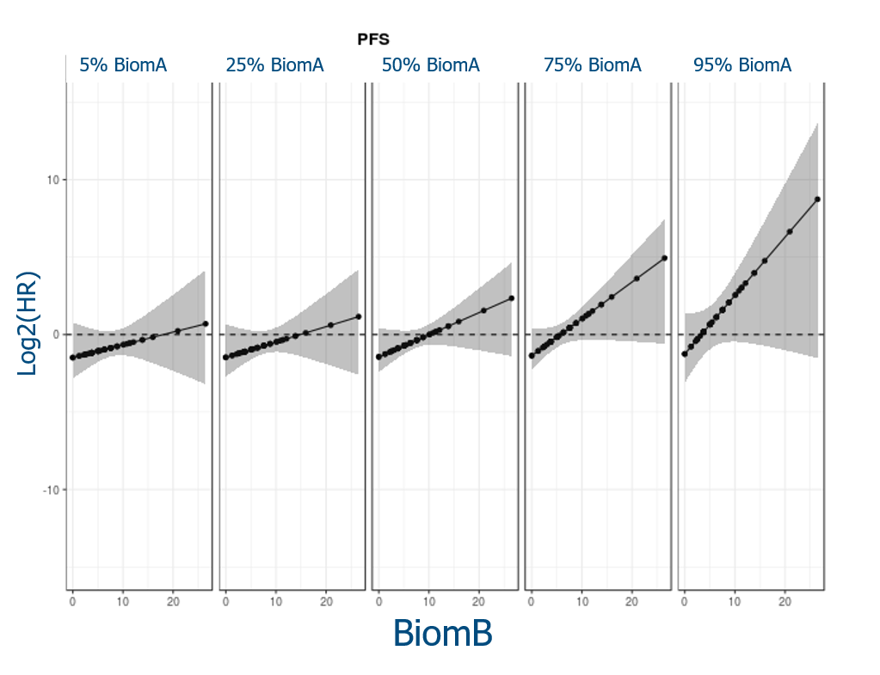
PFS, BiomA+BiomB: Effect of BM on HR of TRT vs Control
Effect of BiomB for fixed BiomA
Log2(HR) for TRT vs Control

Slide 19
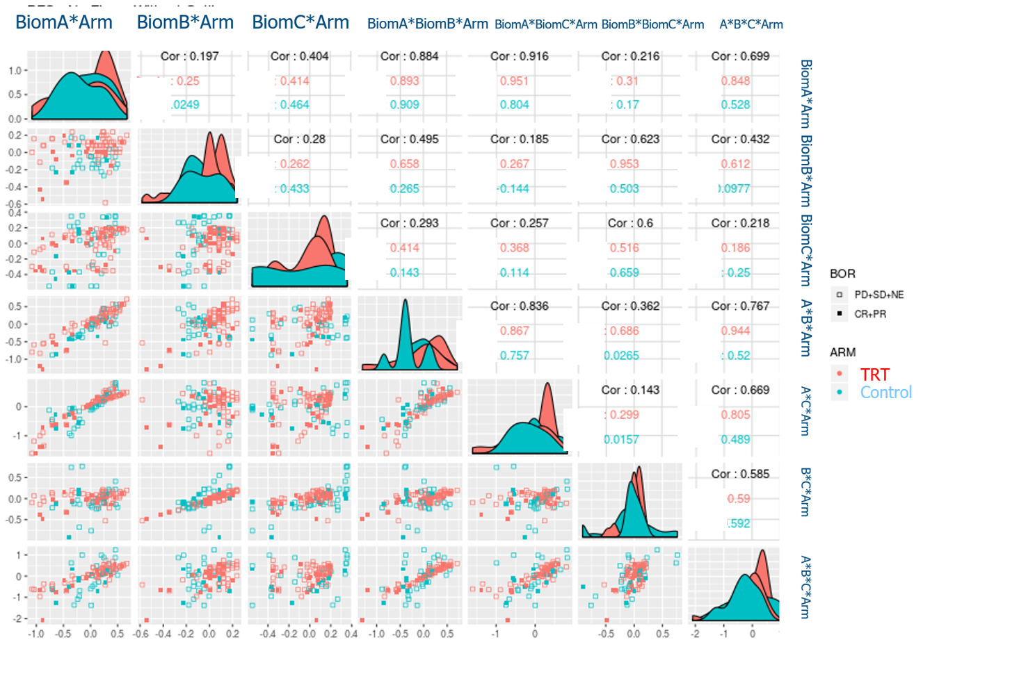
PFS: Predicted Relative Hazard
A*Arm B*Arm C*Arm A*B*Arm A*C*Arm B*C*Arm A*B*C*Arm
Legend:
A = BiomA
B = BiomB
C = BiomC
A*Arm B*Arm C*Arm A*B*Arm A*C*Arm B*C*Arm A*B*C*Arm

Slide 20
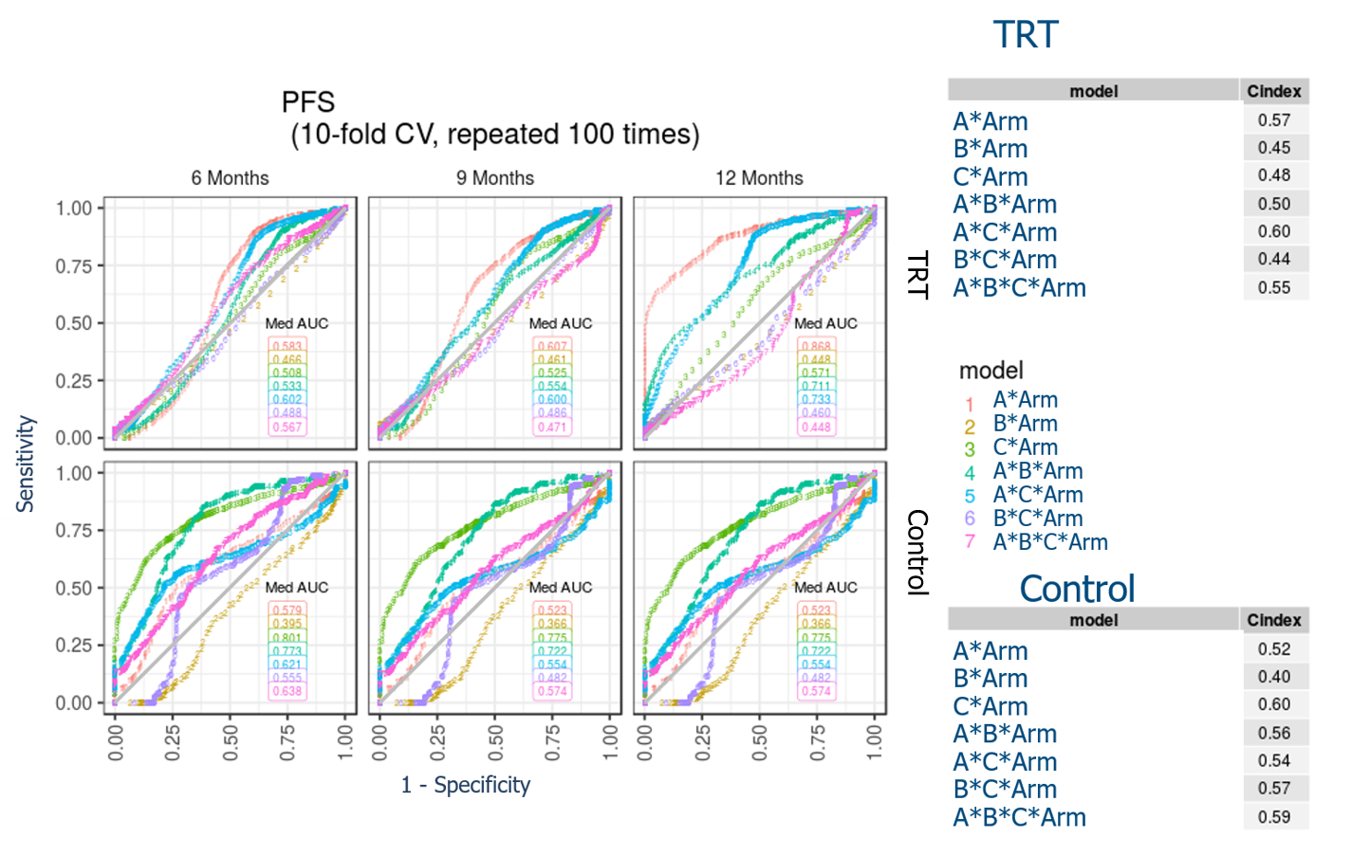
PFS - ROC

Slide 21
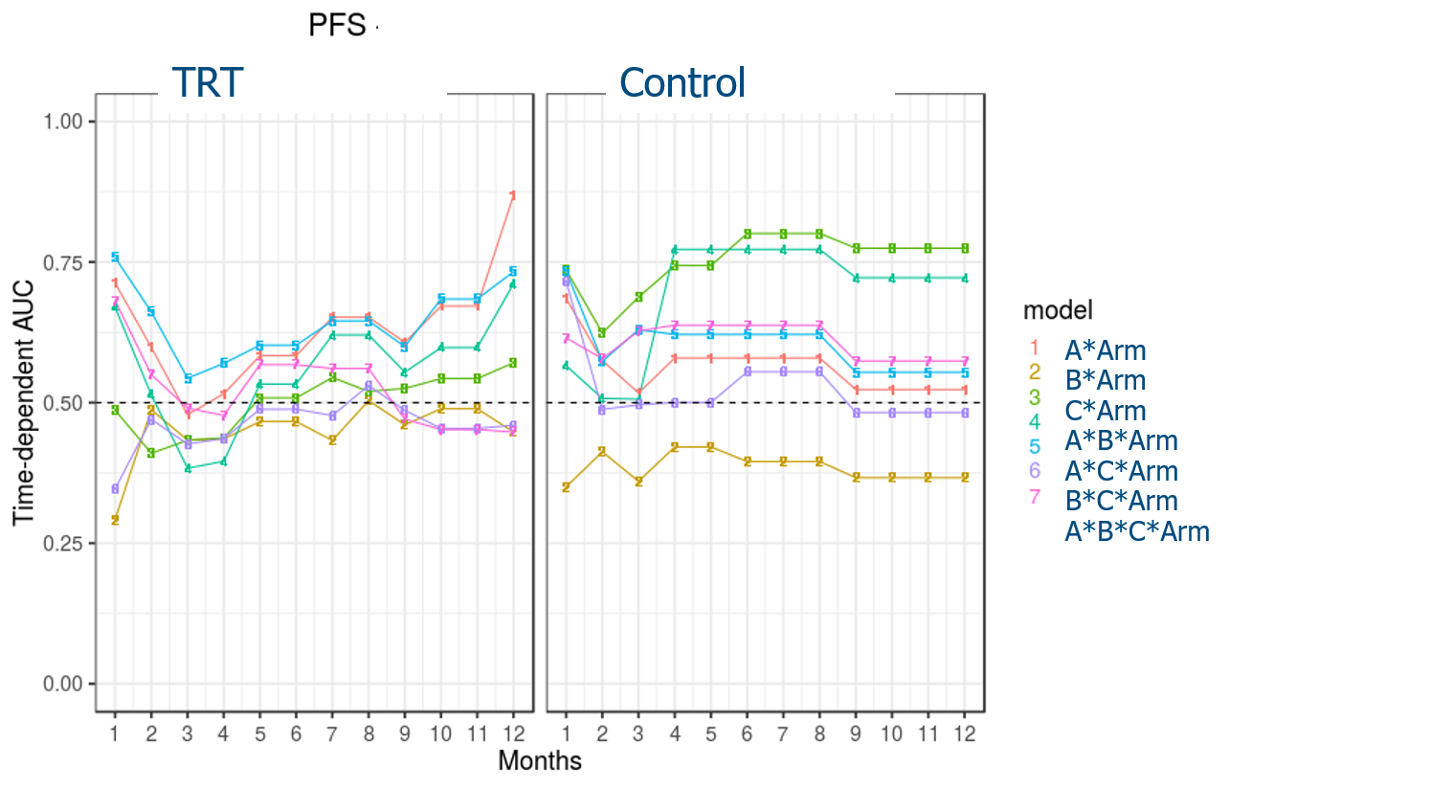
PFS - AUC

Slide 22
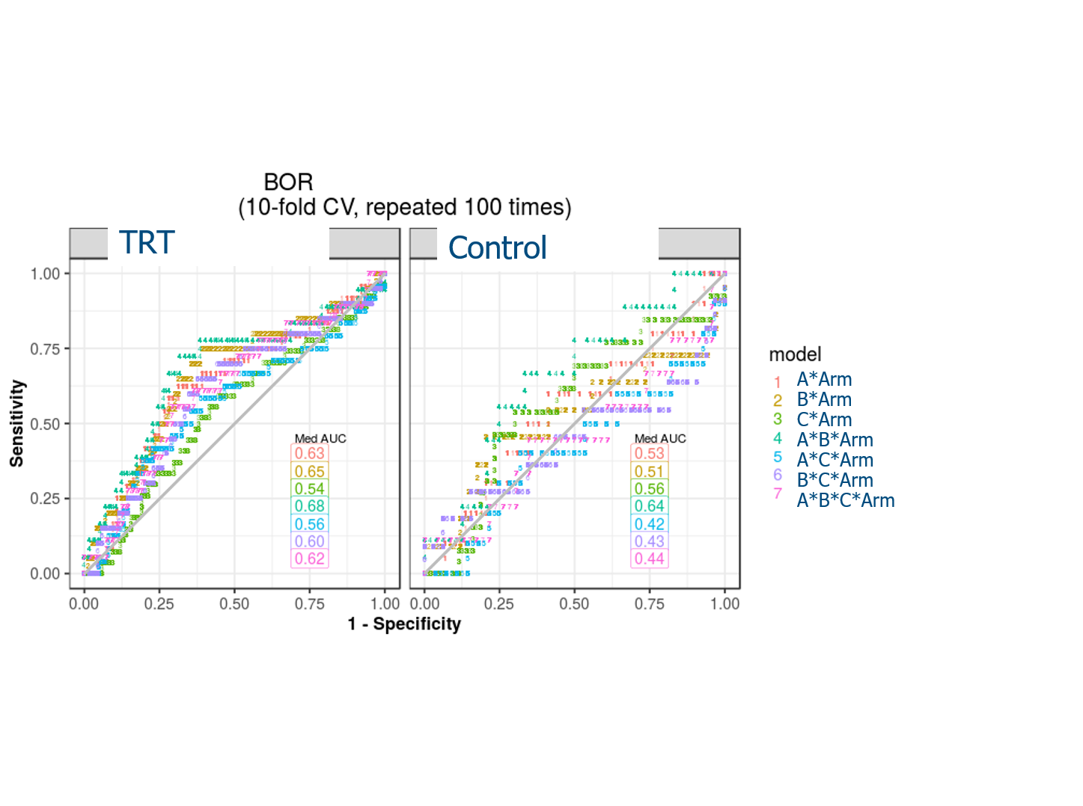
BOR - ROC

Slide 23
Acknowledgements
Scott Chasalow
Donald Jackson

Slide 24
Backup

Slide 25
GLM Likelihood Ratio Tests (LRTs)
A saturated model includes all main effects and interactions for four variables – BiomA, BiomB, BiomC, and Treatment Arm – with biomarker effects assumed linear
Test contribution of all biomarkers as a collective whole
Compare saturated model to reduced model containing only treatment effect
1 Chi-Square Test with 14 Degrees of Freedom
Test contribution of individual biomarkers to saturated model
Compare saturated model to reduced model which excludes one of the biomarkers
3 Chi-Square Tests with 8 Degrees of Freedom each
Test contribution of interactions with treatment arm to saturated model
Compare saturated model to reduced model which excludes all interactions containing treatment arm
1 Chi-Square Test with 7 Degrees of Freedom
Test contribution of each pair of biomarkers to a saturated model that excludes the third biomarker
Repeat Test 1 after excluding one biomarker at a time from saturated model
3 Chi-Square Tests with 6 Degrees of Freedom each
Test contribution of each pair of biomarkers to saturated model
Compare saturated model to reduced model which excludes each pair of the biomarkers
3 Chi-Square Tests with 12 Degrees of Freedom each

Slide 26
GLM Summary
 |  |  | OR |  | PFS |  | OS
Hypothesis Test | Biomarker (BM) | N | P-value | FDR | P-value | FDR | P-value | FDR
1. Contribution of all BM | All | 105 | 0.08 | 0.44 | 0.18 | 0.50 | 0.32 | 0.50
2. Individual BM contribution to saturated model | BiomA | 105 | 0.36 | 0.50 | 0.20 | 0.50 | 0.35 | 0.50
 | BiomB | 105 | 0.70 | 0.70 | 0.56 | 0.64 | 0.68 | 0.70
 | BiomC | 105 | 0.04 | 0.44 | 0.30 | 0.50 | 0.59 | 0.65
3. Treatment-arm interactions | All | 105 | 0.35 | 0.50 | 0.70 | 0.70 | 0.26 | 0.50
4. Contribution of BM pairs | A & B | 124 | 0.30 | 0.50 | 0.01 | 0.18 | 0.26 | 0.50
 | A & C | 108 | 0.01 | 0.18 | 0.06 | 0.44 | 0.13 | 0.45
 | B & C | 132 | 0.10 | 0.45 | 0.30 | 0.50 | 0.32 | 0.50
5. Pairwise BM contribution to saturated model | A & B | 105 | 0.52 | 0.64 | 0.27 | 0.50 | 0.41 | 0.54
 | A & C | 105 | 0.07 | 0.44 | 0.14 | 0.45 | 0.30 | 0.50
 | B & C | 105 | 0.14 | 0.45 | 0.55 | 0.64 | 0.53 | 0.64

