Slide 1
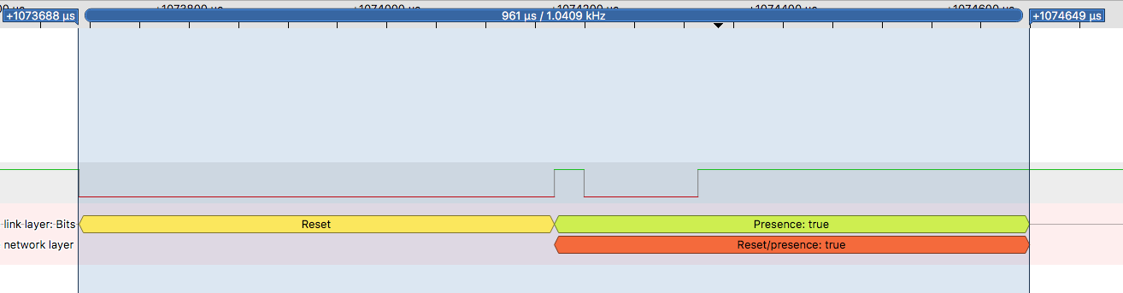
30
115

Slide 2
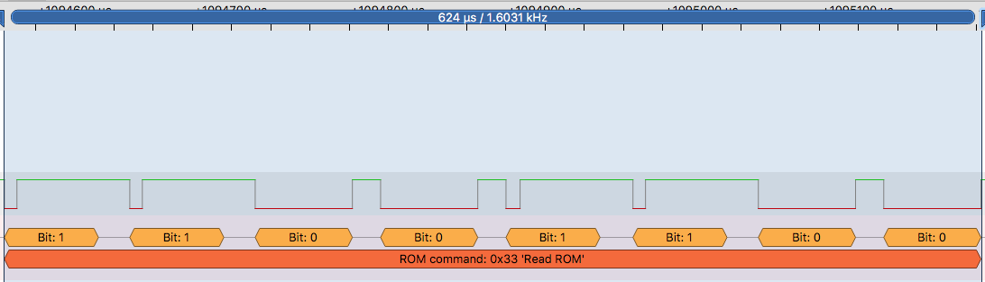
8
72
8
72
20 – between bits
60 – bit length

Slide 3
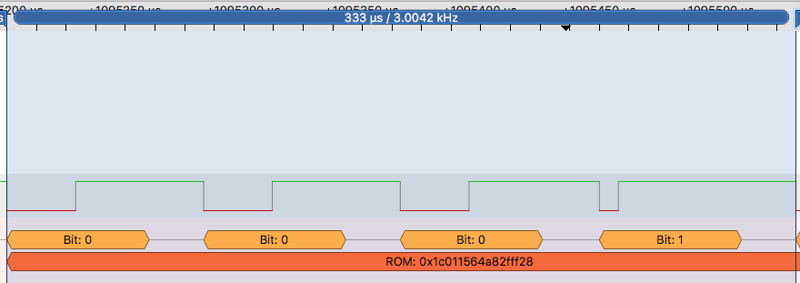

Slide 4
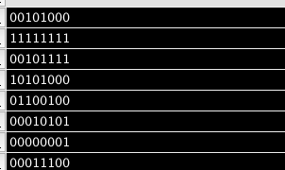
LSB -> MSB
0001 0100
1111 1111
1111 0100
0001 0101
0010 0110
1010 1000
1000 0000
0011 1000
Matches binary string on wire

Slide 5
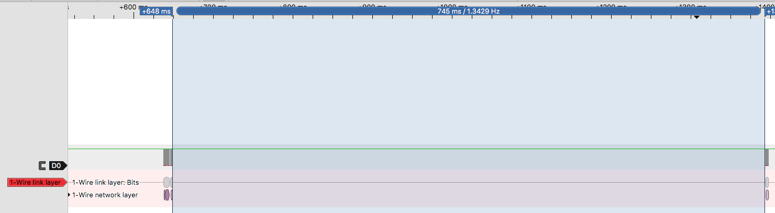
OW_reset_pulse();
OW_reset_pulse();
OW_write_byte(0xCC);
OW_write_byte(0x44);
OW_reset_pulse();
OW_write_byte(0xCC);
OW_write_byte(0xBE);

Slide 6
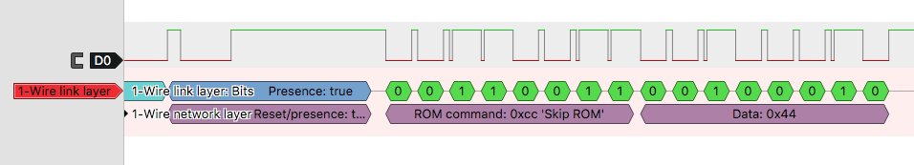
Binary representation of the temperature

