Slide 1
PARADIGM FRIENDS REALTORS LLP
BuildSight
End-to-End Real Estate & Construction Management

Slide 2
Document Generation Engine
Automated template based DOCX Agreement Generation for new Sale and Redevelopment
AI-powered KYC to eliminate manual errors
Customized demand letter generation as per milestone
Automated receipt generation on recording payment
Dynamic Quote generation for any inquiry received

Slide 3
Communication & Automation
Automated Demand Letter communication on project milestone
Automated payment reminder after 7 days if payment not done
Demand with interest added sent on Admin approval after 14 days
Auto-generated Receipt sent once payment is recorded
Dual channel strategy for all communications. Multiple numbers per buyer supported.
Audit Trail: 100% visibility into when communications were sent and their delivery status.

Slide 4
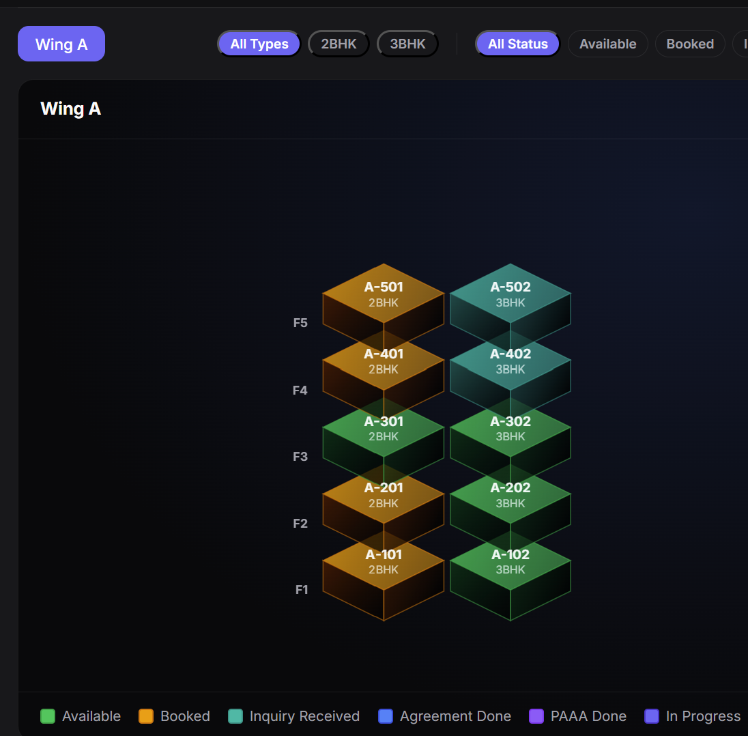
Project & Inventory Management
Interactive Building Viewer
Color-coded Legend
Single-Click Filtering
Supports both Fresh Sales and Redevelopment

Slide 5
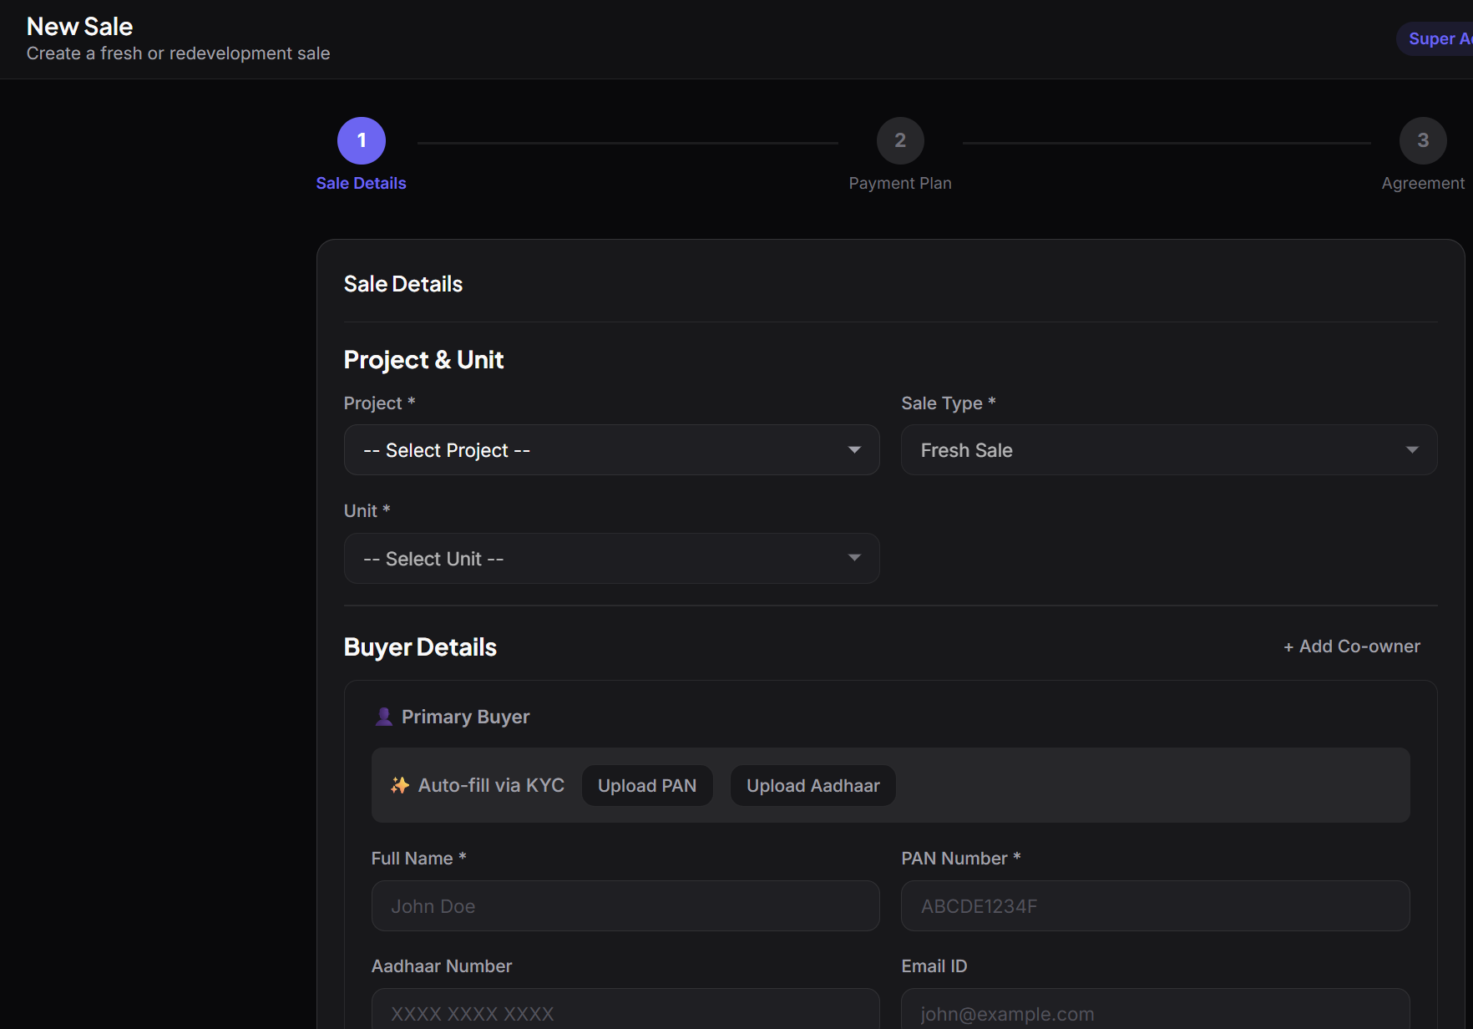
Sales & CRM Onboarding
Multi-Buyer Architecture
Tenant Linking: Seamlessly attach existing tenants
Simple, easy to use digital Sale Onboarding Wizard
Automated Smart Payment Plan in line with project milestones

Slide 6
Financial & Payment Planning
Fully customizable milestone-based payment plans.
Automatically aggregates past-due milestones for mid-construction sales.
Spill-Over Credits: Intelligently cascade excess booking amounts into upcoming milestones.
GST & Stamp Duty Integration: Exclude/Include statutory taxes effortlessly.

Slide 7
Role Based Access Control
Based on Least Privilege Access principle
Sales team gets only Status of units and Inquiry Access
Operations team gets access to create New Sale and Generate Agreements
Admin gets all the above access and overall Dashboard Analytics

Slide 8
Dashboard & Analytics
Real-Time Aging Buckets: Instantly view Current Due, Overdue 7, Overdue 15, and Overdue 30+ days.
Collection Efficiency: Monitor cash flow health and milestone conversions.
Financial Summaries: Track Total Outstanding, Collected This Month, and TDS Pending.
Actionable Insights: Focus your sales team on the highest-priority outstanding accounts.

Slide 9
Pricing
₹2999/- per unit with a minimum of 40 units
₹6000- per month infrastructure and maintenance charges
Add ₹2000/- per month for additional project

Slide 10
Roles and Responsibilities
BuidSight Team | Developer
Maintain cloud infrastructure including Server, Database, e-KYC APIs, Whatsapp API | Provide Sale and PAAA agreement templates
Addition of new project including configuration, area and floorplan | Provide detailed floorplan drawings, area and configuration of each unit
Mapping of tenants for redevelopment project | Create New Sale, Update Construction Milestones and Record Payments
Provide overall support and training

Slide 11
Ready for Deployment
Thank You

