Slide 1
ABB Case Study
Reducing Lead Time Variability in ABB Drives Services
Anh Pham Vappu Valtonen Thomas Vial

Slide 2
Background
Objective: Indentify key drivers behind lead-time variation, backlog build-up, and capacity pressure
Order complexity and fluctuating demand creates variation in:
Lead times
Workload levels
Capacity utilization
These variations make short-term planning and delivery predictability challenging
Notes:
The objective of this study was therefore to identify the key operational drivers behind lead-time variation, backlog build-up, and capacity pressure in the analyzed service operations.
Because order complexity and incoming demand fluctuate, both lead times and workload levels can vary significantly over time, which also affects capacity utilization across the service network.
These variations make short-term planning more difficult and reduce delivery predictability, especially during workload peaks.

Slide 3
Analysis methods
Process flow review used to indentify delay points and bottlenecks
Operational datasets analyzed to evalueate:
Demand patterns
Lead-time variability
Backlog levels
Capacity pressure
Tools used:
Excel (data preparation)
Python (analysis)
Power BI (dashboards)
Focus: identify where time is spent and which stages create the largest planning uncertainty
Notes:
The analysis combined process flow review with operational data analysis to identify where delays and variability occur in the service process.
Operational datasets were used to examine demand patterns, lead-time variation, backlog levels, and capacity pressure.
Data was prepared in Excel, visualized in Power BI dashboards, and analyzed further in Python to evaluate lead-time structure and variability across process stages.
The objective was to identify where time is spent in the process and which stages create the largest planning uncertainty.

Slide 4
Results

Slide 5
Outcome analysis (Python): What drives lead time and variability
Retrofit/Modernization + DSW | 2023–2025 demand, 2025 capacity stress, timestamp lead times
We measured where time is actually spent (not just “average lead time”)
The main issue is waiting + uncertainty before work starts
Recommendations focus on visibility, predictability, and segmentation
Notes:
This section is the evidence base for our recommendations. We used Python to quantify demand patterns, overtime pressure, and where lead time accumulates across process stages
The consistent message: ABB is usually fast at execution once work starts, the big delays happen before that, due to queues, coordination and uncertainty.
Likely question: “Is this about technical speed?”
Answer: “No, the data points more strongly to waiting/coordination and upstream uncertainty.”

Slide 6
Data used and how we interpret lead time
Demand: monthly order intake (€), 2023–2025 (Retrofit + DSW)
Capacity stress: overtime hours, 2025 (Retrofit + DSW)
Lead time structure: timestamps to split total lead time into stages
We report median + p90 because lead times are right‑skewed
Notes:
Median shows the typical case. p90 shows reliability, the ‘bad cases’ that drive customer pain and firefighting.
We use these because averages hide the long tail.
Likely question: “Why not just average?”
Answer: “Because a few extreme delays pull the average up; median/p90 reflect typical performance and reliability.”

Slide 7
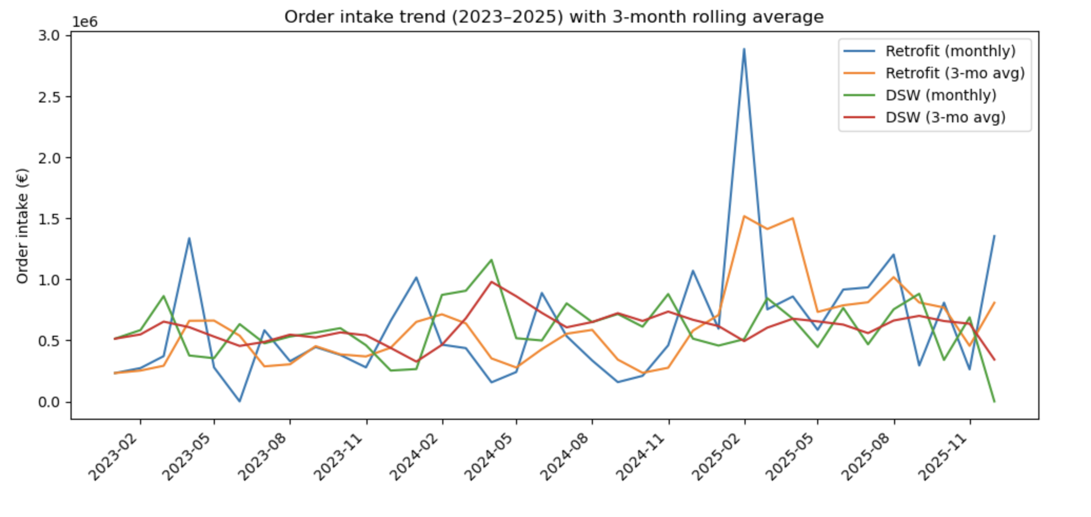
Retrofit demand changed materially in 2025 (and it is lumpy)
Retrofit yearly intake: €5.17M (2023) → €5.97M (2024) → €11.46M (2025)
DSW is more stable: €6.21M → €8.39M → €6.83M
Retrofit intake is more uneven month‑to‑month → queues build during peaks
Notes:
Retrofit has a clear step-change in 2025: roughly doubling compared to 2023.
Volatility matters more than averages. Lumpy arrivals create backlog, and backlog doesn’t disappear when demand drops next month, it carries over as waiting time.
-> This supports building earlier workload visibility and stronger planning rules for peaks (Recommendations 1 and 2).
Likely question: “Order intake is euros, does it equal hours?”
Answer: “Not directly, but it’s a strong signal of workload shifts and volatility; we use it as a demand proxy alongside overtime and lead time timestamps.”

Slide 8
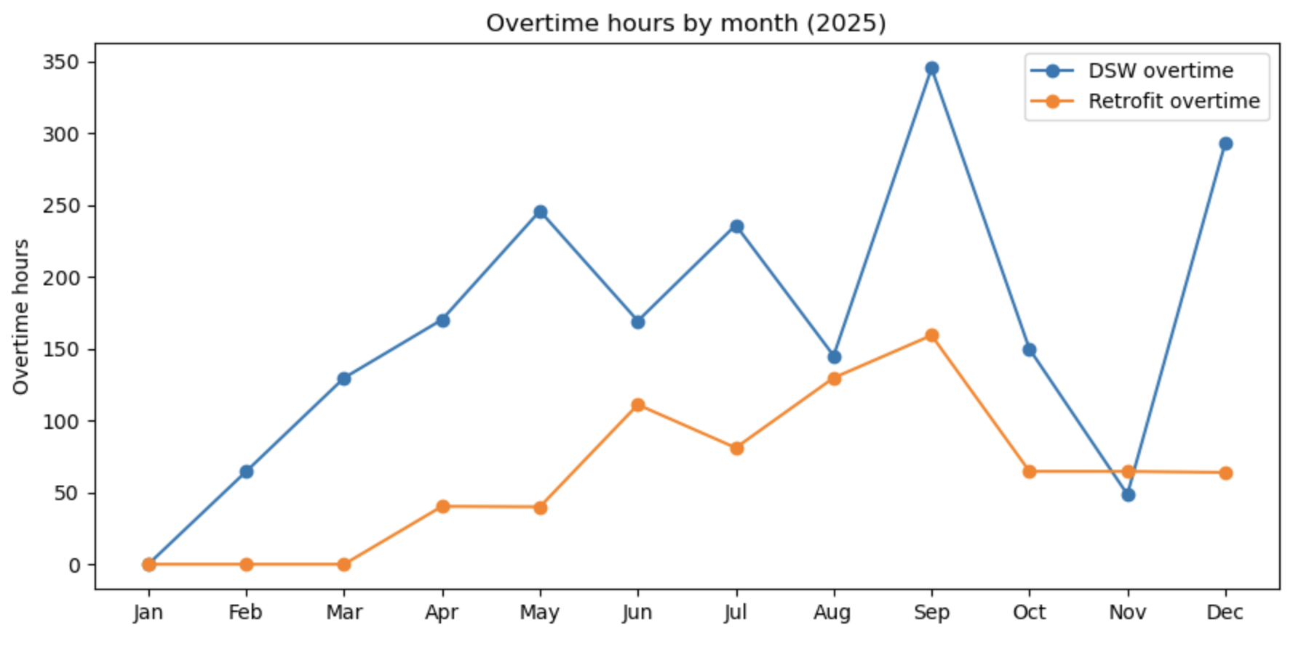
Overtime looks like a backlog symptom, not a simple ‘high demand’ reaction
Overtime shows distinct stress periods (spikes), especially in late year
Overtime is weakly correlated with same‑month intake (DSW ~ -0.11, Retrofit ~ -0.32)
Suggests overtime is driven by timing, batching, uncertainty, job mix
Note: correlation is weak
Notes:
If overtime were purely about intake, the relationship would be tighter. Instead, overtime likely reflects late releases, shifting priorities, missing information, and recovery work after delays.
So the lever is not only ‘add capacity’, it’s reduce uncertainty and control how work is released.
-> This supports queue visibility + predictive planning to reduce firefighting (Recommendations 1 and 2).
Likely question: “So should ABB hire more people?”
Answer: “Capacity helps, but the bigger win is stabilizing flow: visibility + better release/coordination reduces peaks that trigger overtime.”

Slide 9
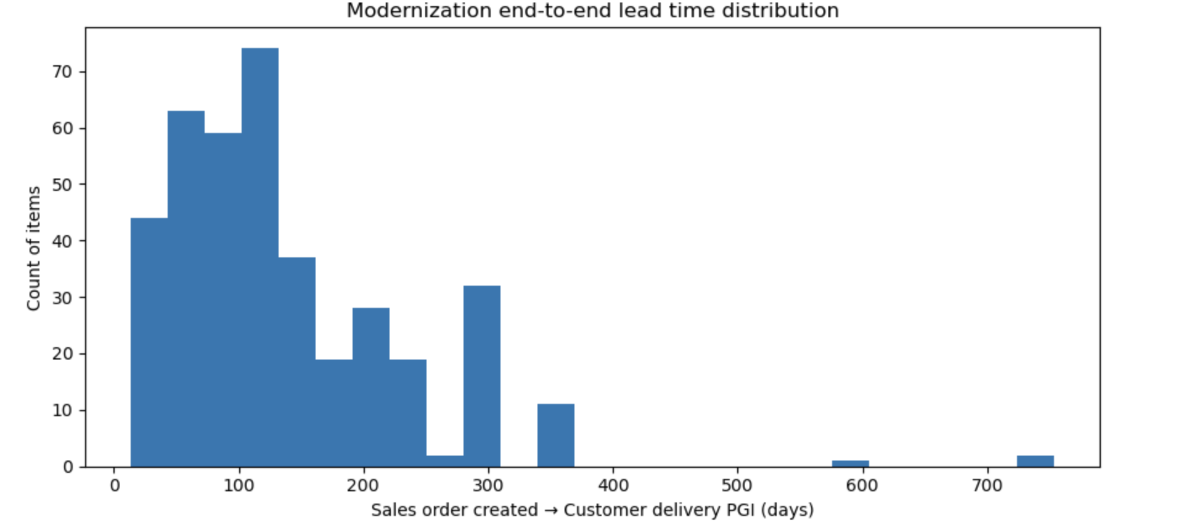
Modernization lead time has a long tail (reliability problem)
Total lead time: mean ~138 days, median 112 days
Reliability issue: p90 ~ 287 days, max 753 days
Mean > median → long tail drives customer dissatisfaction and planning risk
Notes:
Typical cases are around 3–4 months, but the long tail creates the reliability problem.
This is why we focus on queue and readiness -> to prevent cases from falling into the tail.
Likely question: “Are these outliers real or data errors?”
Answer: “Some may be exceptions or holds; regardless, the long tail is operationally meaningful because those cases create the biggest customer and planning impact.”

Slide 10
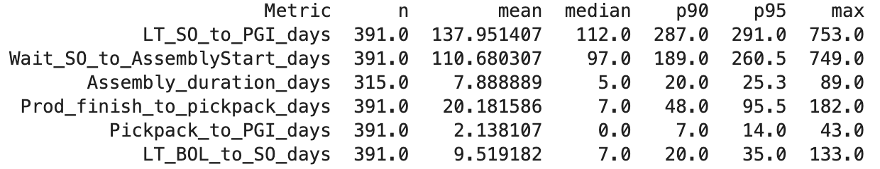
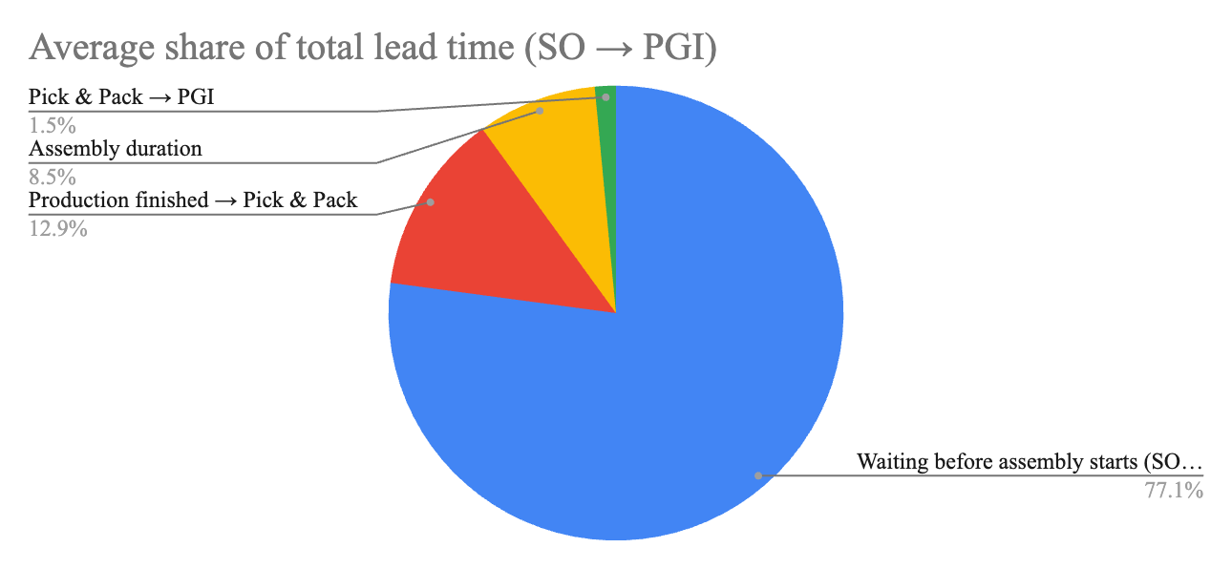
The bottleneck is pre‑assembly waiting, not assembly work
Median SO → assembly start: 97 days
Median assembly duration: 5 days
~77% of total lead time occurs before assembly begins
Improvement lever: make the queue visible and manageable
Notes:
This is the most actionable result: most time is waiting before assembly starts.
So improvements should target readiness and queue discipline: what is waiting, why, how long, and what is needed to start.
-> Queue visibility + proactive unblocking has the biggest potential impact (Recommendations 1 and 2).
Likely question: “Why is the pre-assembly wait so long?”
Answer: “Likely a mix of readiness (info/parts/approvals), prioritization rules, and release timing, which is exactly what queue visualization makes measurable.”

Slide 11
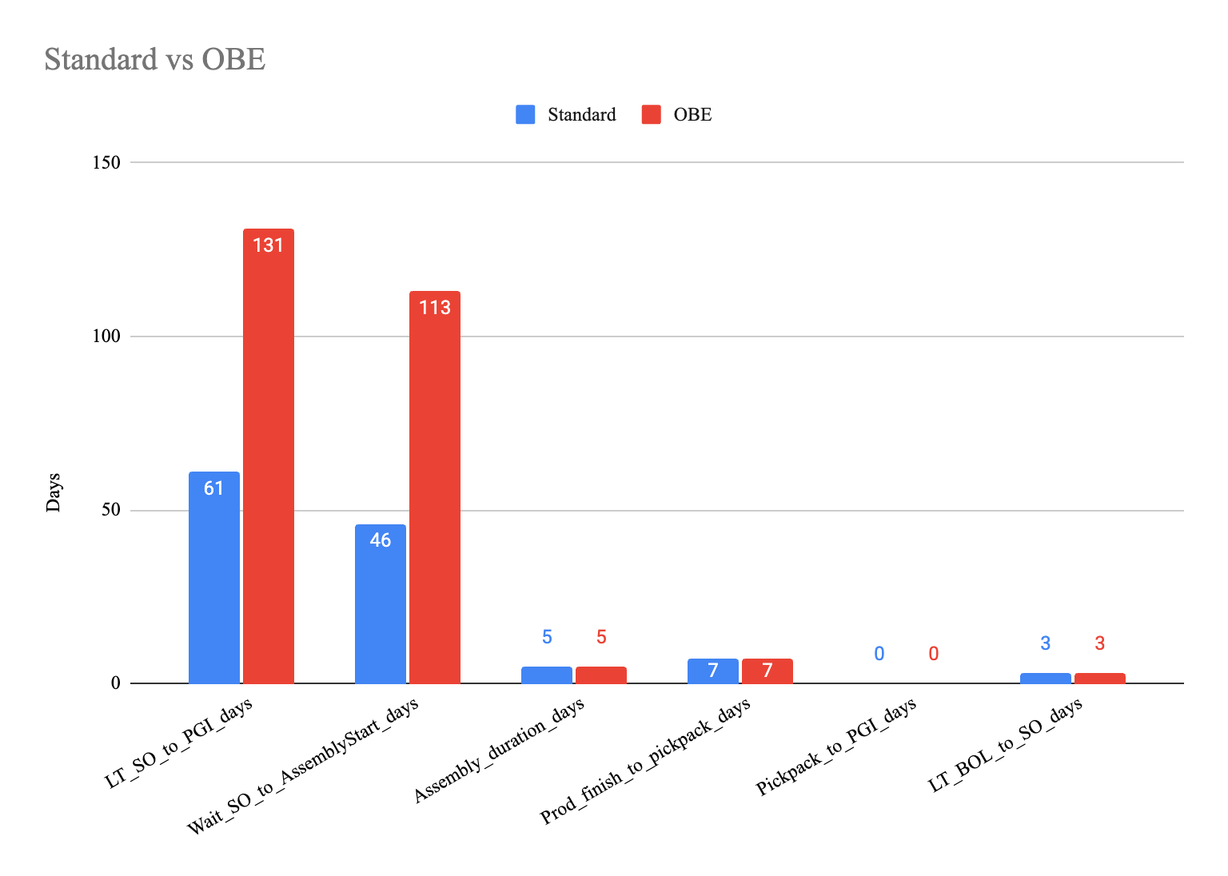
Different order types need different planning rules
Median SO → PGI: Standard 61 days vs OBE 131 days
Median SO → assembly start: Standard 46 days vs OBE 113 days
Difference is mainly waiting, not longer assembly work
Implication: separate expectations + prioritization by type
Notes:
This supports planning segmentation: engineered work behaves differently, mainly due to uncertainty before execution.
If ABB plans everything the same, the queue becomes harder to manage and dates become unreliable.
Likely question: “Does this mean OBE should be deprioritized?”
Answer: “Not necessarily, it means OBE needs a different planning approach and earlier readiness checks.”

Slide 12
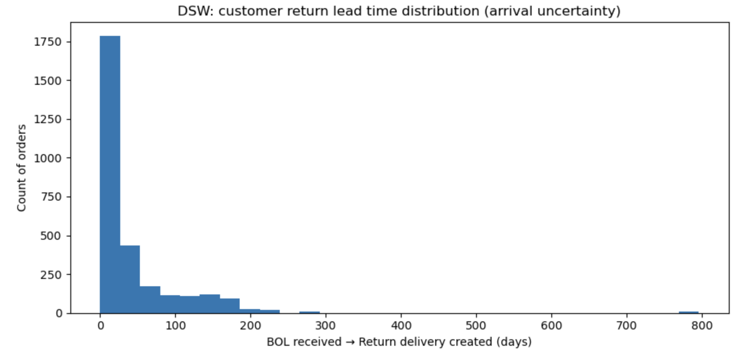
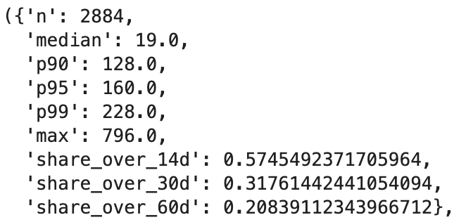
DSW variability comes mainly before ABB can start work
Inbound median 19 days, p90 128 days, max 796 days
Tail risk is substantial (many cases exceed 30–60 days)
This inbound uncertainty causes unpredictable workload arrivals
Notes:
This supports planning segmentation: engineered work behaves differently, mainly due to uncertainty before execution.
If ABB plans everything the same, the queue becomes harder to manage and dates become unreliable.
Likely question: “Does this mean OBE should be deprioritized?”
Answer: “Not necessarily, it means OBE needs a different planning approach and earlier readiness checks.”

Slide 13
Once the unit is received, processing is typically quick
Internal execution (Return delivery → release): median 1 day, p90 8 days
Most cases are completed quickly after receipt
Implication: focus improvement effort upstream, not on shop-floor speed
Notes:
This is important because it prevents ABB from optimizing the wrong thing. The workshop seems to do its job quickly once it has the unit.
So the biggest win is reducing inbound uncertainty and improving readiness/coordination.
Likely question: “But some repairs are complex?”
Answer: “Yes, but the dataset shows the typical internal cycle is short; complexity likely appears in exceptions and coordination-heavy cases.”

Slide 14
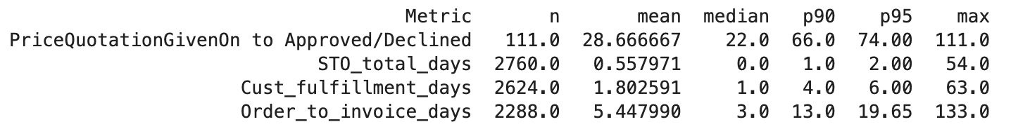
Quotation approval adds lead time and uncertainty upstream
Quotation approval: median 22 days, p90 66 days, max 111 days
Not only adds time — it also blocks scheduling (“go/no‑go” uncertainty)
Treat as a KPI with clear targets and customer expectations
Notes:
This is a hidden queue: while approval is pending, the order can’t be planned confidently.
Standardization and SLA-style targets reduce both lead time and planning disruption.
-> directly supports Recommendation 4.
Likely question: “Is this mostly customer delay?”
Answer: “It’s a shared process. The point is to make it measurable and managed, with clear response expectations.”

Slide 15
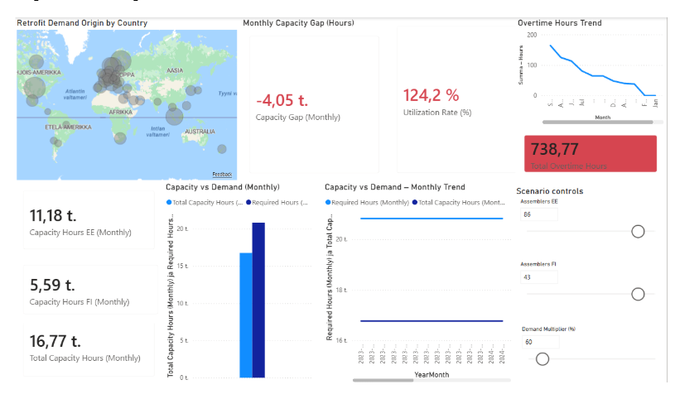
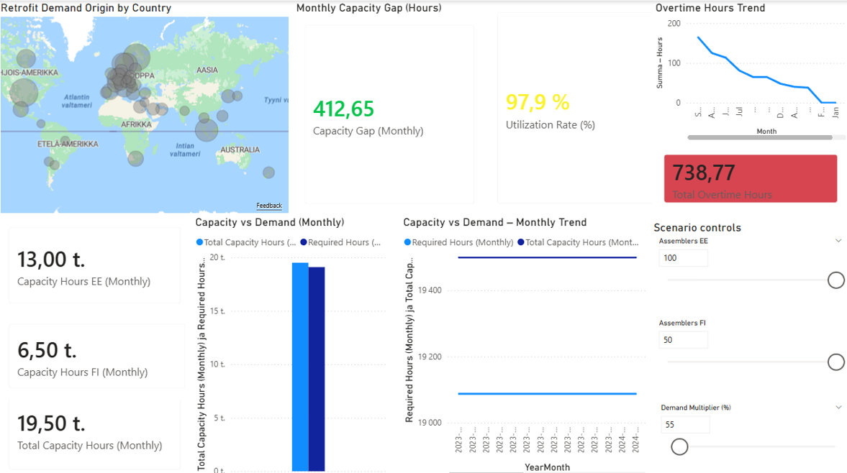
Capacity and planning dashboard
Baseline scenario shows capacity pressure and overtime-driven recovery
Improved planning scenario shows: positive montly capacity gap, more balanced capacity utilization
Results indicates that workload balancing imrpoves capacity stability without increading capacity
Implication: planning improvements can reduce capacity pressure without major resource increases
Notes:
Baseline scenario shows capacity pressure and overtime-driven recovery
Improved planning scenario shows: positive montly capacity gap, more balanced capacity utilization
When workload release is balanced and planning visibility is improved, the system shows a positive capacity gap and more stable utilization levels.
This demonstrates that operational stability can be improved primarily through planning and visibility improvements, without necessarily increasing total capacity.
These results also support our recommendations to move toward predictive planning and earlier workload visibility.

Slide 16
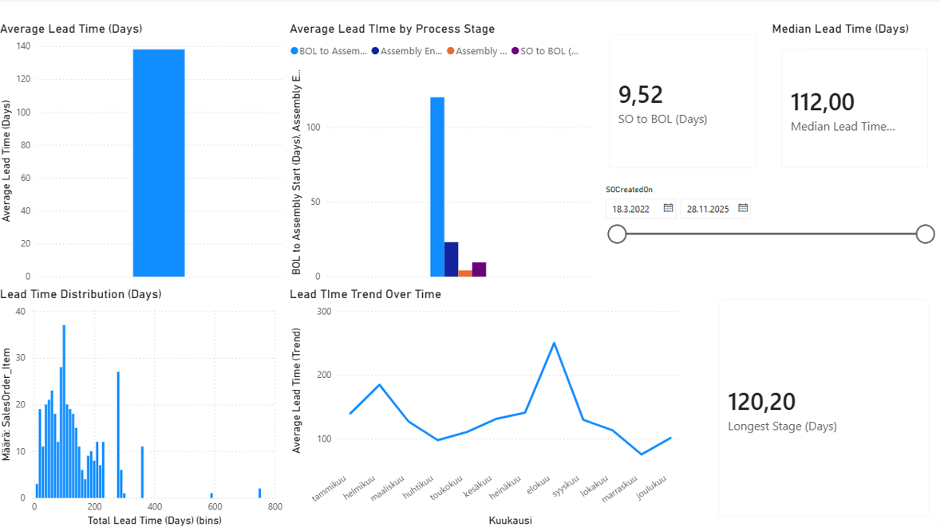
Lead-time strcuture dashboard
Median toal lead time around 112 days with high variability
Majority of total time occurs before assembly start
Assembly and delivery stages are short and stable
Long lead times driven mainly by queu waiting and readiness delays
Improvement focus: queue visibility and readiness
Notes:
The dashboard shows that total lead times are long and highly variable, but most of the delay occurs before assembly begins.
Assembly itself is relatively short and stable, meaning the main improvement opportunity is not faster execution but better visibility and control of the waiting stages.
Improving queue visibility and readiness tracking would therefore have the largest impact on total lead-time performance.

Slide 17
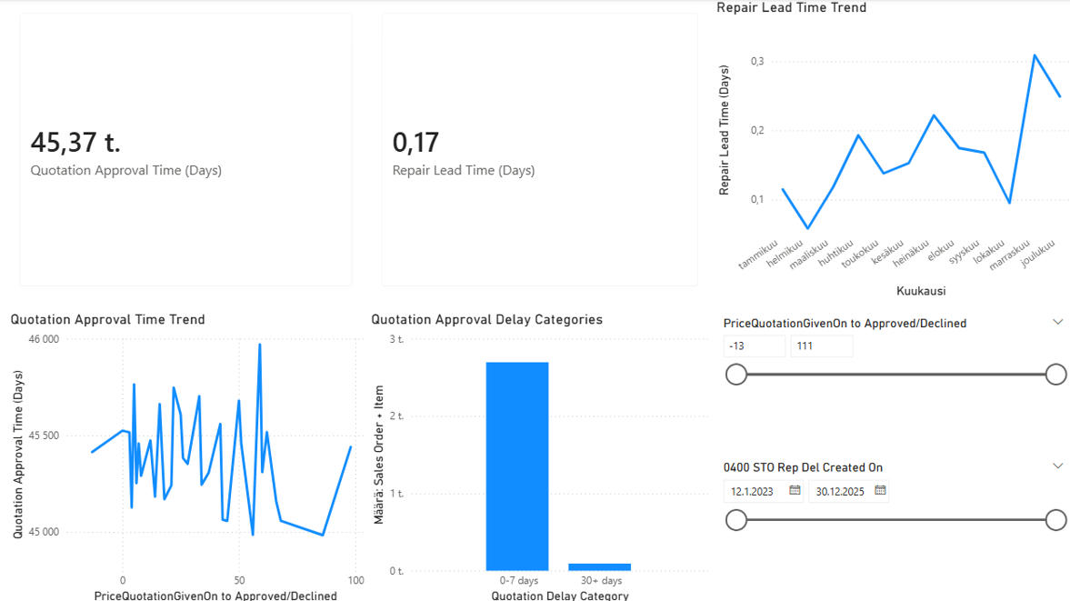
Repair flow dashboard
Internal repair execution is typically fast and stable
Workload peaks driven by uneven arrival timing of units
Long-tail cases mainly caused by inbound uncertainty
Main planning challenge: arrival predictability, not execution duration
Improvement focus: inbound pipeline segmentation and coordination
Notes:
The repair dashboard shows that once the unit arrives and processing begins, execution times are typically short.
However, arrival timing varies significantly, creating workload fluctuations and temporary capacity pressure.
This indicates that the main planning challenge is inbound pipeline uncertainty rather than workshop performance.
Segmenting the inbound pipeline based on predictability would improve planning stability and reduce disruptions.

Slide 18
What the data points to (and what we propose)
Evidence | Recommendations
77% of Modernization lead time is pre‑assembly waiting | make backlog + readiness status visible; track “blocked reasons”
Retrofit demand volatility + overtime not tracking intake | forecast risk using history; plan releases, not firefights
inbound time long‑tailed; internal execution typically fast | separate fast-track vs high‑uncertainty cases; different follow-ups
approval median 22 days, p90 66 days | standardize + KPI + improve customer coordination / automation options
Notes:
This is the bridge slide: each recommendation is anchored in a measured delay driver

Slide 19
Recommendations

Slide 20
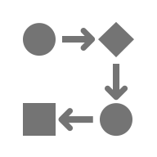



Overview
1
Queue visualization
2
From reactive to predictive planning
3
Inbound pipeline for DSW
4
Reduce quotation approval delays

Slide 21




Queue visualization - Modernization
Need for better tracking of parts
All recorded in a digital portfolio
Internal & external parts (incoming and outgoing)
Real-time tracking
Simple and intuitive
Link queue priorities with KPIs

Slide 22
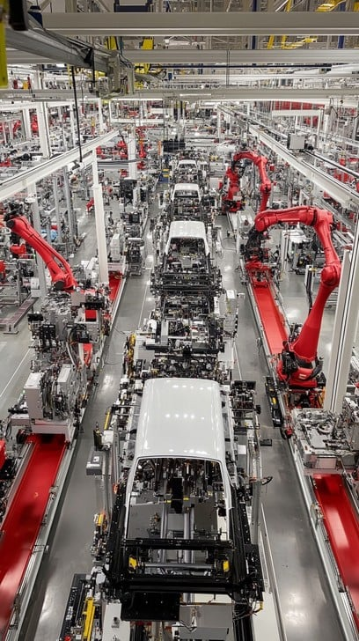
Queue visualization - Benefits
Every part of the process visible & measurable
Easily identity bottlenecks
Tracking from intake to delivery
Better capacity utilization
Faster reaction time & decision making
Foundation for predictive planning
Often found in automotive production lines

Slide 23
From reactive to predictive planning - Switch
Reactive panning waits for:
Predictive panning will:
Backlog to build up
Delay to be reported
Customer complaint
Bottlenecks
Problems are known but not planned for
Anticipates capacity constraints
Simulates future workload
Allocates labor in advance
Use historical data
Problems are known but planned for

Slide 24
From reactive to predictive planning - Data
Predictive planning is based on
Historical data
Demand order & volumes
Lead time & cycle time
Queue length
Capacity usage
Approval delays
Client response patterns
Known bottlenecks
Real-time data
Current workload
Current capacity
Others
What-if analysis
Supplier delivery status
Patterns
Business constraints
AI models
Forecast & models
Demande forecast
Seasonality analysis

Slide 25

From reactive to predictive planning - Benefits
Reducing operational disruptions – the uncertainty is “priced in”
More stable lead times (usually shorter)
Better resources utilization – better use of the capacity
Better decision-making & long-term planning
More efficient & stable

Slide 26
Inbound pipeline for DSW - Operations
One of the biggest challenges for DSW: workflow uncertainty
Missing information
Customer coordination
Transiting of units & parts
Internal
Standard & recurring repair time, consistency, faster turnaround, better access, faster turnaround
External
Lower volume, longer, niche expertise, variable capacity

Slide 27
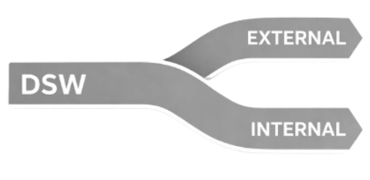
Inbound pipeline for DSW - Segmentation
Better performance tracking
Accountability for each structure
Better cost control
Clearer cost structure
Better capacity planning - fewer bottlenecks
Better supplier management
Benefits: Increase transparency regarding lead-time, more efficient, better strategic control, cost optimization

Slide 28


Reducing quotation approval delays - Benefits
Faster revenue recognition
Improved customer experience – fast response, less waiting
Predictable turnaround – better long-term planning
Operational efficiency
Better resource allocation & re-allocation
Company seems organized & prioritizes customer
Responsive and client-focused
Long-term customer loyalty
Competitive advantage

Slide 29

Reducing quotation approval delays - Specifics
Introduce a very standardized with clear and defined KPIs
Implicate the customer as much as needed
Separate the different delays
Strengthen collaboration and relationship with customer
Clear and consistent quotation structure
Understand what the customer wants right away – less back-and-forth
Make the customer understand their role in the timeline

Slide 30
Reducing quotation approval delays - AI
AI Implementation
AI Software can approve routine quotes from repeating customers
It can send it to a human if needed
Reduce human workload – better use of capital
Faster response rate for routine quotes
AI receives quote
Routine task?
Yes
AI can respond?
Yes
Work done by AI
No
No
Work done by human

Slide 31
Implementation challenges

Slide 32


Overview
Outline potential implementation issues for eachrecommendations
Tailored to ABB’s motion division.
Focus on operational, technological,
organizational and management challenges
rather than on benefits

Slide 33
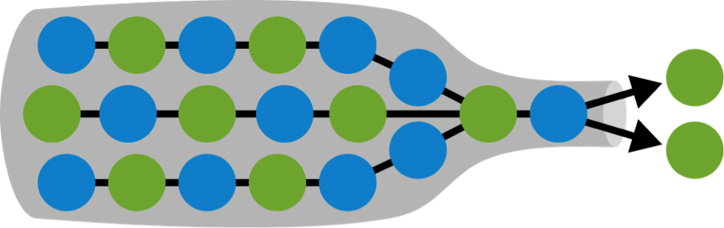
Regarding queue visualization
System integration – complexity to intergrade existing systems with new ones
High initial investment – high capital initial cost
Discipline regarding data collection & shop-floor behavior
Training for teams &
Synergies with suppliers

Slide 34

Regarding predictive planning
Data readiness – need for clear, historical, structured and reliable data
Widespread adoption of model
Possible process redesign – revised KPIs & cadence
Risk of over-automation or over-planning
Alignment of planning systems – all software must be on the same “track”

Slide 35


Regarding DSW inbound pipeline
Need for everything to be well classified
Possible underutilization or overutilization
Resource allocation – too much or not enough
Customer miscommunication
Possible internal fragmentation – can lead to bad coordination
Internal repair channel
Existing workflow
External repair channel
Possible fragmentation

Slide 36

Regarding quotation delays reduction 1
Issues regarding client behavior
Standardization vs Flexibility – risk of being too rigid or too simple
AI requires strong boundaries and clear guard-rails
Legal & commercial risks with non-human approval
KPIs might be inconsistent/misaligned
Speed vs Liability - tradeoff

Slide 37


Regarding quotation delays reduction 2
Client don’t always perceive quotations delay as part of overall delay
Can make company look unorganized or unresponsive
Delay project start
Longer overall time
Re-prioritize tasks due to uncertain project start date - uncertainty

Slide 38
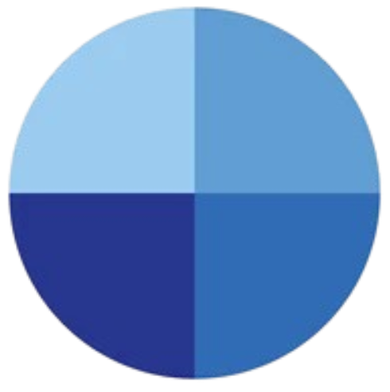
Division-wide challenges
Fatigue – too many changes can lead to fatigue from staff & customers
Change requires strong management, trust & discipline
Strong governance regarding data
Interdependence of each recommendation
Isolated implementation = limited impact
Sub-div.
Sub-div.
Motion
division
Sub-div.
Sub-div.

Slide 39
Mitigation approach
Pilot program: Test queue visualization & DSW segmentation on a small scale – if it works, roll out division-wide
Data cleaning & structuring for AI to work well
AI validation – make sure early AI decisions are verified by humans, help with learning & boundaries
Customer alignment – keep customers in the loop & work with them, design potential changes together
Transformation roadmap – not everything at the same time, give time for adaptation
Careful about over-changing things – not everything needs to be changed, but some things can be optimized

Slide 40
Questions

