Slide 1
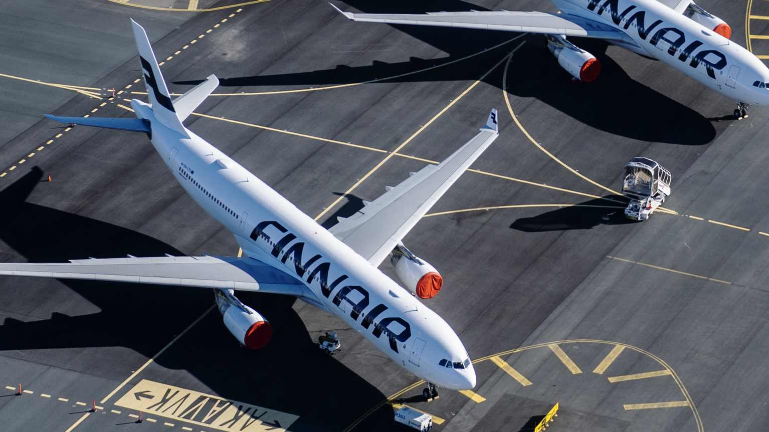
ROIC Sensitivity Among (European) Airlines
Group 8: Ali Sultan, Bui Minh Anh Pham, Kalle Isokangas, Phuong Ngan Le, Tomi Sieppi Xi

Slide 2
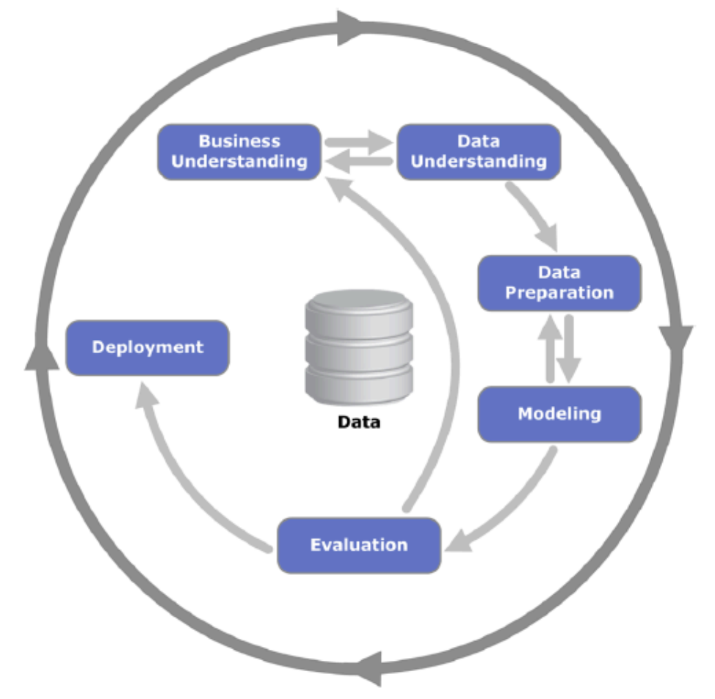
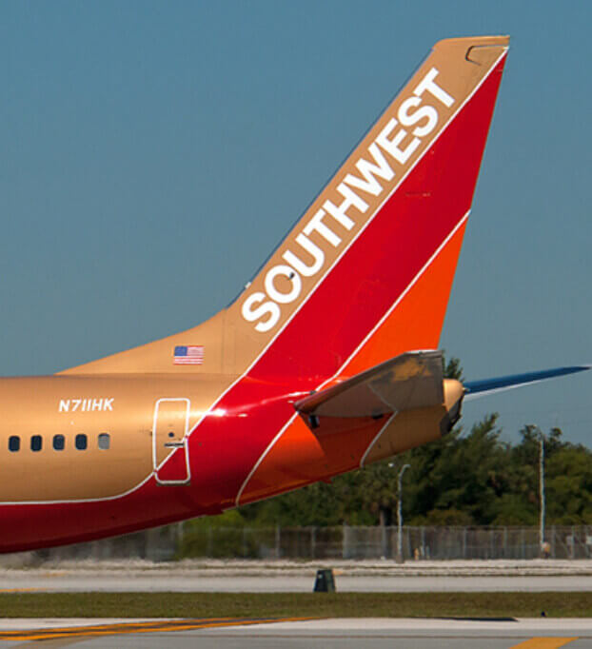
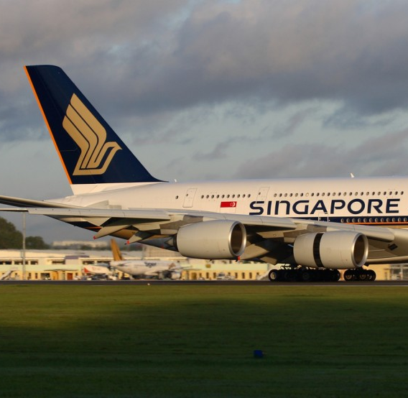

Business Problem
The airline indsutry is...
Highly capital-intensive
Aircraft, maintenance facilities, airport infrastructure, IT, aviation processes, etc.
ROIC
Sensitive to external factors
Fuel prices, business cycles, geopolitical events, pandemics, regulations, etc.
SENSITIVITY ANALYSIS

Slide 3
Business Problem
SENSITIVITY ANALYSIS
ROIC

Slide 4
Data Understanding
Airlines: Aegean, AirBaltic, Air-France-KLM, Finnair, Lufthansa, Norwegian, RyanAir, WizzAir
Period: 2012 – 2024
Size: 91 data points
Dataset: Financial statements of chosen airlines from Orbis
Key components from financial statements:
EBIT (Earnings before Interest & Taxes)
Measures core operating performance of the company
Invested Capital (Total Assets – Cash – Non-interest-bearing Liabilities)
Excluding cash and non-interest-bearing liabilities, so we can isolate the capital truly tied to the operations of the company

Slide 5
Data Preparation
Checked and unified formats across all airlines.
Extracted key financials: Revenue, EBIT, Tax Rate, Invested Capital, ROIC
Standardized units: All data converted to millions of euros
Fixed formatting issues: Removed commas, converted % to decimals
Handled errors and missing data: Replaced formula errors and documented gaps
Created new variable: ROIC calculated using EBIT × (1 – Tax Rate) / Invested Capital
Why It Matter: Clean, consistent data is essential for accurate modeling and trustworthy strategic insights.

Slide 6
Modeling
Hypothesis: Strategic shifts and external shocks impact ROIC across different airline business models.
Methodology:
Time series and cross-sectional analysis → Trends and comparisons
Volatility analysis → ROIC stability and its drivers across firms (Correlation matrix, Regression, Std Dev)
ROIC prediction under baseline and stress tests → How ROIC responds to changes in key inputs across models: CapEx -10% (fleet expansion), Revenue -10% (demand drop), Invested Capital +15% (M&A)
ROIC forecasts → Estimate future ROIC trajectories under realistic strategic assumptions (ARIMA(0,1,1))

Slide 7
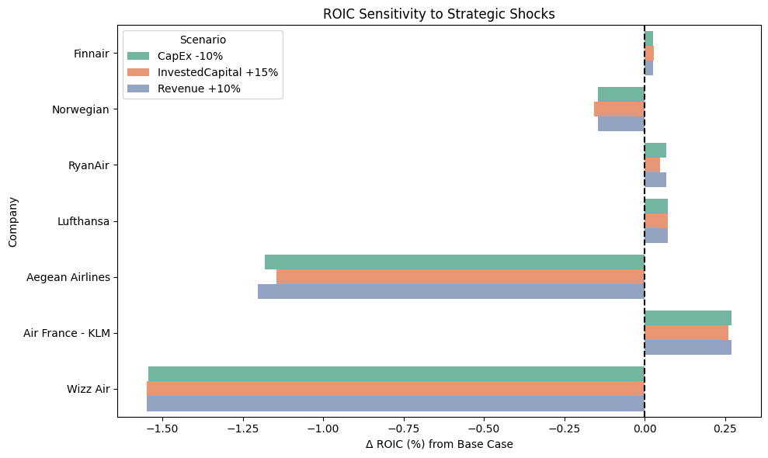
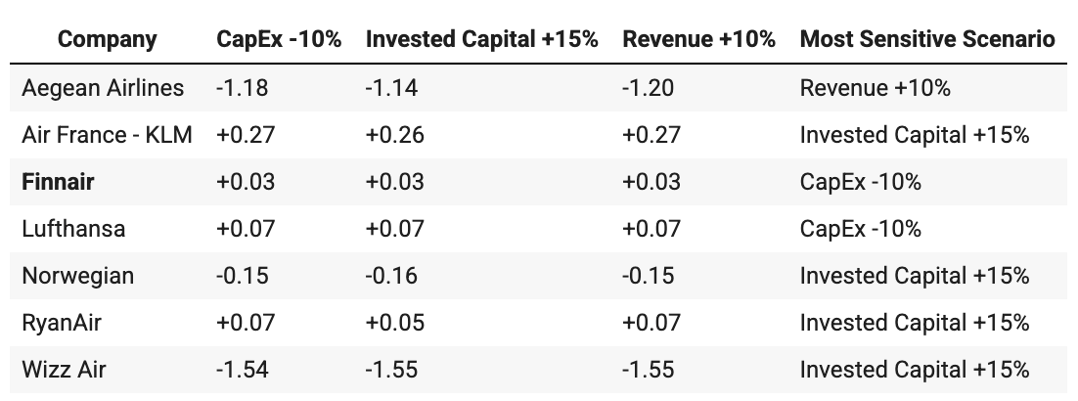
Modeling Visualizations

Slide 8
Evaluation Methodology
Methodological Step | Evaluation
1. Time Series & Cross-Sectional Analysis | Identify business model patterns and relative performance Be strong for benchmarking
2. Volatility Analysis | Implement different models for identifying ROIC drivers (Correlation matrix, Regression, Random forest, Std Dev) Separated stable vs volatile drivers Highlight firm-specific sensitivities
3. ROIC Prediction Under Scenarios | Realistic stressors tied to strategic levers Allow direct firm comparisons
4. ROIC Forecasting (ARIMA) | Time series model well-suited for noisy, mean-reverting metric like ROIC

Slide 9
Evaluation Limitations
Simplified ROIC Decomposition
Complex real-world interactions (might not be linear)
Some capital efficiency metrics (e.g., asset turnover by segment, route profitability) were not available or modeled explicitly.
Scenario Assumptions
Stylized and hypothetical scenarios
Not accounting for firm-specifics.
Modeling Constraints
Interdependencies between financial variables.
Outlier Influence
Extreme ROIC values (Aegean, Wizz Air...)

Slide 10
Deployment
Finnair, Lufthansa, and RyanAir
Low ROIC sensitivity (Lufthansa & RyanAir slightly more responsive to positive demand conditions)
⇒ Incremental CapEx reduction or targeted capital efficiency to slightly improve ROIC
Air France-KLM
Highest ROIC positive sensitivity to conditions
⇒ Good position to benefit from strategic investment and demand-side growth
Wizz Air and Aegean
Very high ROIC values skew the distribution in all scenarios
⇒ Urgent reassessment of capital planning or asset utilization, especially in volatile markets or rely heavily on lease financing
Norwegian
Mild negative sensitivity
⇒ Being "asset-light" doesn’t make ROIC invulnerable.

Slide 11
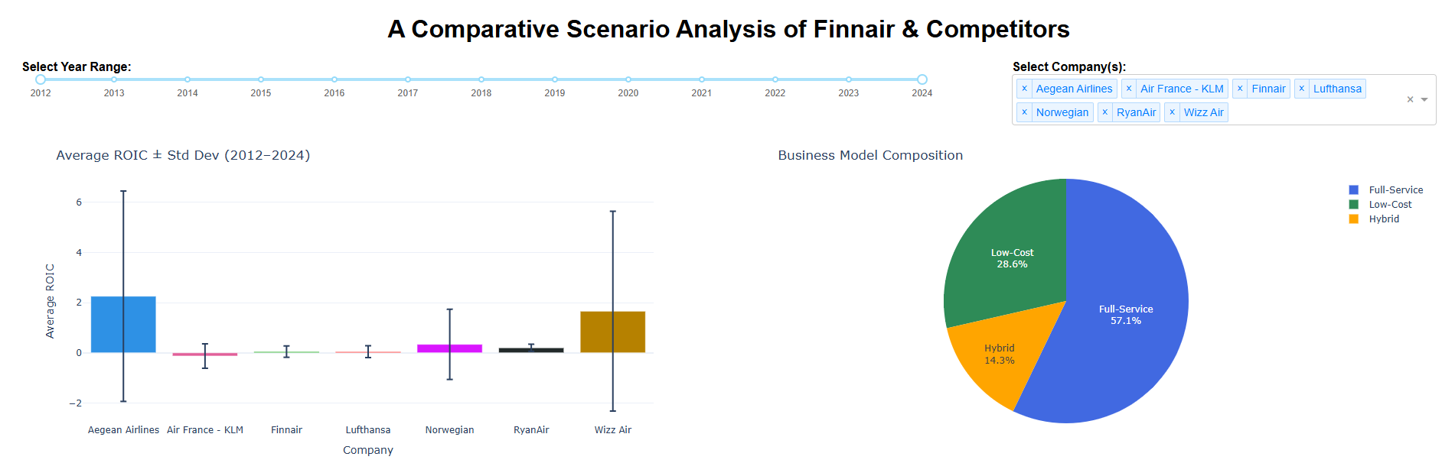
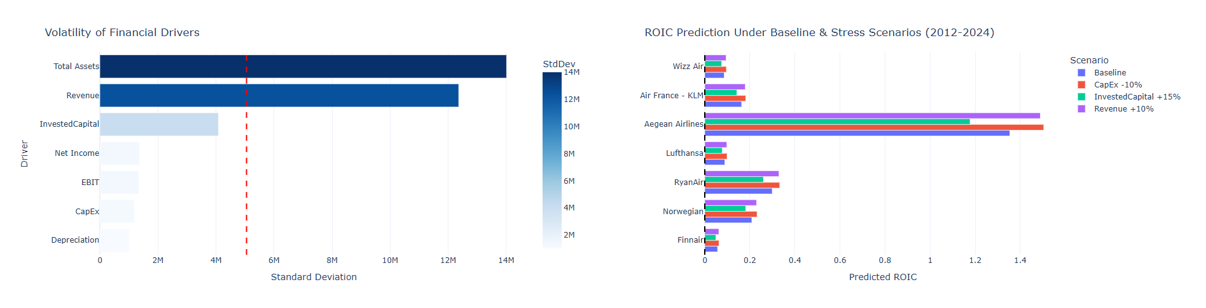
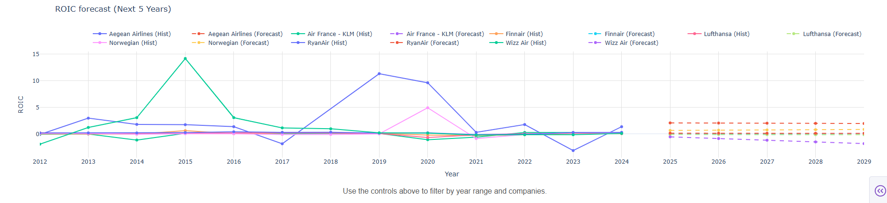
DASHBoard

Slide 12
THANK YOU FOR LISTENING!
Q&A?

