Slide 1
Jobs and Salaries in Data Science
UNVEILING INSIGHTS WITH SQL
Anh Phan

Slide 2
Some SQL functions used in this analysis:
Some tools used:
COUNT | AVERAGE | DENSE_RANK | PARTITION BY
DISTINCT | CROSSTAB | CASE WHEN
POSTGRESQL
TABLEAU

Slide 3
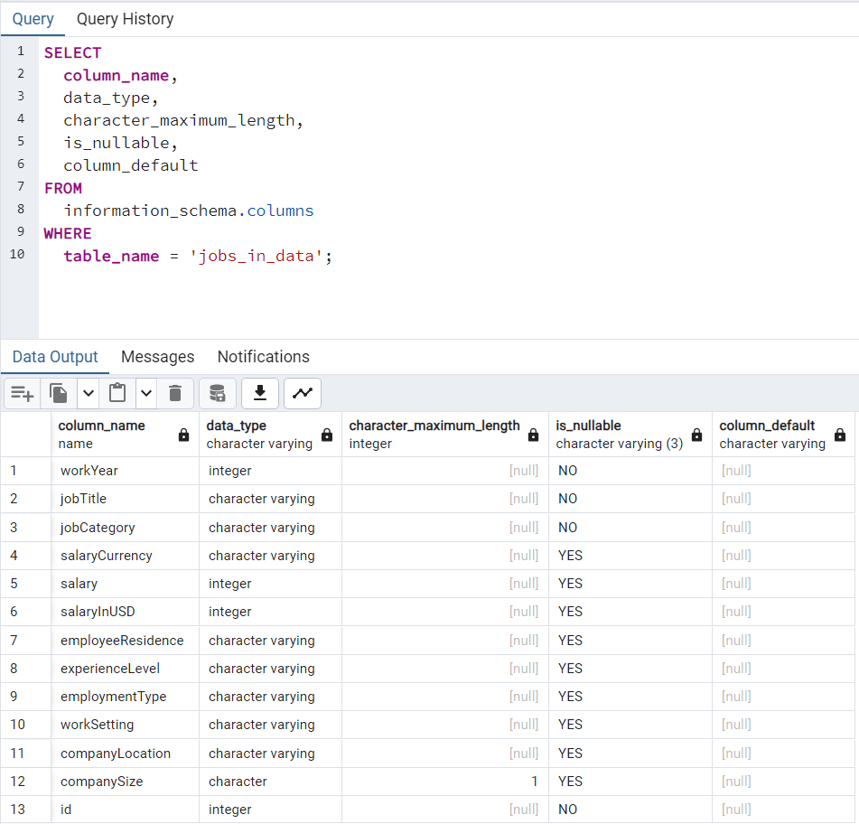
Facts about the dataset
Job Category: 10
Job Title: 125
Total Number of Records: 9355
Most available job title in the dataset is Data Engineer: 2195

Slide 4
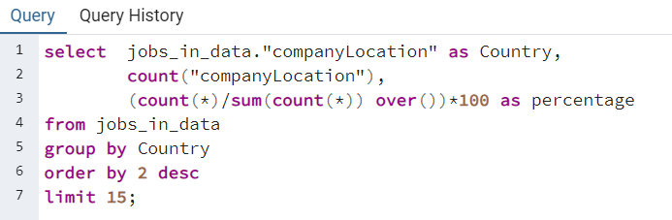
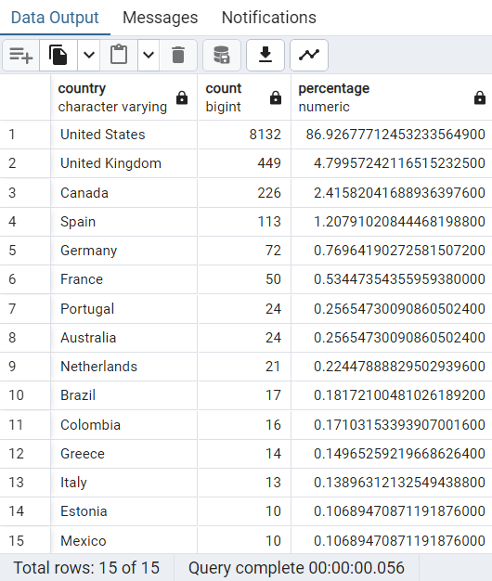
1. Proportions of each country's jobs in dataset
To find the proportions of each country’s jobs in the dataset, I ran the SQL query to count the occurrence of each location then divided by the total of records, and multiply with 100 to find the proportion percentage.
The result of the query above shows that the US has the most records in the dataset (8132 records), takes 87% of the data. The dataset is heavily skewed towards the United States, which may not be representative of global job trends. Job markets, requirements, and opportunities can vary significantly between countries and regions.

Slide 5
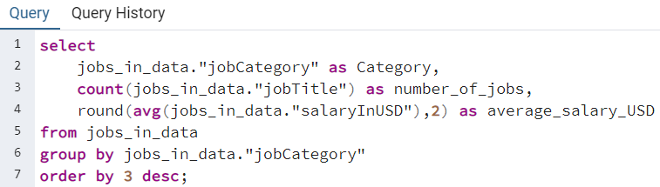
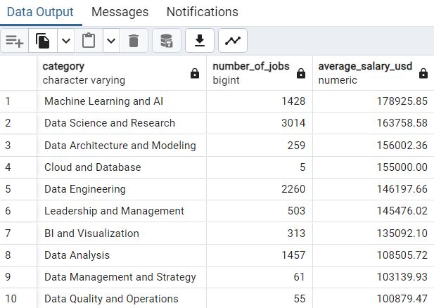
2. Number of Jobs and Average salary (in USD) of each
Job Category
To calculate the average salary of each job category, I used an AVG function across the salary column and group it by job category.
In terms of jobs count, Data Science and Research has the most with 3014 jobs. Data Engineering placed second with 2260 jobs, nearly 1000 jobs away from the third category which is Data Analysis.
In terms of salary, jobs in Machine Learning and AI have highest salary.

Slide 6
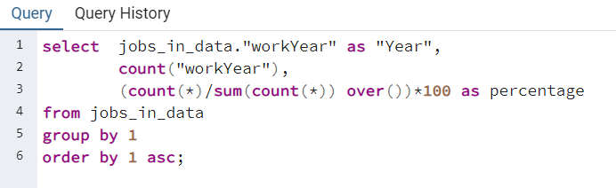
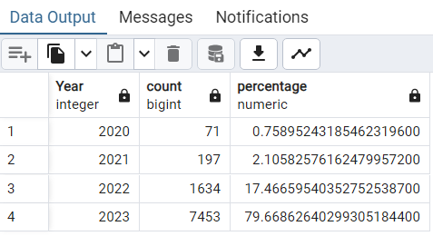
3. Proportions of each year's jobs in dataset
The data in this dataset is from 2020 to 2023.
However, majority of the data is from the year of 2023 (79.6%)

Slide 7
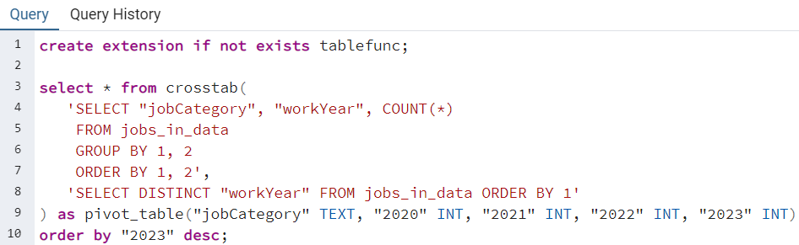
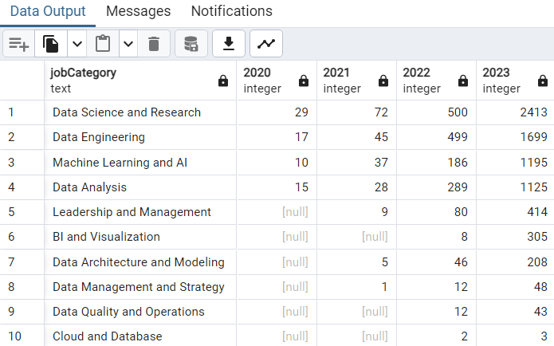
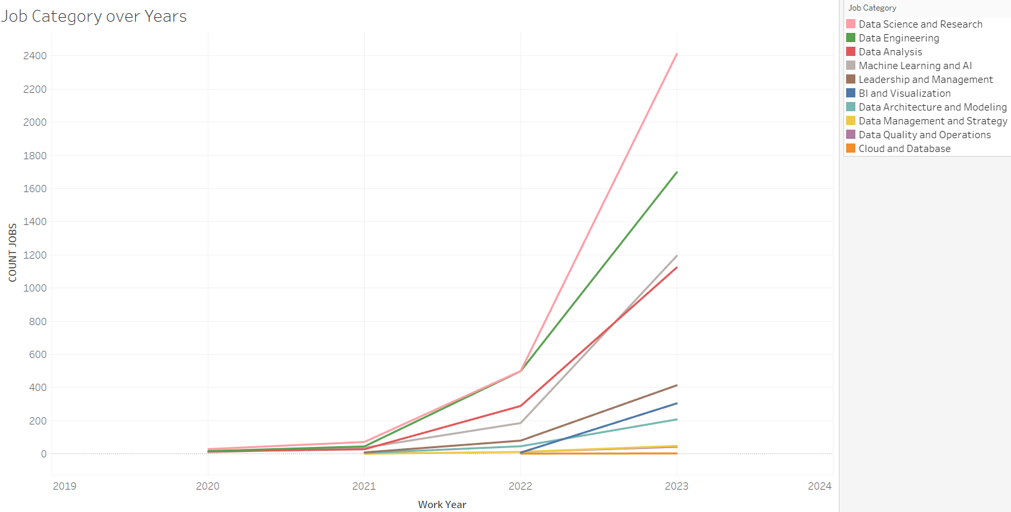
4. Jobs posting over the years based on Job Category
Data jobs grow with more opportunities over the years, especially in categories such as:
Data Science and Research
Data Engineering
Machine Learning and AI
Data Analysis
Based on the line chart, number of ML and AI jobs were less than DA jobs up until mid of 2022 and with the faster growth compared to DA jobs, ML and AI will continue to generate more job opportunities in upcoming years.

Slide 8
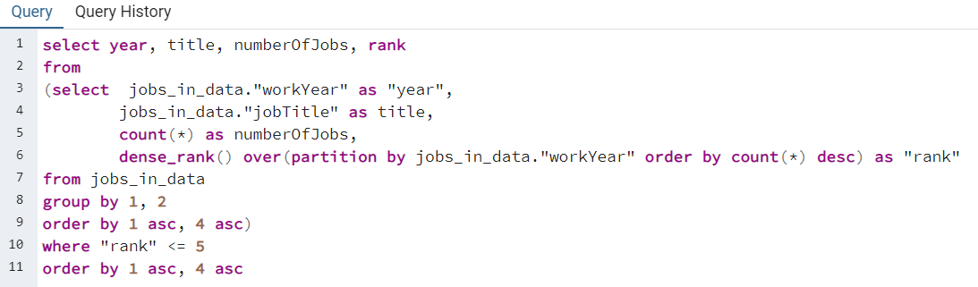
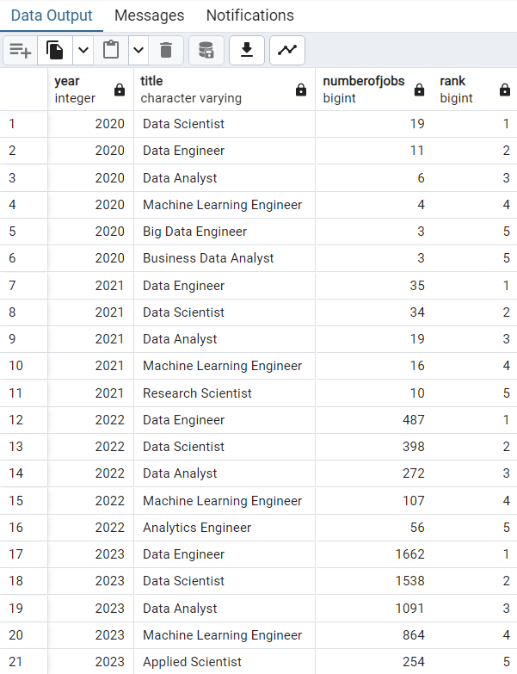
5. Top 5 most available jobs each year
To find top 5 most available jobs each year, I used dense_rank() function to rank the job titles based on the number of jobs, and also partitioned them by the year. Then from the subquery, I selected those that have rank of 5 or less.
Out of the top 5 results, the first 4 every year revolve around the 4 roles: Data Scientist, Data Engineer, Data Analyst, and Machine Learning Engineer.
Over the course of 4 years, out of 125 job titles in the dataset, these 4 job positions remains the most popular.

Slide 9
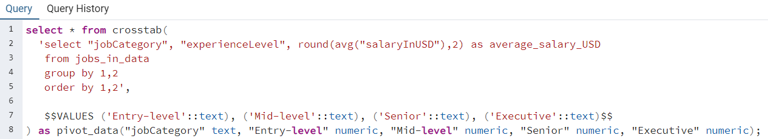
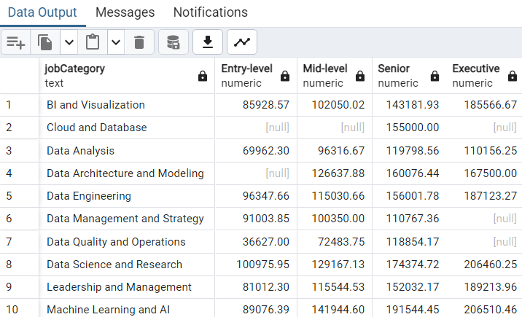
6. Average salary of different experience level for each
Job Category
Entry-level positions for jobs in Data Science and Research make the highest salary on average (USD $100,975.95), however starting Mid-level to Executive, jobs in Machine Learning and AI have higher average salary compared to all other job categories.

Slide 10
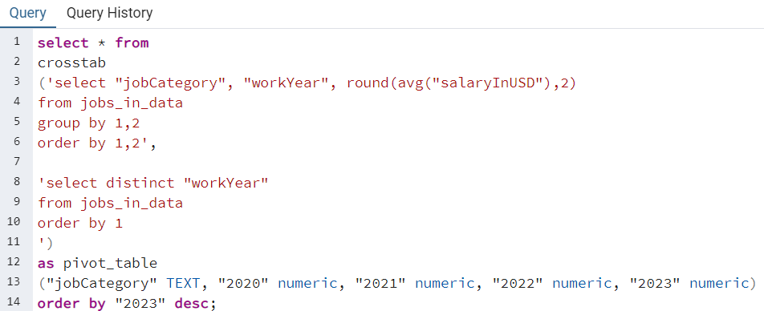
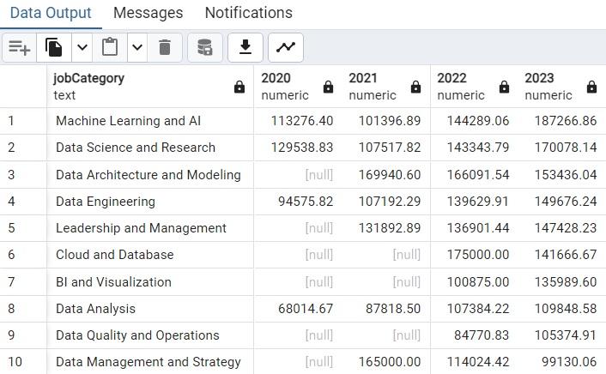
7. Average salary of Job Categories over the years
Machine Learning and AI job positions’ salary increase constantly over the course of 4 years, and with the rapid and strong development of AI technology, the job opportunities and average salary of this job category is going to increase still in the next few years.

Slide 11
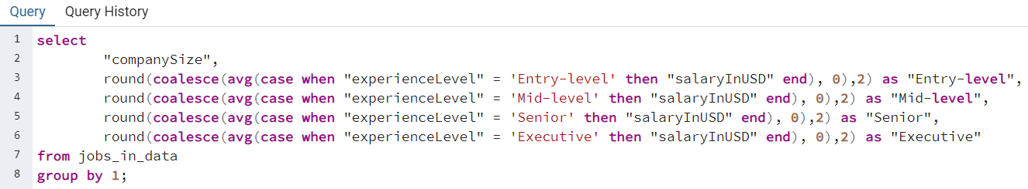
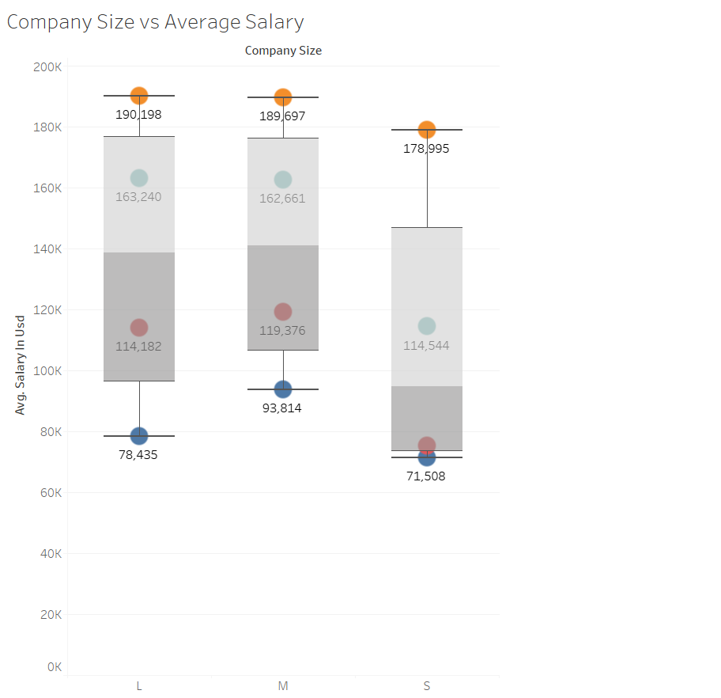
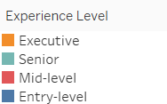
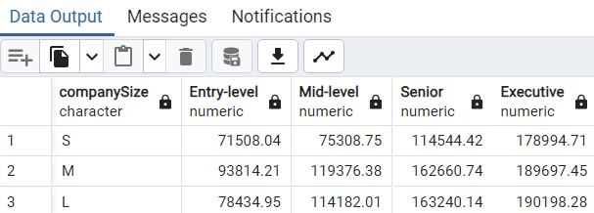
8. How is Company size affect salary
On average, medium sized companies are willing to pay more for entry-level and mid-level roles. Large sized companies pay more for senior and executive roles.
This plot does not consider other factors such as company location. For example, the 'United States' has more medium-sized companies in the data than large-sized.

Slide 12
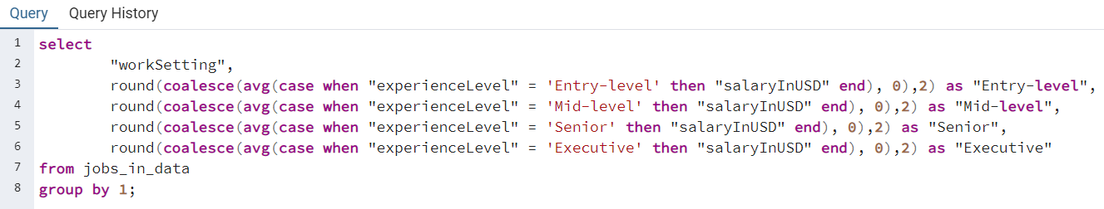
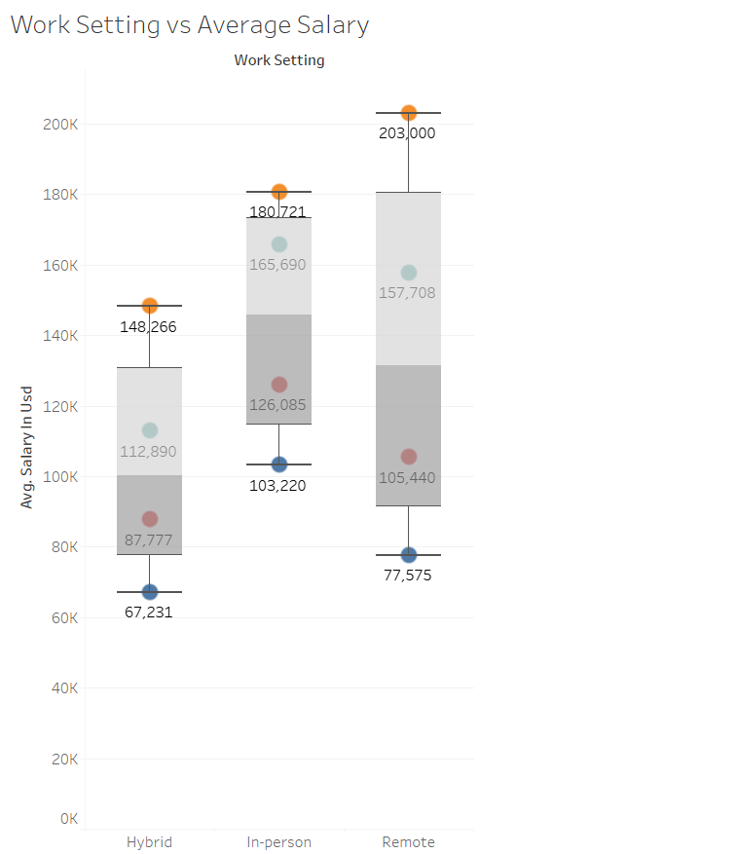
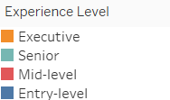
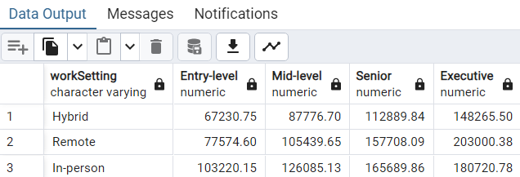
9. How is work settings affect jobs' salary
To see how work settings affect jobs’ salary, I created boxplots for ease of visualization. We can see that those who work in-person at entry-level, mid-level, and senior positions make highest on average compared to those working hybrid or remote. Executives who work remote

Slide 13
Final Thoughts
The analysis of jobs in data across multiple countries provided valuable insights. Using postgresql, we explored different job categories and the average salaries over the years, we were able to uncover trends such as the job trends and different experience levels’ salary range. Jobs in data ranges from multiple categories, and data is an important resource on which any company operates and makes decisions. Noteworthy findings include Data Science & Research and Data Engineering job categories generate the most number of jobs throughout the years from 2020 to 2023. Within the past few years, Machine Learning and AI jobs are following closely in both job opportunities and salaries, and with the strong development of AI technology, Machine Learning and AI job category is going to grow more in the upcoming years. We also looked into factors that affect different experience levels salary, such as company size and work settings. This jobs data analysis focuses on jobs opportunities in data, offering insights for those who thinking about getting into data.

Slide 14
Thank you!
Thank you for reading my ‘Jobs in Data’ Analysis, you can see more of my data findings on LinkedIn & Github.

