Slide 1

WiFi Security Auditing Tool
Presented by: Anh Phan, Dawn Marshall, & Jared Robinson

Slide 2

Ethical Considerations
Use only on networks with explicit authorization.
Intended for educational or professional audit purposes.
Unauthorized use violates laws and ethical guidelines.
Running the tool in a sandbox environment such as Kali Linux is highly recommended.

Slide 3

The Significance of WiFi Security Auditing
Detecting vulnerabilities before attackers do.
Preventing unauthorized access.
Identifying rogue access points, which help in mitigating “Evil Twin Attacks”.
Reducing the risk of a data breach.

Slide 4

Project Purpose
Automates Wi-Fi network security auditing tasks.
Designed for educational and authorized penetration testing.
Helps identify vulnerabilities in WPA/WPA2-secured networks.

Slide 5

Key Features
Wi-Fi network scanner and information enumerator.
Handshake capture for WPA/WPA2 networks.
Deauthentication attacks to force device reconnection.
Password cracking using dictionary attacks.
Rogue access point detection.

Slide 6

Setup Process
Install Kali Linux (VM or Dual Boot). Connect the external Wi-Fi USB adapter. Pass the adapter to Kali (in VM settings). Update system packages: sudo apt update && sudo apt upgrade
Install required tools:
sudo apt install aircrack-ng python3-pip
pip3 install scapy pywifi
Set Wi-Fi adapter to monitor mode:
sudo ifconfig wlan0 down
sudo iwconfig wlan0 mode monitor
sudo ifconfig wlan0 up

Slide 7
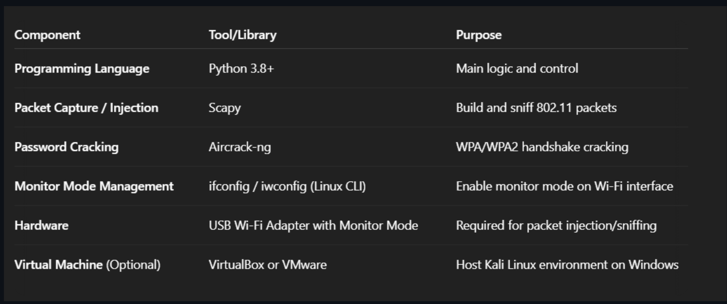
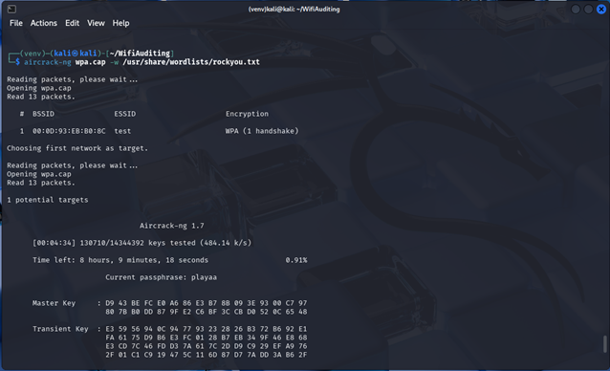
Tool Implementation

Slide 8
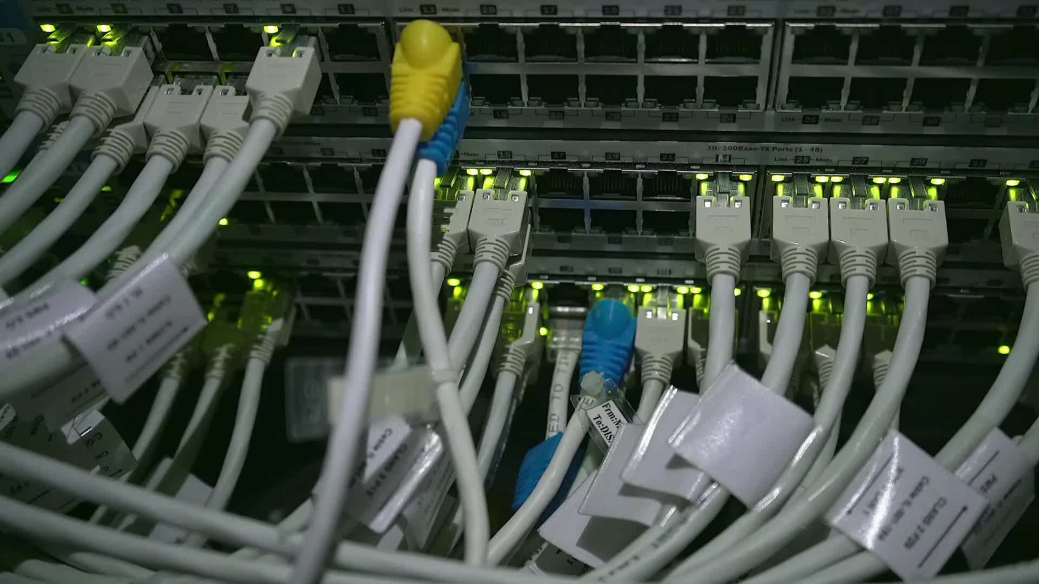
Tool Implementation
Python built-in module in Kali is fragile, so we need to create a virtual environment: python3 -m venv venv
Activate the environment: source venv/bin/activate
pip install scapy pywifi
wget https://github.com/aircrack-ng/aircrack-ng/raw/master/test/wpa.cap
sudo gzip -d /usr/share/wordlists/rockyou.txt.gz
aircrack-ng wpa.cap -w /usr/share/wordlists/rockyou.txt

Slide 9

Conclusion
Technical implementation involves use of Scapy or pywifi for scanning, subprocess calls to aircrack-ng for decryption, and shell scripting for interface control (monitor mode).
The integration of Python with command-line tools like aircrack-ng, shows a novel blend of automation and manual testing processes. The potential addition of custom Python scripts for detecting suspicious SSIDs adds value.

Slide 10
References
https://www.geeksforgeeks.org/how-to-audit-network-performance-security-and-troubleshooting-in-linux/
https://www.securew2.com/blog/complete-guide-wi-fi-security
https://www.tutorialspoint.com/wireless_security/wireless_security_tools.htm
https://www.cliffsnotes.com/study-notes/21306336

Slide 11

Questions?

