Slide 1
KnowDeal
The Mobile App

Slide 2



How it works
Register
Connect
Ranking
Notes:
Hypothesis: people want to share their financial experience as a measure of status
http://www.nelsonslaw.co.uk/site/library/privateclient/finplan/areyou_a_sophisticated_investor.html
To self-certify as a sophisticated investor you must:
have been a member of a business angels network for at least six months; or
have made at least one investment in an unlisted security in the previous two years; or
have worked in a professional capacity in the provision of finance to small- or medium-sized businesses in the last two years or in the provision of private equity; or
be or have been within the last two years a director of a company with a turnover of at least £1m.
Not sure how our platform will get users closer to being classed as a sophisticated investor. I cannot find any articles on people with professional qualifications being classed as professional investors.
Also sophisticated investors lose:
> Right to complain to FSA/FCA
> Right to access FSCS
I'm not sure how many investors who earn under £100k/year would want to give up these benefits?
-----------
That’s the “self-certified investor” (COBS 4.12.8); there is also “certified investor” (COBS 4.12.7), where the criterion is whether you are “sufficiently knowledgeable to understand the risks”. This can’t be self-certified, but has to be done by “a firm” which has assessed you. That’s the role we want to either perform or facilitate.

Slide 3

LOGIN
Email:
Token:
Login
Register
Notes:
Login:
(Find Customers – token is the primary key)
GET http://t24demo.cloudapp.net/hothouse-iris/Hothouse.svc/GB1001001/verCustomer_Inputs('100100')
IF email address matches supplied email GOTO FEED
IF email address does not match SHOW “Login failed”
IF 404 (Not Found) SHOW “Login failed”
Register: GOTO REGISTER

Slide 4
REGISTER
Email:
Begin
Notes:
Begin:
(Find Customers By Email Address)
GET http://t24demo.cloudapp.net/hothouse-iris/Hothouse.svc/GB1001001/verCustomer_Inputs()?$filter=email eq ‘aaron.phethean@gmail.com’
IF None POST http://t24demo.cloudapp.net/hothouse-iris/Hothouse.svc/GB1001001/verCustomer_Inputs()/new
GOTO YOUR_DETAILS

Slide 5

YOUR_DETAILS
Email:
Read only abc@xyz.com
Given name:
Family name:
Mobile:
Identification
Sign Up Now
Notes:
Sign Up Now:
IF Identification provided
POST rel=‘http://temenostech.temenos.com/rels/input’ (see REGISTER step where we POST’d to ‘new’
IF 201 (Created)
Create the account:
POST http://t24demo.cloudapp.net/hothouse-iris/Hothouse.svc/GB1001001/verAccount_HotOpens()/new
POST rel=‘http://temenostech.temenos.com/rels/input’
Identification: Take Photo’s of documents:
Save some photos

Slide 6

FEED
Achievements
Post message
Feed
*
Name
Rank
Short message
Feed just like Twitter
Name
Rank
Short message
Name
Rank
Short message
$

Slide 7
OPPORTUNITIES
Invest
Name
Risk
Short message
Searchable feed
Name
Risk
Short message
Name
Risk
Short message
$

Slide 8
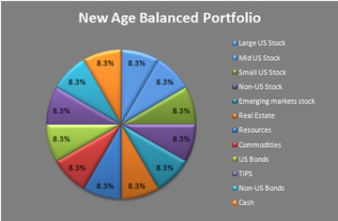
PORTFOLIO
My Portfolio
$

Slide 9
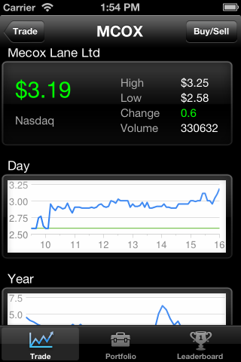
LEARN
Portfolio Simulation
$

Slide 10
ACHIEVEMENTS
Achievements
Logo
10pts Registered
Logo
100pts Profitable exit
Logo
50pts Stock trade
Logo
100pts Investment property

