Slide 1
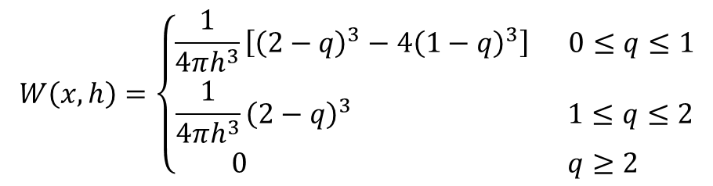
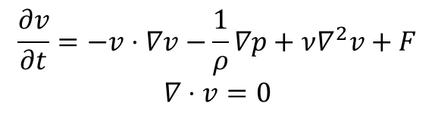
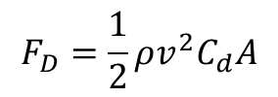
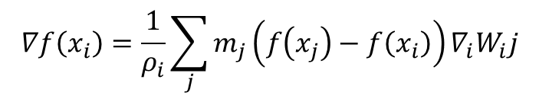
This demo brought to you by
$$\frac{∂v}{∂t}=−v⋅∇v−\frac{1}{ρ}∇p+ν∇^{2}v+F$$
$$∇⋅v=0$$
$$F_{D}=\frac{1}{2}ρv^{2}C_{d}A$$
$$W\left(x,h\right)=\left\{\begin{matrix}\frac{1}{4πh^{3}}\left[{\left(2−q\right)}^{3}−4{\left(1−q\right)}^{3}\right] 0≤q≤1 \\ \frac{1}{4πh^{3}}{\left(2−q\right)}^{3} 1≤q≤2 \\ 0 q≥2\end{matrix}\right.$$
$$∇f\left(x_{i}\right)=\frac{1}{ρ_{i}}\sum_{j}{m_{j}\left(f\left(x_{j}\right)−f\left(x_{i}\right)\right)∇_{i}W_{i}j}$$

Slide 2



Directional Viscosity
$$d−v$$
$$v$$
$$d$$

Slide 3
Applications
Education
Design
Control
Notes:
UAV – Unmanned Areal Vehicle
Education – Teaching people about fluids stuff
Medical – surgery without cutting open body
Automotive design – car manufacturers

Slide 4
Applications
Education
Design
Control

Slide 5
Applications
Education
Design
Control

Slide 6
Applications
Education
Design
Control

Slide 7
Education
Design
Control

Slide 8
Education
Design
Control

