Slide 1
RAPIDWATCH · GULF GEOSPATIAL CANVAS
Understanding Hurricane
Rapid Intensification
Where and when hurricanes explode in the Gulf of Mexico — and where to point the instruments that could see it coming.
Alex Philp, Ph.D. · RapidWatch independent analysis
175 years of NOAA best-track data (1851–2025) · 326 Gulf hurricanes

Slide 2
THE PROBLEM
The hardest forecast in meteorology
Track forecasts have improved for thirty years. Intensity — and rapid intensification above all — has lagged.
Rapid intensification turns a modest storm into a major one with little warning. It is the most dangerous surprise in tropical forecasting — and the Gulf of Mexico is where it happens most in the United States.
Camille ’69 · Katrina & Rita ’05 · Michael ’18 · Ida ’21 · Milton ’24 — each blew up over the Gulf.
WHAT COUNTS AS RAPID INTENSIFICATION
+30 kt
in 24 hours
≈ 35 mph of extra wind in a single day — the 95th percentile of all 24-hour changes in the North Atlantic, and the operational standard.
RAPIDWATCH · Gulf Rapid-Intensification Observatory
02

Slide 3
THE PHYSICS
Three ingredients must align
The mechanism is well understood. RapidWatch’s question is operational: where and when do all three coincide?
FUEL
Warm sea surface
Tropical cyclones need water of roughly 26 °C or more — the energy source.
AMPLIFIER
Deep warm water
Deep warm layers suppress the cold wake that would otherwise cap intensification.
SWITCH
Low wind shear
Vertical wind shear is the on/off switch — it tears a developing core apart.
≥ 26 °C SST
Ocean heat / D26
Weak 200–850 hPa shear
RAPIDWATCH · Gulf Rapid-Intensification Observatory
03

Slide 4
DATA & METHOD
Measuring preference, not traffic
▸ 175 years of NOAA HURDAT2 best-track data (1851–2025) — 2,004 Atlantic systems.
▸ Restricted to the 326 hurricanes that reached hurricane strength inside a Gulf polygon.
▸ An RI onset = any fix whose wind rises ≥ 30 kt over the next 24 h, placed at the start.
▸ Domain gridded at 0.25°; every cell counts onsets AND all storm fixes passing through.
▸ The quantity is propensity — onsets ÷ traffic — so a busy shipping lane can’t fake a hotspot.
WHY NORMALIZE BY TRAFFIC?
Storms cluster along certain paths. Counting raw onsets would just rediscover where storms travel.
Dividing by the number of storms that passed through each cell isolates a real preference — the places where storms are unusually likely to ignite, not merely present.
RAPIDWATCH · Gulf Rapid-Intensification Observatory
04

Slide 5
HEADLINE NUMBERS
What 175 years of storms reveal
3.1×
More likely in the core
RI onset in the southern-Gulf core vs. basin average
47%
Of Gulf hurricanes
underwent at least one RI onset inside the Gulf
84%
Of onsets in Aug–Oct
peaking sharply in September
50 kt
Median strength at onset
RI begins while a storm is still a tropical storm
66%
Begin at ≤ TS strength
the storms that explode rarely look dangerous yet
326
Gulf hurricanes analyzed
411 RI-onset intervals detected, 1851–2025
RAPIDWATCH · Gulf Rapid-Intensification Observatory
05

Slide 6
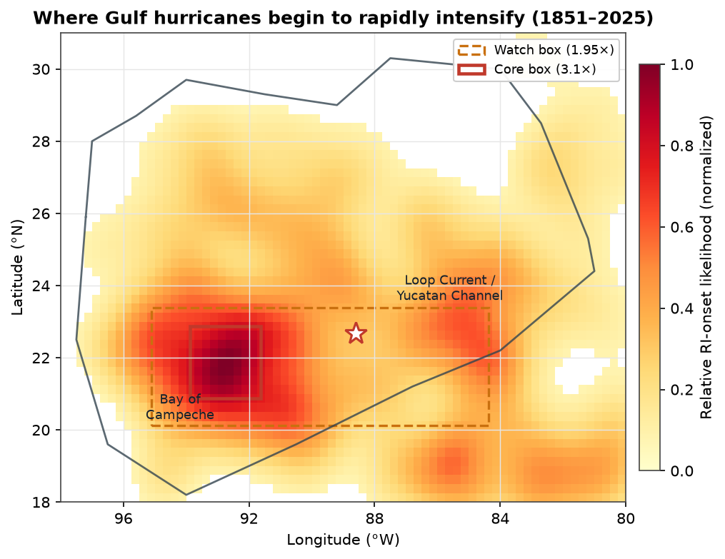
FINDING 1 — WHERE
It is geographically concentrated
Nearly one fix in four in the southern-Gulf core is an RI onset — 3.1× the basin average.
The tightest core sits over the Bay of Campeche and the southwestern flank of the Loop Current (≈ 21–23 °N, 92–94 °W), fanning east toward the Yucatán Channel.
TAKEAWAY
A genuine preference — it survives normalization by storm traffic.
RAPIDWATCH · Gulf Rapid-Intensification Observatory
06

Slide 7
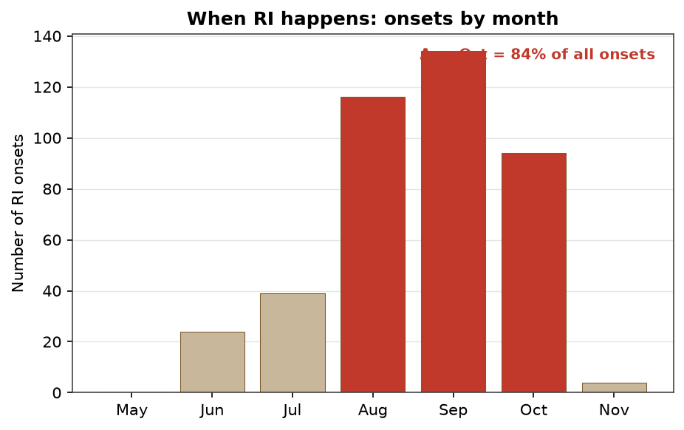
FINDING 2 — WHEN
It is strongly seasonal
September is the peak month; 84% of all onsets fall in August–October.
This is when the three ingredients align at once: sea-surface temperature at its annual peak, the Loop Current carrying its deepest warm layer, and basin-wide shear at its climatological lowest.
TAKEAWAY
One calendar: pre-position for the warm season, peaking in September.
RAPIDWATCH · Gulf Rapid-Intensification Observatory
07

Slide 8
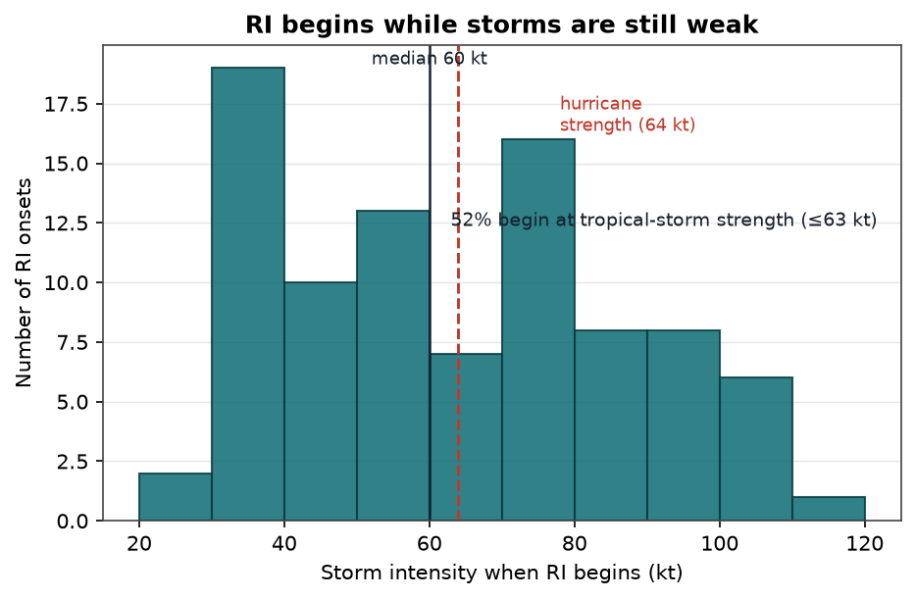
FINDING 3 — AT WHAT STRENGTH
It starts in weak systems
Median intensity at onset is just 50 kt. Two-thirds of onsets begin at tropical-storm strength or below; 87% at Cat 1 or below.
By the time a storm looks dangerous, the window most in need of observation has often already opened.
TAKEAWAY
Targeting must include developing systems — not just the storms that already look like a threat.
RAPIDWATCH · Gulf Rapid-Intensification Observatory
08

Slide 9
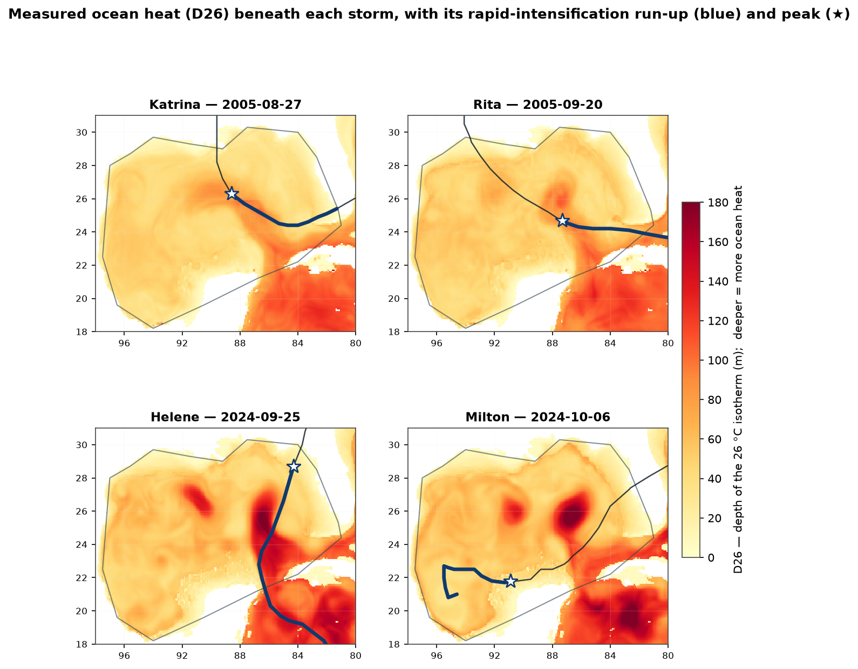
FINDING 4 — WHY
The hotspot sits on the deep warm water
The geography is no coincidence. The core overlies the Gulf’s two deepest warm-water features — the Loop Current and the Bay of Campeche warm pool.
Measured ocean heat (depth of the 26 °C isotherm, D26) confirms it storm by storm: Katrina, Rita, and Helene each intensified over water 1.2–1.7× the Gulf-median depth.
RAPIDWATCH · Gulf Rapid-Intensification Observatory
09

Slide 10
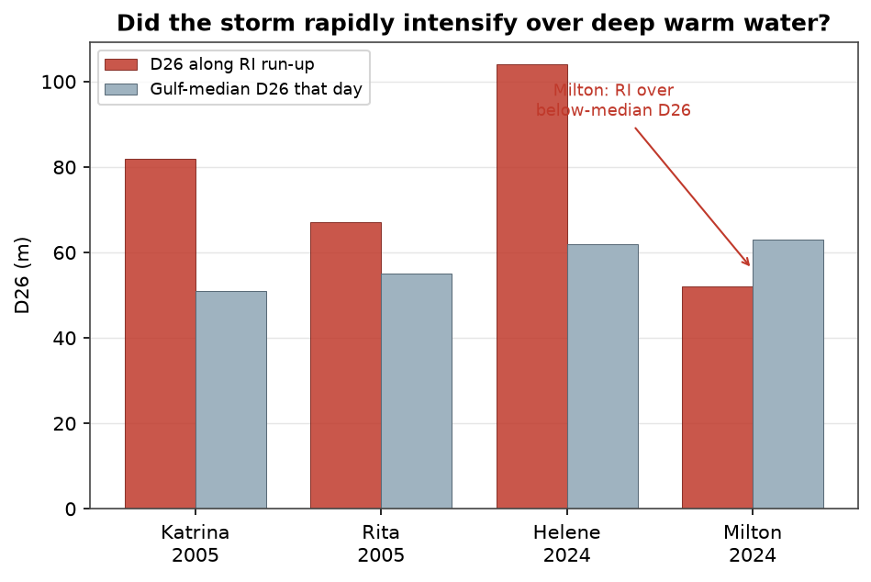
THE INSTRUCTIVE EXCEPTION
Milton 2024 — deep heat is not the only trigger
The most explosive case on record — +80 kt in a day — began over the Bay of Campeche where the warm layer was only ~52 m deep, below the Gulf median.
Its fuel was record sea-surface temperature and near-zero shear — not the deepest ocean heat.
TAKEAWAY
Deep warm water amplifies rapid intensification — but it is not the sole trigger.
RAPIDWATCH · Gulf Rapid-Intensification Observatory
10

Slide 11
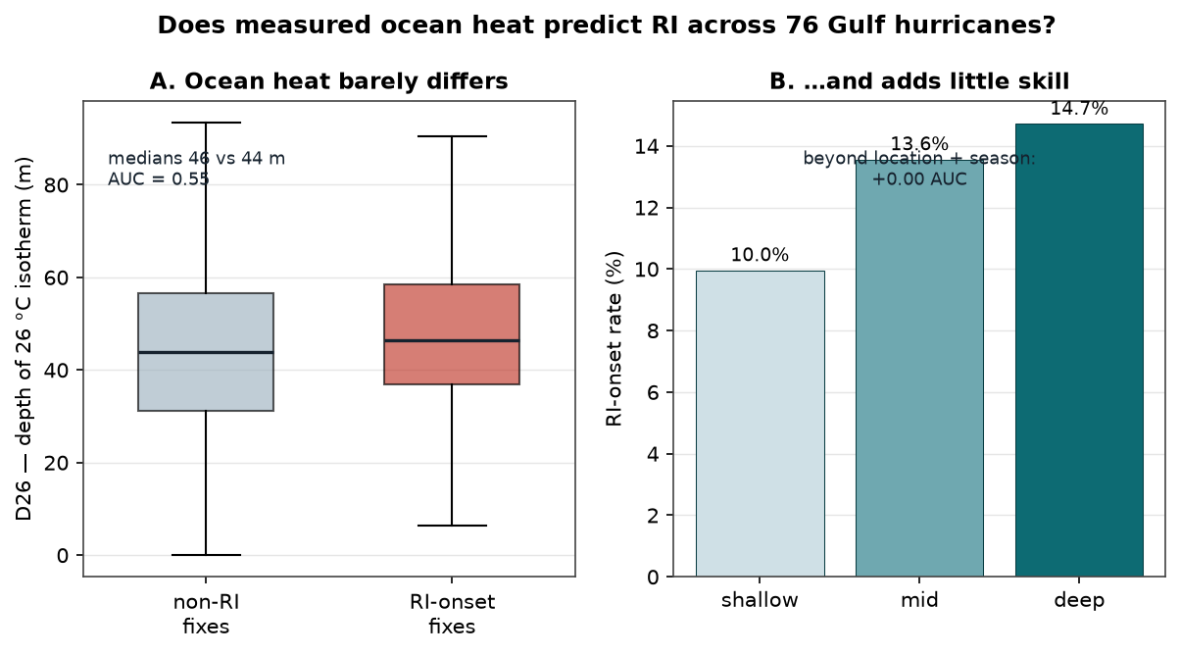
THE HONEST TEST
Does warm-water depth add forecasting skill?
Across 76 Gulf hurricanes (698 fixes, 89 onsets), depth alone is barely better than a coin flip at separating onsets from non-onsets (AUC 0.55).
Add D26 to location, season, and current intensity, and out-of-sample skill is essentially unchanged (0.693 → 0.689).
Not irrelevance — redundancy. Where and when already encode where the deep warm water lies.
RAPIDWATCH · Gulf Rapid-Intensification Observatory
11

Slide 12
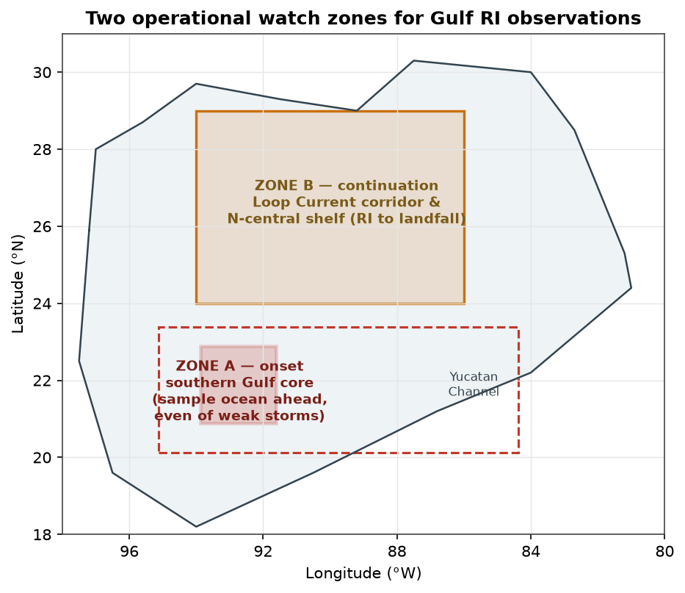
FROM SCIENCE TO STRATEGY
Two distinct operational zones
ZONE A — ONSET
Southern-Gulf core
Where RI begins, in weak systems entering from the south. Sample the ocean ahead of the storm to catch it early.
ZONE B — IMPACT
Loop Current corridor & shelf
Where RI continues toward U.S. landfall — Katrina, Rita, Michael, Ida. Highest stakes for warning.
RAPIDWATCH · Gulf Rapid-Intensification Observatory
12

Slide 13
RECOMMENDATION
The Gulf RI Watch protocol
WHEN — TRIGGER
WHERE — TARGET
HOW — LEAD & ORDER
▸ Any system forms in the Gulf or Bay of Campeche — any intensity, including disturbances.
▸ A NW-Caribbean system is forecast through the Yucatán Channel within 72 h.
▸ A Gulf system is forecast over the Loop Current toward the north-central shelf.
▸ Primary: the southern-Gulf core box (20.9–22.9 °N, 91.6–93.9 °W).
▸ Expanded to the watch box to take in the Yucatán intrusion.
▸ Secondary: the Loop Current corridor along the forecast track.
▸ Sample 12–36 h ahead of projected onset, ahead of the track.
▸ In warm season, treat any qualifying system as RI-capable by default.
▸ Priority: ocean heat → inner core of weak systems → environmental shear.
RAPIDWATCH · Gulf Rapid-Intensification Observatory
13

Slide 14
CLOSING THE GAPS
The platforms — by the two persistent gaps
GAP 1 Subsurface ocean heat ahead of the storm
GAP 2 Inner core of developing systems
▸ AXBT / AXCTD ocean profilers dropped from P-3 & C-130 across the core box
▸ Air-deployed ALAMO / APEX profiling floats through the event
▸ IOOS hurricane-glider picket line, Yucatán to Campeche Bank
▸ Satellite altimetry — Sentinel-6, Jason, SWOT — for ocean-heat mapping
▸ Enhanced seasonal Argo to anchor altimetry → warm-layer depth
▸ NOAA WP-3D with Tail Doppler Radar + dropsondes — tasked earlier, at TS strength
▸ Small uncrewed aircraft (Altius-600, Coyote) in the boundary-layer inflow
▸ Saildrone surface vehicles for air–sea flux through the season
▸ G-IV synoptic surveillance to constrain shear and steering
▸ Protect passive-microwave coverage (DMSP/SSMIS ending) over the Gulf
RAPIDWATCH · Gulf Rapid-Intensification Observatory
14

Slide 15
BOTTOM LINE
A seasonal calendar and a priority map
Concentrated — RI onset is ~3× more likely in a southern-Gulf core (≈ 21–23 °N, 92–94 °W).
THE OPERATIONAL PAYOFF
Point finite flight-hours and glider-days at the high-propensity core, in the right season, at 12–36 h lead.
The value of real-time ocean heat is in initializing the coupled forecast models — not as a stand-alone warning signal.
Seasonal — 84% of onsets fall Aug–Oct, peaking in September.
Early — It begins in weak systems — two-thirds at tropical-storm strength or below.
Redundant signal — Measured ocean heat adds little skill beyond location + season — they already encode it.
RAPIDWATCH · Gulf Rapid-Intensification Observatory
15

Slide 16
RapidWatch
Gulf Geospatial Canvas — Rapid-Intensification Observatory
Interactive map · 326-storm history · live buoys & NHC cone · four measured ocean-heat fields
aphilp1.github.io/rapidwatch
Alex Philp, Ph.D. · Data: NOAA HURDAT2 1851–2025 · HYCOM GOFS 3.1 · Copernicus GLORYS

