Slide 1
Forecast Package System

Slide 2
Progressive System

Slide 3
Display System
01
Part List Master
02
Package Master
03
Part List and Package Master
04
Supplier Master
05
Standard WIP Master
06
Input Stock Package
07
Sum Stock by Box/Partition
08
All-Part list Forecast Package
09
Forecast Use Box
10
Forecast Use Partition

Slide 4
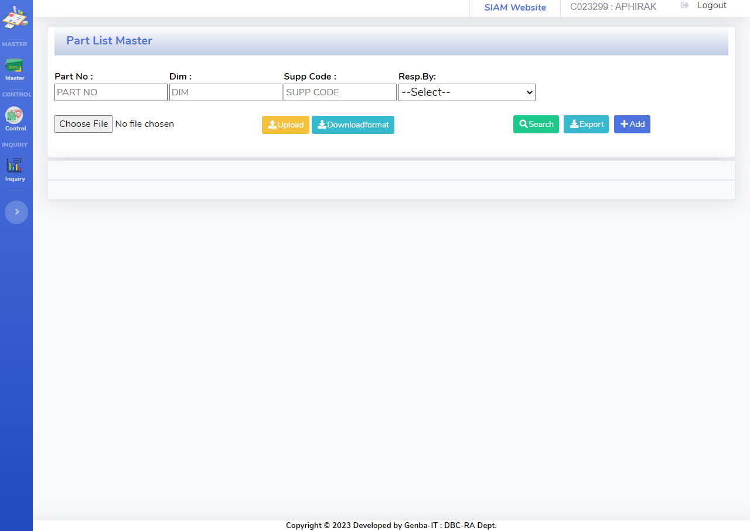
Display System
Part List Master
Detail:
-User Can Search By Part No
-Insert , Update, Delete Part List
-Upload Data By CSV. File
-Export data to file Excel

Slide 5
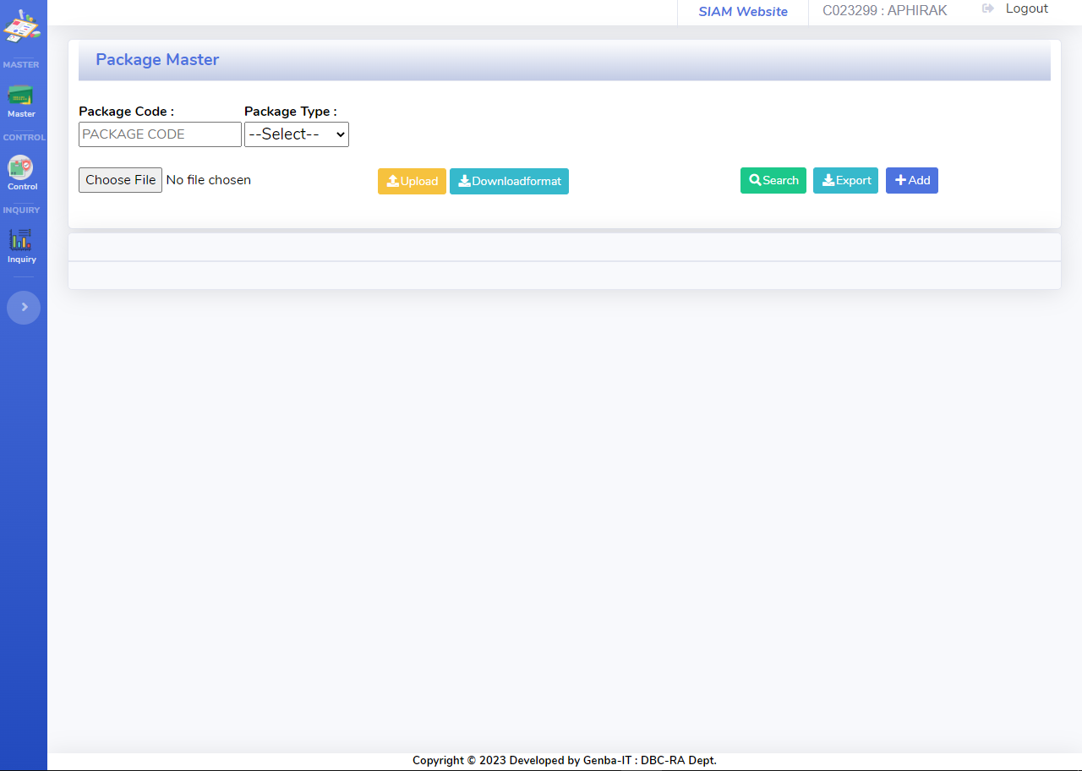
Display System
Package Master
Detail:
-User Can Search by Package Code ,Package Type
-Insert , Update, Delete Detail Package
-Upload Data By CSV. File
-Export data to file Excel

Slide 6
Display System
Part List and Package Master
On develop
Detail:
-User Can Search by Part No ,Supplier ,Package Code ,Package Type
-Insert , Update, Delete Suppler
-Upload Data By CSV. File
-Export data to file Excel

Slide 7
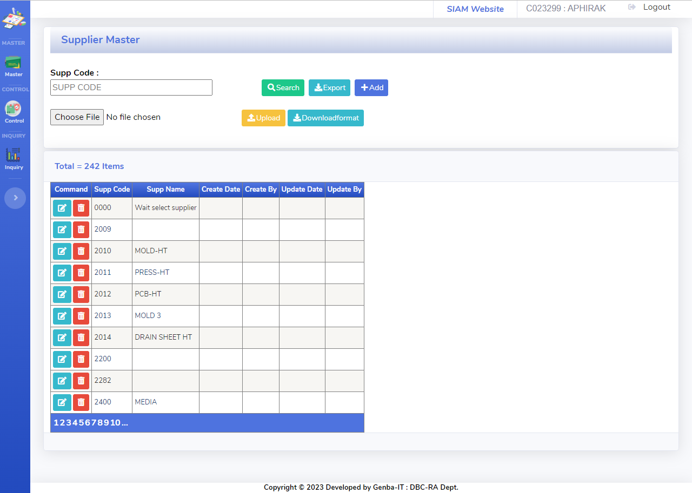
Display System
Supplier Master
Detail:
-User Can Search by Supplier Code
-Insert , Update, Delete Suppler
-Upload Data By CSV. File
-Export data to file Excel

Slide 8
Display System
Standard WIP Master
On develop
Detail:
-User Can Search by Part No
-Insert , Update, Delete Standard WIP Master
-Upload Data By CSV. File
-Export data to file Excel

Slide 9
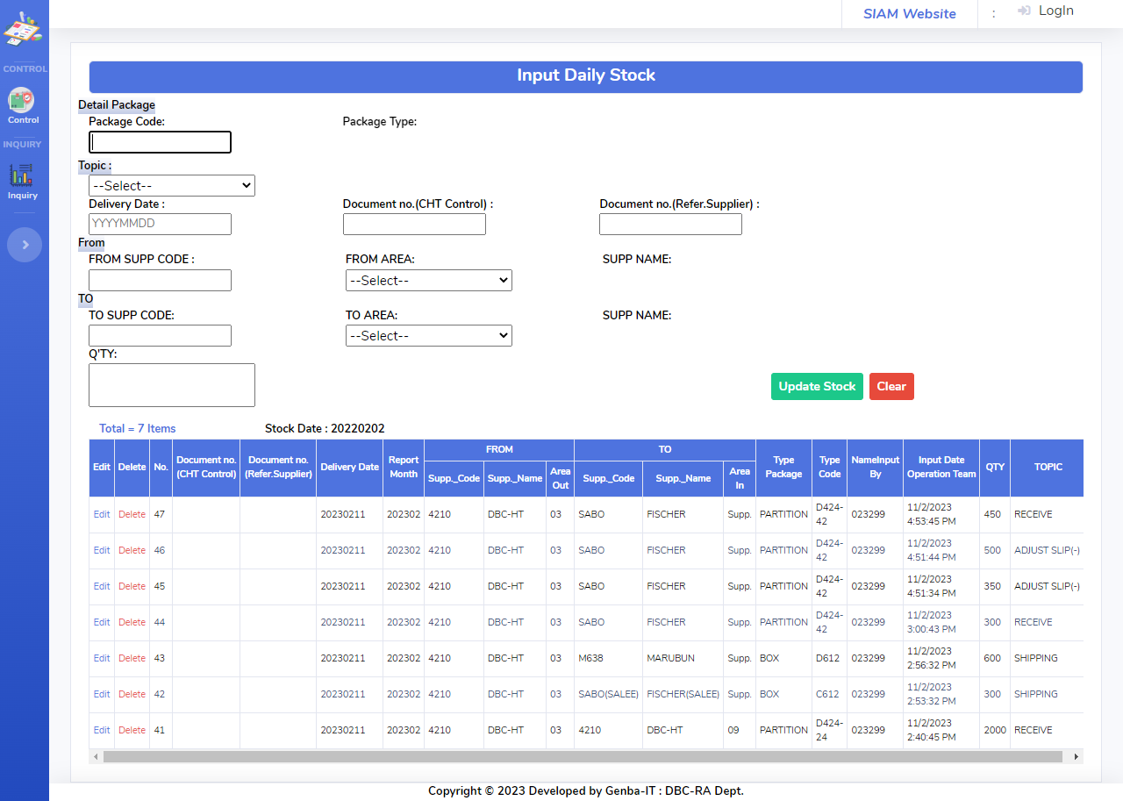
Display System
Input Stock Package
Detail:
-User Can Insert, Update, Delete Stock Package

Slide 10
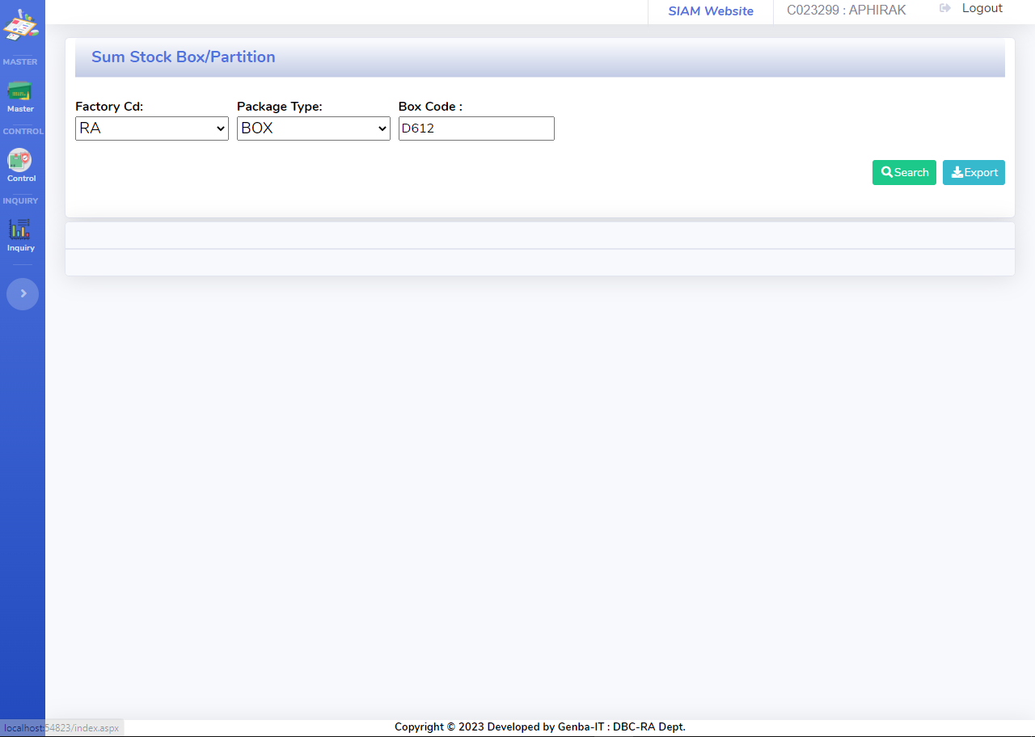
Display System
Sum Stock Package By Box/Partition
On develop

Slide 11
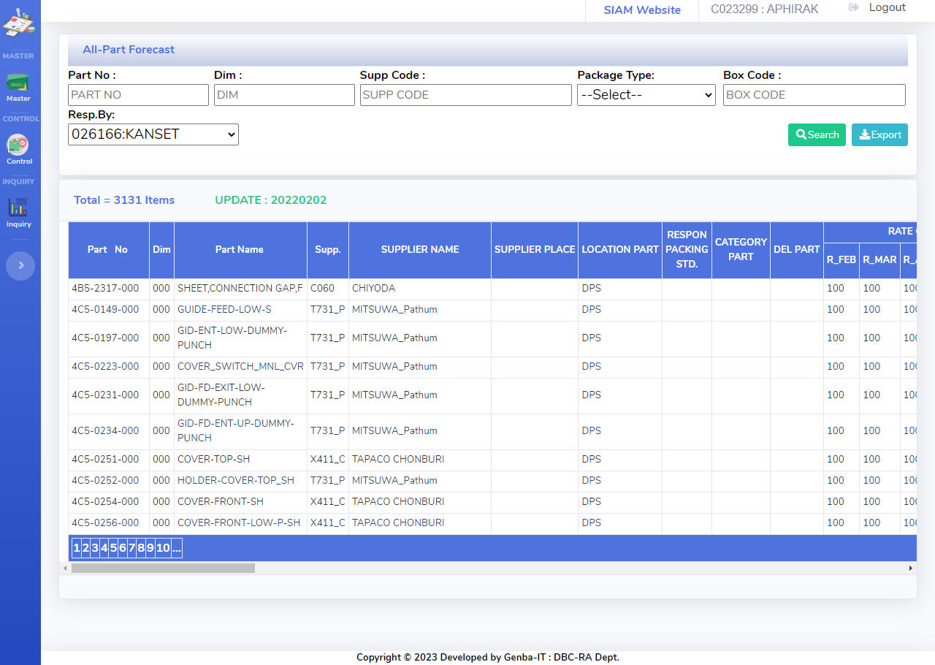
Display System
All Part list Forecast Package
Detail:
-User Can Search All Part list Forecast Package
-Export data to file Excel

Slide 12
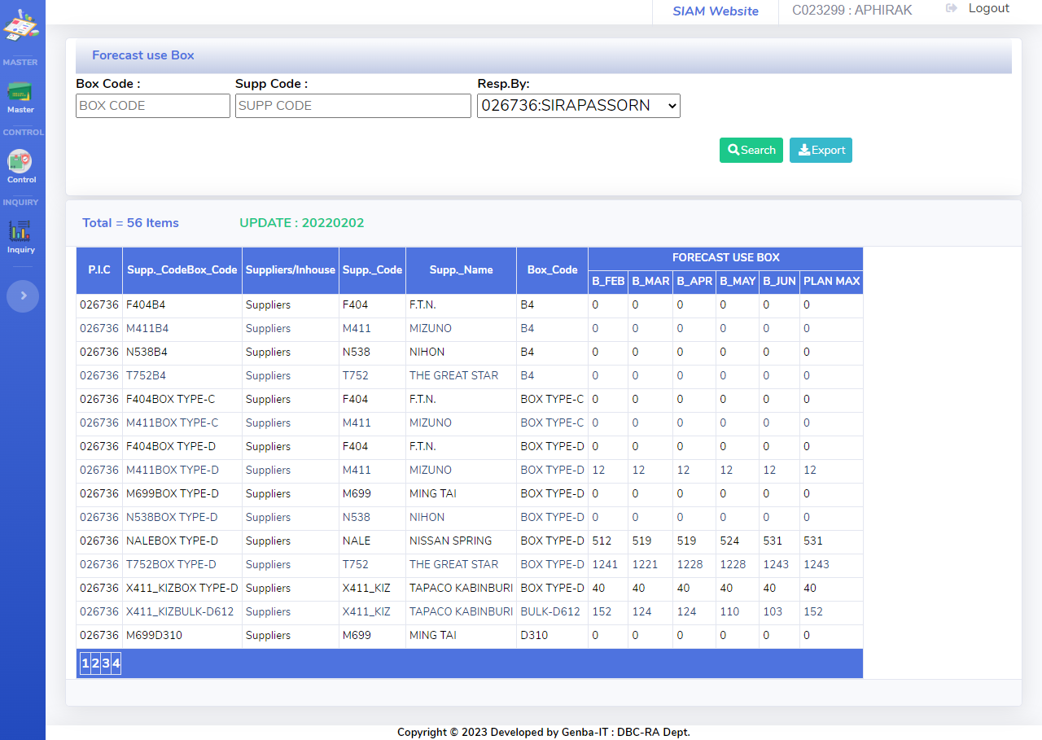
Display System
Forecast Use Box
Detail:
-User Can Search Forecast Use Box
-Export data to file Excel

Slide 13
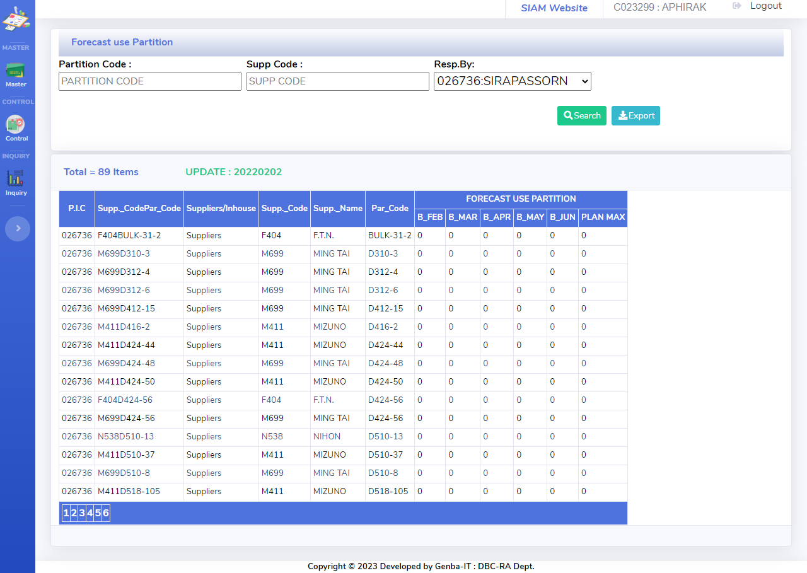
Display System
Forecast Use Partition
Detail:
-User Can Search Forecast Use Partition
-Export data to file Excel

