Slide 1
CONTENT OF PRESENTATION
System
In
Department

Slide 2
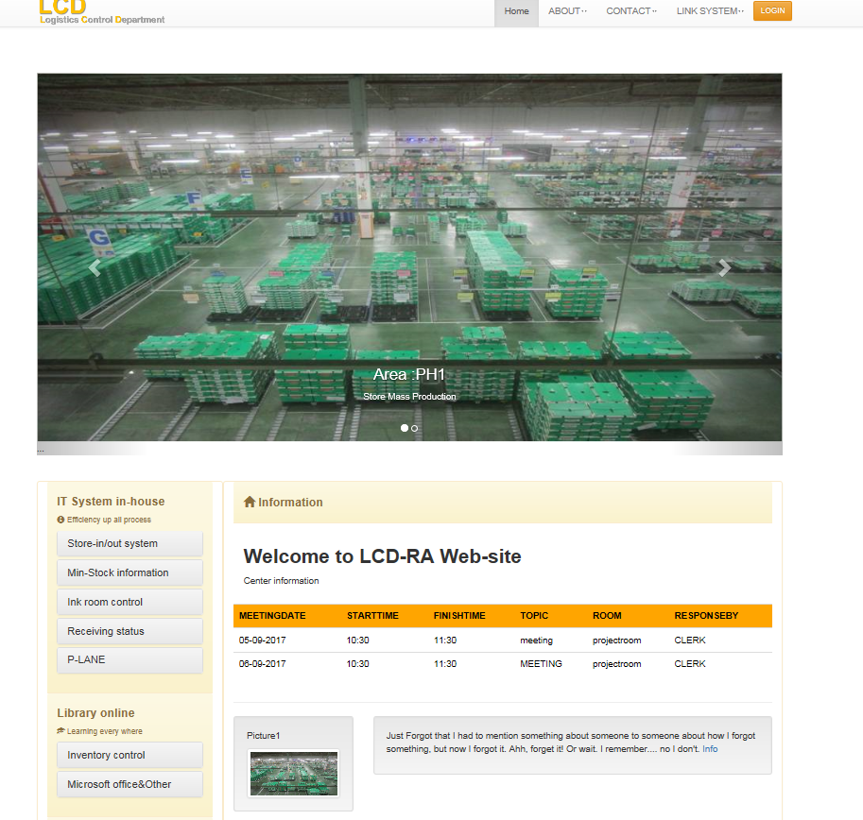
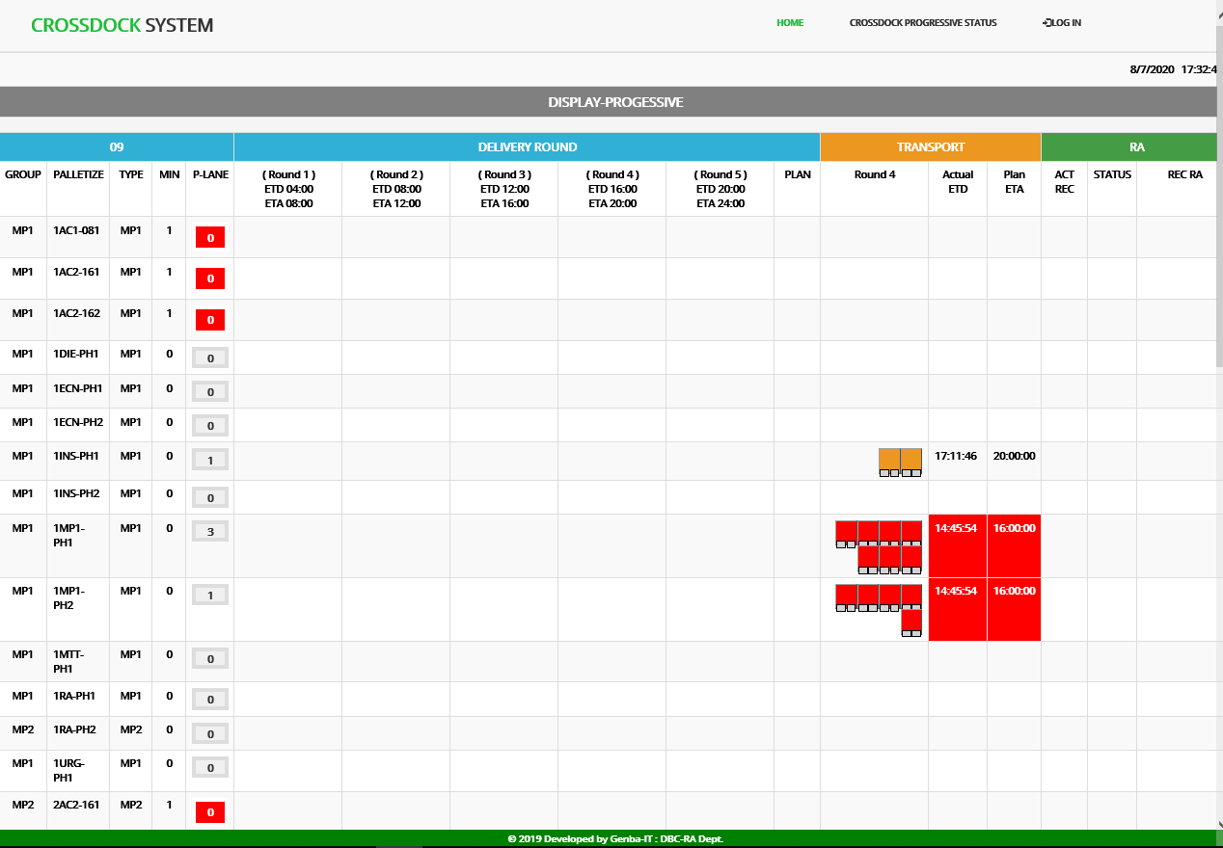
Web Main page
Cross Dock System

Slide 3
Web Main page

Slide 4
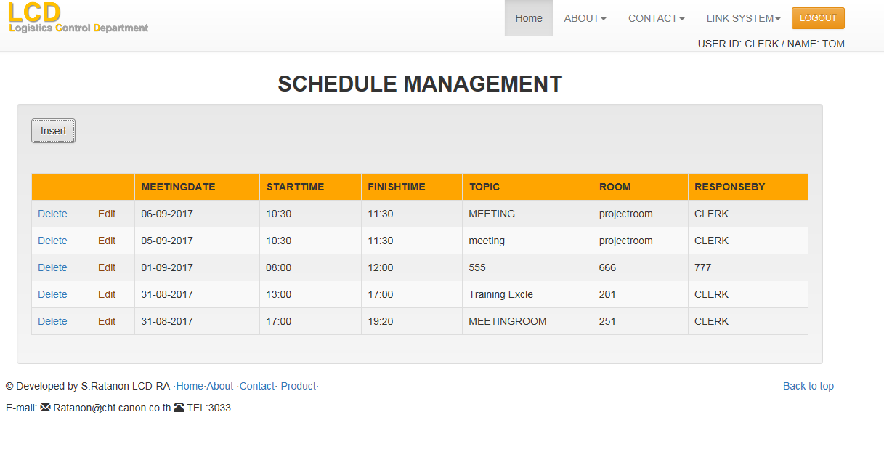
Web Schedule Management

Slide 5
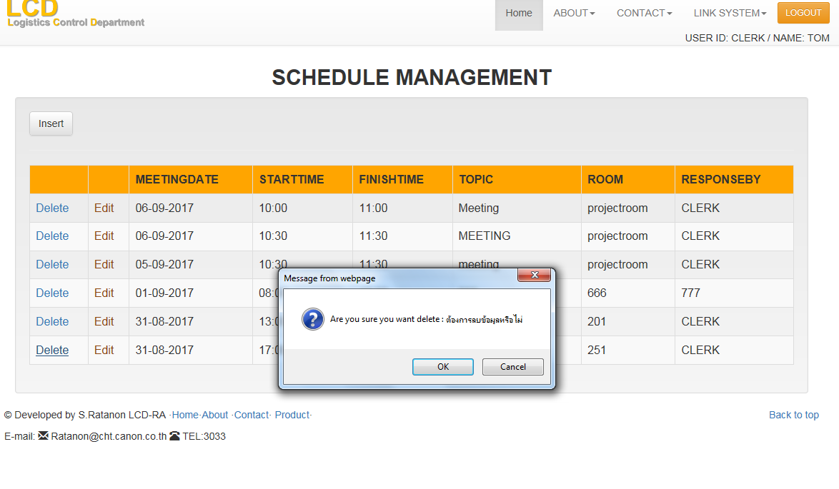
Web Schedule Management
1

Slide 6
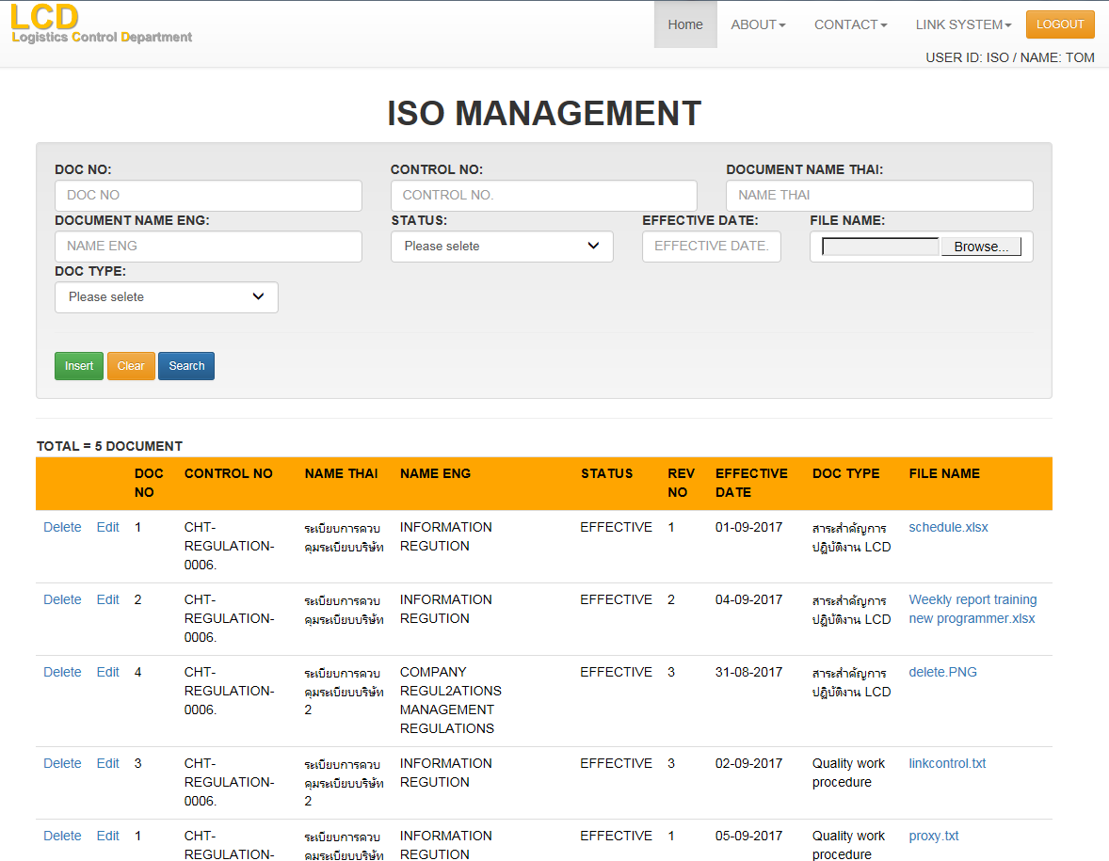
Web ISO Document Control
*Sort by Control No and Revision No

Slide 7
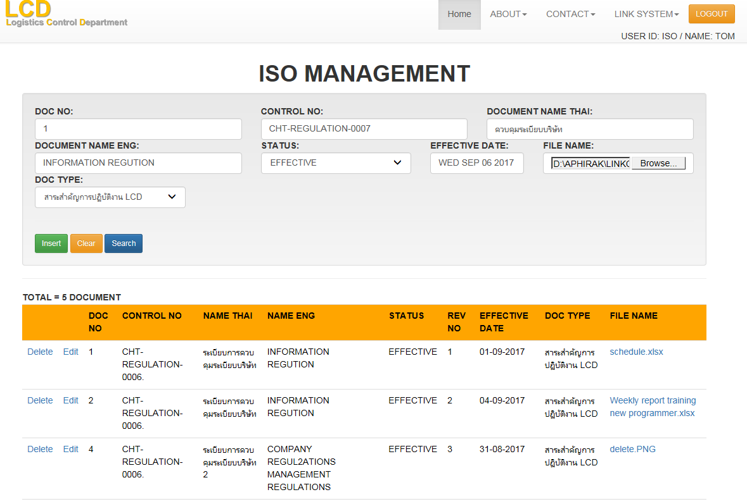
Web ISO Document Control

Slide 8
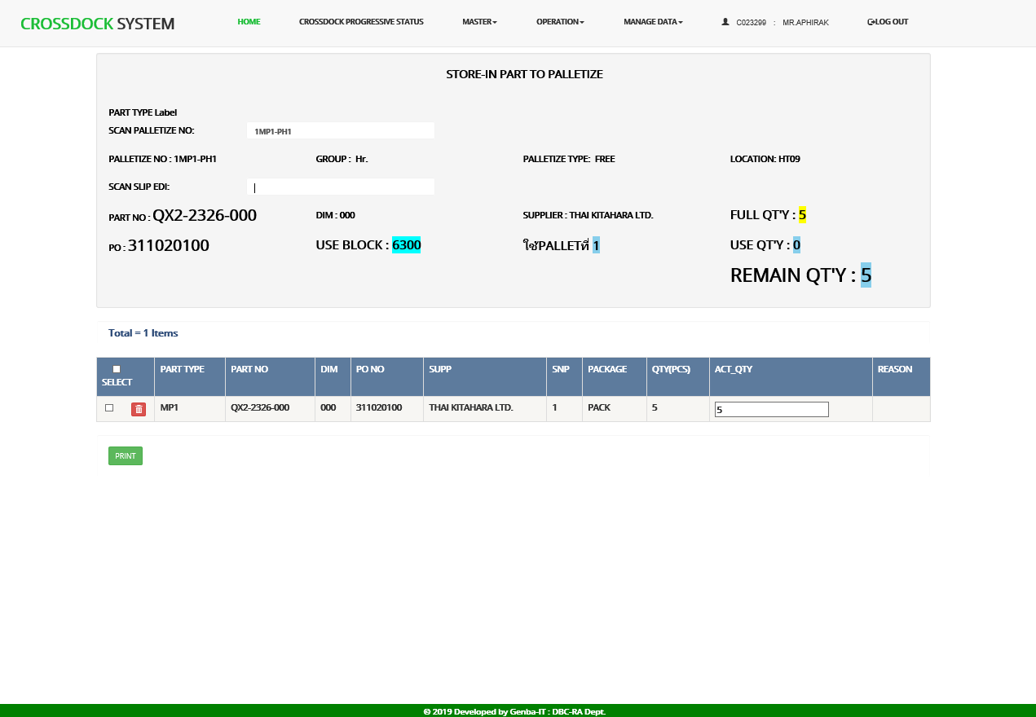
Cross Dock System

Slide 9
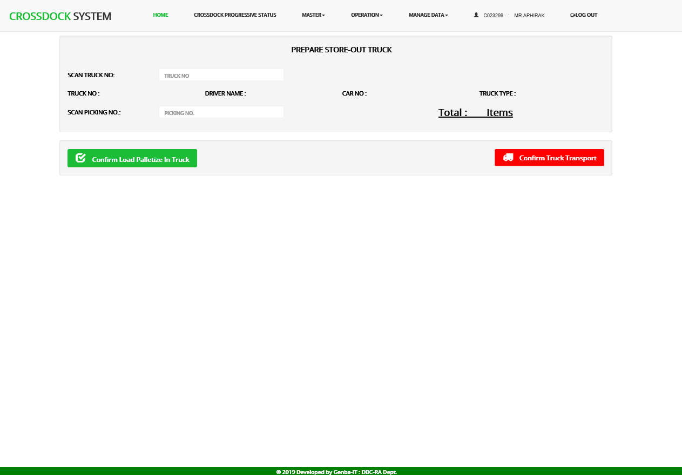
Cross Dock System

Slide 10
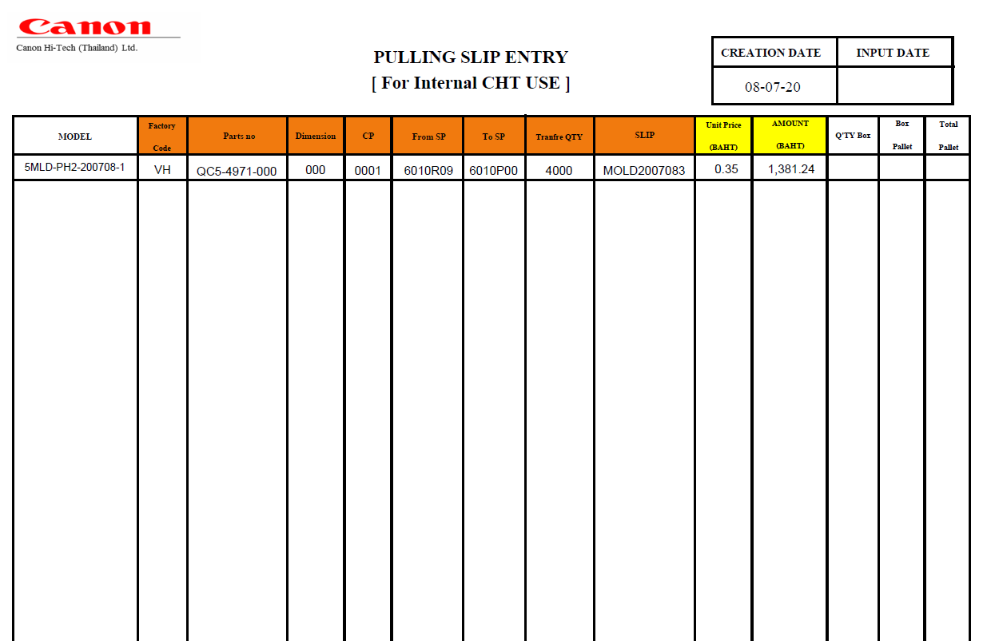
Cross Dock System

Slide 11
Cross Dock System

Slide 12
End of
Presentation

