Slide 1
APHA Workshop Applied Public Health Statistics
Rajib Paul, PhD* and Oluwaseun Adeyemi, MBChB, MPH, PhD **
*University of North Carolina at Charlotte
** New York University Langone Health
Emails: Rajib.Paul@uncc.edu
Oluwaseun.Adeyemi@nyulangone.org

Slide 2
Outline of the Workshop
Basics of Epidemiological Measures and General Introduction to Underreporting and Count and Rate Regressions for Spatial Data – first 50 minutes
Running Count and Rate Regressions in R/RStudio: Interpretations of Results – Next 50 minutes
Adjusting Count/Rate Regressions for underreporting in data – Final 50 minutes

Slide 3
Acknowledgements
This tutorial is prepared as part of our funded research supported by the American Public Health Association in conjunction with the Centers for Disease Control and Prevention on Data Science Demonstration Project for Injury and Trauma Prevention
The Centers for Disease Control and Prevention (CDC)
The National Highway Traffic Safety Administration (NHTSA)
Dr. Ahmed Arif, University of North Carolina at Charlotte
Ms. Janice Williams, MS, Director of Injury Prevention, Atrium Health, Charlotte, NC.

Slide 4
Underreporting in Health Data
Why underreporting occurs in health data and what are the consequences?
Depends on measurement process and how data are collected and reported
If in a certain jurisdiction, infrastructure only allows to detect presence of Marijuana and Cocaine (types of illegal substance), but not Ketamine, we will not be able to know whether a person used Ketamine. This would contribute to underreporting of aggregated data at the jurisdiction.
COVID-19 Data: Two issues – (1) Asymptomatic Cases and (2) Variations in state/county reporting systems (Design Issue)
Lack of resources – poor/socially deprived regions (de Oliveira, 2022)

Slide 5
Underreporting: Impact on Individual Level Analysis
When we run a Cox-Proportional Hazard Model, often our interest is to compare survival curves for two or more groups
If we consider two groups: Case: the individuals having the disease or condition and Control: the individuals not having the disease or condition
If a person’s disease status is unknown (e.g., because that person was not tested), do you want to assign that person in the Control group (misdiagnosis)?
Treat the classification status as “missing,” apply appropriate missing data techniques, and conduct a thorough sensitivity analysis

Slide 6
Underreporting: Reporting Lag
If data are reported with a lag, underreporting can occur
COVID-19: Some regions have the mechanism for updating daily, some regions update weekly, some regions update on certain days of a week
Lower time resolution data are more reliable than granular level time series
One can conduct analysis at weekly or monthly level using better quality data
If we still need daily level analysis: Downscaling approach can be helpful – using weekly level data to get predictions at daily level

Slide 7
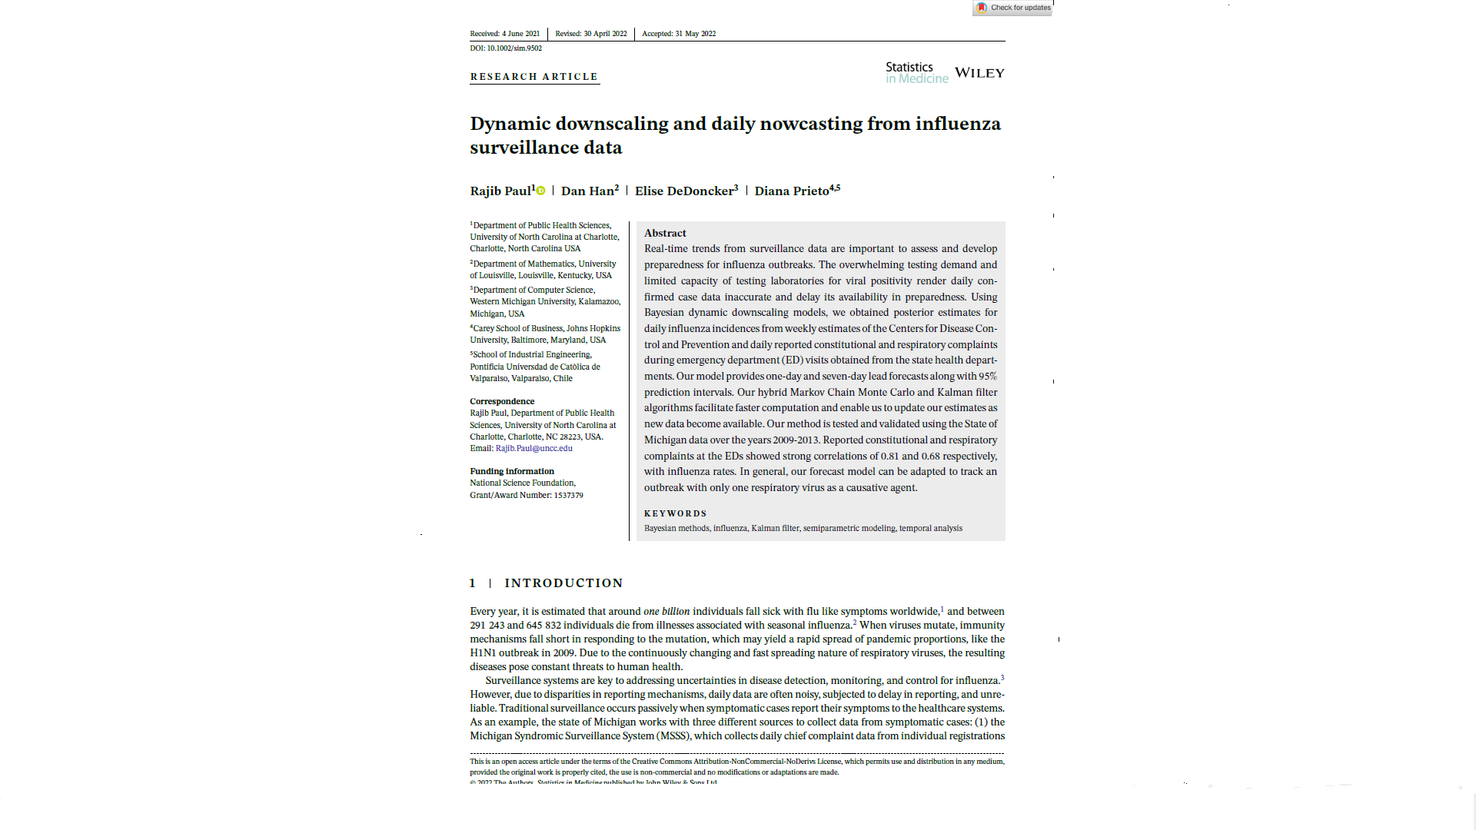
Dynamic Downscaling: Weekly to Daily

Slide 8
Count/Rate Regression
For aggregated counts data, the most commonly used spatial regressions are based on Poisson and Negative Binomial distributions.
Negative Binomial regression is used when there is overdispersion in the data.
To run a regression with spatial random effects, often a simple county-specific random intercept term that follows a zero-mean Gaussian distribution with a spatial correlation is assumed.
Models can be modified to incorporate space-time dependencies when data come with labels of space and time.
We will restrict to spatial only models in this workshop.

Slide 9
The Fatality Analysis Reporting System (FARS): National Highway Traffic Safety Administration (NHTSA)
The Fatality Analysis Reporting System (FARS) of the National Highway Traffic Safety Administration (NHTSA) represents the data repository of all crash events involving at least one death, either at the crash scene or within 30-days post-crash.
The FARS data are released yearly as multiple linkable files that capture the personal, vehicular, environmental, and crash scene-related factors.
The ability to explore information across geographic areas, the size of the data set for significance, and multiple variable collections make this a widely used and valuable data set.

Slide 10
Limitations: FARS Data
A major limitation acknowledged by the developer is that there is not a standard process for substance use data collection nationwide and should not be used for comparing rates.
Analysis is restricted to alcohol use only. Limitations to this data also include under-reporting and missing data information. This type of data gap is the most challenging to address when analyzing the data in considering the quality of crash data.
To assist, in addition to releasing FARS standard files, NHTSA also provides supplemental imputed files to address the missing data issue in FARS.
This tutorial will provide analytical tools for addressing the issues such as underreporting and missingness common in public health surveillance data. This tutorial will provide analytical tools for addressing these issues. However, users should be cautious while using these techniques in other contexts/databases depending on the assumptions made, including, checking sensitivity to inferential results is crucial.

Slide 11
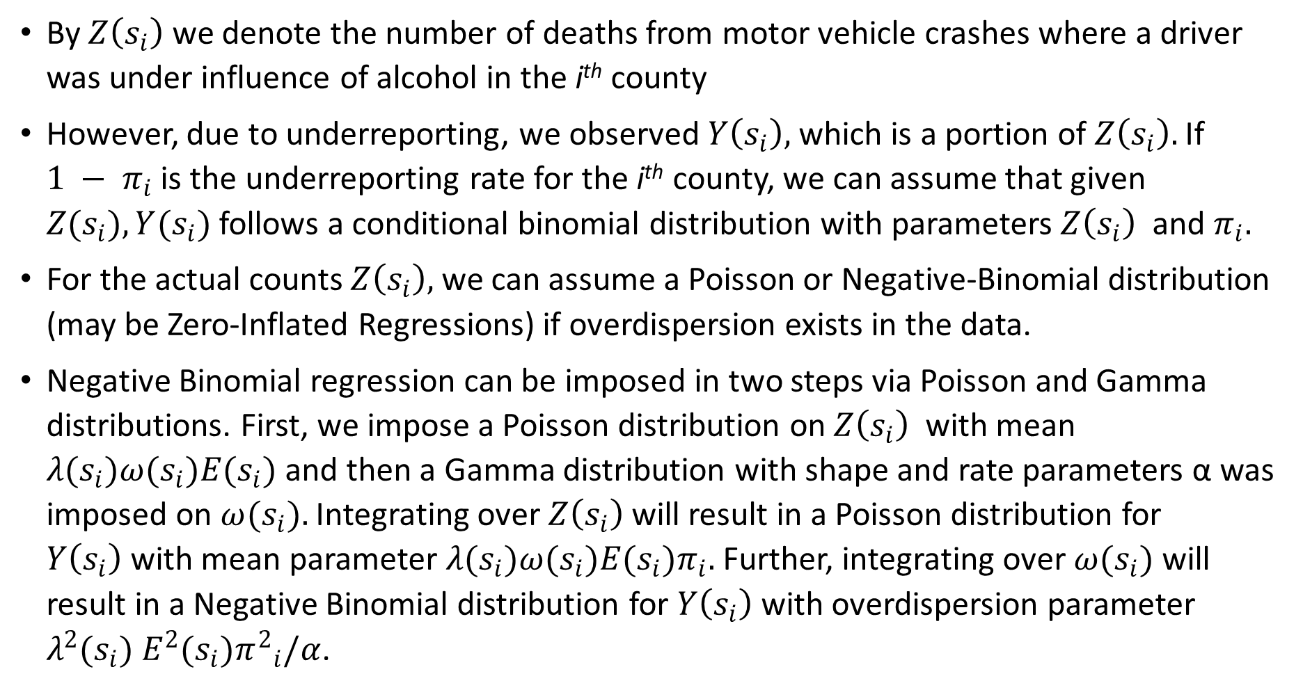
Spatial Regression
By $Z\left(s_{i}\right)$ we denote the number of deaths from motor vehicle crashes where a driver was under influence of alcohol in the i^{th} county
However, due to underreporting, we observed $Y\left(s_{i}\right),$ which is a portion of $Z\left(s_{i}\right).$ If ${1 − π}_{i}$ is the underreporting rate for the i^{th} county, we can assume that given ${Z(s}_{i}), {Y(s}_{i})$ follows a conditional binomial distribution with parameters $Z\left(s_{i}\right)$ and $π_{i}.$
For the actual counts $Z\left(s_{i}\right),$ we can assume a Poisson or Negative-Binomial distribution (may be Zero-Inflated Regressions) if overdispersion exists in the data.
Negative Binomial regression can be imposed in two steps via Poisson and Gamma distributions. First, we impose a Poisson distribution on $Z\left(s_{i}\right)$ with mean ${λ(s}_{i}){{ω(s}_{i})E(s}_{i})$ and then a Gamma distribution with shape and rate parameters α was imposed on ${ω(s}_{i}).$ Integrating over $Z\left(s_{i}\right)$ will result in a Poisson distribution for $Y\left(s_{i}\right)$with mean parameter ${λ(s}_{i}){{ω(s}_{i})E(s}_{i})π_{i}.$ Further, integrating over ${ω(s}_{i})$ will result in a Negative Binomial distribution for $Y\left(s_{i}\right)$with overdispersion parameter ${λ^{2}(s}_{i}) {E^{2}(s}_{i}){π^{2}}_{i}/α$.

Slide 12
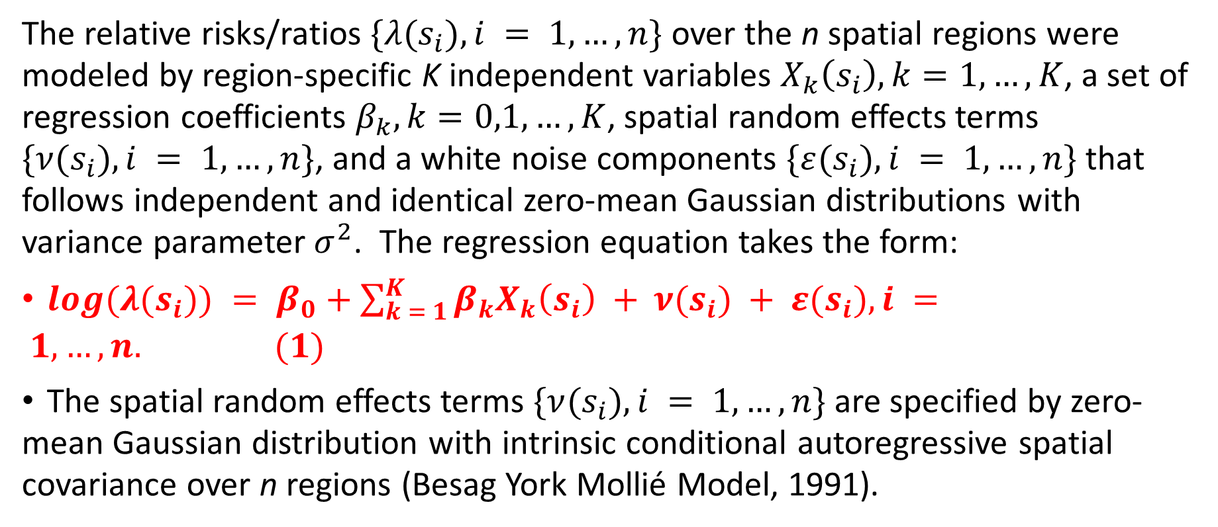
Modeling Risk Ratios
The relative risks/ratios $\{{λ(s}_{i}), i = 1, …, n\}$ over the n spatial regions were modeled by region-specific K independent variables $X_{k}\left(s_{i}\right),k=1,…,K$, a set of regression coefficients $β_{k},k=0,1,…,K$, spatial random effects terms $\{{ν(s}_{i}), i = 1, …, n\}$, and a white noise components $\{{ε(s}_{i}), i = 1, …, n\}$ that follows independent and identical zero-mean Gaussian distributions with variance parameter $σ^{2}$. The regression equation takes the form:
$log({λ(s}_{i})) = β_{0}+\sum_{k = 1}^{K}{β_{k}X_{k}\left(s_{i}\right) + }{ν(s}_{i}) + {ε(s}_{i}), i = 1, …, n. (1)$
The spatial random effects terms $\{{ν(s}_{i}), i = 1, …, n\}$ are specified by zero-mean Gaussian distribution with intrinsic conditional autoregressive spatial covariance over n regions (Besag York Mollié Model, 1991).

Slide 13
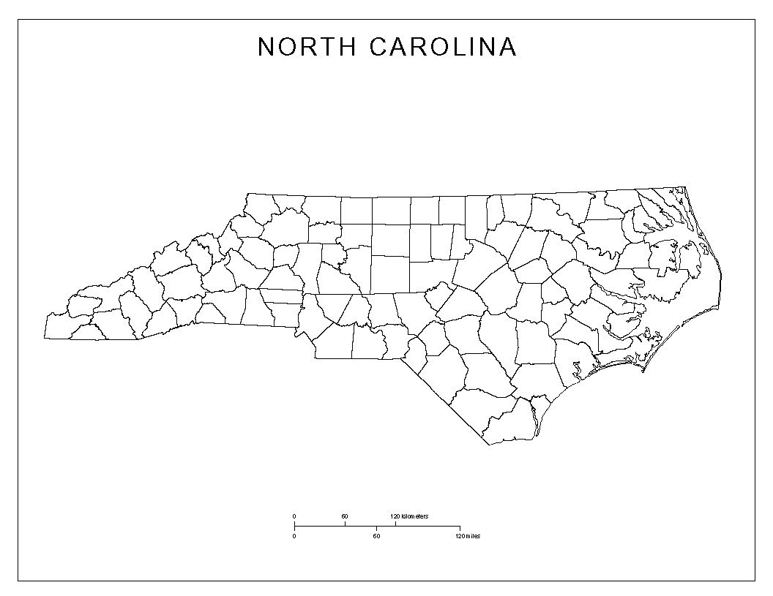
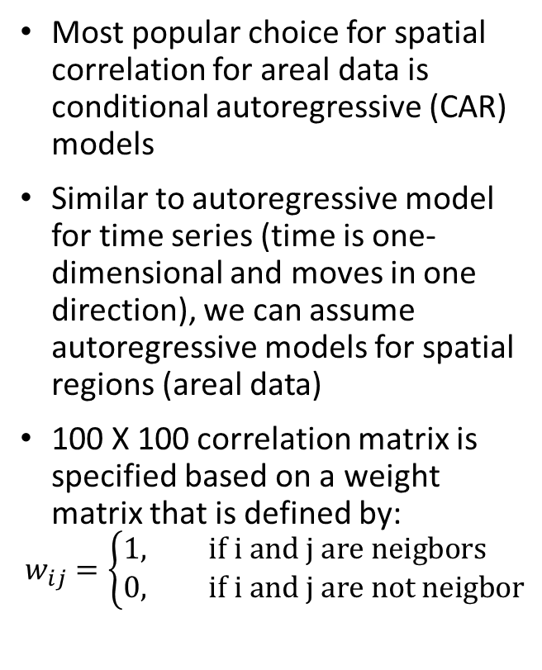
Spatial Correlation for Areal Data
Most popular choice for spatial correlation for areal data is conditional autoregressive (CAR) models
Similar to autoregressive model for time series (time is one-dimensional and moves in one direction), we can assume autoregressive models for spatial regions (areal data)
100 X 100 correlation matrix is specified based on a weight matrix that is defined by:
$$w_{ij}=\left\{\begin{aligned}1, &if i and j are neigbors \\ 0, &if i and j are not neigbor\end{aligned}\right.$$

Slide 14
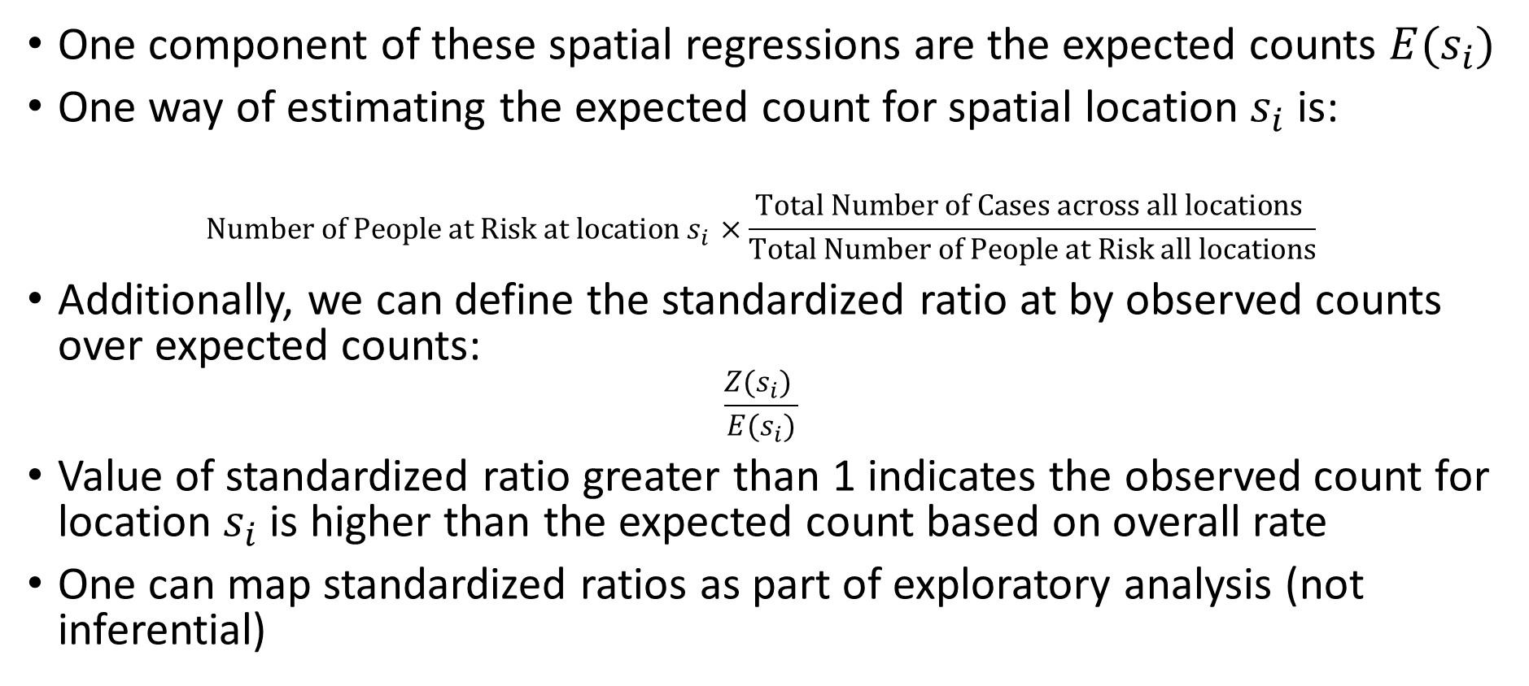
Expected Counts and Standardized Ratios
One component of these spatial regressions are the expected counts ${E(s}_{i})$
One way of estimating the expected count for spatial location $s_{i}$ is:
$$Number of People at Risk at location s_{i}×\frac{Total Number of Cases across all locations }{Total Number of People at Risk all locations}$$
Additionally, we can define the standardized ratio at by observed counts over expected counts:
$$\frac{Z(s_{i}) }{E(s_{i})}$$
Value of standardized ratio greater than 1 indicates the observed count for location $s_{i}$ is higher than the expected count based on overall rate
One can map standardized ratios as part of exploratory analysis (not inferential)

Slide 15
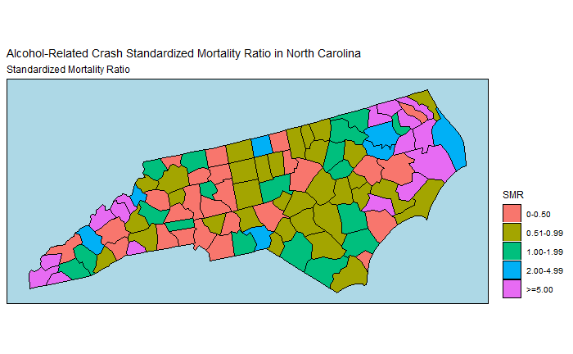
Map of Standardized Ratios: Deaths from crashes involved Alcohol

Slide 16
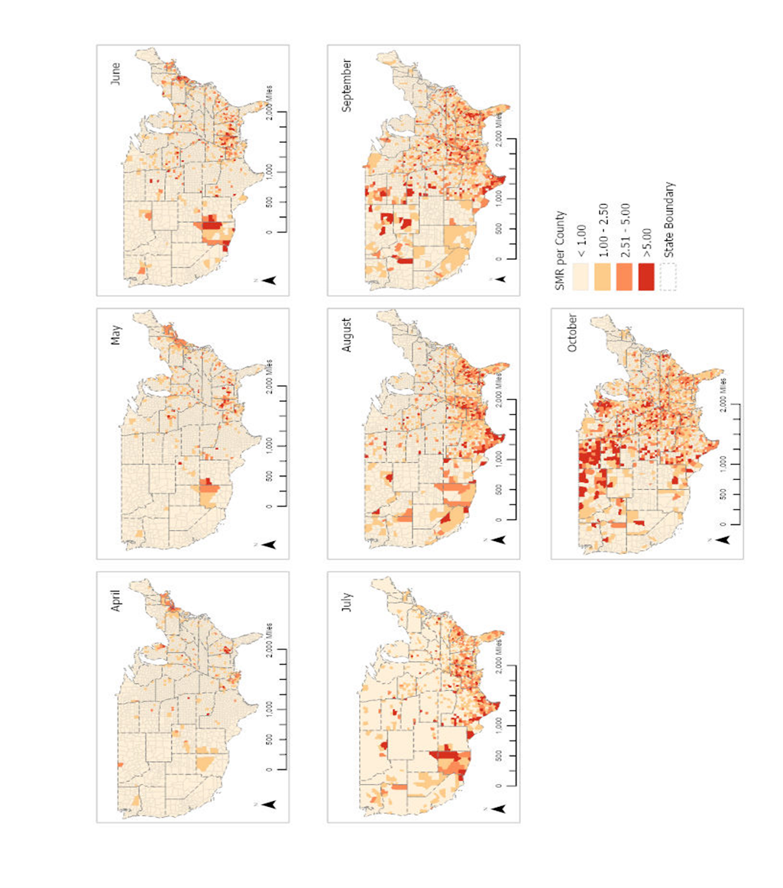
Map of Standardized Ratios: Deaths from COVID-19
Paul, R., Adeyemi, O., Ghosh, S., Pokhrel, K., & Arif, A. A. (2021). Dynamics of Covid-19 mortality and social determinants of health: a spatiotemporal analysis of exceedance probabilities. Annals of epidemiology, 62, 51-58.

Slide 17
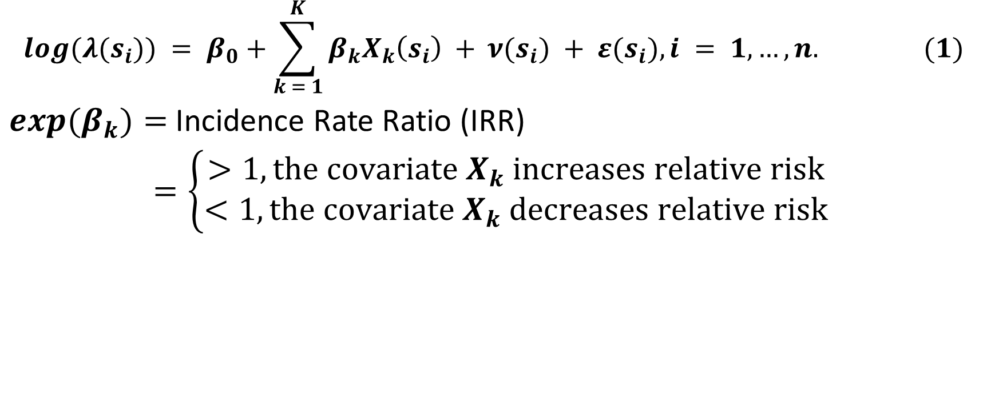
Relative Risks and Effects of Covariates
$$log({λ(s}_{i})) = β_{0}+\sum_{k = 1}^{K}{β_{k}X_{k}\left(s_{i}\right) + }{ν(s}_{i}) + {ε(s}_{i}), i = 1, …, n. (1)$$
${exp(β}_{k})=$ Incidence Rate Ratio (IRR)
$=\left\{\begin{aligned}>1, the covariate{ X}_{k} increases relative risk \\ <1, the covariate{ X}_{k} decreases relative risk\end{aligned}\right.$

Slide 18
Interpretation of IRR: 95% Credible Intervals
If we fit models in Bayesian paradigm imposing prior distributions on unknown parameters, we can obtain 95% Credible Intervals for IRR
We will avoid the word “significant”
Bayesian analogue of p-value can be computed using the posterior distribution of IRR: P(IRR ∈ [- ε, ε]), for some predefined value of ε
Alternatively, one can examine the inclusion of zero in the 95% Credible Intervals to assess influence of a particular covariate
Interpretation of IRR: The rate of a particular group is IRR times more than the overall rate compared to the baseline group
or: The rate of a particular group increased by IRR times the overall rate for one unit increase in the continuous covariate

Slide 19
Interpretation of IRR: 95% Credible Intervals: COVID-19 Example
Variables | Unadjusted |  | Adjusted
 | Rural | Urban | Rural | Urban
Neighborhood and Built Environment
Percent Severe Housing Cost Burden | 1.13 (1.10, 1.17) | 1.18 (1.14, 1.21) | − | −
Residential Segregation Index | 1.01 (1.01, 1.02) | 1.03 (1.02, 1.04) | 1.01 (1.00, 1.01) | 1.03 (1.02, 1.04)
Economic Stability
Percent Unemployed | 1.41 (1.30, 1.53) | 1.69 (1.54, 1.86) | 1.08 (0.97, 1.20) | 1.41 (1.24, 1.60)
Percent Uninsured | 1.32 (1.30, 1.35) | 1.34 (1.30, 1.37) | 1.22 (1.18, 1.26) | 1.09 (1.04, 1.13)
Income Inequality Ratio | 1.01 (1.01, 1.01) | 1.01 (1.01, 1.01) | 1.00 (1.00, 1.00) | 1.00 (1.00, 1.00)
Education
Percent Some College or Associate Degree | 0.79 (0.78, 0.81) | 0.78 (0.76, 0.80) | 0.92 (0.90, 0.95) | 0.80 (0.77, 0.83)
Social and Community Context
Percent Black Population | 1.11 (1.10, 1.12) | 1.10 (1.08, 1.11) | 1.07 (1.06, 1.08) | 1.05 (1.04, 1.07)
Percent 65 Years and Above | 0.91 (0.89, 0.93) | 0.92 (0.90, 0.95) | 0.95 (0.92, 0.98) | 1.03 (0.98, 1.07)
Percent Female Population | 1.19 (1.14, 1.26) | 1.20 (1.14, 1.26) | 1.17 (1.11, 1.24) | 1.3 (1.22, 1.38)
Health and Health Care
Percent Frequent Mental Distress | 1.26 (1.17, 1.34) | 1.32 (1.22, 1.42) | − | −
Percent Frequent Physical Distress | 1.21 (1.17, 1.34) | 1.31 (1.22, 1.40) | − | −
Percent Diabetes | 1.09 (1.06, 1.12) | 1.13 (1.09, 1.17) | 1.09 (1.06, 1.13) | 1.06 (1.01, 1.11)
HIV Rate per Million | 1.12 (1.11, 1.13) | 1.05 (1.04, 1.06) | 1.02 (1.01, 1.03) | 1.01 (1.00, 1.02)
Percent Adult Smoker | 1.10 (1.06, 1.14) | 1.14 (1.09, 1.18) | − | −
Percent Obesity | 1.17 (1.15, 1.20) | 1.18 (1.15, 1.20) | − | −
Paul, R., Adeyemi, O., Ghosh, S., Pokhrel, K., & Arif, A. A. (2021). Dynamics of Covid-19 mortality and social determinants of health: a spatiotemporal analysis of exceedance probabilities. Annals of epidemiology, 62, 51-58.

Slide 20
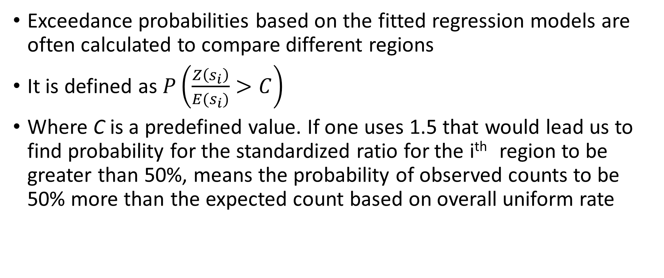
Exceedance Probability
Exceedance probabilities based on the fitted regression models are often calculated to compare different regions
It is defined as $P\left(\frac{Z\left(s_{i}\right)}{E(s_{i})}>C\right)$
Where C is a predefined value. If one uses 1.5 that would lead us to find probability for the standardized ratio for the i^{th} region to be greater than 50%, means the probability of observed counts to be 50% more than the expected count based on overall uniform rate

Slide 21
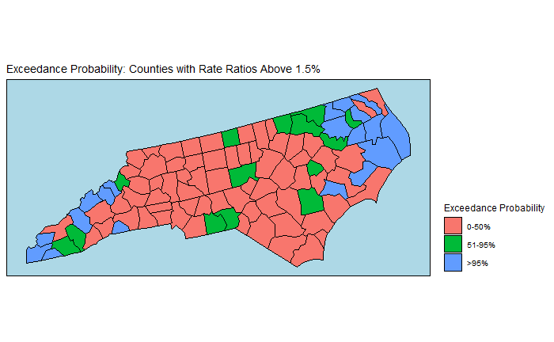
Interpretation of Exceedance Probability

Slide 22
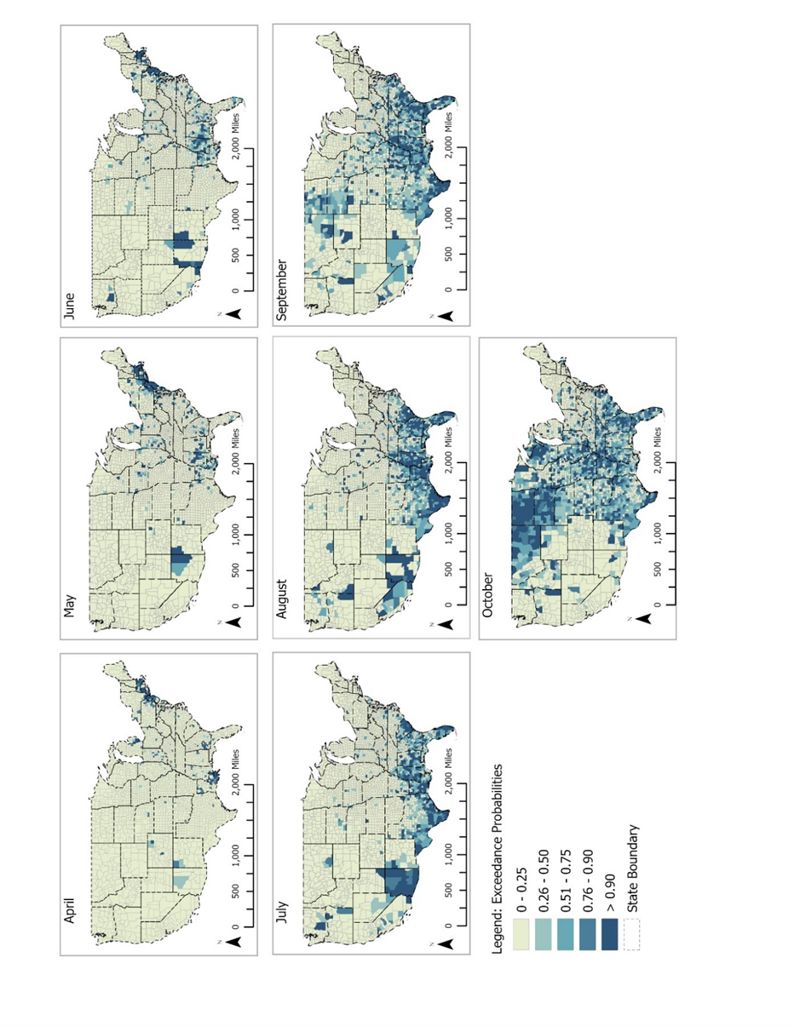
Exceedance Probability: COVID-19 Example
Paul, R., Adeyemi, O., Ghosh, S., Pokhrel, K., & Arif, A. A. (2021). Dynamics of Covid-19 mortality and social determinants of health: a spatiotemporal analysis of exceedance probabilities. Annals of epidemiology, 62, 51-58.

Slide 23
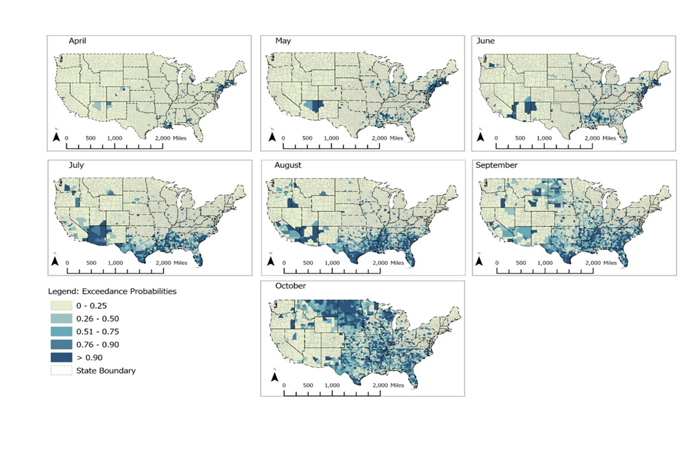
Exploratory vs. Model Based Approaches
Data: SMR - Exploratory Analysis
Exceedance Probabilities: Modeling Based Approach

Slide 24
Spatial Analysis using R-INLA
Dr. Oluwaseun Adeyemi’s R Tutorial

Slide 25
Underreporting: When and how?
Underreporting in count data are not uncommon
Often underreporting occurs in regions lack resources and socially deprived
This leads to biased estimates of disease risks and regions across spatial domain cannot be compared
If underreporting rates are same (unknown) across the entire area of study, that will not impact the estimation of IRR

Slide 26
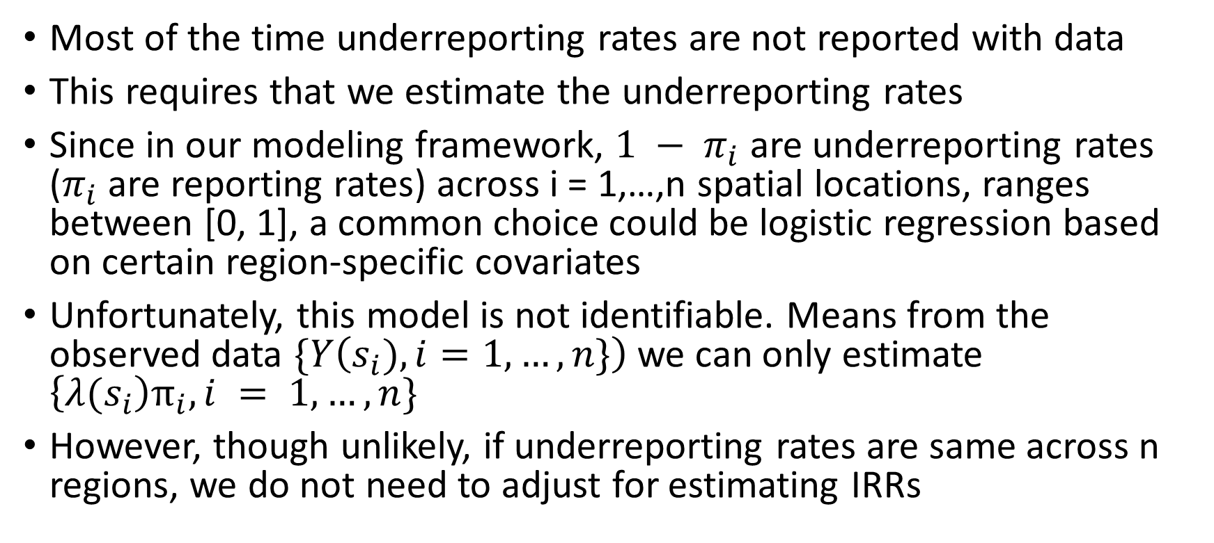
Challenges with Underreporting Rates
Most of the time underreporting rates are not reported with data
This requires that we estimate the underreporting rates
Since in our modeling framework, ${1 − π}_{i}$ are underreporting rates ($π_{i}$ are reporting rates) across i = 1,…,n spatial locations, ranges between [0, 1], a common choice could be logistic regression based on certain region-specific covariates
Unfortunately, this model is not identifiable. Means from the observed data $\{Y\left(s_{i}), i=1, …, n\}\right)$ we can only estimate $\left\{{λ(s}_{i}\right)π_{i}, i = 1, …, n\}$
However, though unlikely, if underreporting rates are same across n regions, we do not need to adjust for estimating IRRs

Slide 27
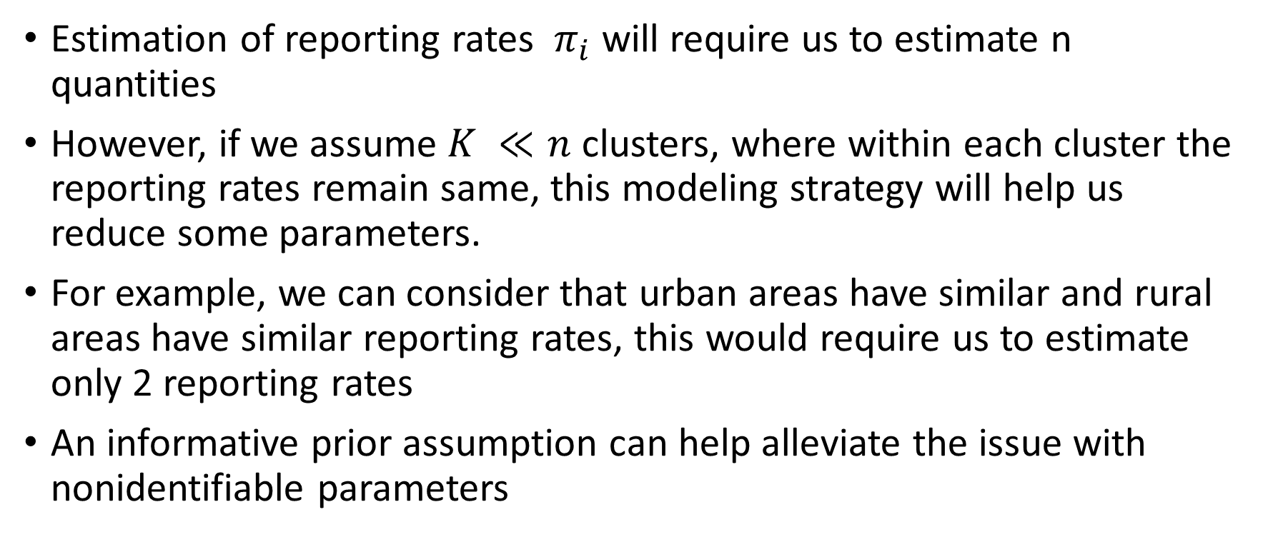
Estimating Reporting Rates
Estimation of reporting rates ${ π}_{i}$ will require us to estimate n quantities
However, if we assume $K ≪n$ clusters, where within each cluster the reporting rates remain same, this modeling strategy will help us reduce some parameters.
For example, we can consider that urban areas have similar and rural areas have similar reporting rates, this would require us to estimate only 2 reporting rates
An informative prior assumption can help alleviate the issue with nonidentifiable parameters

Slide 28
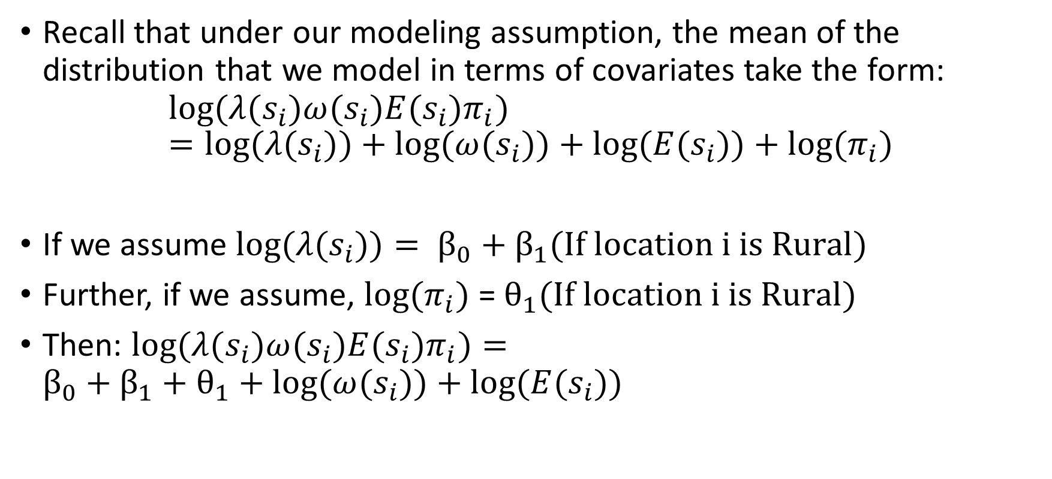
Reporting Rates: Why Nonidentifiability Issues?
Recall that under our modeling assumption, the mean of the distribution that we model in terms of covariates take the form:
$${log⁡(λ(s}_{i}){{ω(s}_{i})E(s}_{i})π_{i})={log⁡(λ(s}_{i}){{)+log⁡(ω(s}_{i}))+log⁡(E(s}_{i}))+log⁡(π_{i})$$
If we assume ${log⁡(λ(s}_{i}))= β_{0}+β_{1}(If location i is Rural)$
Further, if we assume, $log⁡(π_{i})$ = $θ_{1}(If location i is Rural)$
Then: ${log⁡(λ(s}_{i}){{ω(s}_{i})E(s}_{i})π_{i})={{β_{0}+β_{1}+θ_{1}+log⁡(ω(s}_{i}))+log⁡(E(s}_{i}))$
Overdispersion, integrate out
Known
Linearly Related

Slide 29
Remedies: Estimating Reporting Rates
Do not use same covariates for modeling rates and reporting probabilities – not full proof, there could be multicollinearity effects even if we use different covariates as they are tied to same spatial location
If possible, find some ideas on plausible values of reporting rates from the literature and use them to specify hyper-priors. Try to avoid noninformative (vague) priors
Consider the reporting rates as tuning parameters, and conduct a thorough sensitivity analysis to assess impact of different values of reporting rates

Slide 30
Guesstimating Reporting Rates
What would be the possible datasets for estimating reporting rates? DMV report and trauma centers (Emergency Department) data. Linking them is expensive! Other resources could be death registry and FARS data
Castle et al. (2014) provided state wise estimates of reporting rates of alcohol involvement deaths from death certificates
They found that reporting ratios varied across states, from 0.02 (Nevada and New Jersey) to 0.81 (Delaware)
For North Carolina, they reported 0.32
Do reporting rates vary within states? Yes.
At least, we have a value of 0.32 to start with

Slide 31
R Tutorial: Adjusting for Underreporting Rates
Dr. Rajib Paul’s R/RStudio Tutorial

Slide 32
Same Known Reporting Rates Across State
Without Adjustment
Same Known Reporting Rate

Slide 33
Variable Unknown Reporting Rates Across State
Without Adjustment
Unknown Reporting Rate (R/U)

Slide 34
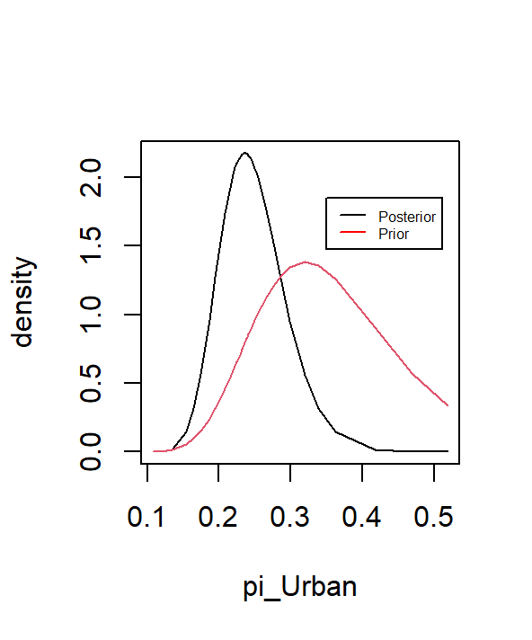
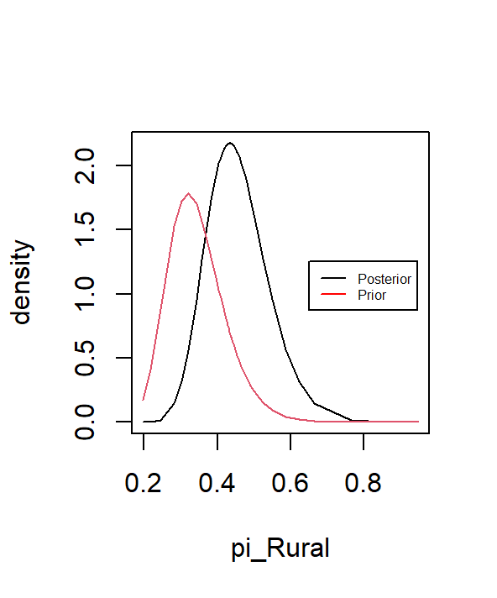


Prior and Posterior Marginals for Reporting Rates
$$π_{Urban} (0.24)$$
$$π_{Rural} (0.43)$$

Slide 35
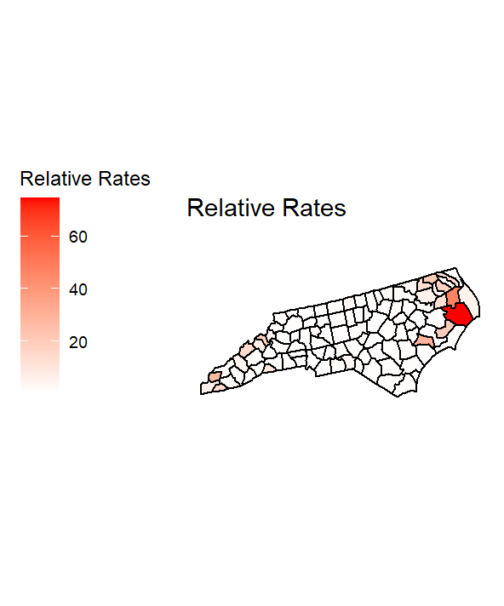

Map of Relative Rates
No Adjustment for Underreporting
Same Known Reporting Rates

Slide 36

Map of Relative Rates
No Adjustment for Underreporting
Unknown Reporting Rates (R/U)

Slide 37
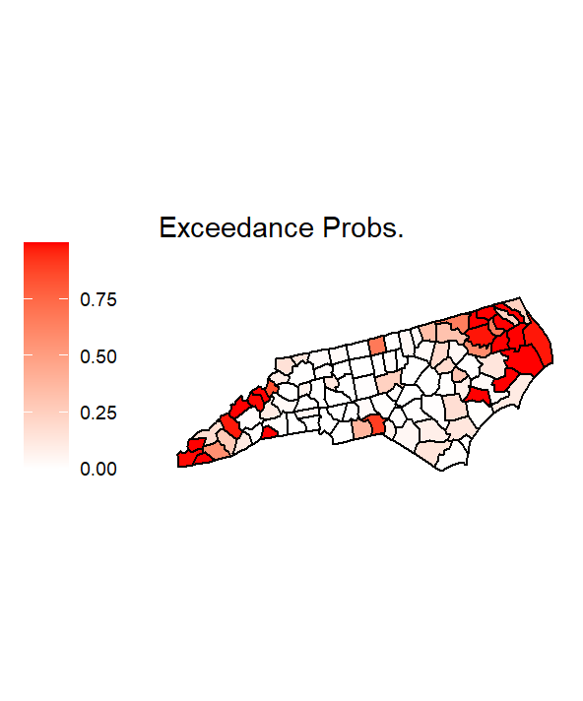

Map of Exceedance Probability: RR > 2
No Adjustment for Underreporting
Unknown Reporting Rates (R/U)

Slide 38
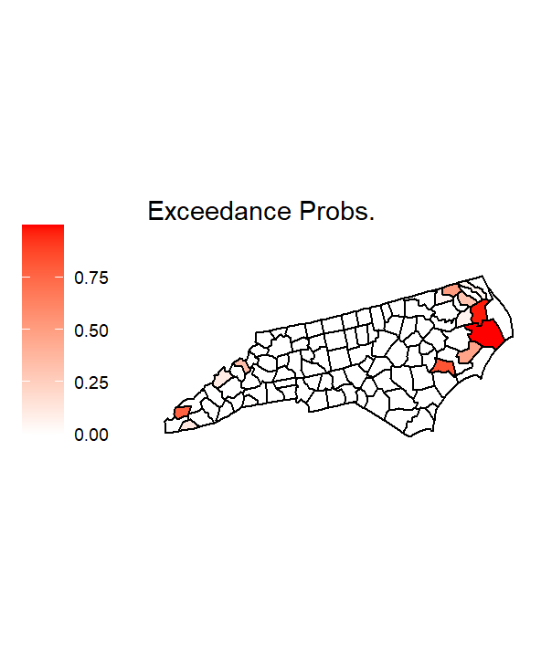
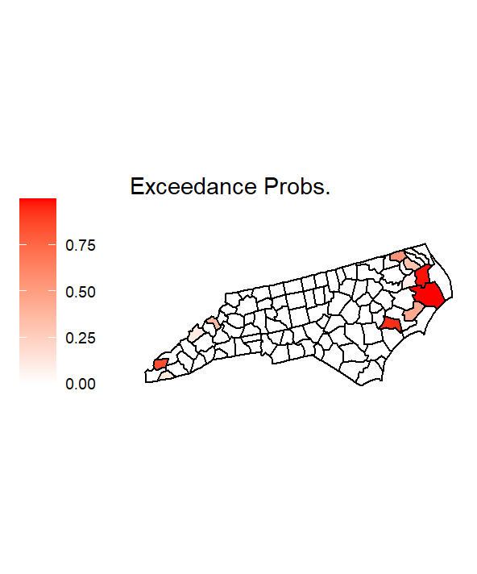
Map of Exceedance Probability: RR > 20
No Adjustment for Underreporting
Unknown Reporting Rates (R/U)

Slide 39
Final Remarks
What would happen if there is no underreporting, however, we adjust for it? The incidence risk ratios would be biased
What would happen if there is underreporting, and we do not adjust for it? The incidence risk ratios would be biased
Can we mis-specify clusters? Specifying clusters will require a judgement on number and criteria for clusters.
Yes. If we mis-specify clusters, incidence risk ratios would be biased, however, the bias would be smaller than not at all adjusting for underreporting rates.
For details, see simulation studies conducted by de Oliveira et al. (2022), Section 3.

Slide 40
References
Besag, J., York, J., & Mollié, A. (1991). Bayesian image restoration, with two applications in spatial statistics. Annals of the institute of statistical mathematics, 43(1), 1-20.
Castle, I. J. P., Yi, H. Y., Hingson, R. W., & White, A. M. (2014). State variation in underreporting of alcohol involvement on death certificates: motor vehicle traffic crash fatalities as an example. Journal of studies on alcohol and drugs, 75(2), 299-311.
de Oliveira, G. L., Argiento, R., Loschi, R. H., Assunçao, R. M., Ruggeri, F., & Branco, M. D. E. (2022). Bias correction in clustered underreported data. Bayesian Analysis, 17(1), 95-126.
Paul, R., Adeyemi, O., Ghosh, S., Pokhrel, K., & Arif, A. A. (2021). Dynamics of Covid-19 mortality and social determinants of health: a spatiotemporal analysis of exceedance probabilities. Annals of epidemiology, 62, 51-58.
Paul, R., Han, D., DeDoncker, E., & Prieto, D. (2022). Dynamic downscaling and daily nowcasting from influenza surveillance data. Statistics in Medicine, 41(21), 4159-4175.
Virgilio Gómez-Rubio (2021): Bayesian Inference with INLA: https://becarioprecario.bitbucket.io/inla-gitbook/index.html

Slide 41
Thank You!

