Slide 1
Overview Class 8
Camera analogy
3D matrix transformations
Display list
ViewImage?

Slide 2
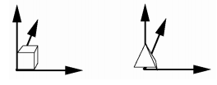
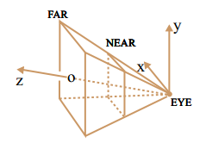
3D Coordinate Systems
Maps points (x, y, z) from one coordinate system to points (x', y‘, z’) in another coordinate system.
Common Coordinate Systems:
Object space – local to each object
World space – common to all objects
Eye space / Camera space – derived from view frustum
Screen space – indexed according to hardware attributes
Transformations can be used for:
Positioning objects in a scene
Changing the shape of objects
Creating multiple copies of objects

Slide 3
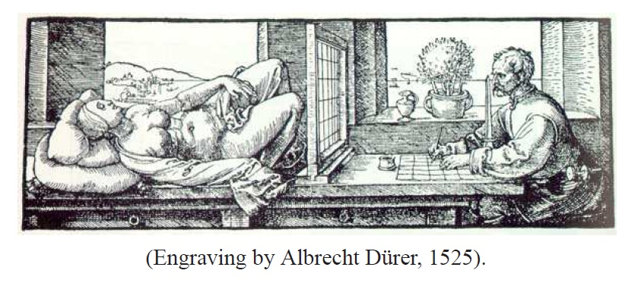
Pinhole Camera Model
View a scene with one eye looking through a square window, and draw a picture of what you see through the window:

Slide 4
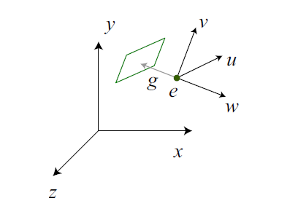
Camera Position and Orientation
Camera coordinates have their origin at the camera’s pinhole (the “eye” ).
The gaze direction, points to a vector perpendicular to the view plane (parallel to the camera’s z-axis) .
Two more orthogonal vectors u and v to specify a camera coordinate frame, with u and v parallel to the view plane.

Slide 5
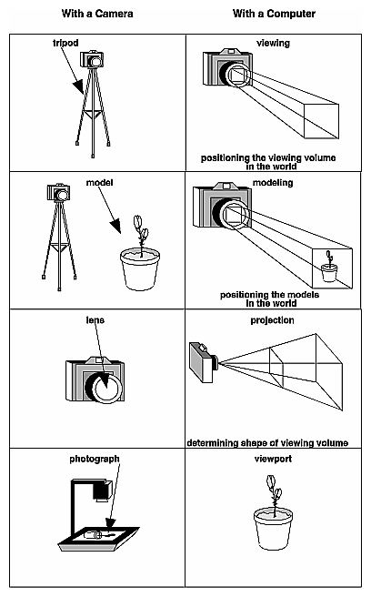
The Camera Analogy
The process to produce the desired scene for viewing is analogous to taking a photograph.
1. Creating the scene. Set up your tripod and pointing the camera at the scene (viewing transformation). gluLookAt() (default is (0, 1, 0))
2. Placing objects in the scene. Arrange the scene to be photographed into the desired composition (modeling transformation), rotate (glRotatef), translate (glTranslatef), or scale (glScalef) the model.
3. Setting up the projection. Choose a camera lens or adjust the zoom (projection transformation). glFrustum(left, right; bottom, top; nearVal, farVal;)
4. Setting the image size. Determine how large you want the final photograph to be - for example, you might want it enlarged (viewport transformation).
After these steps are performed, the scene can be drawn in the computer window.

Slide 6
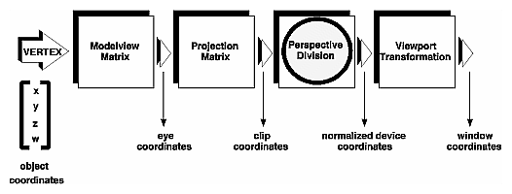
Stages of Vertex Transformation
The viewing and the modeling form the modelview matrix.
The modeling, and projection transformations are specified by 4x4 matrix (the modelview matrix).
Clipping planes are applied to remove certain objects from the scene, defining a viewing volume. Some objects might be outside of it.
Finally, the transformed coordinates are converted to window coordinates by applying the viewport transformation.
By manipulating the dimensions of the viewport you can cause the final image to be enlarged, shrunk, or stretched.

Slide 7
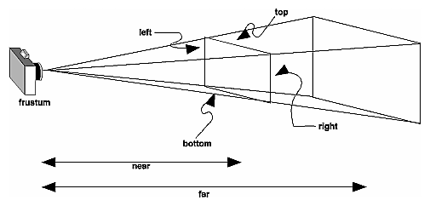
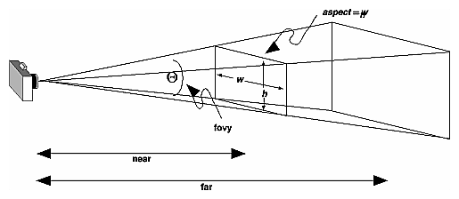
Projection transformation
See Camera Analogy code
glFrustum(left, right; bottom, top; nearVal, farVal;),
gluPerspective(view angle, aspect ratio, near and far planes)

Slide 8
Set the viewport - glViewport
glViewport(x,y,width,height) specifies the affine transformation of x and y from normalized device coordinates to window coordinates.
x-The lower-left corner of the viewport rectangle, in pixels. The default is (0,0).
y-The lower-left corner of the viewport rectangle, in pixels. The default is (0,0).
width -The width of the viewport. When an OpenGL context is first attached to a window, width and height are set to the dimensions of that window.
height -The height of the viewport. When an OpenGL context is first attached to a window, width and height are set to the dimensions of that window.

Slide 9
The Camera Analogy Lab Project
1) viewing transformation, creating the scene. gluLookAt(eye(x,y,z),center(x,y,z),up(x,y,z))
If gluLookAt() was not called, the camera has a default position and orientation. By default, the camera is situated at the origin, points down the negative z-axis, and has an up-vector of (0, 1, 0).
2) modeling transformation, to position and orient the model in the scene by rotate (glRotatef), translate (glTranslatef), or scale (glScalef) the model.
Note that instead of moving the camera (with a viewing transformation) so that the cube could be viewed, you could have moved the cube away from the camera (with a modeling transformation).
Example: gluLookAt (0.0, 0.0, 5.0, 0.0, 0.0, 0.0, 0.0, 1.0, 0.0); is the same as glTranslatef(0.0, 0.0, -5.0);
Show rotated object as gluLookAt (0.0, 0.0, 5.0, 0.0, 0.0, 0.0, 1.0, 1.0, 0.0);
3) projection transformation, Setting up the projection (glFrustum(left, right; bottom, top; nearVal, farVal;), or gluPerspective)
Some preparation needs to happen in the reshape() routine. glMatrixMode() is used first.
4) viewport transformation, how large the 2D image is going to be. (glViewport)
The modeling, and projection transformations are specified by 4x4 matrix (glMatrixMode(GL_MODELVIEW);) which is then multiplied by the coordinates of each vertex v in the scene to accomplish the transformation. (Remember that vertices always have four coordinates (x, y, z, w), though in most cases w is 1 and for two-dimensional data z is 0.)
z values reflect the depth of a given vertex (measured in distance away from the screen).

Slide 10
The Camera Analogy Lab Project
Position camera @ gluLookAt(0.0, 0.0, 5.0, 0.0, 0.0, 0.0, 0.0, 1.0, 0.0);
glViewport(0, 0, (GLsizei)width, (GLsizei)height);
glFrustum (-2.0, 2.0, -2.0, 2.0, 3, 6);
Is the cube drawn as rectangle or a square? What is the size of the window?
Change it to so cWinW= cWinH. What is the shape of the cube now?
Can you zoom in on the cube by a viewport transformation?
Display cube so that front face does not show up
Display cube so that back face does not show up
What happens if you change upX=1 and upY=0 in gluLookAt?
Change camera position so you can see blue(z) and green(y) axis.

Slide 11
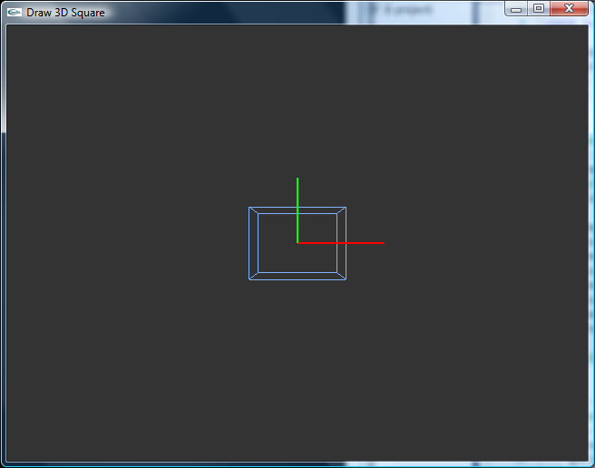
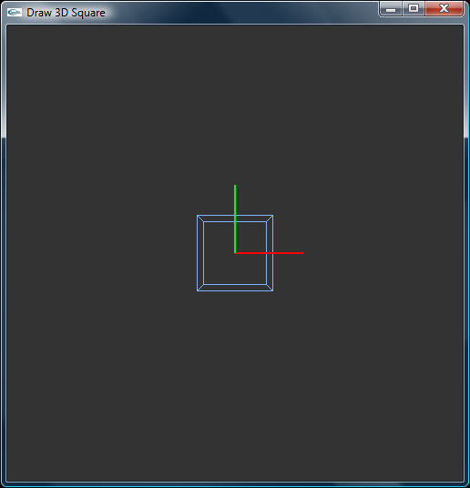
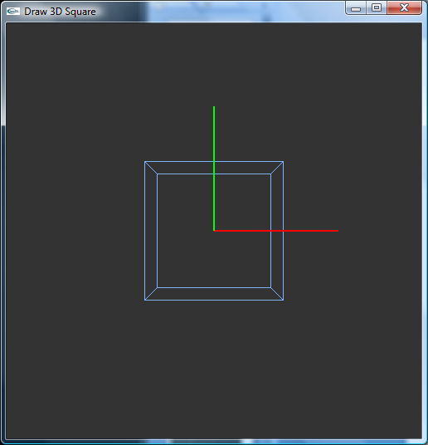
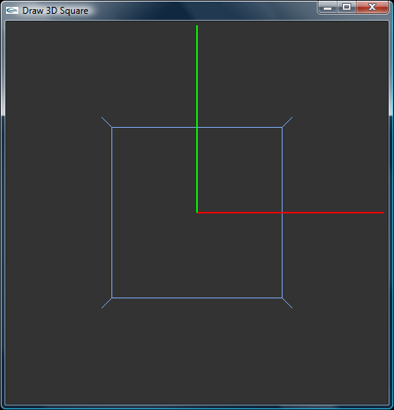
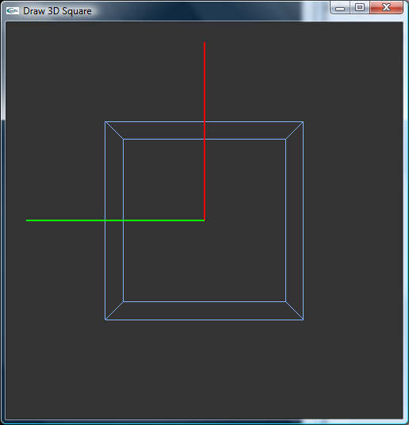
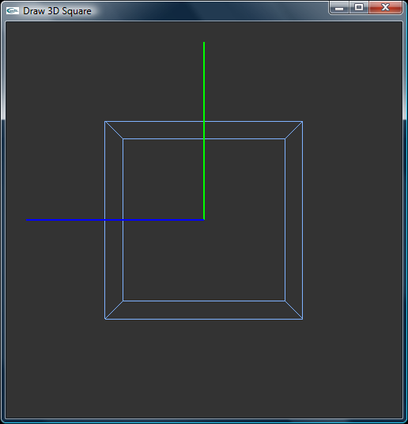

Slide 12
The Camera Analogy Lab Project
Position camera @ gluLookAt(0.0, 0.0, 5.0, 0.0, 0.0, 0.0, 0.0, 1.0, 0.0);
glViewport(0, 0, (GLsizei)width, (GLsizei)height);
glFrustum (-2.0, 2.0, -2.0, 2.0, 3, 6);
Is the cube drawn as rectangle or a square? What is the size of the window? 640x480
Change it to so cWinW= cWinH. What is the shape of the cube now? 500x500
Can you zoom in on the cube by a viewport transformation?
glViewport(-250, -250, (GLsizei)width*2.0, (GLsizei)height*2.0);
Display cube so that front face does not show up glFrustum (-2.0, 2.0, -2.0, 2.0, 4.6, 5.5);
Display cube so that back face does not show up glFrustum (-2.0, 2.0, -2.0, 2.0, 4.5, 5.4);
What happens if you change upX=1 and upY=0 in gluLookAt?
gluLookAt(0.0, 0.0, 5.0, 0.0, 0.0, 0.0, 1.0, 0.0, 0.0);
Change camera position so you can see blue(z) and green(y) axis.
gluLookAt(5.0, 0.0, 0.0, 0.0, 0.0, 0.0, 0.0, 1.0, 0.0);

Slide 13
General-Purpose Transformation
See 3D Transformations code
3 ways of implementing modeling transformations
All viewing and modeling transformations are represented as 4 × 4 matrices.
To specify explicitly a particular matrix to be loaded as the current matrix, use glLoadMatrix*().
Use glMultMatrix*() to multiply the current matrix by the matrix passed in as an argument, a vector of sixteen values.
Note that if few transformations ABC are implemented in succession, the order in the code is reversed CBA.
1) Transform using OpenGL functions (glTranslate, glRotate, glScalef).
2) Transform by matrix multiplication using OpenGL glMultMatrix.
3) Transform by coded matrix multiplication. You can get the current modelview matrix by:
GLdouble modelview[16];
glGetDoublev( GL_MODELVIEW_MATRIX, modelview );

Slide 14
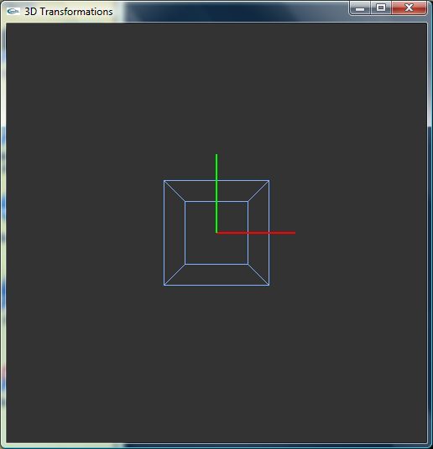
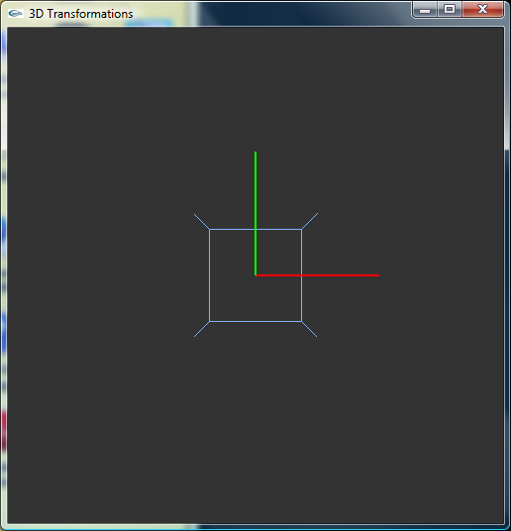
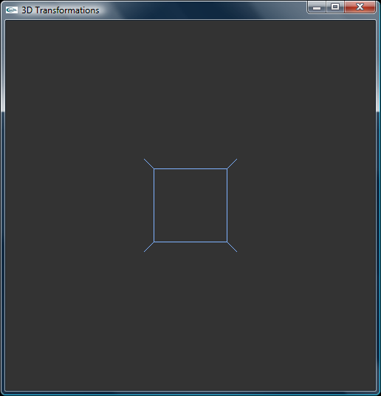
1) 3D Transform by using OGL Function
Unite cube, with a center located at origin (not transformed).
1) Using glTranslatef(0.0, 0.0, 0.5); glTranslatef(0.0, 0.0, 1.0);

Slide 15
2) 3D Transform by using glMultMatrixf
Let’s repeat the same, do translation for 0.5 along z by using the matrix multiplication with OpenGL glMultMatrix.
float TM[16]; // Set 3D Transform matrix
TM[0] = 1; TM[4] = 0; TM[8] = 0; TM[12] = 0;
TM[1] = 0; TM[5] = 1; TM[9] = 0; TM[13] = 0;
TM[2] = 0; TM[6] = 0; TM[10] = 1; TM[14] = 0.5;
TM[3] = 0; TM[7] = 0; TM[11] = 0; TM[15] = 1;
glMultMatrixf(TM); // Use glMultMatrix*() to multiply the current matrix with TM
The result has to be the same. Check it out.

Slide 16
Using a Matrix Stack
Because matrix manipulation is such an important part of 3D graphics, there are set of functions or classes for creating and manipulating matrices.
Transformations are often applied in a hierarchical manner.
Matrix stack are employed in order to avoid a great deal of matrix construction and management by the client code to traverse a complex scene in 3D space.
Maximum depth of the stack can be specified, and it is initialized by the identity matrix.
Given state is saved by PushMatrix, and restored by PopMatrix.

Slide 17
Transforming only a single object
A typical OpenGL application first sets the matrix mode with a call to glMatrixMode(GL_MODELVIEW) and loads a viewing transform, for example with gluLookAt().
How would you transform only one object in the scene (give each object its own transform)?
Use glPushMatrix() and glPopMatrix(); around the object you want to transform.
In 3D transformations code change
gluLookAt (0.0, 0.0, 5.0, 0.0, 0.0, 0.0, 0.0, 1.0, 0.0); // zoom out to see more
Replace the cube glutWireCube(1.0); with
glColor3f(0.5f, 0.7f, 1.0f); // Line color
glutWireTeapot(1.0);
In case 2: add another object and translate it from the center and then rotate it around z-axes 45 deg.
glPushMatrix();
glColor3f(1.0f, 0.2f, 0.1f); // Object Color
glRotatef(45., 0., 0., 1.);
glTranslatef(-3.0, 0.0, 0.0f); // Object Position
glutWireTeapot(1.0);
glPopMatrix();

Slide 18

3D Transformations
The 3D transform is given by the following matrix equation.
Transforms are combined by matrix multiplication which is not commutative (AB≠BA).
Example:
Transformation set 1: first scale an object (x2) and then translate (3,0,0).
Transformation set 2: first translate an object (3,0,0) and then scale (x2).
Result should differ!
Try this in the 3D transformations code using glScale, glTranslate.

Slide 19
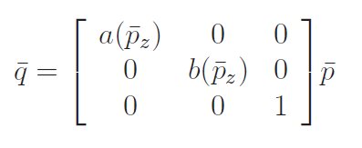
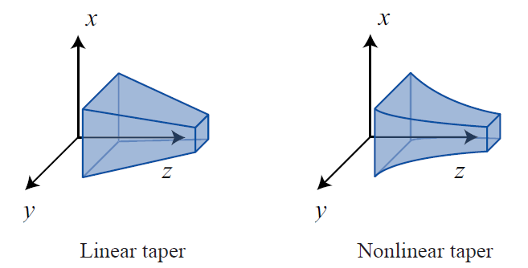
Nonlinear transformations
A linear taper looks like a(z) = α0 + α1z.
A quadratic taper would be a(z) = α0 + α1z + α2z^2.

Slide 20
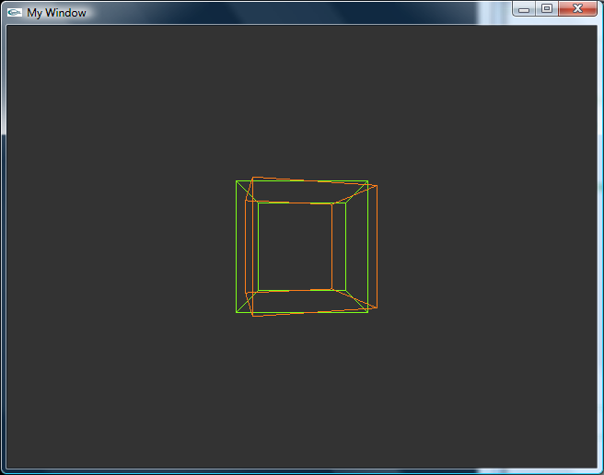
3D wireframe OpenGL
In reshape() set the perspective
gluPerspective(80, (GLfloat)width / (GLfloat)height, 1.0, 100.0);
Sets the field of view angle (in degrees), the aspect ratio of our window, and the new and far planes
void display(void) {
glClear(GL_COLOR_BUFFER_BIT | GL_DEPTH_BUFFER_BIT);
glColor3f(0.5f, 1.0f, 0.1f); // Line color (Green)
glLoadIdentity(); // Load the Identity Matrix to reset our drawing locations
glTranslatef(0.0f, 0.0f, -5.0f); // Push everything 5 units back into the scene, to see the primitive
glutWireCube(2.0f); // Render the primitive
glColor3f(1.0f, 0.5f, 0.1f); // Line color (Orange)
glRotatef(15, 0.0f, 1.0f, 0.0f); // Rotate object around the y axis
glutWireCube(2.0f); // Render the transformed primitive
glutSwapBuffers();
}

