Slide 1
Overview Class 9
Lab Project: Display list (DisplayListObjects.cpp)
Basic OpenGL Lighting & Material
Lab Project: Solid Objects (AddLightSolids.cpp)
Lab Project: Open GL & Normal to a surface
Calculated or analytical
Two objects in a display list (AddLightNormals.cpp)

Slide 2
Using a Display List
A display list is a group of OpenGL commands that have been stored for later execution.
A display list is a convenient and efficient way to name and organize a set of OpenGL commands. For example, suppose you want to draw a torus and view it from different angles. The most efficient way to do this would be to store the torus in a display list. Then whenever you want to change the view, you would change the modelview matrix and execute the display list to draw the torus.
Code to use during this lab project:
DisplayListObjects.cpp

Slide 3
Display List Example
The display list is created in the init routine as
static void init(void) {
theTorus = glGenLists (1); //creates a display list
glNewList(theTorus, GL_COMPILE); // Define the display list
torus(8, 25); // Draw Object
glEndList(); // Define the display list (End)
glShadeModel(GL_FLAT); // initializes the viewing matrices
glClearColor(0.0, 0.0, 0.0, 0.0);
}
The display list is defined by placing the routine for drawing in between glNewList and glEndList. Zero is not a valid display-list index.
All the math to create the object is done only once, increasing rendering performance.
Once commands stored in the display list, they cannot be edited.

Slide 4
Display List Example
For example when keys are used glutPostRedisplay is called causing glutMainLoop to call display and render the object.
The display function clears the window and execute the commands in the display list (glCallList(theTorus);).
void keyboard(unsigned char key, int x, int y) {
case 'i':
glLoadIdentity();
gluLookAt(0, 0, 10, 0, 0, 0, 0, 1, 0);
glutPostRedisplay();
break;
}
}
void display(void) {
glClear(GL_COLOR_BUFFER_BIT); // Clear the window
glColor3f (0.5f, 0.7f, 1.0f); // Draw color
glCallList(theTorus); // Execute the commands in the display list
glFlush();
}

Slide 5
Hierarchical Display Lists
You can create a hierarchical display list, which is a display list that executes another display list by calling glCallList() between a glNewList() and glEndList() pair.
To avoid infinite recursion, there's a limit on the nesting level of display lists.
A display list can contain calls that change the value of OpenGL state variables.

Slide 6
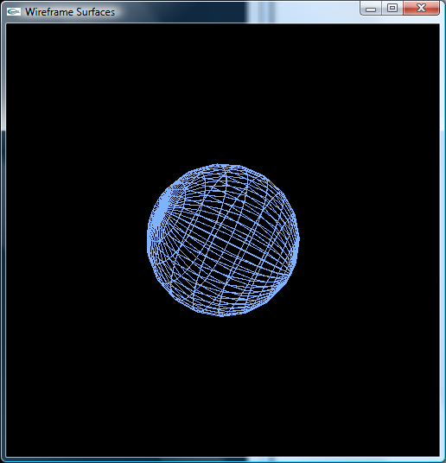
Lab: Display list - Sphere
1) The parametric form of the equations of a sphere are (U,V є[0,2π]): :
In the DisplyListObjects.cpp sample code
Using GL_QUAD_STRIP create a display list and plot a sphere.
Zoom in on the sphere using the view transformation (modify the camera position).
Add keyboard functionality to rotate the sphere along all of the three axis (changes in the modelview matrix ).
void keyboard(unsigned char key, int x, int y) {
case 'i':
glLoadIdentity();
gluLookAt(0, 0, 10, 0, 0, 0, 0, 1, 0);
glutPostRedisplay();
break;
}
}

Slide 7
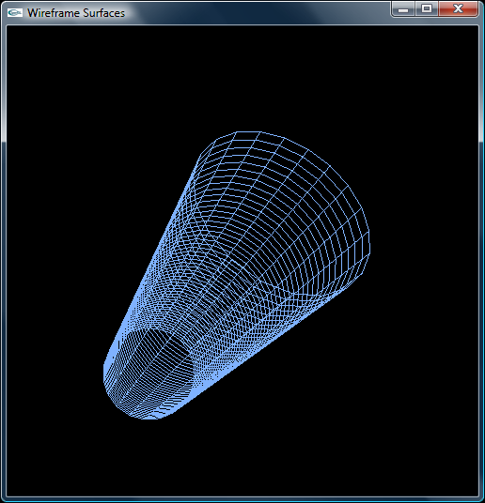
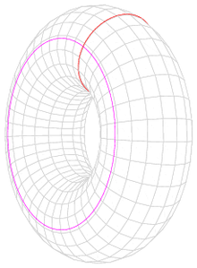
Cylinder & Torus
2) The parametric form of the equations of a cylinder are
(U,V є[0,2π]):
Add a display list to plot the cylinder.
3) Torus is a closed surface defined as the combination of two circles.
The parametric form of the equations of a torus are (U,V є[0,2π]):
The torus is characterized by 2 radii, small(r) and large(R).
Add a display list to plot the torus.

Slide 8
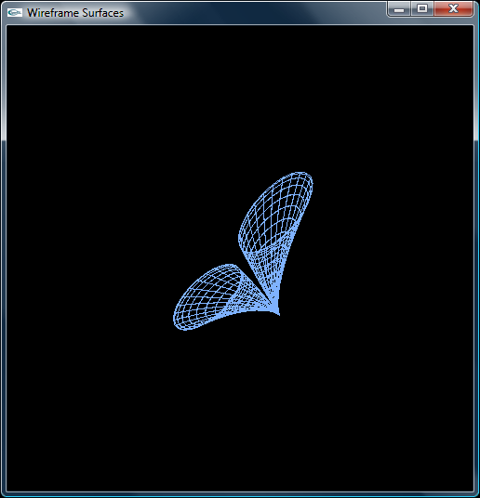
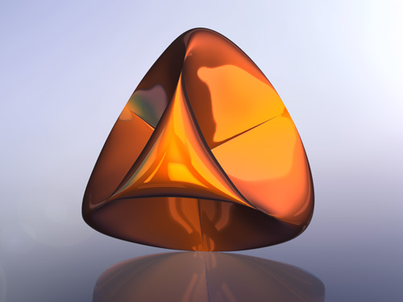
Other surfaces
4) The parametric form of the equations of a double funnel are:
Add a display list to plot the double funnel .
5) Add a display list to plot the Roman Surface with parametric equations :
Change the display list code to use triangles instead of quads. (hint: GL_TRIANGLE_STRIP)

Slide 9
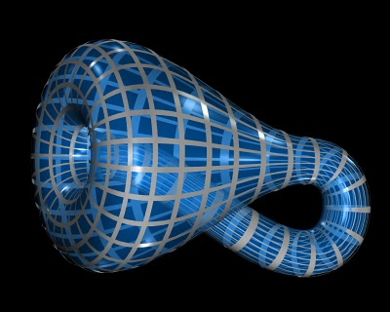
Lab: Display list - Equations
Sphere
x = r*cos(U)*cosh(V/r); // 4) Funnel
y = r*sin(U)*cosh(V/r);
z = V; // Parametric z(U,V)
r=R*(1-cos(U)/2.0);
if ((U<PI) && (U>=0.0)) {
x = 6.0*cos(U)*(1+sin(U))+r*cos(U)*cos(V); // 7) Kline Bottle
y = 16.0*sin(U)+r*sin(U)*cos(V);
}
else {
x = 6.0*cos(U)*(1+sin(U))+r*cos(V+PI); // 7) Kline Bottle
y = 16.0*sin(U);
}
z = r*sin(V);
Cylinder
Torus
Double Funnel
Topology,
Betti numbers,
software metric
Roman Surface

Slide 10
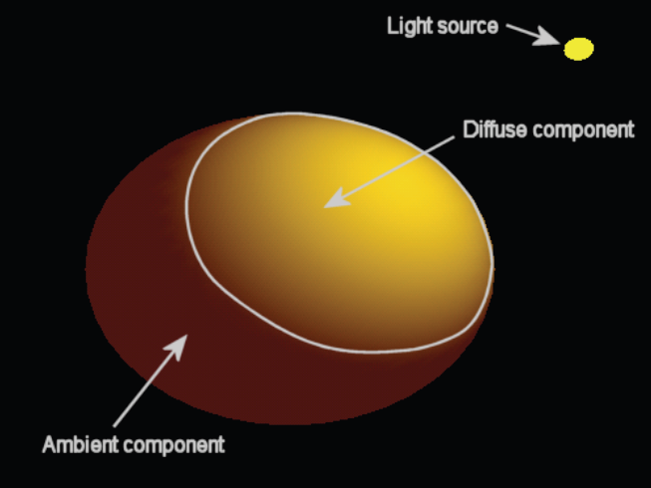
Light
light = emitted + reflected + transmitted − scattered − absorbed

Slide 11
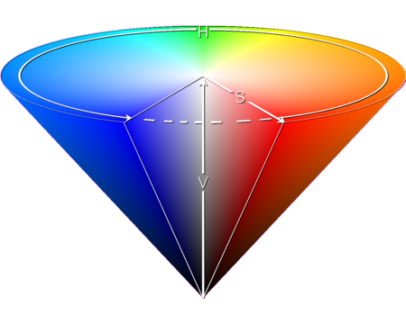

Color
Visual perceptual property of humans. Human eye can distinguish 10 million different colors.
HSV most common cylindrical-coordinate representations of points in an RGB color model.
Hue - The "attribute of a visual sensation according to which an area appears to be similar to one of the perceived colors: red, yellow, green, and blue, or to a combination of two of them".
Saturation-The "colorfulness of a stimulus relative to its own brightness".
Used in computer vision and image analysis for feature detection or image segmentation. The applications of such tools include object detection, for instance in robot vision; object recognition, for instance of faces, text, or license plates; content-based image retrieval; and analysis of medical images.
http://color.method.ac/

Slide 12
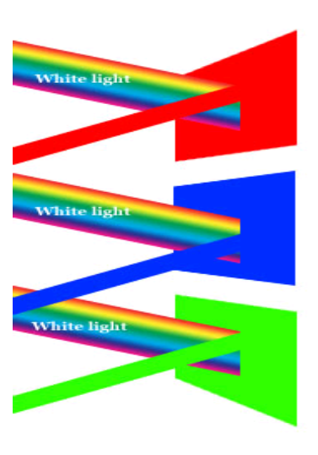
Light and material
The white light is composed of all the colors
The object's color we see is the reflected component

Slide 13
Basic OpenGL Lighting & Material
If color driven materials is enabled by glEnable(GL_COLOR_MATERIAL),
glMaterialfv(GL_FRONT_AND_BACK, channel, color4f);
Object’s ambient, diffuse, and specular components are determined by the channel that can be one set to one of these:
GL_AMBIENT
GL_DIFFUSE
GL_AMBIENT_AND_DIFFUSE
GL_SPECULAR
GL_EMISSION

Slide 14
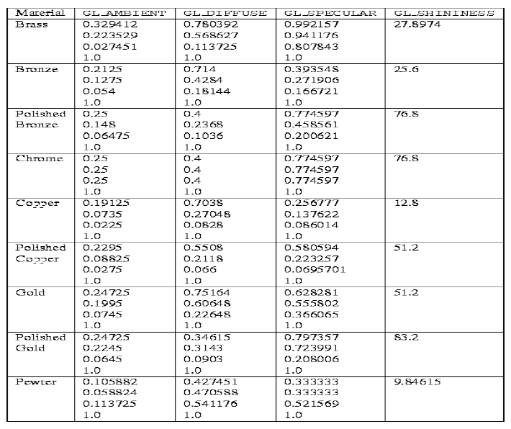
Setting up Material properties
glMaterialfv(GL_FRONT, GL_SPECULAR, value4f); // set material properties

Slide 15
Adding lights
Open GL computes the color of each pixel in a final, displayed scene.
Part of this computation depends on what lighting is used in the scene and on how objects in the scene reflect or absorb that light.
Use glNormal before glVertex to set the normal at each vertex.
OpenGL, lighting can be manipulated in a scene to create many different kinds of effects of a three-dimensional scene such as :
Lighting and light sources
Positioning light sources
Object interaction with light
Hidden-surface removal

Slide 16
Phong Lighting Model
Ambient Light -- light that arrives equally from all directions,
i.e. light that has been scattered so much by its environment
that it is impossible to determine its direction ( so it is a global light )
Diffuse Light -- light from a point source that will be reflected
diffusely ( i.e. reflected evenly in all directions away from the surface )
Specular Light -- light from a point source that will be reflected specularly ( i.e. reflected in a mirror-like fashion, as from a shinny surface )

Slide 17
Lab Project: Solid Objects
In the AddLightSolid.cpp sample code
Add several solid objects in display as a Matrix Stack.
glutSolidCube(3.0f);
glutSolidSphere(2.0, 20, 20);
glutSolidCone(2.0, 5, 20,20);
Make sure you position (translate) the solid objects after you create them
glTranslatef(1.0, -2.0, 0.0f);
Use glPushMatrix and glPopMatrix to do this for each object
glPushMatrix();
glColor3f(0.5f, 0.7f, 1.0f); // Object Color
glTranslatef(3.0, 3.0, 0.0f); // Object Position
glutSolidCube(2.0f); // Plot Solid Objects
glPopMatrix();

Slide 18
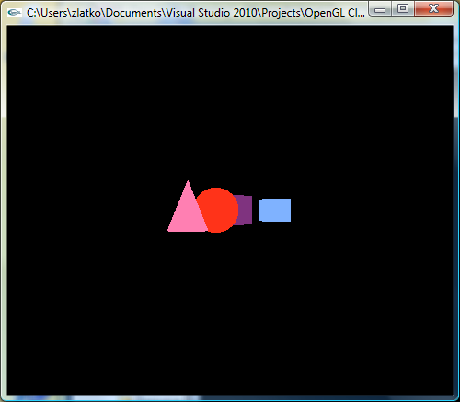
Basic OpenGL No Lighting
1) Specify Object’s color.
Objects in different color, Filling in geometry with solid colors is hardly effective. 3Dimensionality is not obvious.
No Lighting enabled.
Note the No visibility – which objects are hidden by others. Rotate around z-axis to see this!

Slide 19
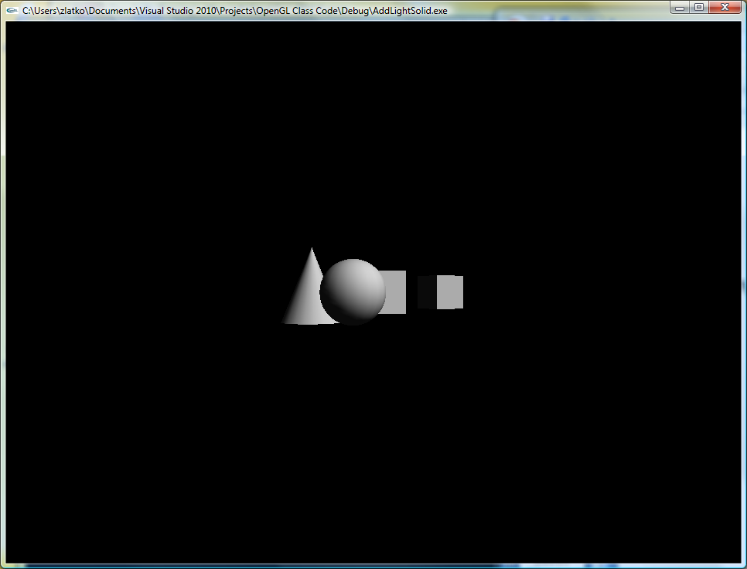
Basic OpenGL Add Lighting
Specify Object’s color.
Object’s color is modified by the color of the light falling on it. If lighting is enabled (glEnable (GL_LIGHTING)) the objects color is modified.
glEnable(GL_LIGHTING); // enable Phong lighting calculation
glEnable(GL_LIGHT0); // up to eight point sources ( radiating in all directions )
glEnable(GL_DEPTH_TEST); // Depth Perception
Note the correct visibility. The ray-tracing algorithm does not use a rasterization phase. It sends one ray from the eye and through each pixel of the image. The intersection between this ray and the objects of the scene is computed, and only the closest intersection is considered.
Note the difference when the light source is positioned
glLightfv(GL_LIGHT0, GL_POSITION, light_position);

Slide 20
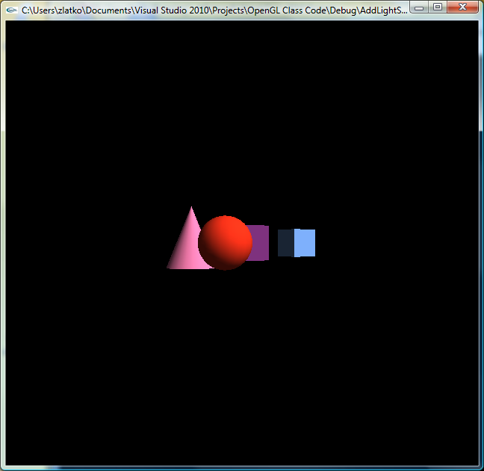
Basic OpenGL Lighting
1) Specify Object’s color.
2) Object’s color is modified by the color of the light falling on it. If lighting is enabled (glEnable (GL_LIGHTING)) the objects color is modified.
glEnable(GL_LIGHTING); // enable Phong lighting calculation
glEnable(GL_LIGHT0); // up to eight point sources ( radiating in all directions )
glEnable(GL_DEPTH_TEST); // Depth Perception
3) If color driven materials is enabled by glEnable(GL_COLOR_MATERIAL), then object’s ambient, diffuse, specular and emission components are determined.
glEnable(GL_COLOR_MATERIAL); // enable color driven materials

Slide 21
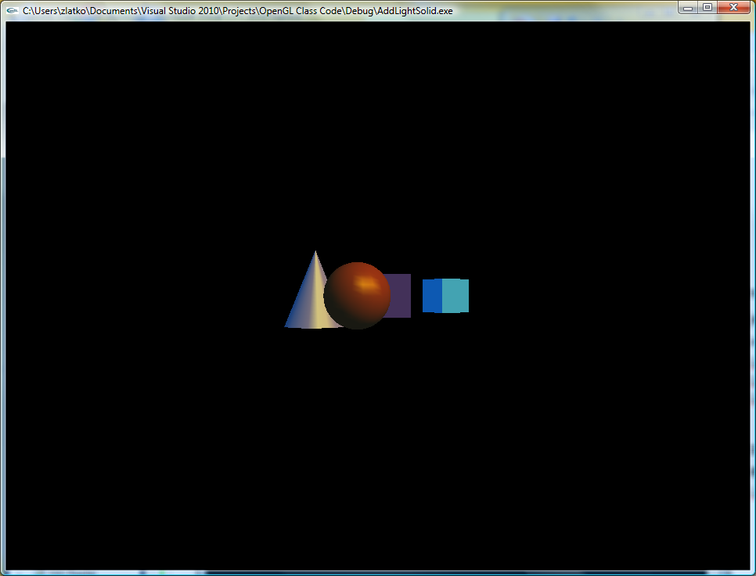
Basic OpenGL Lighting
1) Specify Object’s color.
2) Object’s color is modified by the color of the light falling on it. If lighting is enabled (glEnable (GL_LIGHTING)) the objects color is modified.
glEnable(GL_LIGHTING); // enable Phong lighting calculation
glEnable(GL_LIGHT0); // up to eight point sources ( radiating in all directions )
glEnable(GL_DEPTH_TEST); // Depth Perception
3) If color driven materials is enabled by glEnable(GL_COLOR_MATERIAL),
4) The object’s ambient, diffuse, and specular components are determined.
glLightfv(GL_LIGHT0, GL_DIFFUSE, light ); // 4)
glLightfv(GL_LIGHT0, GL_SPECULAR, light ); // 4)
glLightModelfv(GL_LIGHT_MODEL_AMBIENT, lmodel_ambient); // 4)
glMaterialfv(GL_FRONT, GL_SPECULAR, mat_specular); // 5) set material properties
glMaterialfv(GL_FRONT, GL_SHININESS, mat_shininess); // 5) set material properties

Slide 22






Some Linear Algebra
Dot product:
Meaning: Dot product of the two vectors is a measure to what degree two vectors are aligned.
Magnitude of a vector:
Meaning: length of a vector
Unit Vector :
Meaning: Keeps only vector’s directionality (normalization).
Vectors have magnitude (length) and directionality (angle).
Many times just the vector’s directionality is needed. Compare alignment of two vectors:
Perpendicular
Collinear

Slide 23

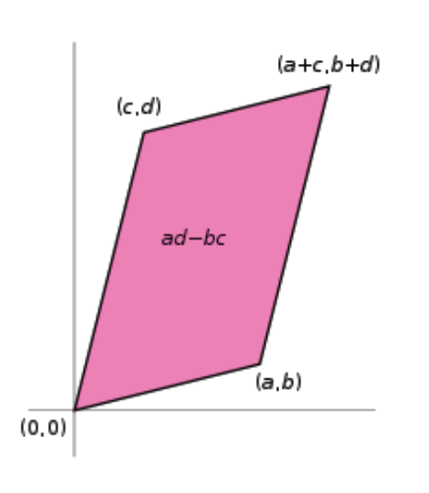
2x2 Determinant
Determinant of a 2x2 matrix:
Meaning: Area between the two vectors

Slide 24

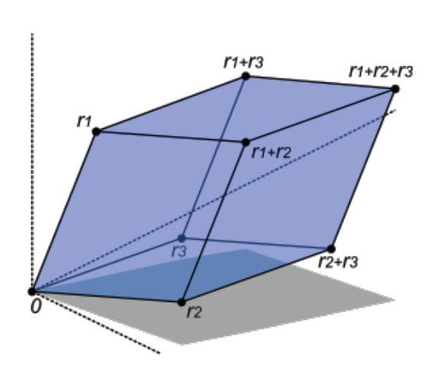
3x3 Determinant
Determinant of a 3x3 matrix:
Meaning: Volume between the three vectors

Slide 25
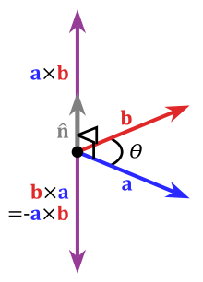


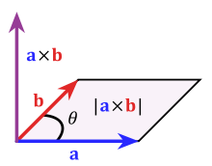
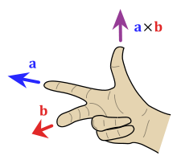
Cross Product
The cross product of the two vectors (matrix notation) is
The geometric meaning of the cross product is the area (determinant) between
the vectors a and b. And the product vector is perpendicular to the area.

Slide 26
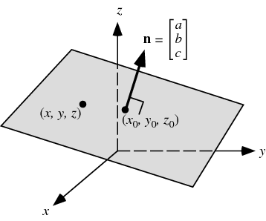


Equation of a plane
Three points specify a plane
Equation of a Plane (normal through a point )
Three point form
Intercept form

Slide 27
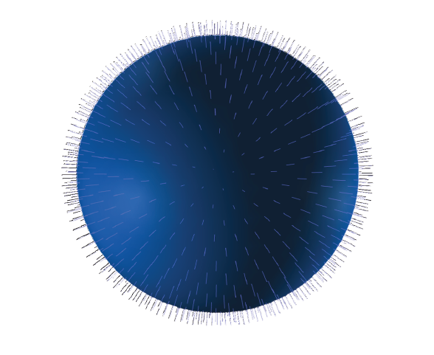
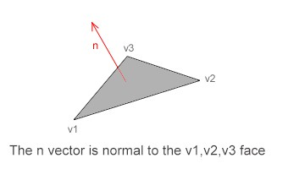
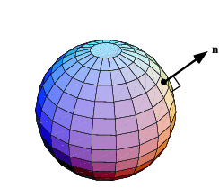
Open GL & Normal
This lighting processing is performed at eye coordinate space, therefore, normal vectors in object coordinates are also transformed to eye coordinates with GL_MODELVIEW matrix.
Normal vectors are transformed in different way as vertices do. We cannot simply multiply GL_MODELVIEW matrix and normal. Consider a normal vector (1,0,0) at vertex (0,0,0). If GL_MODELVIEW matrix is simply translating 2 unit up along Y-axis, then the vertex coordinates will be (0,2,0). But, the normal should remain same as (1,0,0), not (1,2,0).
A surface normal for a triangle can be calculated by taking the vector cross product of two edges of that triangle.

Slide 28
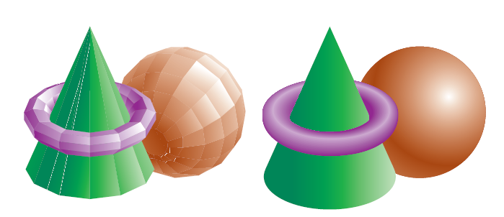
Polygonal Normals versus True Normals
Open GL computes the color of each pixel in a final, displayed scene.
Part of this computation depends on what lighting is used in the scene and on how objects in the scene reflect or absorb that light.
glNormal is used before glVertex to set the normal at each vertex.

Slide 29

Analytical Normals
Analytical calculation for surfaces given by an equation.
Sphere
Cylinder
Torus
Normal: Analytic Surface explicit definition in parametric form:
to find the normal
1) calculate the partial derivatives giving the tangent vectors: and
2) Calculate the cross product which is perpendicular to both and, hence, to the surface.
3) Normalize (Keep just the directionality).
Sphere Equations: Cylinder Equations: Torus Equations:

Slide 30
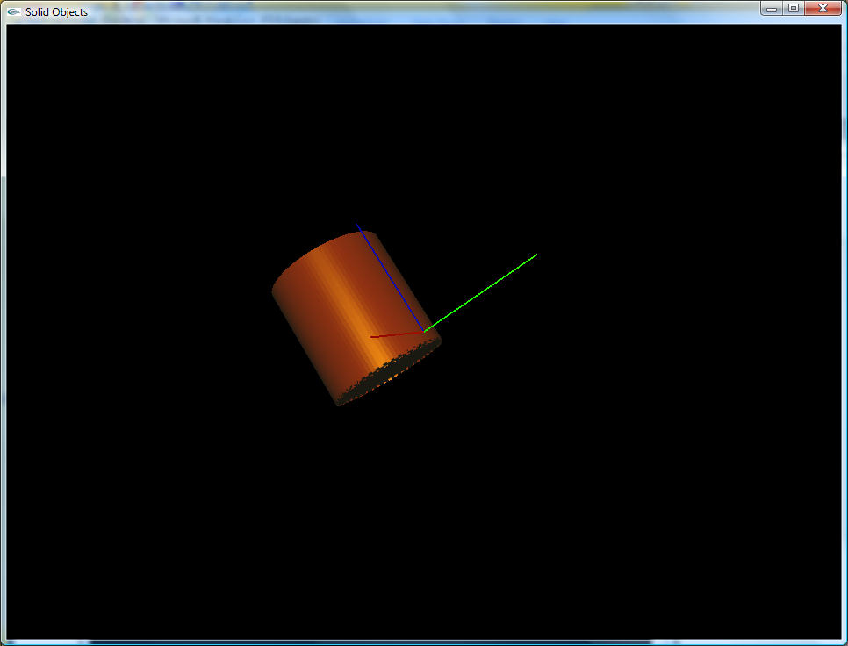
Display list object and Lighting
Modify AddLightSolid.cpp sample code
In display disable drawing solid objects
In main define init();
Insert display list object Cylinder (from DisplayListObjects.cpp).
Add analytical normal vectors to code.
Modify code to work with other surfaces, torus, Roman Surface etc.
Finally calculate normals
Should look the same

Slide 31
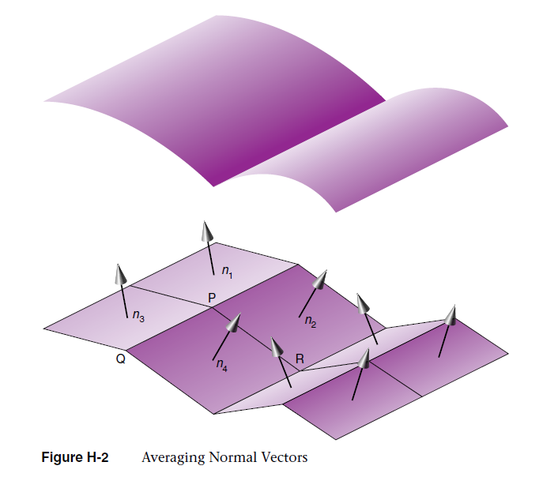
How to calculate Normals
Cross product of two vectors on the mesh.
As a consequence of the cross product, vertices order matters.

Slide 32
Calculate Normals
1) accumulate vertices coordinates
switch (pp) {
case 1:
x1=x; y1=y; z1=z;
break;
case 2:
x2=x; y2=y; z2=z;
break;
case 3:
x3=x; y3=y; z3=z;
break;
case 4:
x4=x; y4=y; z4=z;
break;
}
2) analyze lattice vectors and find cross product
f (pp==4) {
rx1=x3-x1; ry1=y3-y1; rz1=z3-z1; // r1 Latice Vector
rx2=x2-x1; ry2=y2-y1; rz2=z2-z1; // r2 Latice Vector
nX = ry1*rz2 - rz1*ry2; // Cross Product
nY = rz1*rx2 - rx1*rz2;
nZ = rx1*ry2 - ry1*rx2;
dn=sqrt(pow(nX,2)+pow(nY,2)+pow(nZ,2));
pp=0;
}

Slide 33
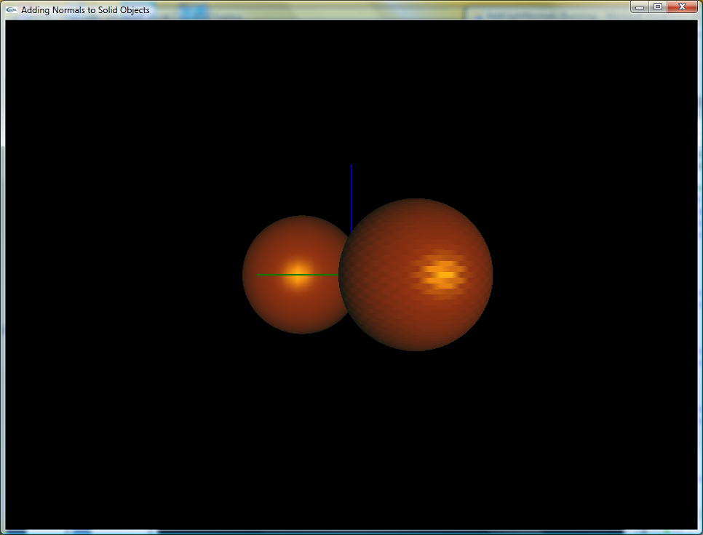
Lab/HW Project
Modify AddLightNormals.cpp
Draw two spheres and position the light at z=10.
One with calculated “discrete” normal vectors (accumulate coordinates of 4 vertices)
Another with analytic “smoother” normal vectors (Check out Matlab’s MuPAD)
Note the glNormal3f glVertex3f difference for these two situations
Modify code to work with
cylinder,
torus
Roman Surface maybe?

Slide 34
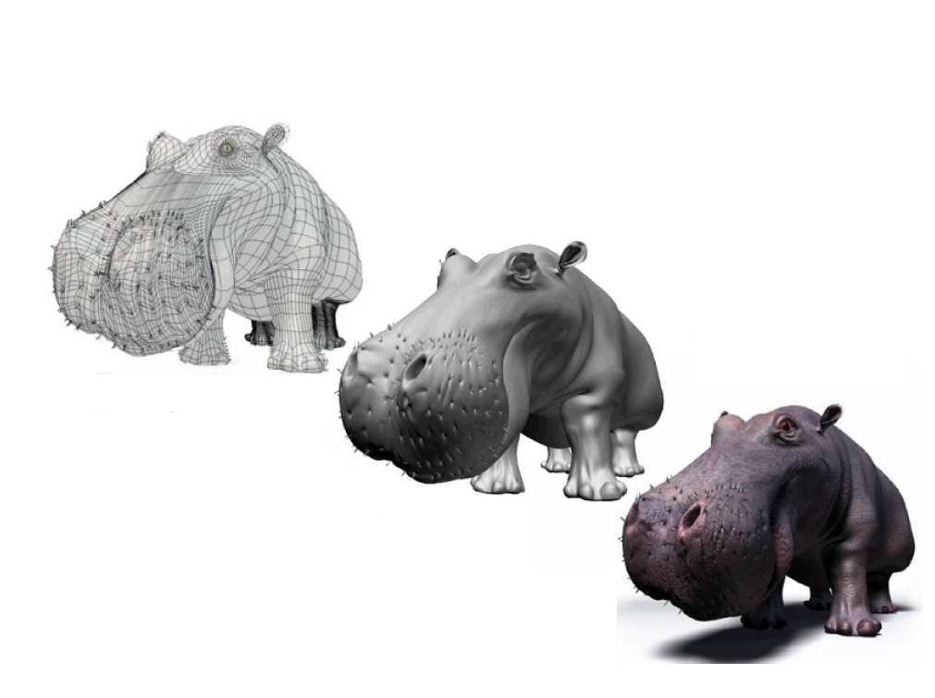
Textures and shading
Model
Model + Shading
Model + Shading + Textures
Computer artwork of Jeremy Birn
http://www.3drender.com/jbirn/productions.html

Slide 35
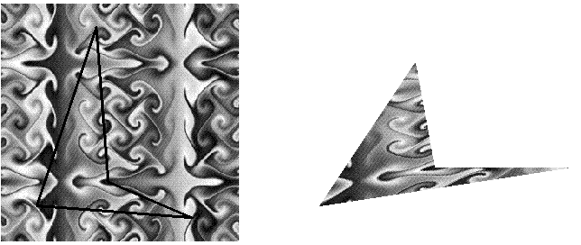
Accessing a texture map from a shader
Texture coordinates are passed to the vertex shader as attributes.
These attributes are usually smoothly interpolated between vertices in the fragment shader.
The fragment shader uses these interpolated texture coordinates to sample the texture.
The sampled filtered texture color comes back as an RGBA color value.
Create a texture object and specify a texture for that object.
Indicate how the texture is to be applied to each pixel.
Enable texture mapping.
Draw the scene, supplying both texture and geometric coordinates.

Slide 36
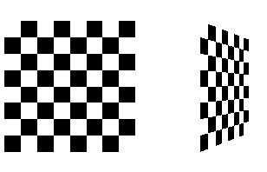
A Sample Program
Textures are read from an image file.
Interesting textures are large since they need to be specified programmatically.
The sample program applies this texture to two squares, which are then rendered in perspective, one of them facing the viewer squarely and the other tilting back at 45 degrees.
The checkerboard texture is generated in the routine makeCheckImage().
texture-mapping initialization occurs in the routine init().
glGenTextures(1, &texName); // name a texture object
glBindTexture(GL_TEXTURE_2D, texName); // create a texture object
glTexImage2D(); // specify texture map
Parameters: size of the image, type of the image, location of the image, and other properties.
glTexParameter*() specify how the texture is to be wrapped and how the colors are to be filtered if there isn't an exact match between pixels in the texture and pixels on the screen.
Texturing is enabled in display() (glEnable())
glTexEnvf(); // draw using the colors from the texture map
glTexCoord*(); // sets the current texture coordinates

