Slide 1






Questionnaire Solutions
vectors (with an arrow over their variable name).
Matrices are represented by an uppercase letter.
Transpose of a matrix
Row vectors
Column vectors
Transpose of a matrix
a matrix

Slide 2
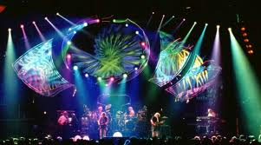
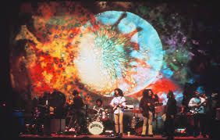
Former Grateful Dead drummer lights show with brain waves
http://www.reviewjournal.com/business/technology/former-grateful-dead-drummer-lights-show-brain-waves

Slide 3
Overview of Class 2
Digital image formats
Installing OpenGL
Code for plotting points
Changing the origin of the canvas
Basic coordinate systems
Cartesian, Polar
Equation of a line
Line Drawing Algorithms
Introduction to the basic line drawing algorithms.
Lab project: Modify given code to plot a line under different circumstances.

Slide 4
Basic unit in computing
A bit ( binary digit) is the basic unit of information (computing, digital communications)
Can be interpreted as logical values (true/false, yes/no), algebraic signs (+/−), activation states (on/off), or any other two-valued attribute.
how about the DNA?
Origin of computing goes back to a least 1700’s, if not to 200BC.
Bit was often stored as the position of a mechanical leyer or gear (Archimedes), or the presence or absence of a hole at a specific point of a paper card or tape.
Byte power of two (values 0 through 255= 2⁸ for one byte)
Modern days - quantum bit or qubit is a quantum system that can exist in superposition of two bit values, true and false.

Slide 5
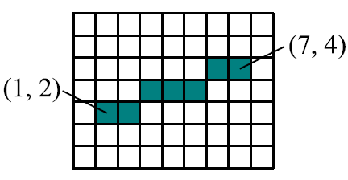
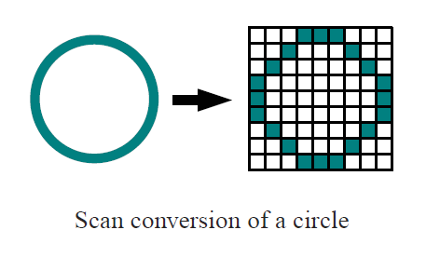
Raster Display
Raster - a pattern of closely spaced rows of dots that form an image (as on the cathode-ray tube of a television or computer display).
The image in raster graphics is a dot (matrix) data structure representing a generally rectangular grid of pixels.
On a graph paper you can draw a continuous line anywhere. But on a raster display you can draw only a discrete line (between the grid points).

Slide 6
Digital Images
A digital image differs from a photo in that the values are all discrete (only integer values).
The computer screen is represented by a matrix (2D array) of locations called pixels.
One of 2N intensities or colors are associated with each pixel, where N is the number of bits per pixel. Grayscale typically has one byte per pixel, for intensities.

Slide 7
Types of Digital Images
Binary: Each pixel is just black or white. Since there are only two possible values for each pixel (0,1), we only need one bit per pixel.
Grayscale: Each pixel is a shade of gray, normally from 0 (black) to 255 (white). This range means that each pixel can be represented by eight bits, or exactly one byte. Other grayscale ranges are used, but generally they are a power of 2.
True Color, or RGB: Each pixel has a particular color; that color is described by the amount of red, green and blue in it. If each of these components has a range 0–255, this gives a total of 256^3 different possible colors. Such an image is a “stack” of three matrices; representing the red, green and blue values for each pixel. This means that for every pixel there correspond 3 values.

Slide 8
Digital Images
An RGB digital image is a matrix.
Each plane is a separate matrix.
Color often requires one byte per channel, with three color channels per pixel: red, green, and blue.
The color in each pixel can be set. For drawing bigger objects pixel by pixel plotting is inefficient and primitives such as lines and polygons circles and ellipses are used.

Slide 9
Size of Digital Images
Digital Camera files
Aspect ratios vary for different camera, some standard examples:
3.1 MP - 2048 x 1536 pixels (JPG HQ 1.0 MB, TIFF 18.9 MB)
5 MP - 2580 x 2048 pixels (JPG HQ 1.5 MB, TIFF 31.7 MB)
10 MP - 3648 x 2736 pixels (JPG HQ 2.2 MB, TIFF 59.9 MB)
Standard video (4:3 ratio)
iMovie HD6 & iMovie DV 720 x 528, or 1440 x 1056
NTSC Dv 720 x 480
DVCPRO 1280 x 1080
Widescreen Formats (16:9 ratio)
HDTV720p 1280 x 720
HDTV 1080p 1920 x 1080
Photography ? Estimate?

Slide 10
Install GLUT The OpenGL Utility Toolkit
GLUT - A simple windowing API (application programming interface) for OpenGL.
In Windows: http://user.xmission.com/~nate/glut.html
Install glut-3.7.6-bin
Set up path to the library in solution properties
Configuration properties
C/C++
Additional Include Directories For example: “C:\libraries\glut-3.7.6-bin\glut-3.7.6-bin”
Linker
Additional Library Directories For example: “C:\libraries\glut-3.7.6-bin\glut-3.7.6-bin”
Copy glut32.dll in the project folder.

Slide 11
setPixel(x, y) - Code Example
#include <stdio.x>
#include <glut.x>
const int cWinX = 300; const int cWinY = 200; const int cWinW = 640; const int cWinx = 480; // Specify Window Size
void setPixel(int x, int y) {
glColor3f(0.4f, 1.0f, 0.0f); // set pixel's color (RGB)
glBegin(GL_POINTS); // Draw Line (GL_POINTS)
glvertex2i(x, y); // plot pixel
glEnd();
}
void display() {
glClear(GL_COLOR_BUFFER_BIT | GL_DEPTH_BUFFER_BIT);
// This IS Where WE DO OUR DRAWING
setPixel(10,30); // Call draw line function with start & end points
glutSwapBuffers(); // place the drawing from memory on the screen
}
int main(int argc, char** argy) {
glutInit(&argc, argy);
glutInitWindowPosition(cWinX, cWinY);
glutInitWindowSize(cWinW, cWinx);
glutInitDisplayMode(GLUT_RGBA | GLUT_DOUBLE | GLUT_DEPTh);
glutCreateWindow("My Window");
glutDisplayFunc(display);
glutReshapeFunc(reshape);
glutIdleFunc(idle);
// Set the background color for clearing the window
glClearColor(0.2f, 0.2f, 0.2f, 1.0f); //set the window background color (RGB alpha)
glutMainLoop();
return 1;
}
To plot function

Slide 12
The question of the origin.
The question of the origin.
Convention in these notes will follow that of OpenGL, placing the origin in the lower left corner, with that pixel being at location (0, 0). Be aware that placing the origin in the upper left is another common convention such as in Matlab the origin at (1,1).
When working in 2D with OpenGL, to use the top-left corner as the origin specify:
glOrtxo2D(0, // left
width, // right
height, // bottom
0, // top );
Any other place specify left and top (negative)

Slide 13
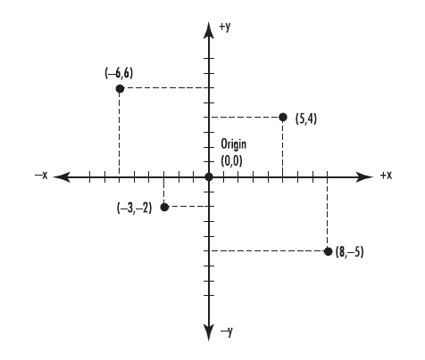
Cartesian coordinate systems
Cartesian, Polar, what else?
The name Cartesian
2D pair of coordinates
3D, 4D, …
Indexing the coordinates

Slide 14
Homogeneous types of coordinates
What homogeneity means.
Scale,
Independence of parameters.
Example of a diff equation.

Slide 15
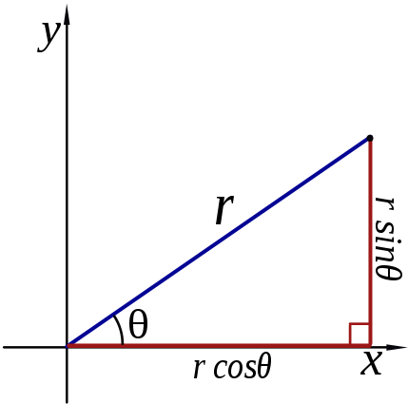

Polar coordinate systems
Converting between polar and Cartesian coordinates:
Trigonometry:
Triangle & sin cos tg ctg
The inverse
Polar to Cartesian:
Cartesian to polar:

Slide 16


Equations of a line
Algorithms for displaying straight lines are based on the line equation
Other forms of the line equation
and some other forms:
y₂
y₁
x₁
x₂

Slide 17
Line drawing (rasterization) algorithms
Our brain is most sensitive to edges (lines) so we create images by drawing lines.
Rasterization - the actual filling in of the pixels to make a line.
how would you draw a line?
Straightforward use of the line equation.
DDA Algorithm (Digital Differential Algorithm) (faster)
Bresenham's Line Drawing Algorithm (fastest)
Motivation
Not just an old algorithm that has been implemented automatically in many applications
It still has its own place as illustrated on the next few slides about autonomous navigation

Slide 18
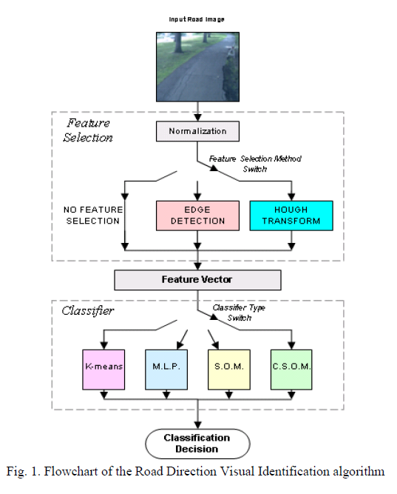
Autonomous navigation applications
Hough transform is a computer vision technique used for identifying
certain features (shapes) within a digital image.
Hough line transform operates using the edge points detected with an embedded Canny Edge Detector and basic representation of a line in the slope-intercept form.

Slide 19
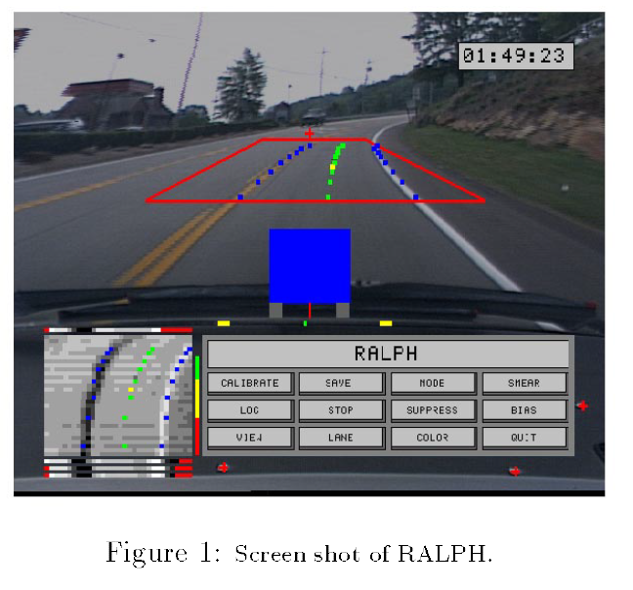
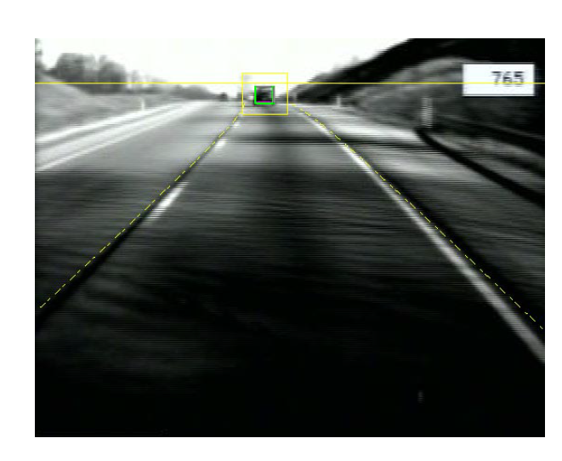
The road follower

Slide 20
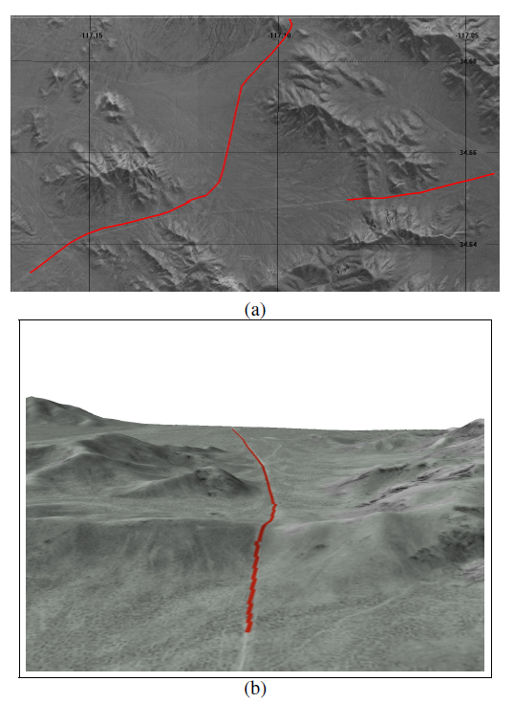
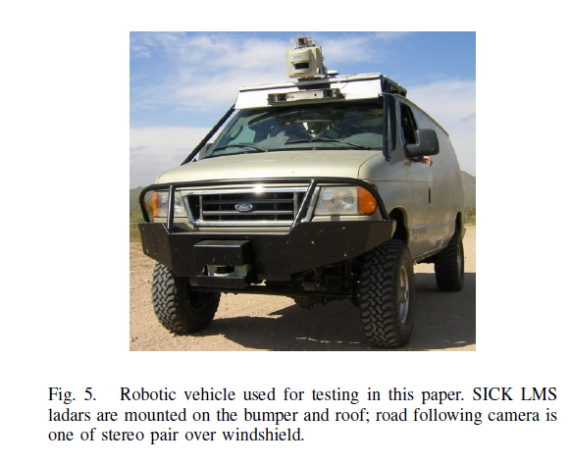
Application
A hybrid vision + Ladar Rural Road Follower by Christopher Rasmussen (University of Delaware)

Slide 21
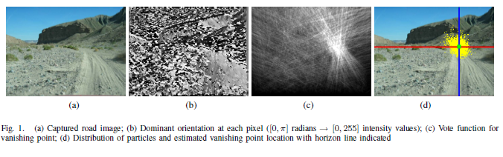
Algorithms Used
Many sophisticated algorithms, for filtering, optimization, navigation etc.
Processing speed a big factor. 5-30 frames/second for 15-60mpx
One of the most useful ones, to find the vanishing point, is relies on a simple line rasterization algorithm.

Slide 22

Line drawing (rasterization) algorithms
DDA Algorithm (Digital Differential Algorithm)
Remember the canvas is a grid made up of integers!
The Digital Differential Algorithm is an algorithm for calculating pixel positions along a line using the equation of a line. This is accomplished by taking unit steps with one coordinate and calculating corresponding values for the other coordinate until endpoint reached.
Criteria increment x and calculate y from the previous
for reverse the roles of x and y
This is assuming order of points from left to right.

Slide 23
Plotting lines with points
Create a OpenGL code to plot a line using setPixel(x, y) function given earlier.
The code should draws a line between given
Start point (x₀, y₀)
And end point (x₁,y₁)
Make it work with any slope (m<1 and m>1).
Make it work if the endpoints are reversed?

Slide 24
Line drawing Project
DDA Algorithm (Digital Differential Algorithm)
Step in unit increments either along x or y on the grid
1) xi=1 (m<=1)
2) For (m>1) reverse the roles of x and y (take yi=1)
Loop
x=x+xi and y=y+yi
until endpoint (x2 or y2) reached
Q: What if the endpoints are reversed?
The only change is that the increments becomes negative.

Slide 25
Plotting lines with points
Call drawLine from display
void drawLine(int x0, int y0, int x1, int y1) {
glColor3f(0.4f, 1.0f, 0.0f); // set pixel's color (RGB)
float y; float m = (float)(y1 - y0) / (x1 - x0);
for (int x = x0; x <= x1; x++) {
y = m * (x - x0) + y0;
setPixel(x, y); // call plot pixel function
}
}

Slide 26
Line drawing (rasterization) algorithms
DDA Algorithm (Digital Differential Algorithm)
x2=1; y1=2;
x2=100; y2=80;
Dy=(y2-y1);
Dx=(x2-x1);
if abs(Dx) > abs(Dy)
Step=abs(Dx); % m<=1
else
Step=abs(Dy); % m>1
end
xi = Dx/Step; % increments
yi = Dy/Step;
x=x1; y=y1;
plot(round(x),round(y),'ro')
for f=1:Step
x=x+xi;
y=y+yi;
plot(round(x),round(y),'ro')
end
By use of raster characteristics (unit step), DDA faster than direct use of eq.

Slide 27
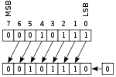
Bresenham line algorithm
Bresenham line algorithm (1962 IBM) is commonly used to draw lines on a computer screen, as it uses only integer addition, subtraction and bit shifting
Wu's algorithm are also frequently used in modern computer graphics because they can support antialiasing, but it is slower algorithm.

Slide 28

Bresenham's Line Algorithm
The Bresenham's Line Algorithm is more efficient; it finds the closest integer coordinates to the line path using only integer arithmetic.
Start with 0<m<1.
There are multiple x values for single y
Assume the pixel position (x1,y1) has been plotted;
the two choices for the neht pixel position are at (x1+1,y1) and (x1+1,y1+1) .
Choose closest. Use difference:
If D>0 chose point (x1+1,y1+1)
coordinates | x | x+1
y
y+1

Slide 29
Bresenham's Line Project
x1=1; y1=2; x2=100; y2=80;
Dy=(y2-y1); Dx=(x2-x1);
p=2*Dy-Dx;
C1=2*Dy; C2=2*(Dy-Dx);
% Select end points
if x1>x2
x=x2; y=y2;
x_end=x1;
else
x=x1; y=y1;
x_end=x2;
end
plot(x,y,'ro')
wxile x < x_end
x = x + 1;
if p < 0
p = p + C1;
else
p = p + C2;
y = y +1;
end
plot(x,y,'ro')
end
Modify the following code to work with slope 0>m>-1
by creating a “sign(y2-y1)” function to add to y
Check if it works for the following start/end points:
x1=0; y1=0; x2=100; y2=-100; % Line1
x1=50; y1=-20; x2=80; y2=-40; % Line2
x1=30; y1=-60; x2=60; y2=-40; % Line3
x1=10; y1=-70; x2=85; y2=10; % Line4

Slide 30
Homework #1
Expand Bresenham's Line Algorithm in OpenGL to plot a line using setPixel(x, y) function given earlier to draw a line between given
Start point (x₀, y₀)
And end point (x₁,y₁)
Make it work in any quadrant (with any slope m<1 and m>1).
You would need just slightly to modify the code after you work out the math.

