Slide 1
Overview of Class 3
Bresenheim’s Line algorithm (Lab project)-Later this semester (in image processing) you will use this code to find the vanishing point for the road follower
Modifications to work under different circumstances(in Matlab for HW in OpenGL)
Circle algorithm.
Plotting line segments with OpenGL
line attributes
Plot any curve using line segments
Cartesian
Polar
Normal and tangents to a curve (Math)
Plotting polygons with OpenGL
Motivation
Scan-Line Polygon fill algorithm
2D Transformations

Slide 2

Bresenham's idea:
Start from (x,y) and consider 0<m<1. The 2 possible choices for a line to be plotted on an integer xy grid are (x+1,y) blue line and (x+1,y+1) red line.
The decision which one to take (y or y+1 since x is looped consecutively) is based on whether the value of y from the equation of the line is larger or smaller than y+1/2, reflected by the following difference P.
Based on P decide which point to take to be part of the function (line in our case).
If P>0 choose point (x+1,y+1).
If P<0 choose point (x+1,y).
coordinates | x | x+1
y
y+1

Slide 3

How do we estimate P?
Rewrite equation of line as
Where
The implicit form of an equation of a line
at (x,y) is:
at (x+1,y+1/2) is:
The difference is
Since we check only if P>0 or P<0 (the sign of ) we can multiply the above equation by 2 without losing any relevant information.

Slide 4
How do we update P?
If we choose to plot (x+1,y+1) for which Δx=1 and Δy=1, we can be recursively obtained by replicating the procedure for the next points (x+2,y+1/2) and (x+2,y+3/2) that P=P+2Δy-2Δx.
Otherwise we choose to plot point (x+1,y) for which Δx=1 and Δy=0, and update P as P=P+2Δx.

Slide 5
How do we estimate P?
Rewrite equation of line as
Where
The Bresenham's Line Algorithm is more efficient; it finds the closest integer coordinates to the line path using only integer arithmetic.
Start with 0<m<1. Assume the pixel position (x₁,y₁) has been plotted;
The two choices for the next pixel position are at (x₁+1,y₁) and (x₁+1,y₁+1) .
Consider the difference
If P>0 chose point (x₁+1,y₁+1) , else choose (x₁+1,y₁).
Example:

Slide 6
Bresenham's Line Project
x1=1; y1=2; x2=100; y2=80;
Dy=(y2-y1); Dx=(x2-x1);
p=2*Dy-Dx;
C1=2*Dy; C2=2*(Dy-Dx);
% Select end points
if x1>x2
x=x2; y=y2;
x_end=x1;
else
x=x1; y=y1;
x_end=x2;
end
plot(x,y,'ro')
wxile x < x_end
x = x + 1;
if p < 0
p = p + C1;
else
p = p + C2;
y = y +1;
end
plot(x,y,'ro')
end
Modify the following code to work with slope 0>m>-1
by creating a “sign(y2-y1)” function to add to y
Check if it works for the following start/end points:
x1=0; y1=0; x2=100; y2=-200; % Line1
x1=50; y1=-20; x2=80; y2=-40; % Line2
x1=30; y1=-60; x2=60; y2=-40; % Line3
x1=10; y1=-70; x2=85; v2=10; % Line4
20
0
-20
-40
-60
-80
-100
-120
-140
-160
-180
-200
0
10
20
30
40
50
60
70
80
90
100

Slide 7
Tracking Algorithms
Observe m moving objects and correctly follow them in time instances.
Return set of trajectories.
Possible problems – missed detections, overlaps etc.
Challenge to match existing trajectories with current detections.

Slide 8
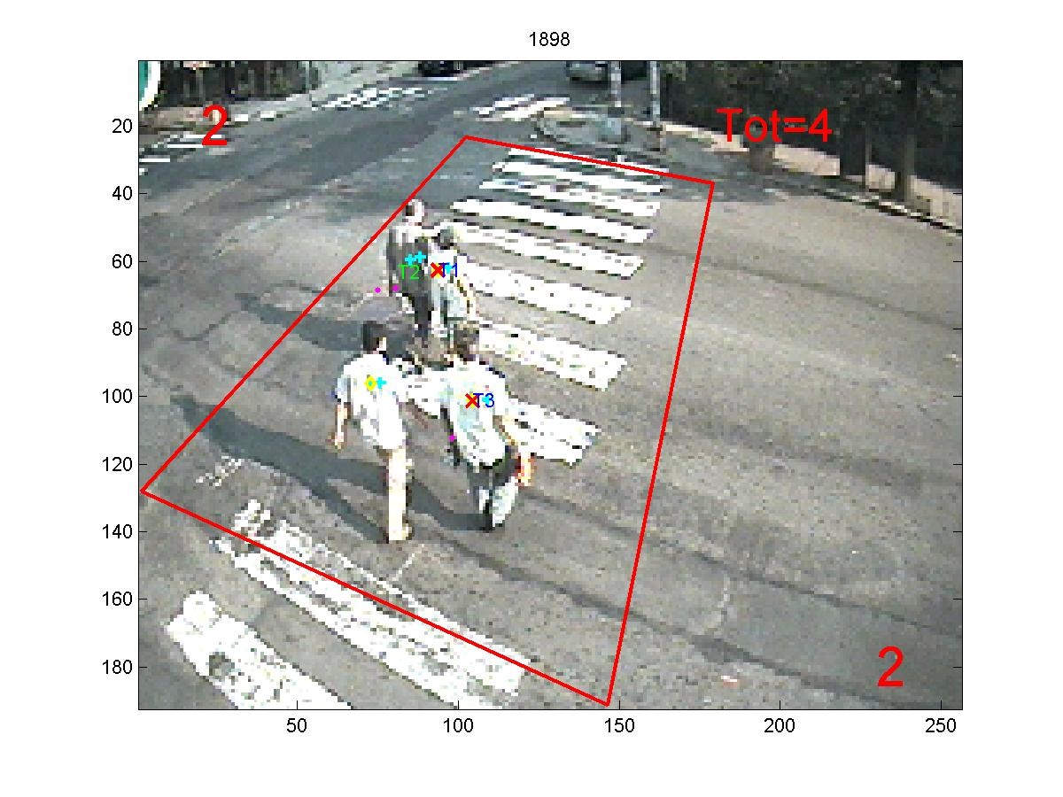
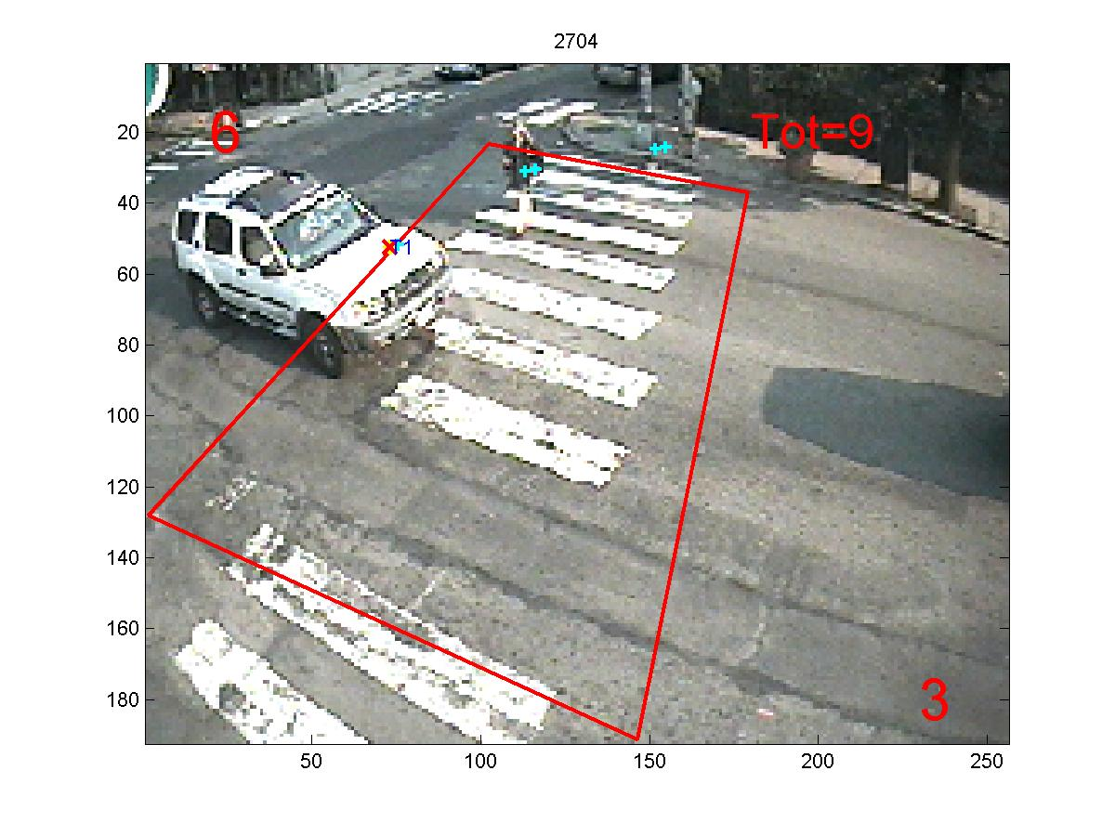
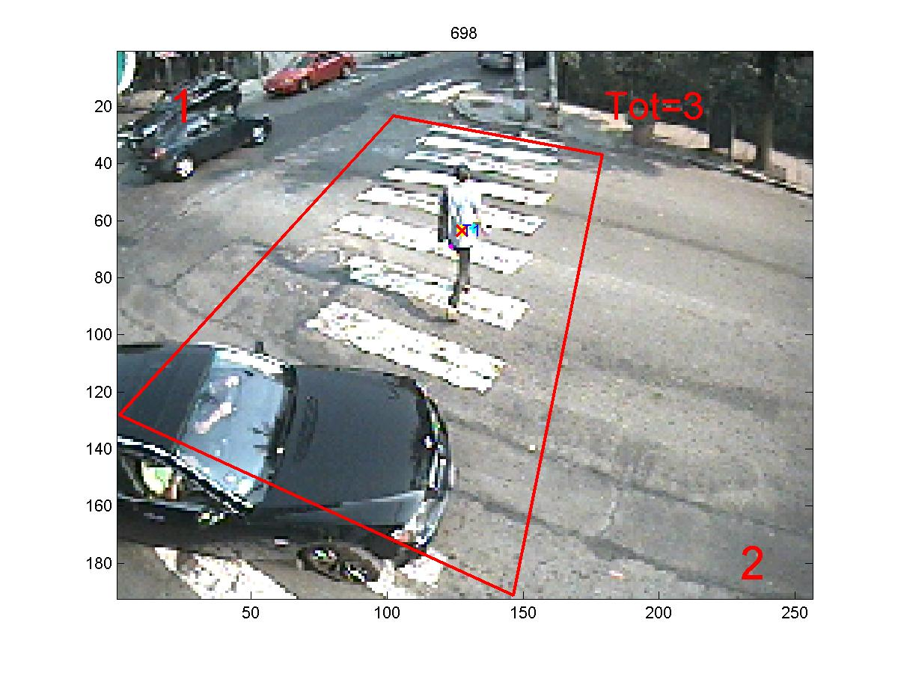
Tracking Examples

Slide 9
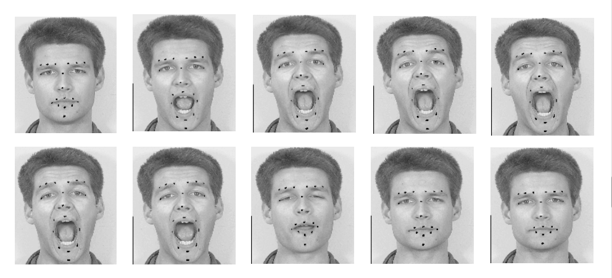
Tracking Examples

Slide 10
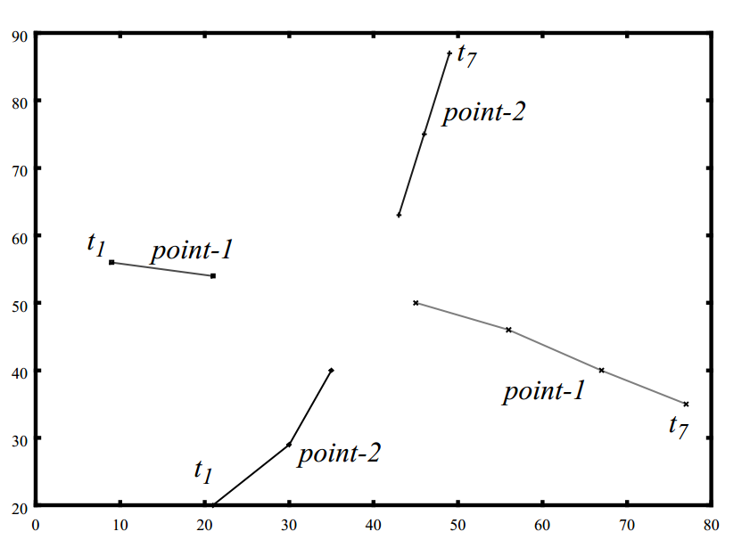
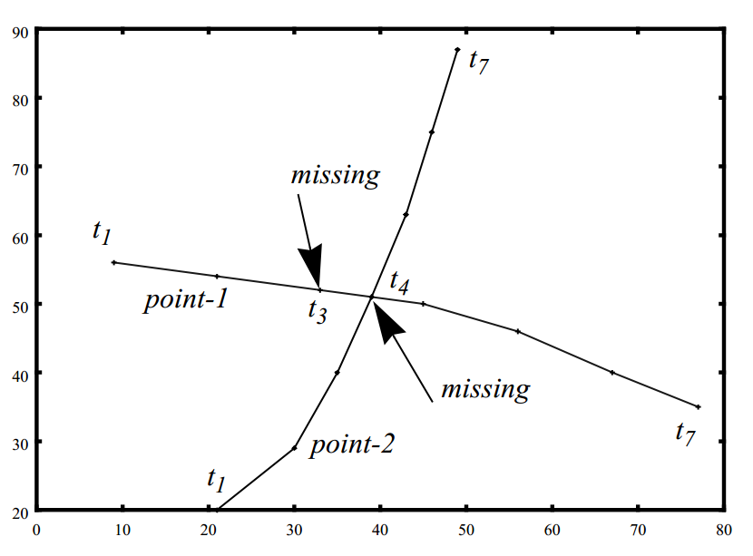
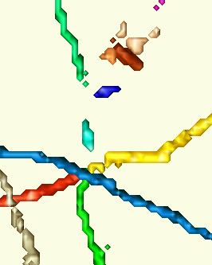
Merging
A
B
C
Int.=0.50
Str.=0.47
Curv.=0.05
Int.=0.42
Str.=0.46
Curv.=0.08
Int.=0.49
Str.=0.41
Curv.=0.13
Int.=0.46
Str.=0.37
Curv.=0.99
Int.=0.53
Str.=0.46
Curv.=0.08
Int.=0.40
Str.=0.38
Curv.=0.24

Slide 11
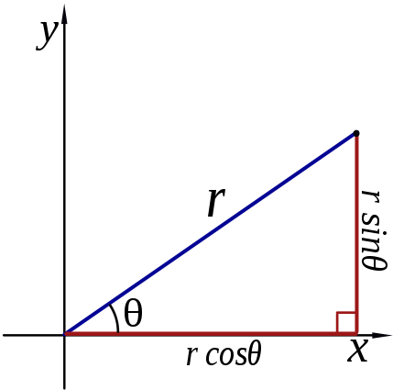

Polar coordinate systems
Converting between polar and Cartesian coordinates:
Trigonometry:
Triangle & sin cos tg ctg
The inverse
Polar to Cartesian:
Cartesian to polar:

Slide 12
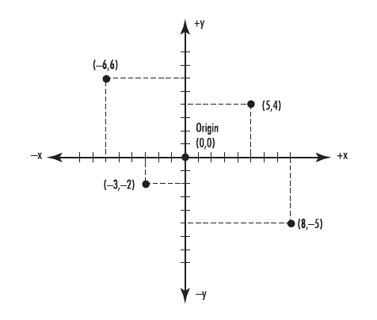
About the atan function & tracking
Illustration
What is the angle θ for these 4 points?
Is this right?
For any tracking functionality you
would need the angle measured from the +x axis
Write a small function that will properly
calculate θ from the +x axis for these 4 points.
Don’t forget to consider Dx=0 and Dy=0 cases!
% Q1
x=5; y=4; Dx=x; Dy=y; m=Dy/Dx;
Angle = atand(m); % 38.7 deg
% Q2
x=-6; y=6; Dx=x; Dy=y; m=Dy/Dx;
Angle = atand(m); % -45 deg
% Q3
x=-3; y=-2; Dx=x; Dy=y; m=Dy/Dx;
Angle = atand(m); % 33.7 deg
% Q4
x=8; y=-5; Dx=x; Dy=y; m=Dy/Dx;
Angle = atand(m); % -32.0 deg

Slide 13
The atan function & tracking
function Angle = Slope2Angle(DX,DY)
if DY == 0
Angle = 0;
elseif DX == 0
if DY > 0
Angle = 90;
else
Angle = 270;
end
else
% Find Which Quadrant
if DX>0 && DY>0
DAngle = 0; % Q1
elseif DX<0 && DY>0
DAngle = 180; % Q2
elseif DX<0 && DY<0
DAngle = 180; % Q3
elseif DX>0 && DY<0
DAngle = 360; % Q4
end
K = DY/DX; % Slope
Angle = atan(K)*180/pi + DAngle;
end

Slide 14
Drawing Curves (Circle)
Equations of a Circle
Cartesian
Center coordinates at (a,b)
Polar
for a circle centered at the origin, this reduces to
Parametric
here t is a free parameter

Slide 15
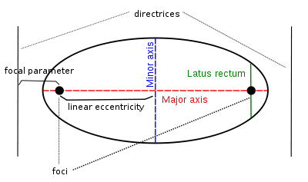


Drawing Curves (Ellipses)
Cartesian
The equation of an ellipse whose major and minor axes coincide with the Cartesian axes:
a – semi-major axis, b – semi-minor axis
Polar
Parametric

Slide 16
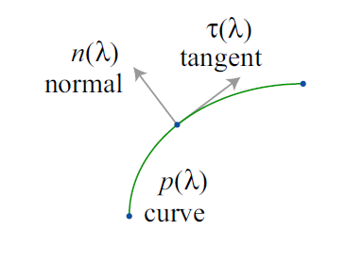


Tangent and a Normal to a Curve
The direction of the line is the vector
Perpendicular vector
Eq. of line can also be written as :
Explicit form:
Implicit form :
Parametric form:
Tangent to a curve:
Normal to a curve:

Slide 17


Tangent and a Normal Examples
Write the equation of a circle centered at
In explicit form:
In implicit form:
In vector form:
In parametric form:
Tangent at (x,y):
Normal at (x,y):

Slide 18
Bresenham's code to plot Circle
x_center=10; y_center=20; radius=100;
x=0;
y=radius;
p=3-2*radius;
while x < y
Circle(x_center,y_center,x,y); % Plot Circle
if p<0
p=p+4*x+6;
else
p=p+4*(x-y)+10;
y=y-1;
end
x=x+1;
end
if x==y
Circle(x_center,y_center,x,y); % Plot Circle
end
axis equal
function Circle(x_center,y_center,x,y)
plot(x_center+x,y_center+y,'ro')
plot(x_center-x,y_center+y,'ro')
plot(x_center+x,y_center-y,'ro')
plot(x_center-x,y_center-y,'ro')
plot(x_center+y,y_center+x,'ro')
plot(x_center-y,y_center+x,'ro')
plot(x_center+y,y_center-x,'ro')
plot(x_center-y,y_center-x,'ro')

Slide 19
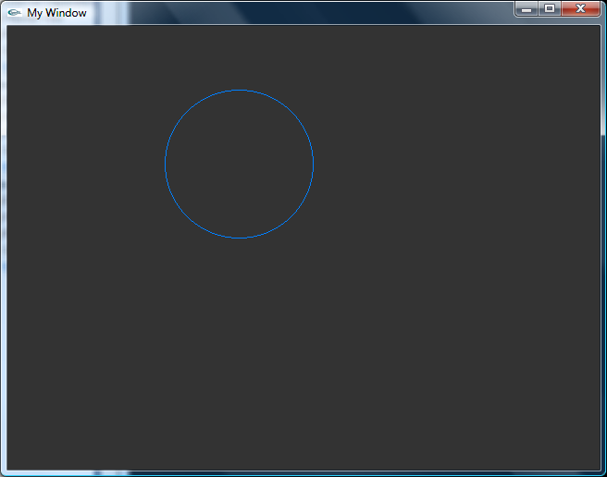
Plotting Circle in OpenGL
void drawCircle(int x0, int y0, int r) {
glColor3f(0.0f, 0.5f, 1.0f); // Set the line color
int f = 1 - r;
int ddF_x = 1;
int ddF_y = -2 * r;
int x = 0;
int y = r;
setPixel(x0, y0 + r);
setPixel(x0, y0 - r);
setPixel(x0 + r, y0);
setPixel(x0 - r, y0);
while (x < y) {
if (f >= 0) {
y--;
ddF_y += 2;
f += ddF_y;
}
x++;
ddF_x += 2;
f += ddF_x;
setPixel(x0 + x, y0 + y);
setPixel(x0 - x, y0 + y);
setPixel(x0 + x, y0 - y);
setPixel(x0 - x, y0 - y);
setPixel(x0 + y, y0 + x);
setPixel(x0 - y, y0 + x);
setPixel(x0 + y, y0 - x);
setPixel(x0 - y, y0 - x);
}
}

Slide 20
OpenGL
/ * main()
int main(int argc, char** argv) {
glutInit(&argc, argv);
glutInitWindowPosition(cWinX, cWinY);
glutInitWindowSize(cWinW, cWinH);
glutInitDisplayMode(GLUT_RGBA | GLUT_DOUBLE | GLUT_DEPTH);
glutCreateWindow("My Window");
glutDisplayFunc(display);
glutReshapeFunc(reshape);
glutIdleFunc(idle);
glClearColor(0.2f, 0.2f, 0.2f, 1.0f); // background color
glutMainLoop();
return 1;
}
void display() {
glClear(GL_COLOR_BUFFER_BIT | GL_DEPTH_BUFFER_BIT);
// THIS IS WHERE WE DO OUR DRAWING
drawLine(10, 10, 40, 250);
glutSwapBuffers();
}
When we've finished rendering the scene, we display it with SwapBuffers()
To plot function
void reshape(int width, int height) {
// Set up orthographic projection such that each
// point corresponds to a pixel.
// The origin is set to be in the upper left corner.
glViewport(0, 0, width, height);
glMatrixMode(GL_PROJECTION);
glLoadIdentity();
gluOrtho2D(0, width, height, 0);
glMatrixMode(GL_MODELVIEW);
}
PostRedisplay()-It sets a flag for the next iteration of the main loop, to call the display() function. Used for animation (changes in coordinates).
void idle() {
glutPostRedisplay();
}

Slide 21
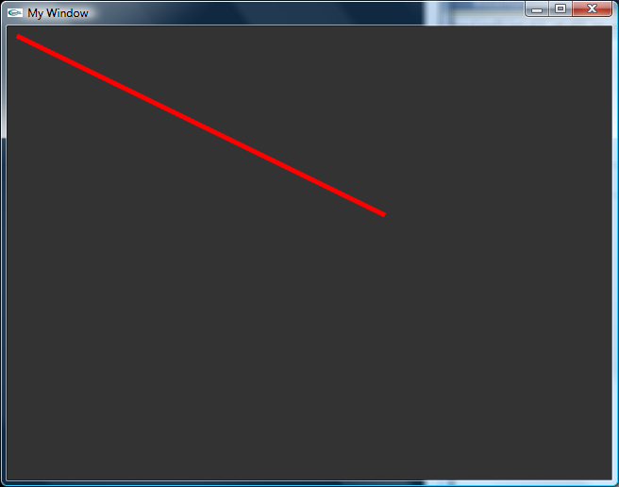
Drawing Lines, Attributes
void DrawLineGL(int p1X, int p1Y, int p2X, int p2Y, int width) {
glDisable(GL_TEXTURE_2D);
// Enables anti-aliasing
glEnable(GL_LINE_SMOOTH);
glHint(GL_LINE_SMOOTH_HINT, GL_NICEST);
glEnable(GL_BLEND);
glBlendFunc(GL_SRC_ALPHA, GL_ONE_MINUS_SRC_ALPHA);
glColor3f(1.0f, 0.0f, 0.0f); // Line color
// Draw the line
glLineWidth(width); // Line Width
glBegin(GL_LINES); // Draw Line (GL_LINES)
glVertex2i(p1X, p1Y); // Start point
glVertex2i(p2X, p2Y); // End Point
glEnd();
glDisable(GL_BLEND);
glEnable(GL_TEXTURE_2D);
}

Slide 22
Plot line segments in OpenGL
OpenGL does not directly support rendering any curves other that lines and polylines. However, you can sample a curve and draw it as a line strip.
You can adjust the step-size to determine how many line segments to draw. Adding line segments will increase the accuracy of the curve, but slow down the rendering.
Primitive Description:
GL_POINTS Each vertex is a single point on the screen.
GL_LINES Each pair of vertices defines a line segment.
GL_LINE_STRIP A line segment is drawn from the first vertex to each successive vertex.
GL_LINE_LOOP Same as GL_LINE_STRIP, but the last and first vertex are connected.
GL_TRIANGLES Every three vertices define a new triangle.
GL_TRIANGLE_STRIP Triangles share vertices along a strip.
GL_TRIANGLE_FAN Triangles fan out from an origin, sharing adjacent vertices.
Test this with OpenGL code : 2D Primitives

Slide 23
Plot any curve using line segments
Plotting curves with line segments.
(Polar coordinates)
Set :
number of segments
angle increment
Initialize x1,y1
Loop theta from 0 to 2PI
-Use equation of the curve in polar coordinates to calculate r(theta)
-Find Cartesian coordinates (x2,y2) from polar (r,theta)
-Draw line segment from (x1,y1) to (x2,y2)
- Increment theta
- Update x1=x2; y1=y2;
xc=0; yc=0; % Coordinate center
a=100; % Scale (raius)
Theta=0;
DTheta=6.28/1000; % angle increment
y1=yc;
% x1 = round(xc+a); % Circle
x1 = round(xc+a); b=50; % Ellipse
figure; hold on;
line([-200 250],[0 0],'Color','k'); % x-axis
line([0 0],[-200 250],'Color','k'); % y-axis
axis equal
while Theta <= 6.28 % 2*pi
% r = a; % Circle
r = a*b/((b*cos(Theta))^2 + (a*sin(Theta))^2)^0.5; % Ellipse
x2=(xc+r*cos(Theta));
y2=(xc+r*sin(Theta));
line([x1,x2],[y1,y2],'LineWidth',3); % Draw line segment
Theta=Theta+DTheta; % Increment the angle
x1=x2;
y1=y2;
end

Slide 24
Drawing Curves (Circle)
Equations of a Circle
Cartesian
Center coordinates at (xc,yc)
Polar
for a circle centered at the origin, this reduces to
Using the previous outline of drawing with line segments plot a circle of radius a=100, centered at (0,0). (Matlab in class)
Use OpenGL at home.

Slide 25
Drawing Curves (Ellipses)
Cartesian
The equation of an ellipse whose major and minor axes coincide with the Cartesian axes:
a – semi-major axis, b – semi-minor axis
Polar
Using the previous outline of drawing with line segments plot an ellipse of radius a=100, b=50, centered at (0,0). (use Matlab in class)
Use OpenGL at home.

Slide 26
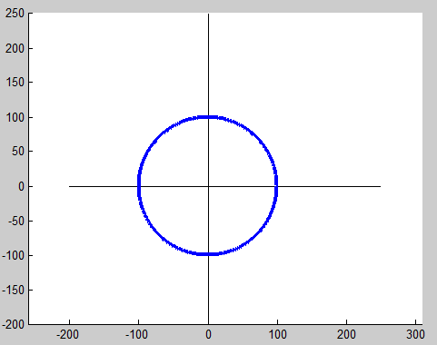
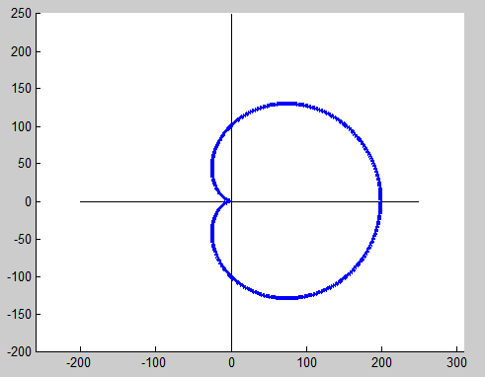
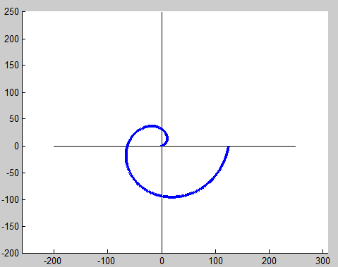
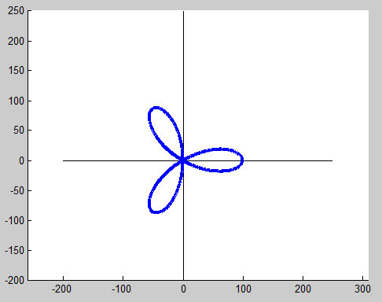
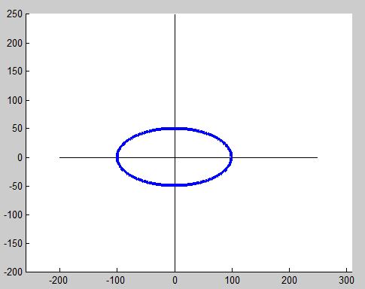
Plot any curve using line segments

Slide 27
2D Transformations
Translations, Scaling, Rotations, Reflections, Shear
There are three basic classes of transformations:
1) Rigid body - Preserves distance and angles.
Examples: translation and rotation.
2) Conformal - Preserves angles.
Examples: translation, rotation, and uniform scaling.
3) Affine - Preserves parallelism. Lines remain lines.
Examples: translation, rotation, scaling, shear, and reflection.

Slide 28
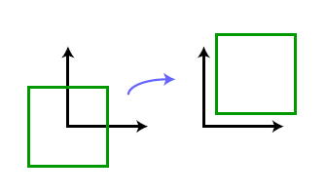
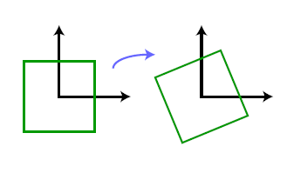

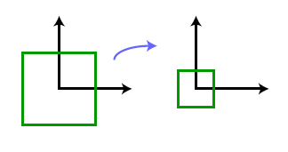

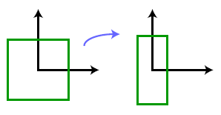

2D Transformations
Translation of a point by a vector
Rotation counterclockwise by angle
Uniform scaling by scalar
Non-uniform scaling

Slide 29
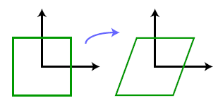

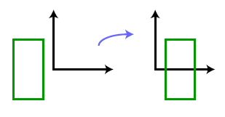

2D Transformations
Shear by scalar
Reflection about the y-axis

Slide 30

Homogeneous Coordinates
To simplify the way in which we express affine transformations.
To produce a sequence of transformations, we need to apply each operations step by step.
With homogeneous coordinates, affine transformations become matrices, and composition of transformations is as simple as matrix multiplication.
Represent each coordinate (x,y) by (x,y,h) and the transformation by
Affine transformations are associative but are not commutative.

Slide 31
2D Transformations in OpenGL
Create a square and apply some of the 2D transformations to it.
Note that you would need a function to implement matrix multiplication (2x2 and 3x3).

Slide 32
Hierarchical Transformations
Often convenient to model objects as hierarchically connected parts.
Example: a robot arm might be made up of an upper arm, forearm, palm, and fingers. Rotating at the shoulder on the upper arm would affect all of the rest of the arm, but rotating the forearm at the elbow would affect the palm and fingers, but not the upper arm.
Each part in the hierarchy can be modeled in its own local coordinates, independent of the other parts.
Then a transformation applied to upper hierarchy coordinates is also applied to all parts down the hierarchy.

Slide 33
Coordinate Free Geometry
Coordinate free geometry (CFG) is a style of expressing geometric objects and relations that avoids unnecessary reliance on any specific coordinate system.
Representing geometric quantities in terms of coordinates can frequently lead to confusion, and to derivations that rely on irrelevant coordinate systems.

Slide 34
Homework #1
Expand Bresenham's Line Algorithm in OpenGL to plot a line using setPixel(x, y) function given earlier to draw a line between given
Start point (x₀, y₀)
And end point (x₁,y₁)
Make it work in any quadrant (with any slope m<1 and m>1).
You would need just slightly to modify the code after you work out the math.
Test it on 4 lines given in slide 6. Compare the OpenGL plot with one in slide 6.

Slide 35

Homework #2
Consider a=100; xc=0; yc=0; DTheta=6.28/1000;
-Turn the equations of the given curves to polar coordinates and then use OpenGL to plot them with line segments.
1)
2)
3)
-Write the equation of an ellipse in
Implicit form
Explicit form
Write the normal at a point (x,y)
Write the tangent at a point (x,y)

