Slide 1
Overview of Class 3
Draw polygons
Anti aliasing
Primitives arguments & color
Passing the coordinates as a vector
Finish 2D Transformations & OpenGL (Lab project)
Create multy vertex object (colors, triangles quads etc)
and transform it with matrix
Fractals
Fern (Create OpenGL code Lab project)
Serpinski
Mandelbrot

Slide 2
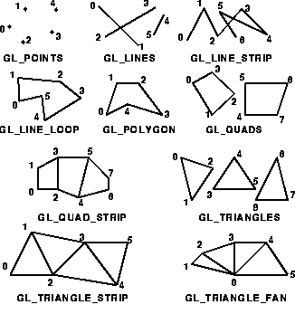
Some Primitives in OpenGL
GL_TRIANGLES Every three vertices define a new triangle.
GL_TRIANGLE_STRIP Triangles share vertices along a strip.
GL_TRIANGLE_FAN Triangles fan out from an origin, sharing adjacent vertices.
GL_QUADS Quads 4 vertices.
GL_QUAD_STRIP Multiple connected quads.
GL_POLYGON Polygon with n vertices.
Always define the coordinates of your OpenGL
shapes in a counterclockwise drawing order
this becomes very important in 3D.
Try to modify the sample Primitives.cpp file

Slide 3
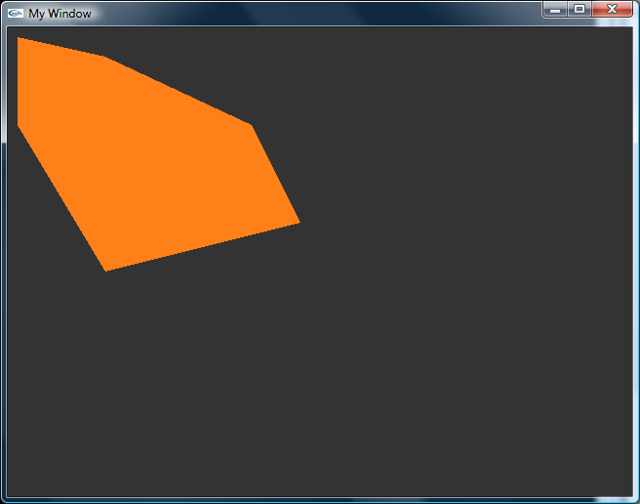
Plot polygons in OpenGL
void PolygonFill() {
glColor3f(1.0f, 0.5f, 0.1f); // Fill color
// Draw the polygon
glBegin(GL_POLYGON);
glVertex2i(10, 10);
glVertex2i(100, 30);
glVertex2i(250, 100);
glVertex2i(300, 200);
glVertex2i(100, 250);
glVertex2i(10, 100);
glEnd();
glDisable(GL_BLEND);
}

Slide 4
Polygon fill algorithm
Scan-Line Polygon fill algorithm
Finds intersection points of a line with the polygon edges.
Found points are sorted from left to right
Points between each pair are set to a specific fill color
Special treatment of vertices in some situation, count them as 1or 2?
Polygon’s self intersection complicates the situation even more.

Slide 5

Moiré patterns
Two patterns made of parallel vertical lines.
The n^{th} line of the second pattern is shifted by nδp compared to the n^{th} line of the first pattern.
d
p
p+δp

Slide 6
Moiré patterns by rotation

Slide 7
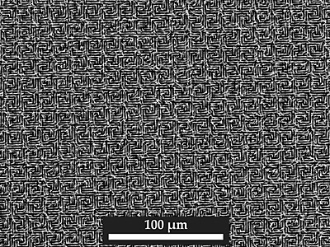
Meniscus lithography and Moiré patterns
In a new approach, Joanna Aizenberg at Harvard University has found a simple, scalable way for masked evaporation to produce complex patterns and long-range order. (S. H. Kang et al., Phys. Rev. Lett.)
Evaporation of a trapped liquid can arrange nanoparticles into tunable patterns with long-range order.
When the mask and substrate are identical and at a slight angle to each other, the misalignment produces a Moiré pattern that is preserved by the bent pillars, as shown in the figure, even after the two arrays are separated.

Slide 8
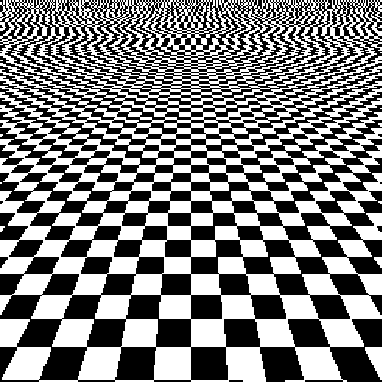
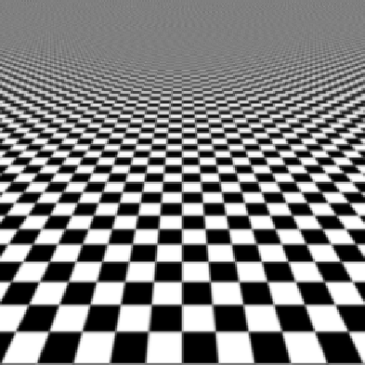
Moiré patterns & aliasing
Aliasing can be removed by filtering out the higher frequencies.

Slide 9
It doesn’t always work
Sometimes it is not possible to resolve the issue because of the scale of displayed objects.

Slide 10
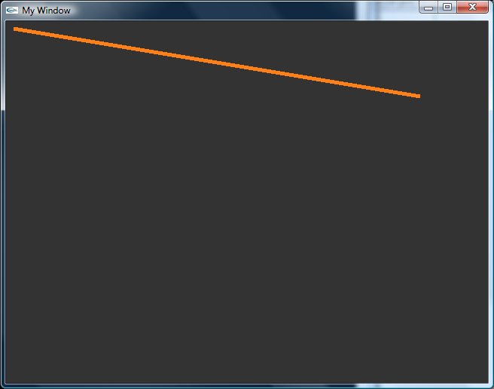
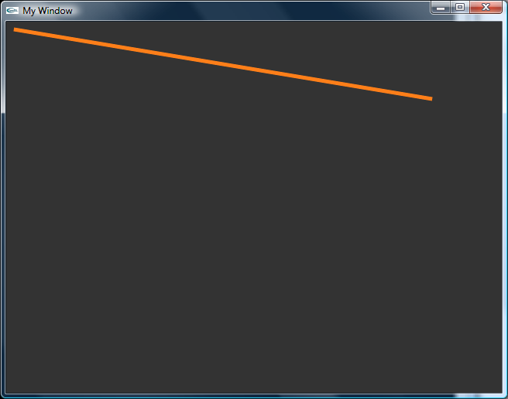
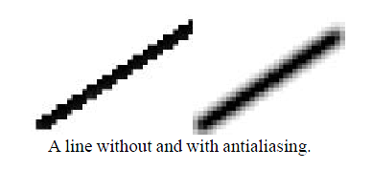
Anti aliasing in OpenGL
void DrawLineGL(int p1X, int p1Y, int p2X, int p2Y, int width) {
glDisable(GL_TEXTURE_2D);
// Enables anti-aliasing
glEnable(GL_LINE_SMOOTH);
glHint(GL_LINE_SMOOTH_HINT, GL_NICEST);
glEnable(GL_BLEND);
glBlendFunc(GL_SRC_ALPHA, GL_ONE_MINUS_SRC_ALPHA);
// Draw the line
glColor3f(1.0f, 0.0f, 0.0f); // Line color
glLineWidth(width); // Line Width
glBegin(GL_LINES); // Draw Line (GL_LINES)
glVertex2i(p1X, p1Y); // Start point
glVertex2i(p2X, p2Y); // End Point
glEnd();
glDisable(GL_BLEND);
// glEnable(GL_TEXTURE_2D);
}
The jaggy aspect of the lines can be avoided by antialiasing techniques that in the case of a line, it consists in using intermediate gray levels to “smooth” the appearance of the line.

Slide 11
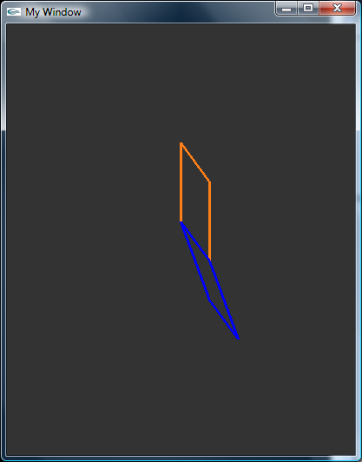
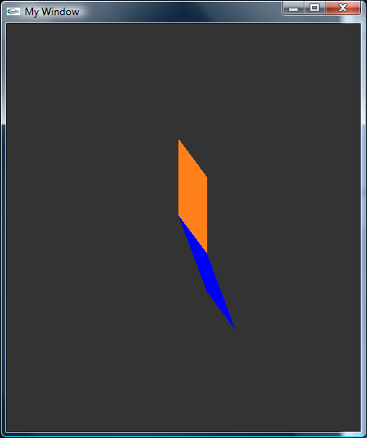
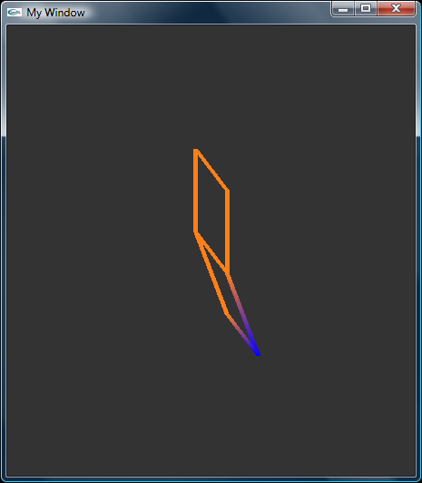
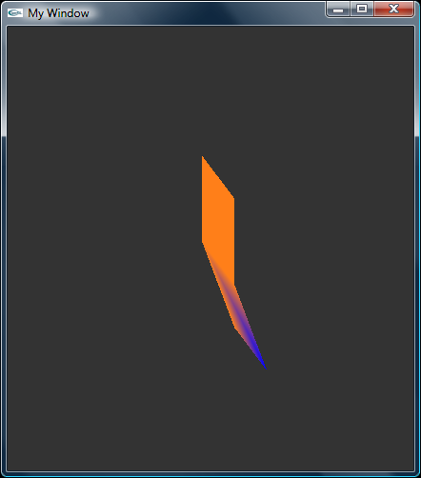
Primitives arguments & color
See 2D Primitives sample code
glShadeModel();
GL_SMOOTH
GL_FLAT
glPolygonMode(face,mode)
face | mode
GL_FRONT | GL_POINT
GL_BACK | GL_LINE
GL_FRONT_AND_BACK | GL_FILL
1) GL_FLAT with GL_LINE
3) GL_SMOOTH with GL_LINE
4) GL_SMOOTH with GL_FILL
2) GL_FLAT with GL_FILL

Slide 12
OpenGL transformations
Some OpenGL commands take parameters that are vectors given in the form of arrays. For some commands, such glVertex and glColor, vector parameters are an option.
Commands that take parameters in array form have names that end in “v”. For example, you can use the command glVertex3fv(A) to generate a vertex that is given by the coordinates in the array A.
Code example:
In display()
// THIS IS WHERE WE DO OUR DRAWING
int P1 [2] = {10, 10}; // Start point Coordinates
int P2 [2] = {550, 100}; // End Point Coordinates
DrawLineGL(P1, P2, 5);
In DrawLineGL(int *P1, int *P2, int width)
// Draw the line
glLineWidth(width);
glBegin(GL_LINES);
glVertex2iv(P1); // Start point
glVertex2iv(P2); // End Point
glEnd();

Slide 13



Homogeneous Coordinates
To simplify the way in which we express affine transformations.
All of the affine transformation can be expressed by the following matrix equation
The matrix M₂ contains the translation vectors.
A more efficient way – to eliminate M₂ by expanding it into a single 3x3 matrix.
With homogeneous coordinates, affine transformations become matrices, and composition of transformations is as simple as matrix multiplication.
Each coordinate position (x,y) is represented with a homogeneous coordinate triplet (xh,yh,h), where
Then the coordinate transformation expression can be written as

Slide 14
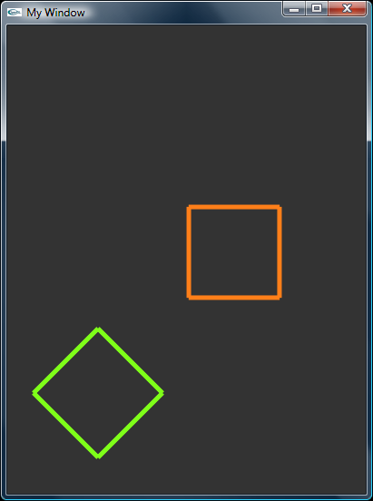
2D Transformations in OpenGL
To:
Create a square and apply some of the 2D transformations to it.
The transformation equations using homogeneous coordinates are:
In display()
for (int i = 0; i <= 3; i++) {
Xn[i] = a*X[i]+b*Y[i]+tx; // x' = ax+by+tx Transformation
Yn[i] = c*X[i]+d*Y[i]+ty;;// y' = cx+dy+ty Transformation
}
glColor3f(0.5f, 1.0f, 0.1f); // Line color
DrawLineLoopGL(Xn, Yn, 5);
Plotting the transformed vertices:
DrawLineLoopGL(double *x, double *y, int width){
glLineWidth(width); // Line Width
glBegin(GL_LINE_LOOP); // Draw Line (GL_LINE_LOOP)
glVertex2i(x[0], y[0]); glVertex2i(x[1], y[1]);
glVertex2i(x[2], y[2]); glVertex2i(x[4], y[4]);
glEnd(); // Done Drawing
}
// 2D Transformation Parameters
double a=0.71; // (rot/scale/reflection)
double b=-0.71; // (rot/shear)
double c=0.71; //(rot/scale/reflection)
double d=0.71; // (rot/shear)
int tx=100; // X-Translation
int ty=50; // Y-Translation

Slide 15
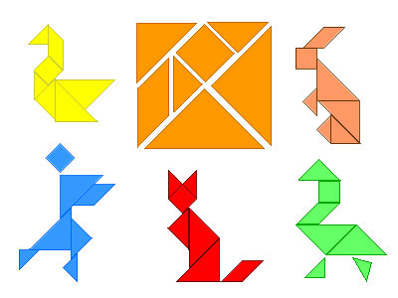
2D Transformations Lab Project
Draw an object using OpenGL primitives. Maybe something like these tangram objects.
Define the vertices as arrays (x,y).
Use primitives arguments & color
Using homogeneous coordinates
transform the object:
Translate
Stretch the object along “y” by 1.3.
Rotate counterclockwise for 45˚.
Shear along “x” by 0.2
Reflect about the y-axis

Slide 16
Homework #3
1) Using OpenGL draw a 2D geometric figure, either by using lines or polygons and implement the following transformations:
a) Draw coordinate axes in different colors.
b) translate your figure along y axis for 1,5 times the figure's y size.
c) rotate your figure clockwise for 30 degrees.
d) scale the y dimension of your figure for 0.75.
e) shear your figure along y by a factor of 1.1
Please submit figures of each transformation and only the portion of the code that created it.

