Slide 1
Overview Class 5
Go over the HW
Keyboard controls
Move Square Lab Project
Fractals
Fern Lab Project
Serpinski Lab Project
Mandelbrot Lab Project

Slide 2
OpenGL State Machine
For a given piece of geometry, many things can affect how it is drawn. The object can be blended with the background, front or back face culling, bound texture etc.
It is not practical to specify all the state variables whenever we try to draw something in OpenGL. All this collection of variables is called the state of the pipeline. When a state value is set, it remains set until some other function changes it. The function to turn state variable on or off use:
glEnable();
glDisable();

Slide 3
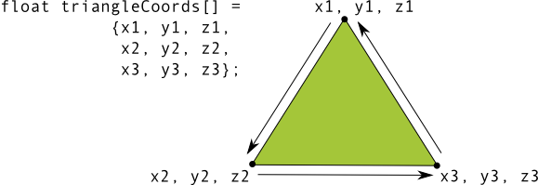
Surface Faces and Winding
Surface - defined by three or more points (in three-dimensional space).
Three or more 3D points (vertices in OpenGL) have a front face and a back face.
Which face is front and which is the back?
OpenGL default - counterclockwise is the front face
Culling - commonly used feature of OpenGL, allows the rendering pipeline to ignore (not calculate or draw) the back face of a shape, saving time, memory and processing cycles.

Slide 4

“Move Square” Lab Project
Use MoveSquare.cpp
draw a square 100x100 pixels positioned at 200,200 as wireframe or quad.
use transformation part of the code from Square.cpp
use keyboard to move (translate) and rotate the square.
Remember the homogeneous coordinates transformation
for (int i = 0; i <= 3; i++) {
Xn[i] = a*X[i]+b*Y[i]+tx; // x' = ax+by+tx Transformation
Yn[i] = c*X[i]+d*Y[i]+ty;;// y' = cx+dy+ty Transformation
}

Slide 5
Key control in OpenGL
See Move Cube.cpp code
bool* keyStates = new bool[256]; // Create an array of Boolean values of length 256 (0-255)
bool* keySpecialStates = new bool[256]; // Create an array of Boolean values of length 256 (0-255)
Set them to false
In main:
glutKeyboardFunc(keyPressed); // Tell GLUT to use the method "keyPressed" for key presses
glutKeyboardUpFunc(keyUp); // Tell GLUT to use the method "keyUp" for key up events
glutSpecialFunc(keySpecialPressed); // Same for arrow keys
glutSpecialUpFunc(keySpecialUp);
In display
keyOperations(); // Check if a key was pressed

Slide 6
Examples of
glScale, glTranslate, glRotate
How they are implemented in OpenGL
See code MoveSquare.cpp
Instead of the transformation matrix try:
glLoadIdentity();
glTranslatef(xLocation, yLocation, 0.0f);
glRotatef(yRotationAngle, 0.0f, 0.0f, 1.0f); // Rotate your object around the z axis
HW Make the square rotate around its middle.

Slide 7
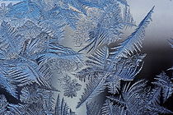
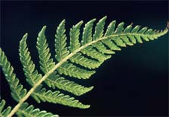
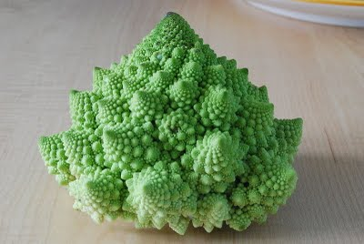
Fractals & Self Similarity
Self similarity properties are so common in nature.
Examples can be found in crystals, plants, neurons, blood vessels etc.
Romanesco broccoli.

Slide 8
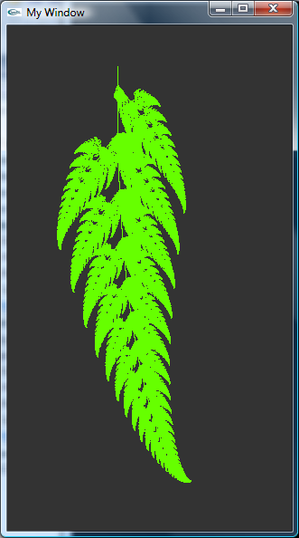
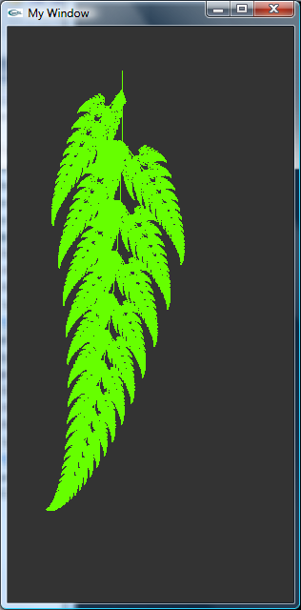

Barnsley Fern Fractal in OpenGL
Barnsley's fern uses four affine transformations. The formula is iterated and for one transformation is the following:
P-represents the probability
of which function to take.
Implement this in OpenGL
Invert the image?
w | a | b | c | d | e | f | p
ƒ₁ | 0 | 0 | 0 | 0.16 | 0 | 0 | 0.01
ƒ₂ | 0.85 | 0.04 | −0.04 | 0.85 | 0 | 1.6 | 0.85
ƒ₃ | 0.2 | −0.26 | 0.23 | 0.22 | 0 | 1.6 | 0.07
ƒ₄ | −0.15 | 0.28 | 0.26 | 0.24 | 0 | 0.44 | 0.07

Slide 9
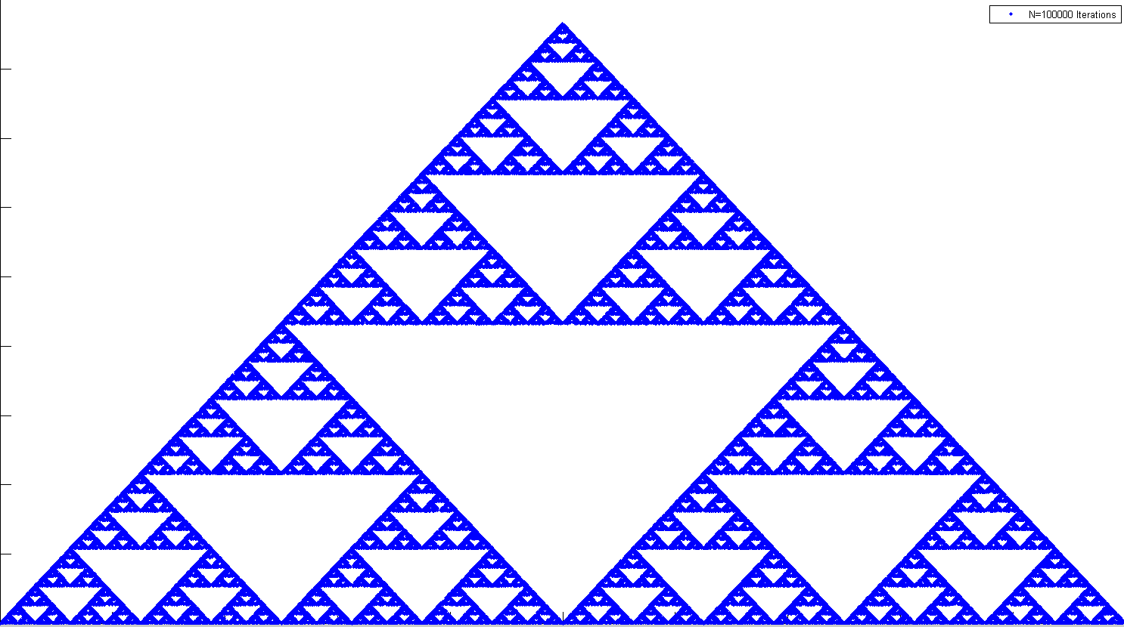
Sierpinski’s triangle
Sierpinski’s triangle can be implemented by plotting points iteratively according to one of the following three rules which are selected randomly with equal probability.
Rule 1: x=0.5*x; y=0.5*y
Rule 2: x=0.5*x+.25; y=0.5*y+ sqrt(3)/4
Rule 3: x=0.5x+.5; y=.5*y
Write a code that calculates x and y and then plots y versus x as individual points.
Start with x1=0 and y1=0 and number of iterations n=100. Increase n until you reach satisfactory resolution.

Slide 10
Sierpinski’s Lab Project in OpenGL
Modify the sampler code to create a plot of the Sierpinski’s triangle.

Slide 11
The Julia Set Fractal
The Julia set is named after the French mathematician Gaston Julia who investigated their properties circa 1915
The Julia set is now associated with those points z = x + iy on the complex plane for which the series z_{n+1} = z_{n}² + c does not tend to infinity.
http://www.youtube.com/watch?v=gruJ0S3TTtI

Slide 12
Homework #4
1) Make the square from Move Square Lab Project rotate around its middle.
2) Implement the Fern algorithm in OpenGL.
3) Modify the sampler OpenGL code to create a plot of the Sierpinski’s triangle. Use the rules given on slide 9 in this presentation.
4) Generate the Sierpinski’s triangle in OpenGL by connecting (plotting) only the odd numbers in Pascal's triangle.

