Slide 1
Overview Class 7
Go over the Midterm
Final projects ideas
Mandelbrot color mapping HW
3D details
Cube Lab Project

Slide 2
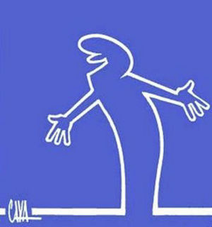
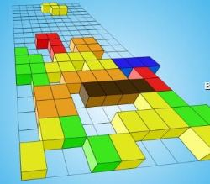
Inspiring ideas
Have to be simple, doable and effective.
http://www.google.com/imgres?imgurl=http://www.bigfuntown.com/Games/747.jpg&imgrefurl=http://www.bigfuntown.com/Game-747.html&h=219&w=250&sz=12&tbnid=ZrTbWidf8_9oTM:&tbnh=90&tbnw=103&prev=/search%3Fq%3D3d%2Btetris%26tbm%3Disch%26tbo%3Du&zoom=1&q=3d+tetris&usg=__QWwC6jlSDZCnY6qnN4Yq-L5WTlY=&docid=j96bd_6Mof5K2M&hl=en&sa=X&ei=U-qbUJCEGrSo0AGPw4HIDA&sqi=2&ved=0CE0Q9QEwBg&dur=1338
http://en.wikipedia.org/wiki/La_Linea_(TV_series)
http://www.youtube.com/watch?v=GavNK48xya4&feature=related
Adding Sound on Windows machines: Add #include <Windows.h> headed file
When key pressed call function
PlaySound(TEXT("C:\\...\\fn.wav"), NULL, SND_FILENAME | SND_ASYNC);

Slide 3
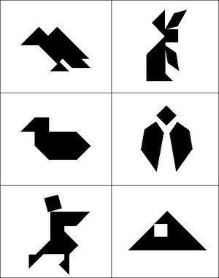
Final project ideas
Final projects
Two cathegories:
Comp graphics
Tangram like games
Polynominoes tiling game (like Tetris)
Cellular automatons 2D & 3D
Flying over 3D Fractal Terrain
Other 3D ideas
Image processing
Neuronal tracing tool
Tracking objects in video stream
Other Image processing projects

Slide 4
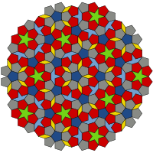
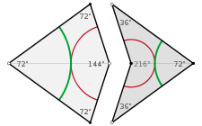
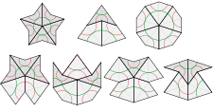
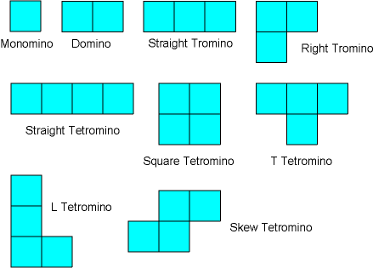
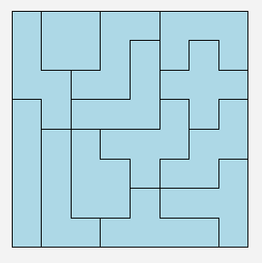
Tiling
Penrose tiling http://en.wikipedia.org/wiki/Penrose_tiling
Randomly generate several types of Polyominoes shapes (2D or 3D)
Enable user to translate and rotate them in order to tile (cover) a randomly generated rectangle – not always possible to do.

Slide 5
Cellular automatons
Create a 2D or a 3D lattice space where the Cellular automaton evolves.
Introduce rules between neighboring cells which will evolve the automaton in time.
Initialize the grid with seed Cellular automata.
Iterate the system.

Slide 6
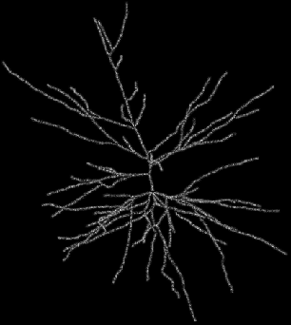
Neuronal Morphology
Total Length
Number of branches
Average branch length
Tortuosity per branch
1.10
manual
trace
1.08
1.06
optimal
trace
tortuosity
1.04
L
L
1.02
T =
R
R
1.00
0
20
40
60
80
100
120
140
segment length, [µm]

Slide 7
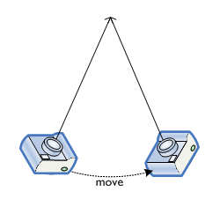
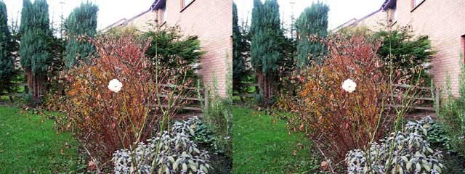
Final project ideas
Other final project ideas:
Tracing tool+morphology(length, tortuosity, etc.)
Stereo images (of neurons)
Image processing, tracking

Slide 8
Stereo views

Slide 9
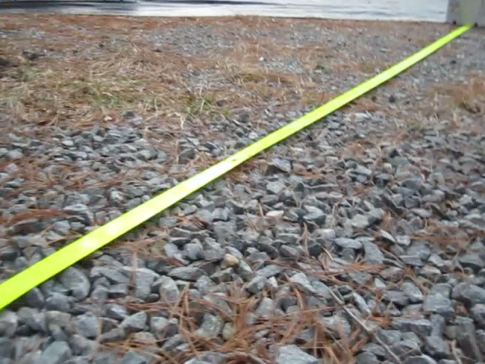
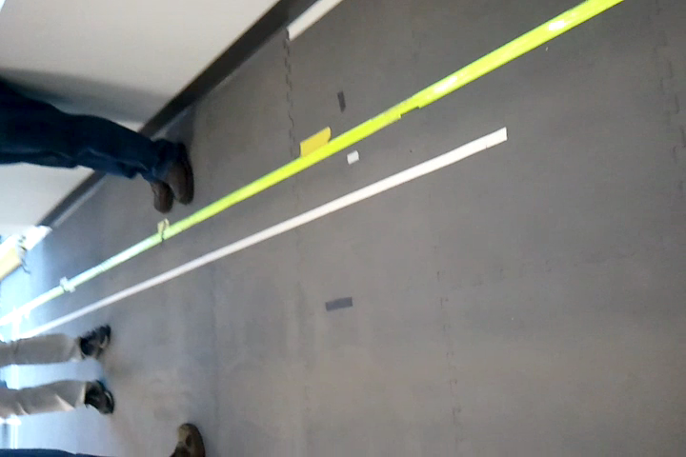
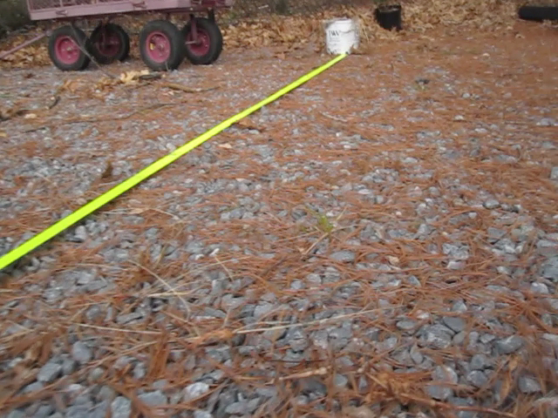
Image processing, tracking
Implement several image processing techniques to analyze and find features in a stream of images

Slide 10
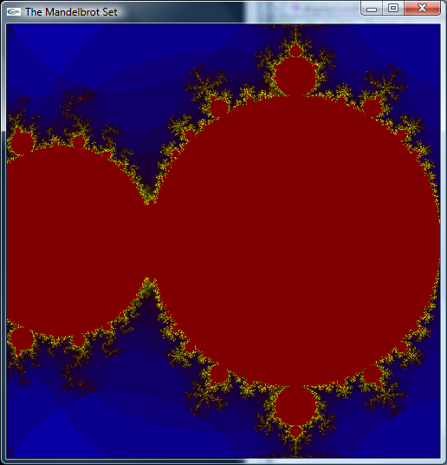
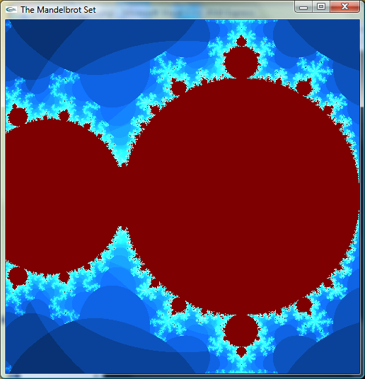
Mandelbrot color mapping
Different algorithms to convert grayscale to RGB. Here we map 0<k<100 into RGB.
Problem the change of k at different scales is not linear.

Slide 11
Mandelbrot color mapping
// Colormapping of k to RGB
float kr, kg, kb;
if (k==100) {
kr=0.5; kg=0; kb=0; // The inside of the set
}
else {
kr=(float)k/depth; // linear (depth=100 –iteration depth)
kg=log10(0.65*kr*10.0); // increasing
kb=exp(-0.15*k); // decreasing
}
glColor3f(kr, kg, kb); // Pixel Color
glVertex2f(x, y); // Plot pixel

Slide 12
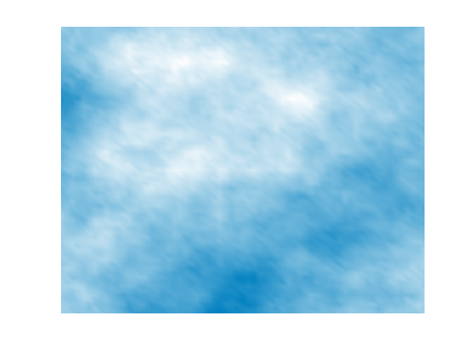
Algorithms for generating 3D Fractal Terrain
Parts of fractal objects look like, but never exactly like parts at different scales. This is used in the algorithms for generating 3D terrains, clouds, etc.
The fractal subdivision algorithm for generating mountains contains the following elements:
The principle of the subdivision method is to recursively subdivide (split) polygons of a model up to a required level of detail.
The higher the level the smaller the perturbation, otherwise the mountains would get higher and higher.
There must be a random number generator to obtain irregularities within the shape.

Slide 13
3D Fractal Terrain
The subdivision method is to recursively subdivide (split) polygons of a model up to a required level of detail. At the same time the parts of the split polygons will be perturbed. The initial shape of the model is retained to an extent, depending on the perturbations.
Concerning mountains, the higher the level the smaller the perturbation, otherwise the mountains would get higher and higher. In addition there must be a random number generator to obtain irregularities within the shape - and to achieve a kind of statistical similarity:

Slide 14
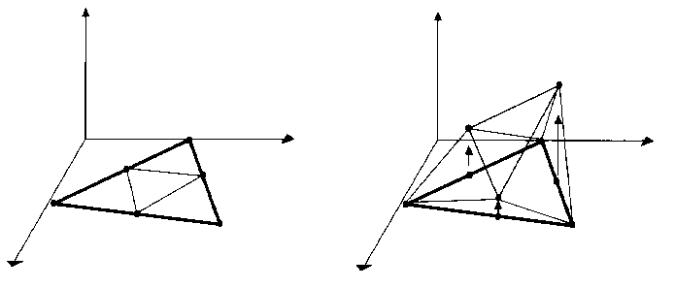
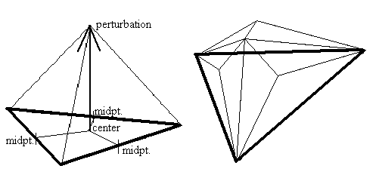
Algorithms for generating 3D Fractal Terrain
The polygon subdivision can be along the sides or in the middle of the polygons.
Here the midpoints of each side of the triangle are connected, creating four new sub-triangles.

Slide 15
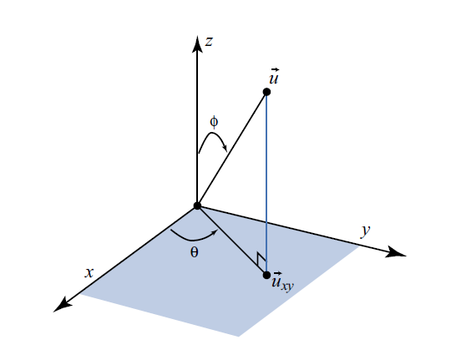
Spherical Coordinates
Note that you can define 2 types of spherical coordinate systems, left and right.

Slide 16
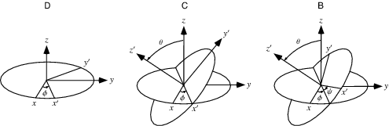
Illustration of Euler angles
Euler angles are a means of representing the spatial orientation of any coordinate system as a composition of rotations from another coordinate system.
In the example below, the first rotation (φ) is around z-axis, creating new coordinates (x’ y’ z’). The second rotation (θ) is around x’ axis. And the third rotation (ψ) is around z’ axis.

Slide 17
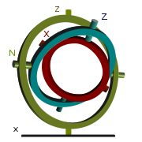
Gimbal lock
Gimbal (as in gyroscopes) with 3 axes of rotation.
A set of three gimbals mounted together to allow three degrees of freedom: roll, pitch and yaw. When two gimbals rotate around the same axis, the system loses one degree of freedom (gimbal lock).
To solve the problem of gimbal lock the outermost ring has to be actively driven so that it stays 90 degrees out of alignment with the innermost axis.

Slide 18




3D Affine Transformations
Used for coordinate transforms, shape modeling, animation, camera modeling, etc.
Similar to 2D.
Translation
Scaling
3D rotations are much more complex than 2D rotations, so we will consider only elementary rotations about the x, y, and z axes given by the rotation matrices below.

Slide 19
3D Graphics Techniques and Terminology in a nut shell
Transformations and Projections
Moving the points around, and drawing lines between them we can produce the illusion of a 3D world on a flat 2D screen. The points (vertices) are moved around by a transformation matrix. Another matrix, a projection matrix takes care of the mathematics necessary to turn our 3D coordinates into two-dimensional screen coordinates, where the final line drawing actually takes place.
Rasterization & Wireframe rendering
Filling in of the pixels between each vertex, including hidden surface removal.
Most of the time we render not with lines, but with solid triangles or polygons.
Shading
Varying the color values across the surface.
Texture Mapping
Picture that we map to the surface of a triangle or polygon.
Blending
Mixing up different colors together, including creation of reflection effects.

Slide 20
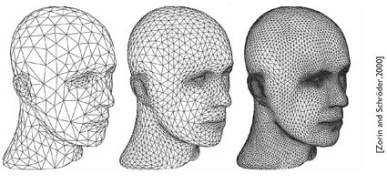
Polygons in OpenGL
The use of polygonal mesh is the most common method for modeling 3D geometry.
Most of the time, triangles are used for simplicity and generality.
Each polygon or triangle can be described by the 3D coordinates of its list of vertices.
The object is approximated by a flat polygon (triangle), but techniques called smoothing or interpolation can be applied.
Another approach is to have a finer mesh - tessellation.

Slide 21
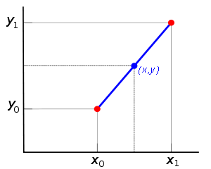


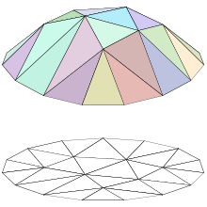
Linear Interpolation (averaging)
Given two points (xo,yo) and (x1,y1), the linear interpolation between these two points is the straight line between them.
We need only one point so chose (x,y).
Since it is the same line, the following slopes must be equal:
Given x, solving for y gives:
Think of the linear interpolation as averaging.
Linear interpolation can be applied to triangular mesh for example

Slide 22
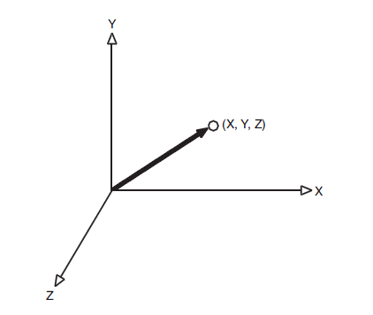
3D Transformations OpenGL
A 3D point considered as a vector is represented by (x,y,z), having a direction and a magnitude (length).
Normalizing a vector scales it such that its length is one.
The two data types that can represent a 3 or 4 vector: Vector3f can represent a three-component vector (X, Y, Z), and Vector4f can represent a four component vector (X, Y, Z, W).
Matrix multiplication to do the transformation
Applying a Modelview Matrix

Slide 23
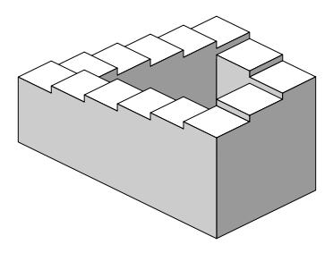
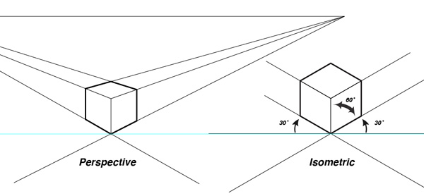
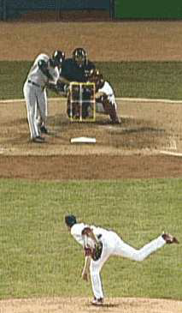
Projections
We have to represent a three-dimensional object in two dimensions
Orthographic (Parallel) Projections - all objects same size
Perspective projections - objects shrink in distance
Intensity cueing
Hidden line removal
Hidden surface removal
Stereo views
For objects sufficiently
far away, rays are nearly parallel, and variation is insignificant. So both players are of same size.

Slide 24
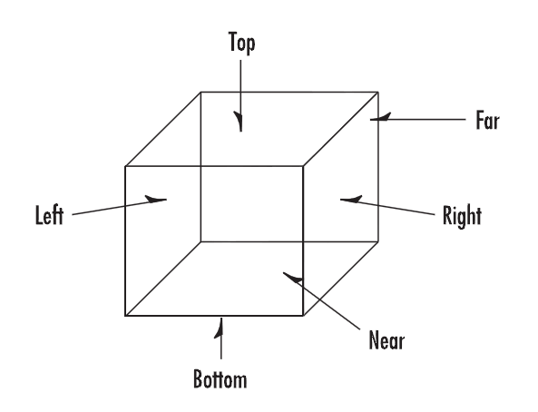
Orthographic Projections
Orthographic, or parallel, projection is specified by a square or rectangular viewing volume. All objects that have the same dimensions appear the same size, regardless of whether they are far away or nearby. It is most often used in architectural design, computer-aided design (CAD), or 2D graphs. Frequently, you can also use an orthographic projection to add text or 2D overlays on top of your 3D graphic scenes.
You specify the viewing volume in an orthographic projection by specifying the far, near, left, right, top, and bottom clipping planes. Objects and figures that you place within this viewing volume are then projected (taking into account their orientation) to a 2D image that appears on your screen.

Slide 25
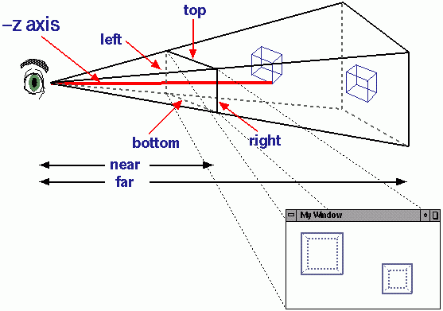
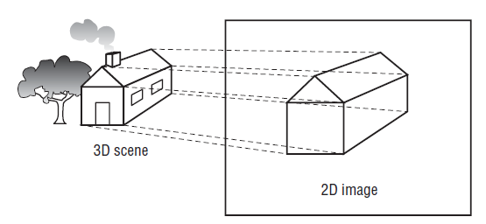
Perspective Projections
Adds the effect that distant objects appear smaller than nearby objects. Objects nearer to the front of the viewing volume appear close to their
Original size, but objects near the back of the volume shrink as they are projected to the front of the volume. This type of projection gives the most realism for simulation and 3D animation.
The geometric (pyramid like) shape is called frustum. Multiplies the current matrix by a perspective matrix.
The viewing volume is also specified by left, right, bottom, top, near, far clipping planes.

Slide 26
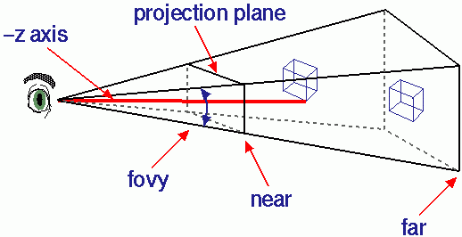
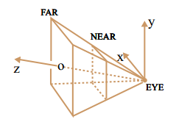
Setting up perspective in OpenGL
In reshape() the perspective is set up.
glOrtho(left, right, bottom, top, nearVal, farVal) multiply the current matrix with an orthographic matrix
6 values needed (5 in terms of view angle)
gluPerspective specifies a viewing frustum into the world coordinate system.
gluPerspective(view angle , width/height, Near, Far);
First argument sets the field of view angle in degrees (Left/Right).
Second argument sets the aspect ratio of our window (Top/Bottom).
Last two arguments set up the Near and far Planes.

Slide 27
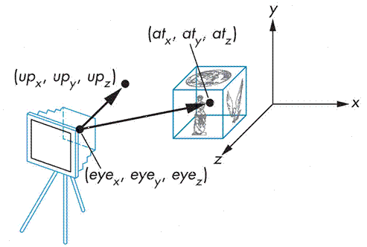
Viewing transformation
gluLookAt — define a viewing transformation
gluLookAt(eyeX, eyeY, eyeZ, atX, atY, atZ, upX, upY, upZ)

Slide 28
Cube Lab Project
Use 3D.cpp to
In display draw a cube of size 2 using
glutWireCube(2.0f); // for cube primitive
Where is the center of the cube located (x,y,z)?
In reshape use frustum
glFrustum (-2.0, 2.0, -2.0, 2.0, 1.5, 20.0); // (left, right, bottom, top, near, far)
gluPerspective(80, (GLfloat)width / (GLfloat)height, 0.0, -3.0); // (view angle , width/height, Near, Far)
What do you see?
In display add
glTranslatef(0.0f, 0.0f, -2.5f);
Can you see the square?
What happens when you change glFrustum (-1.0, 1.0, -1.0, 2.0, 1.5, 20.0);
gluLookAt — define a viewing transformation

Slide 29
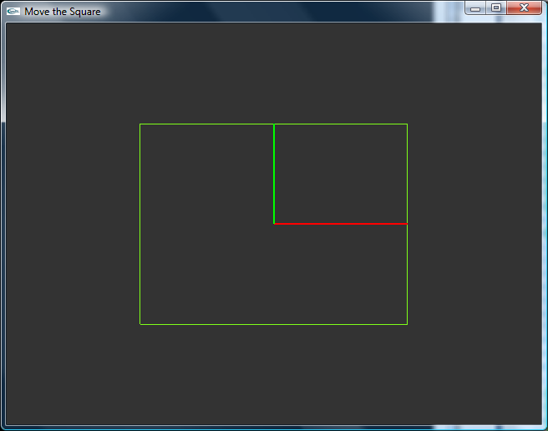
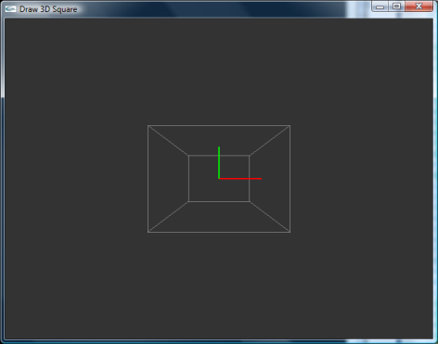
Cube Lab Project
Use 3D.cpp to
Keep glOrtho (keeps lines parallel)
In display draw a cube of size 2 using
glutWireCube(2.0f); // for cube primitive
Where is the center of the cube located (x,y,z)?
In reshape intead of glOrtho use frustum
glFrustum (-2.0, 2.0, -2.0, 2.0, 2.0, 3.0); // (left, right, bottom, top, near, far)
What do you see?
In display add
glTranslatef(0.0f, 0.0f, -2.5f);
Can you see the square?
What happens when you change glFrustum (-1.0, 1.0, -1.0, 2.0, 1.5, 20.0);
What happens if you vary
glTranslatef(0.0f, 0.0f, -2.5f); to glTranslatef(0.0f, 0.0f, -0.5f);

Slide 30
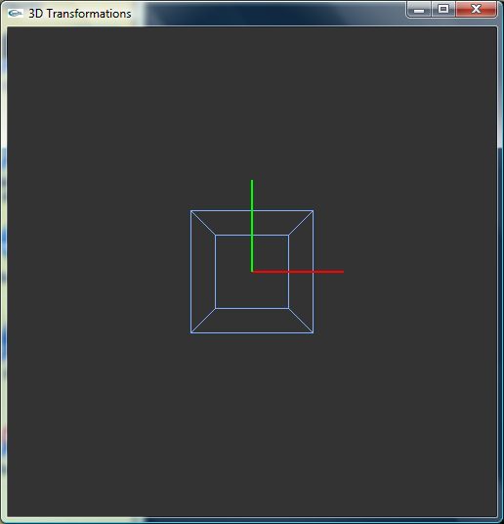
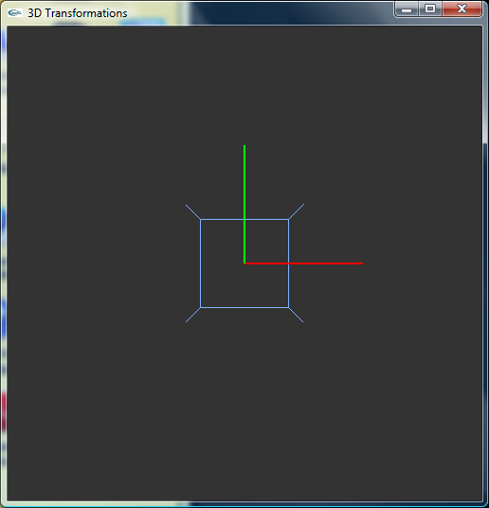
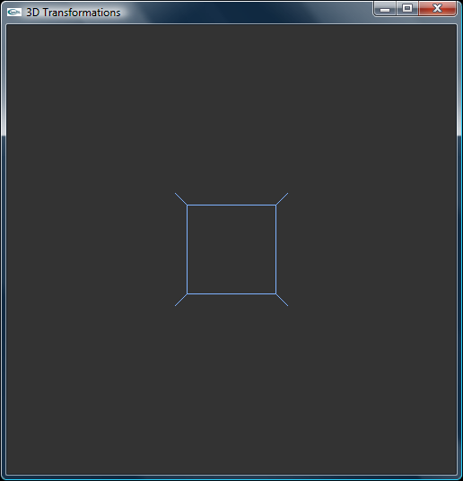
Using OpenGL transformations
Unite cube, with a center located at origin.
glFrustum (-2.0, 2.0, -2.0, 2.0, 1.5, 20.0);, Camera is set at (0,0,2)
What happens if you do glTranslatef(0.0, 0.0, 0.6);?

Slide 31
Homogeneous Coordinates
Perspective projection is not affine transformation.
Object appears to get smaller as it moves farther away from the viewer, a property that no affine transformation can express.
We can still represent a perspective projection as a 4-by-4 matrix where the fourth coordinate can be anything.
OpenGL does it internally, representing three-dimensional points and vectors using homogeneous coordinates, and it represents all transformations as 4-by-4 matrices.

