Slide 1
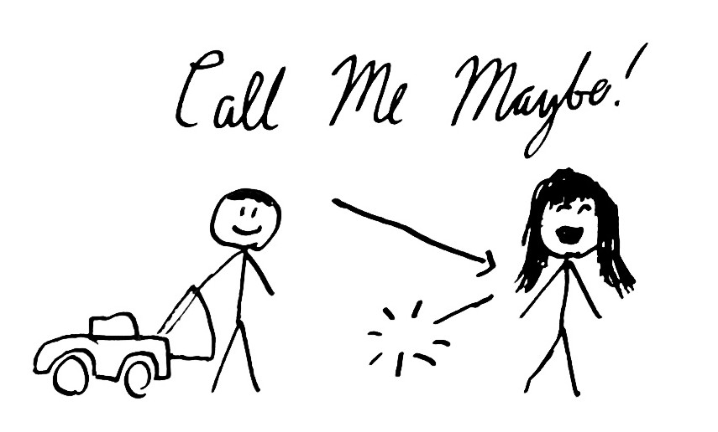

Slide 2
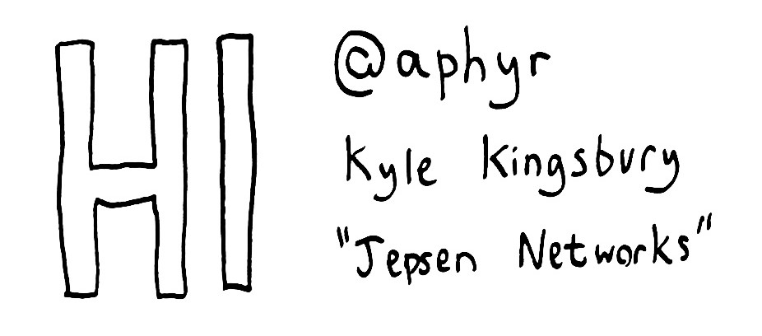

Slide 3
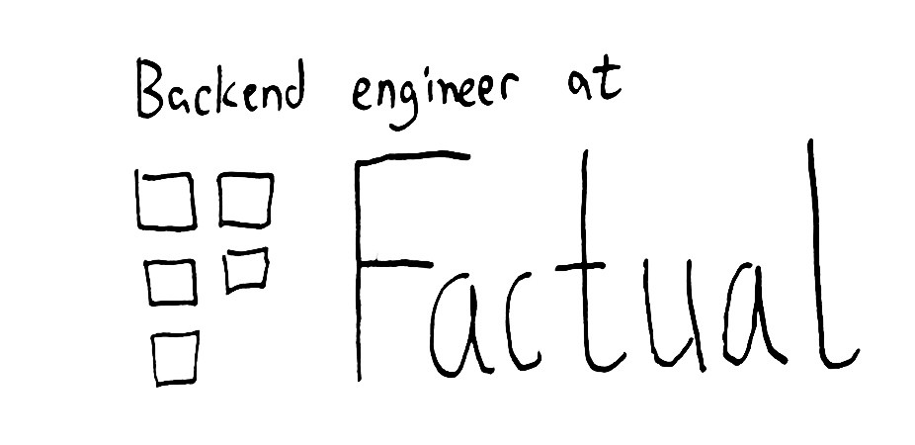

Slide 4
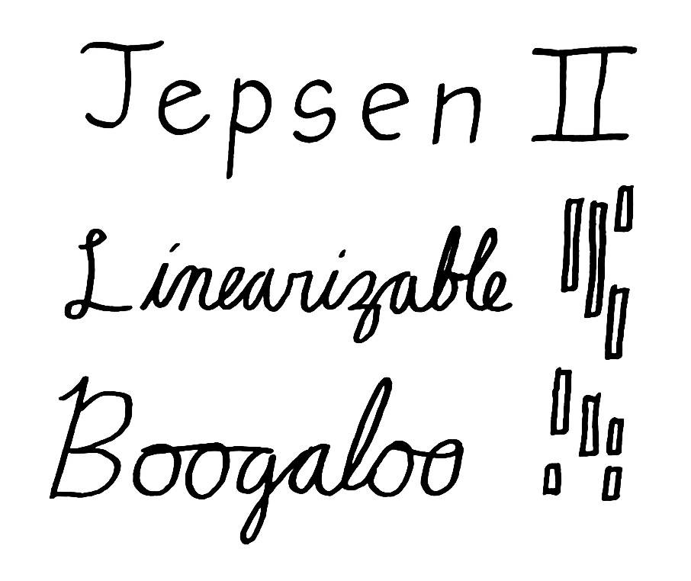

Slide 5
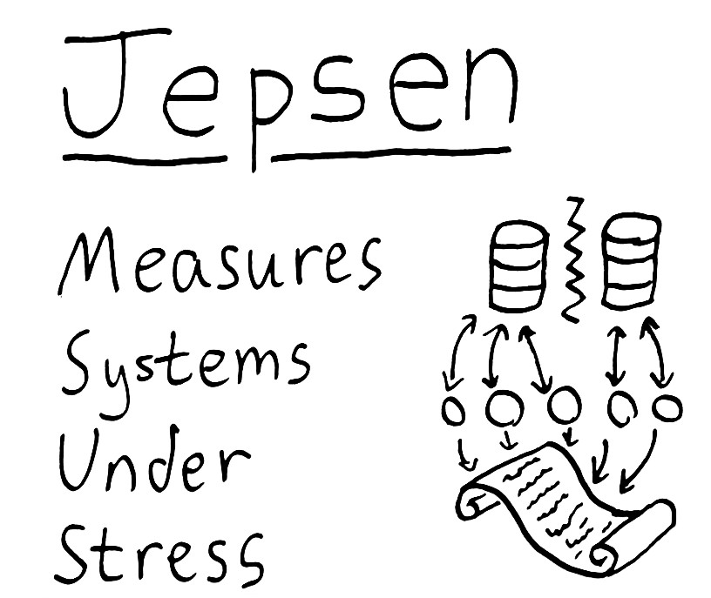

Slide 6


Slide 7
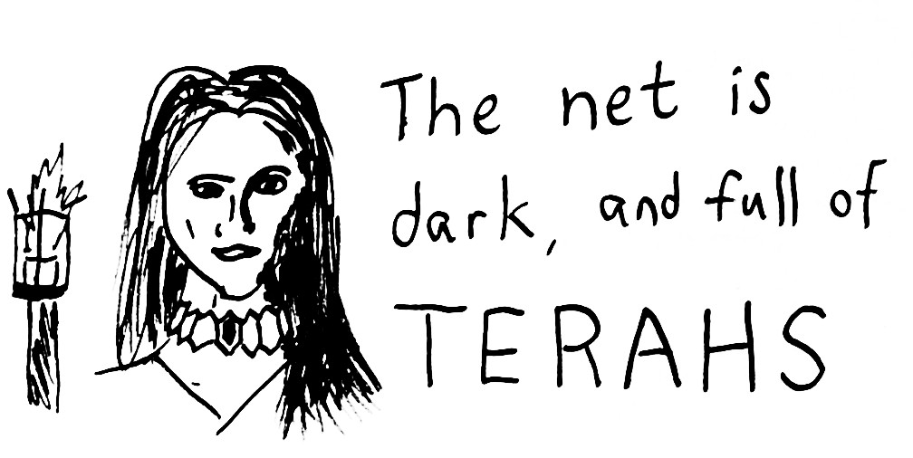

Slide 8
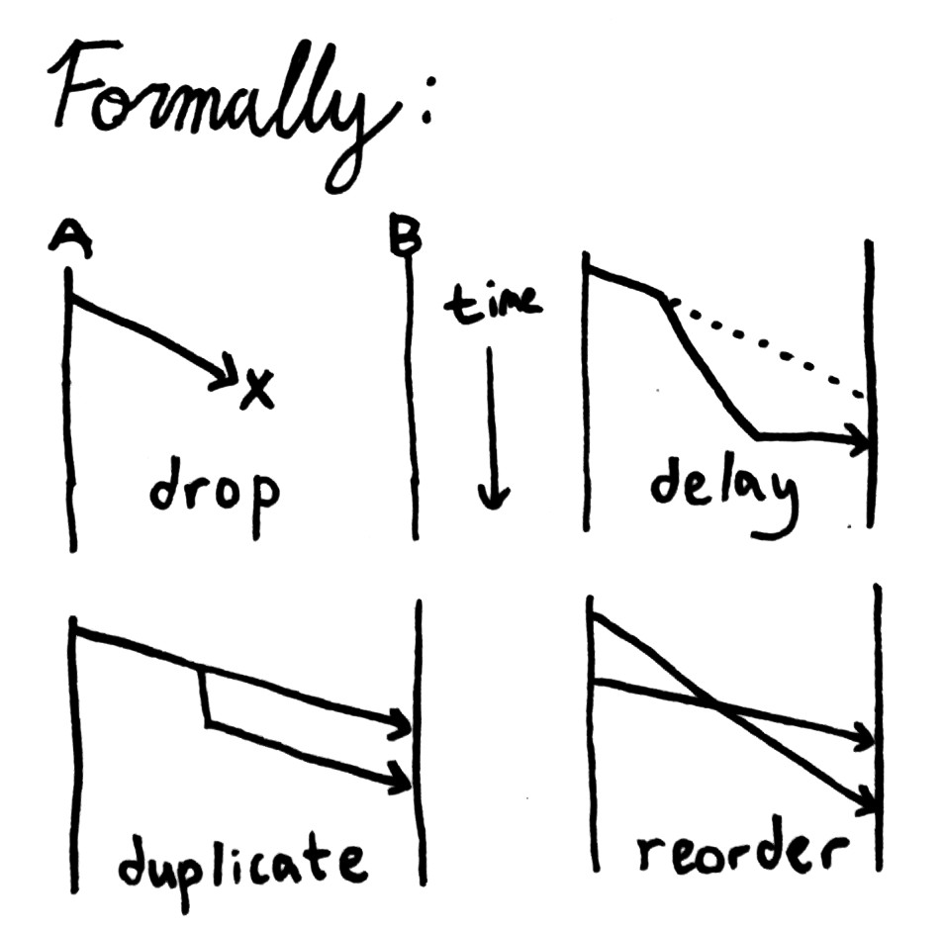

Slide 9
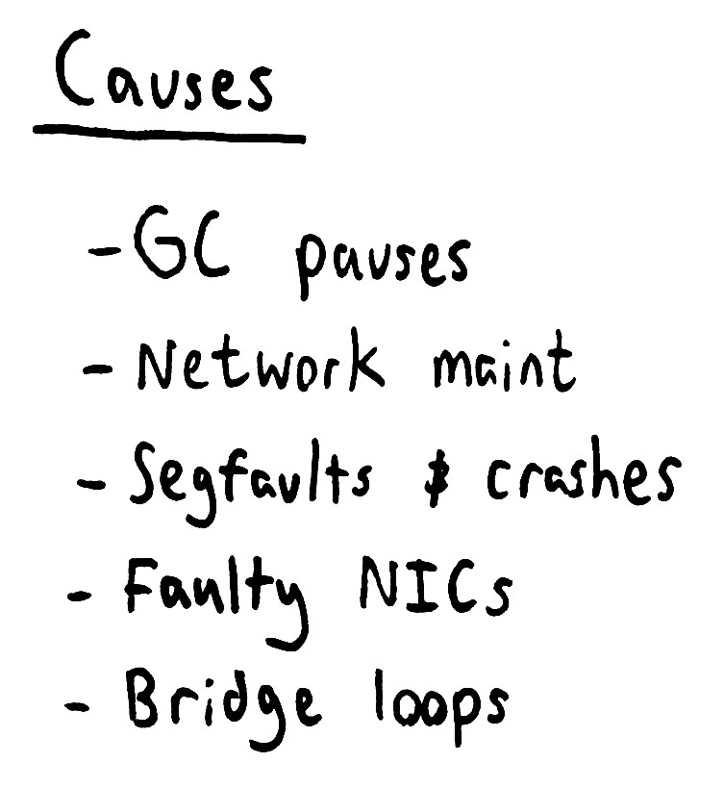

Slide 10
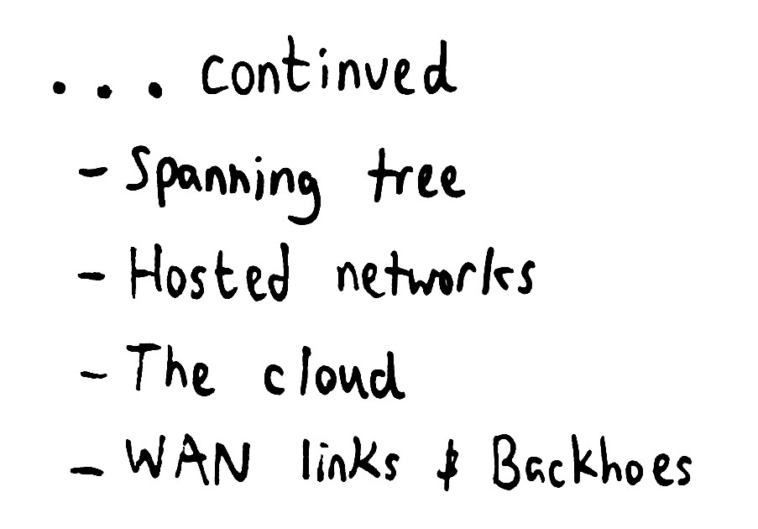

Slide 11


Slide 12
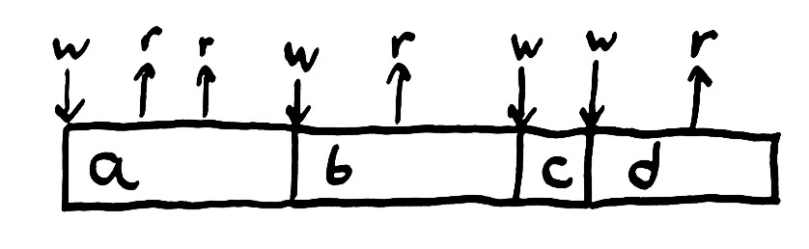

Slide 13
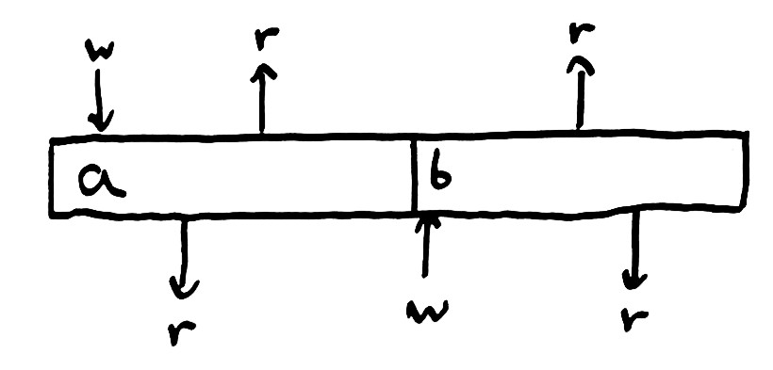

Slide 14
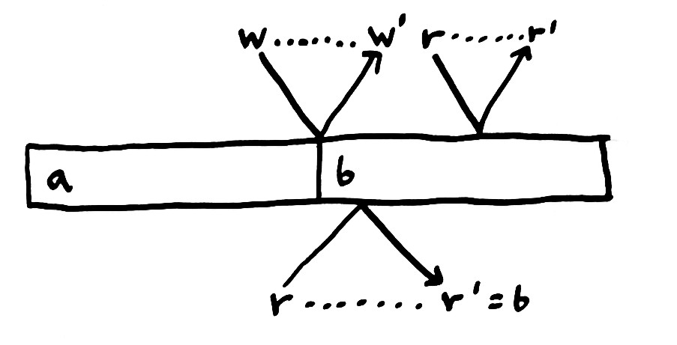

Slide 15
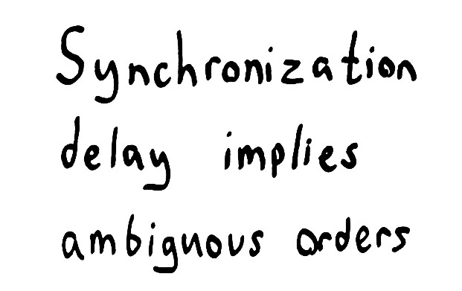

Slide 16
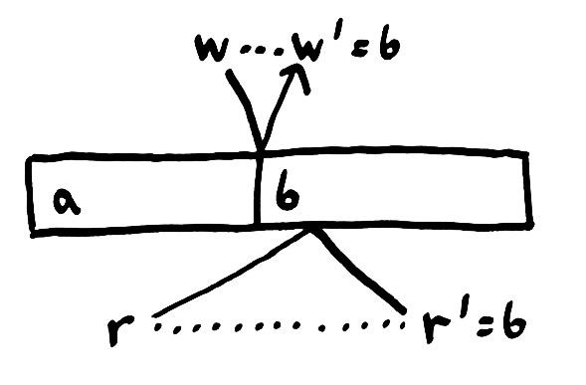

Slide 17
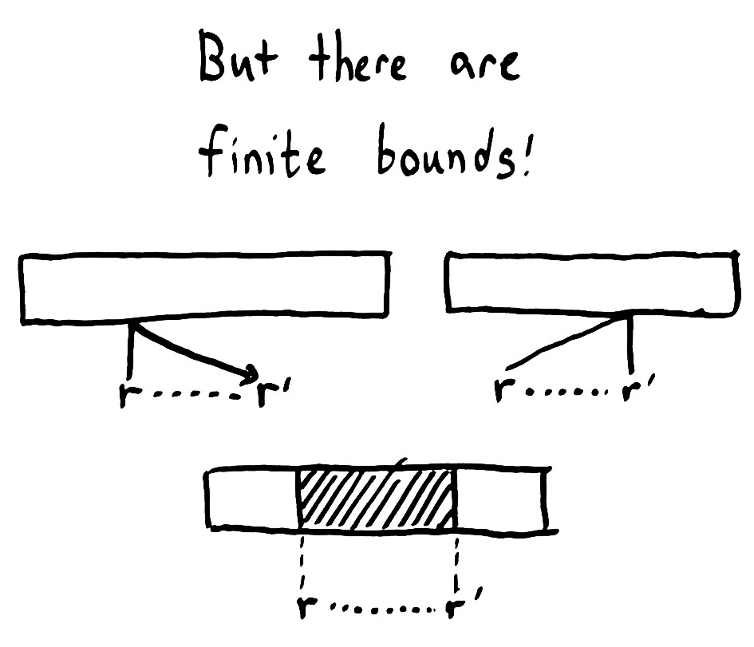

Slide 18
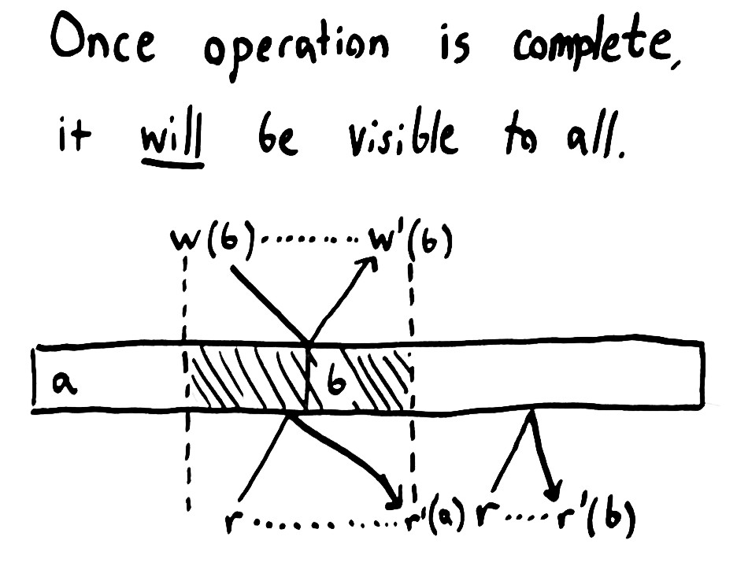

Slide 19
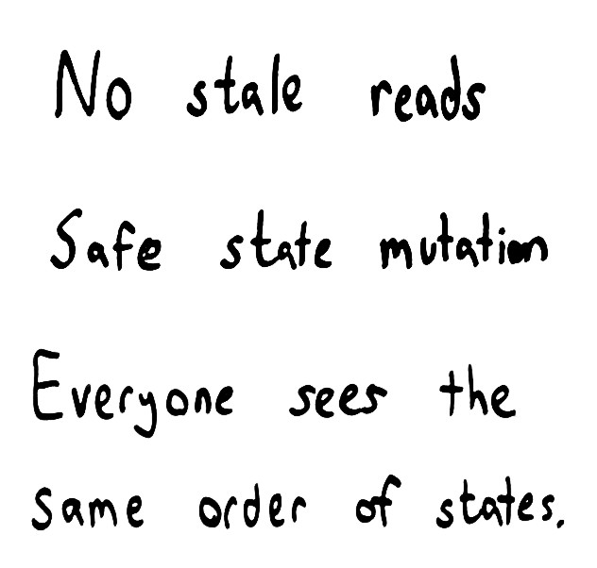

Slide 20
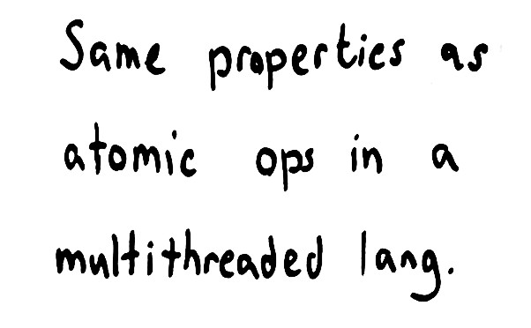

Slide 21
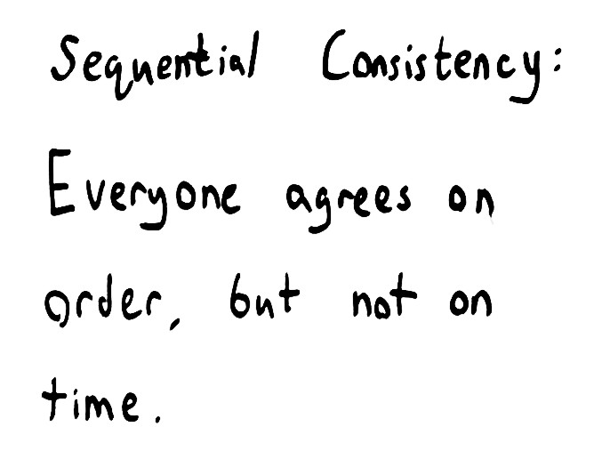

Slide 22
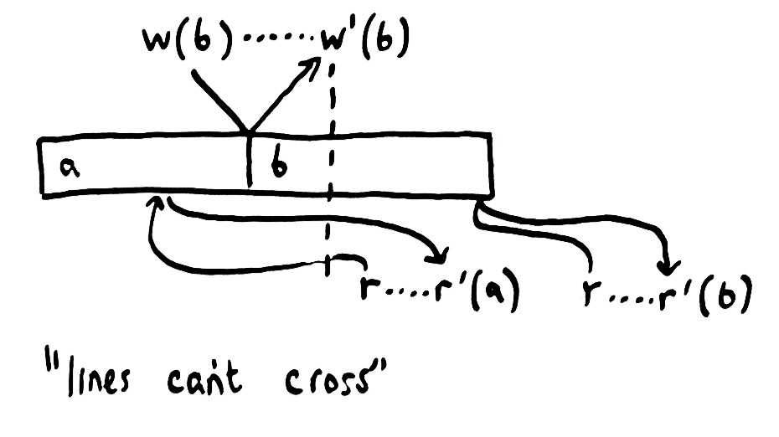

Slide 23
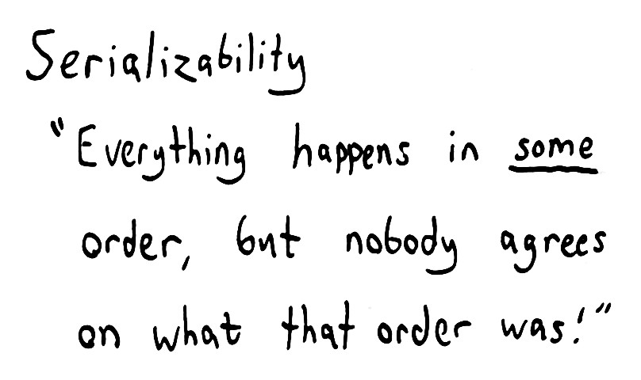

Slide 24
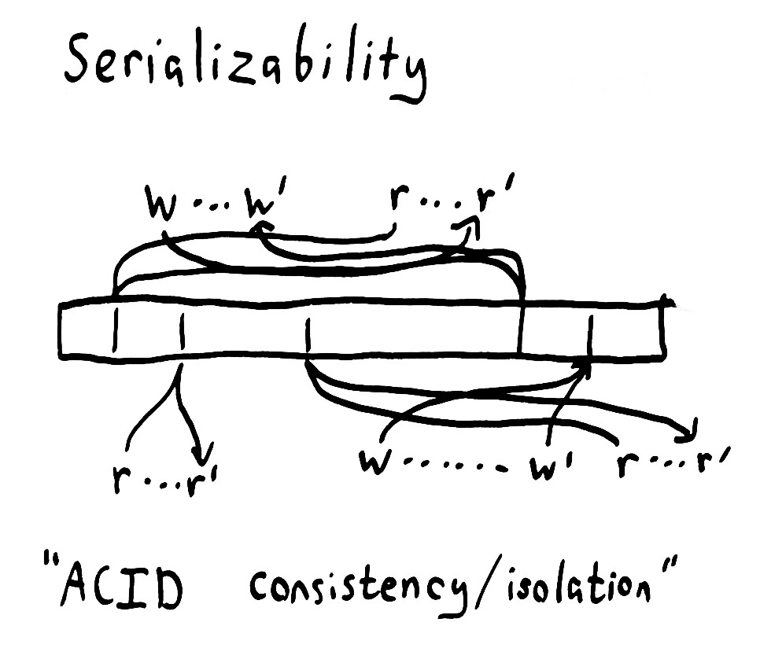

Slide 25


Slide 26
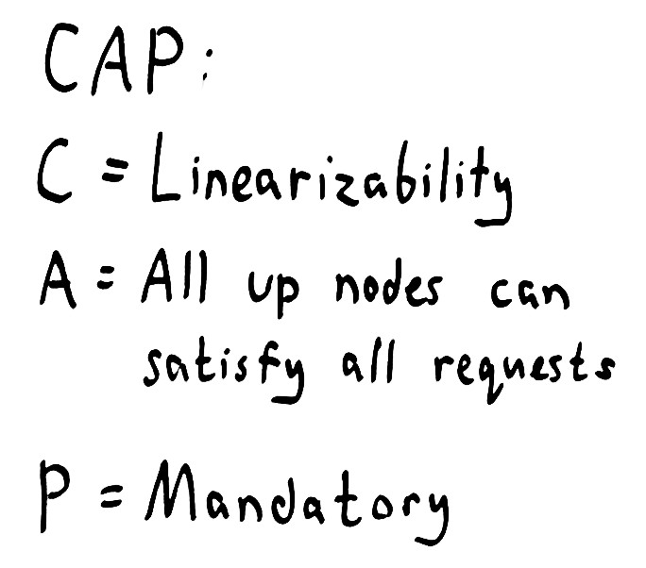

Slide 27
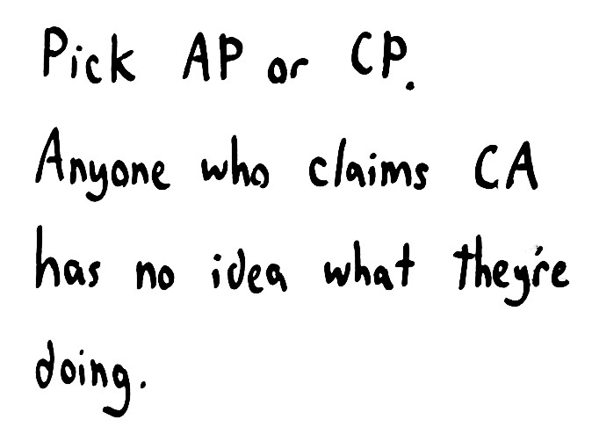

Slide 28
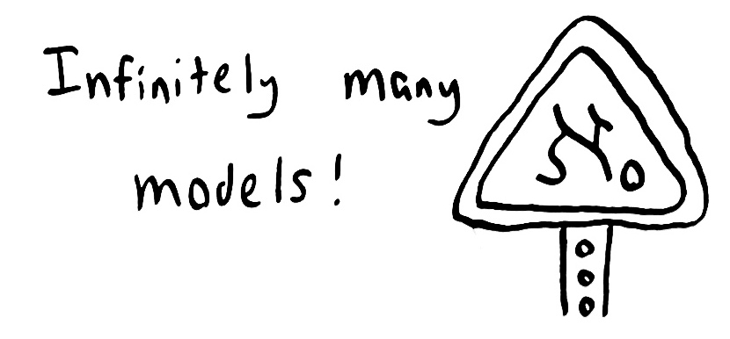

Slide 29
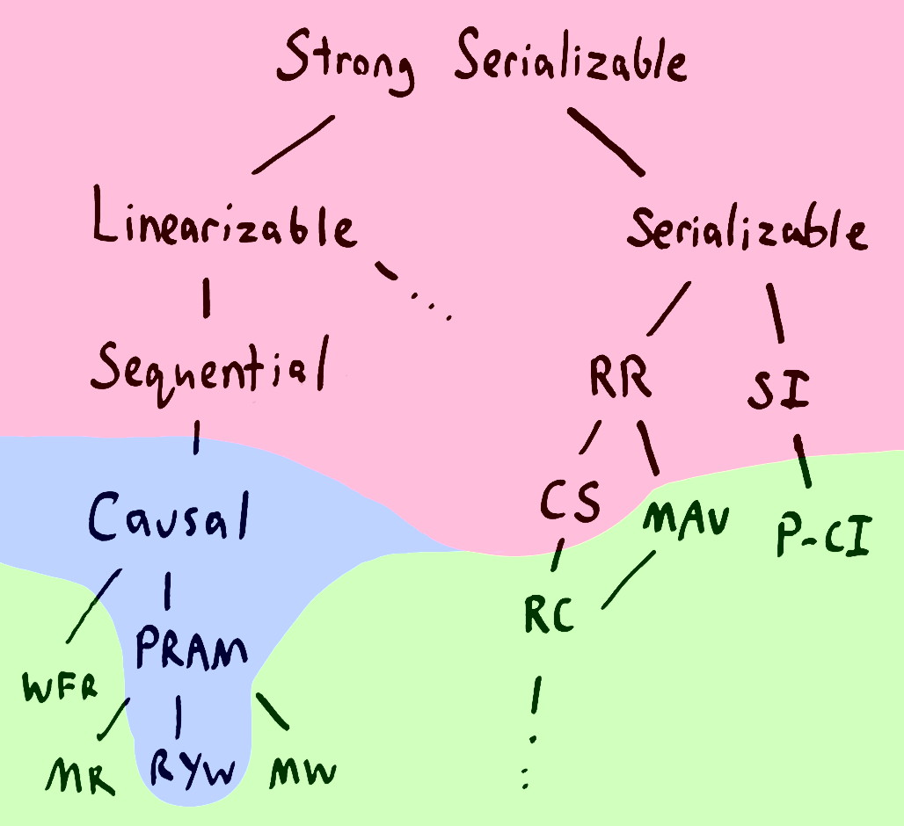

Slide 30
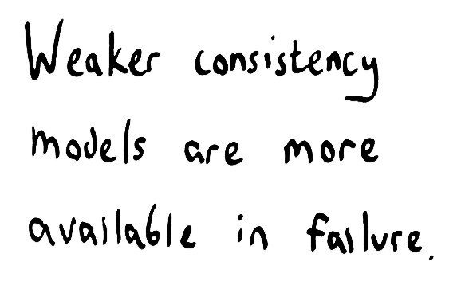

Slide 31
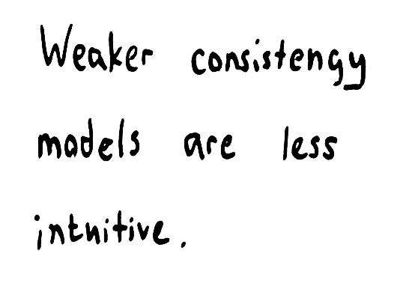

Slide 32
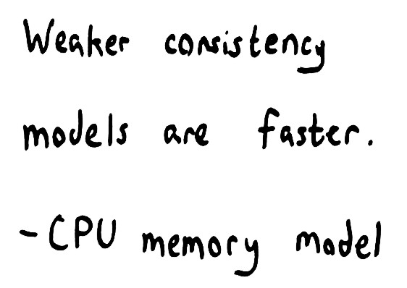

Slide 33
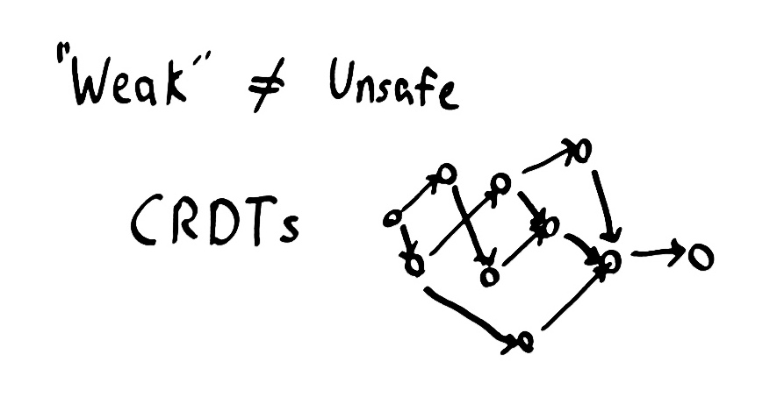

Slide 34
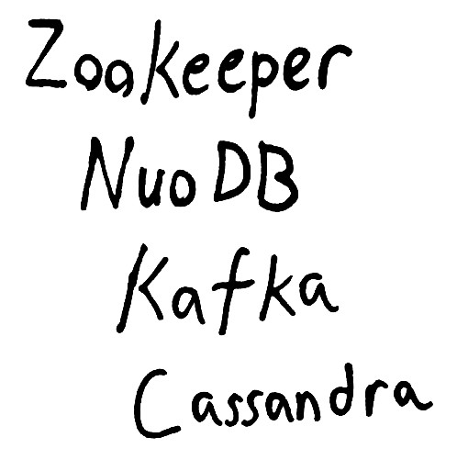

Slide 35
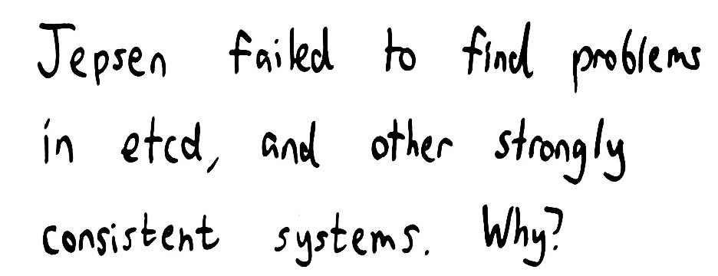

Slide 36
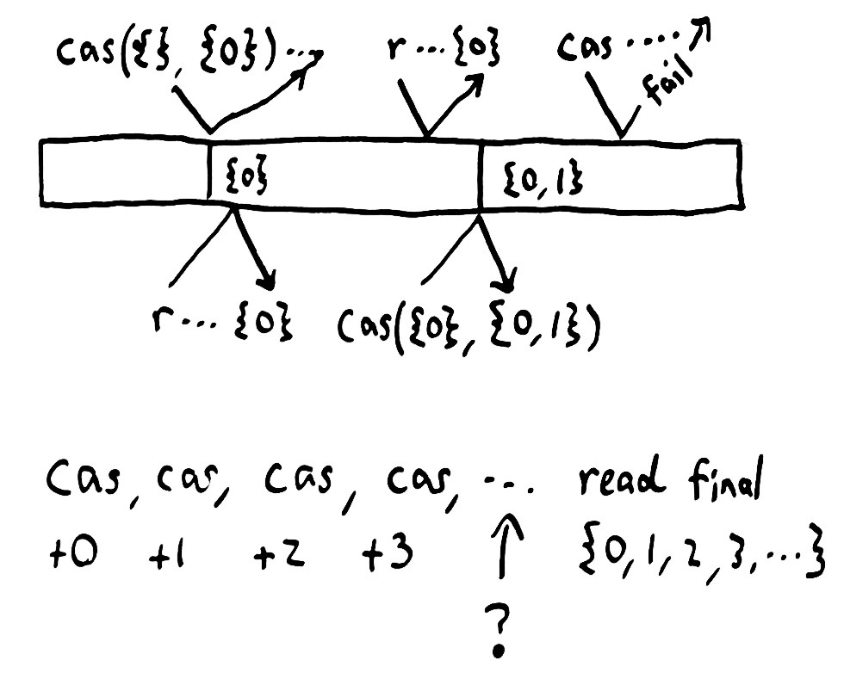

Slide 37
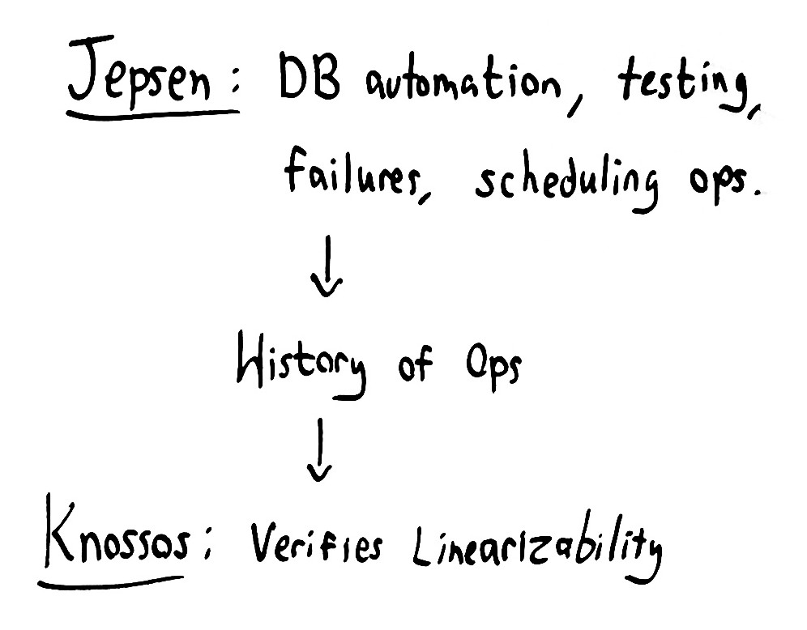

Slide 38
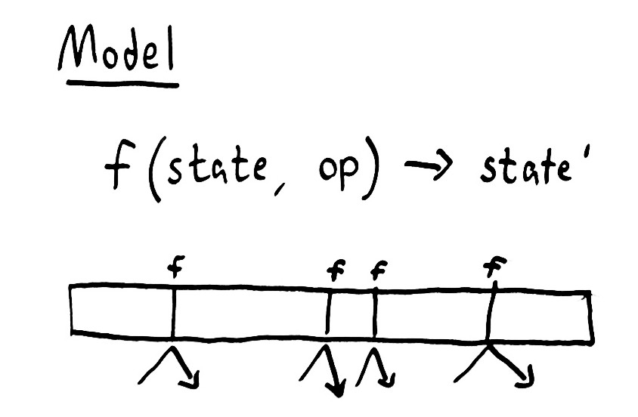

Slide 39
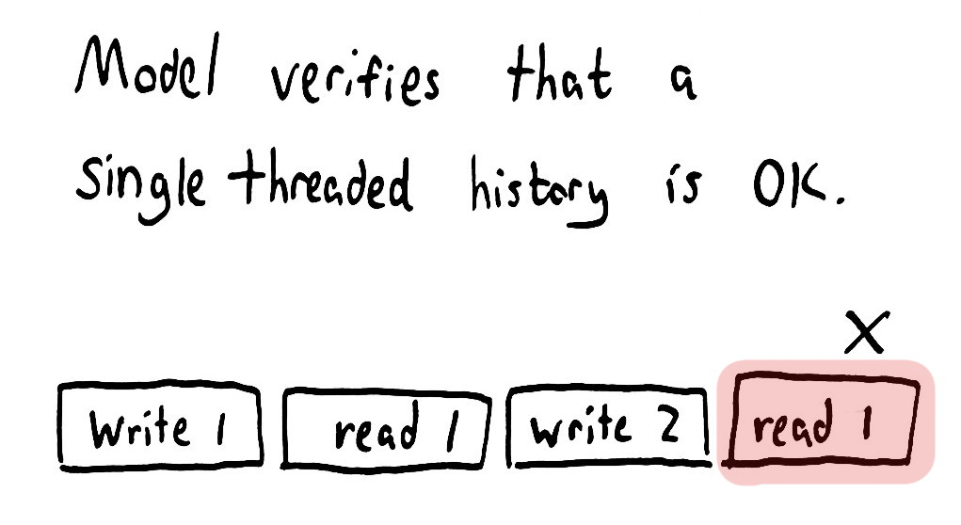

Slide 40


Slide 41
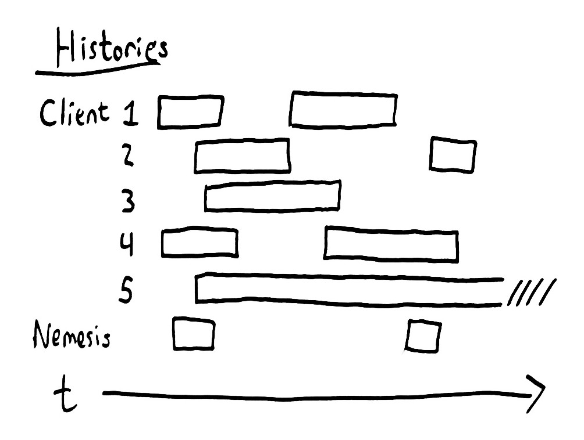

Slide 42
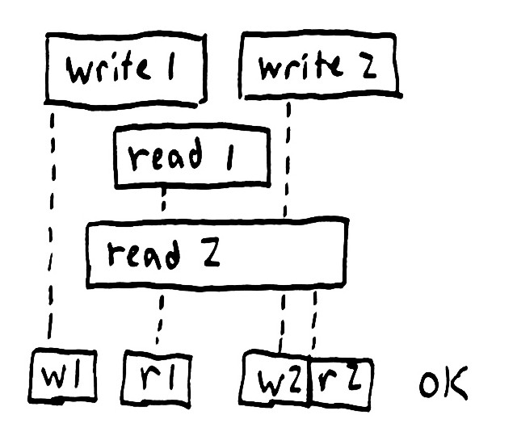
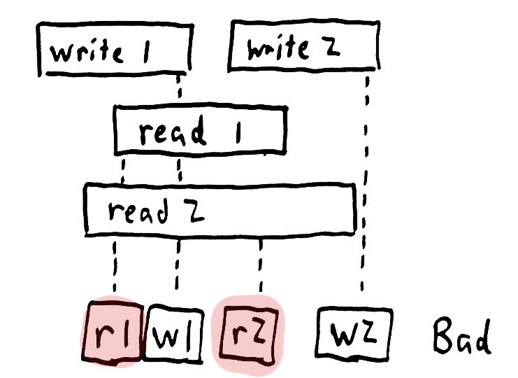

Slide 43
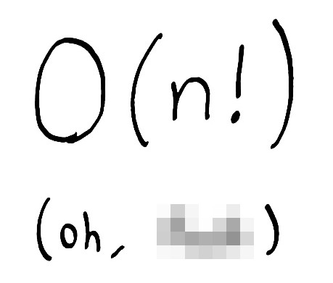

Slide 44
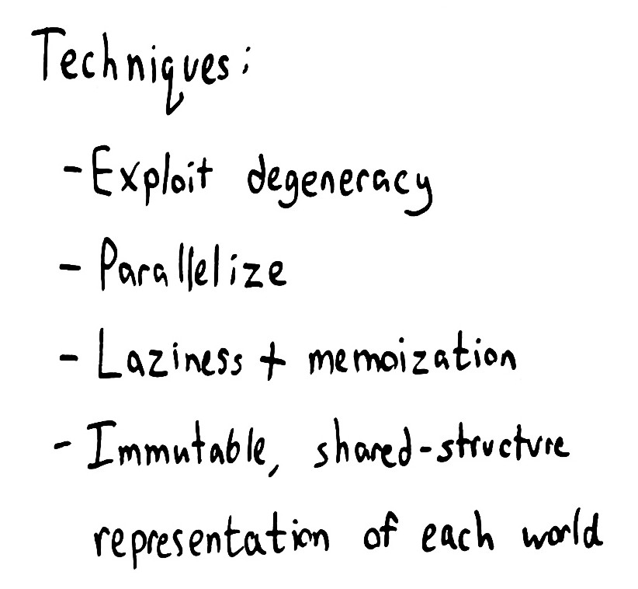

Slide 45
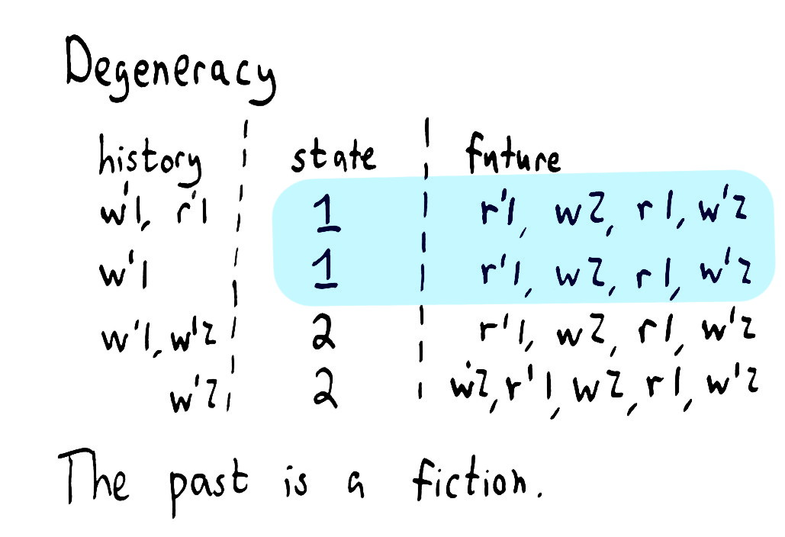

Slide 46
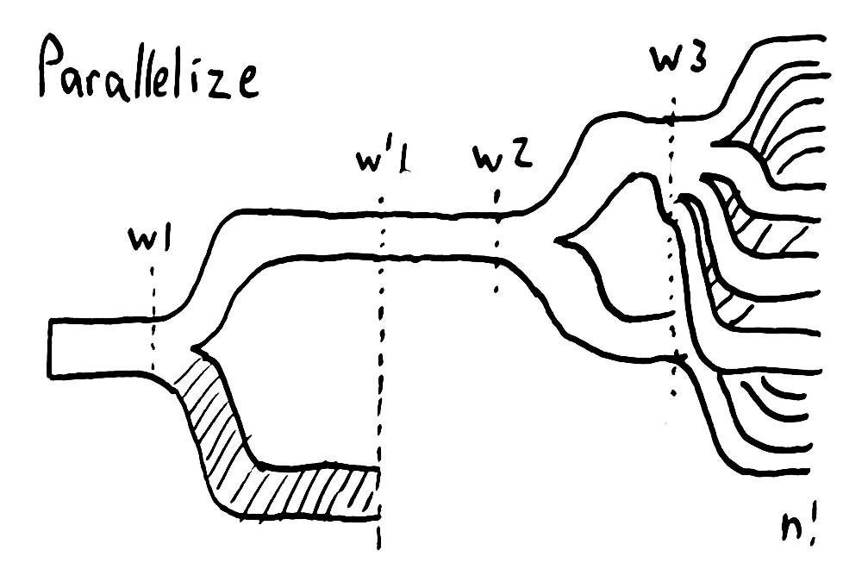

Slide 47
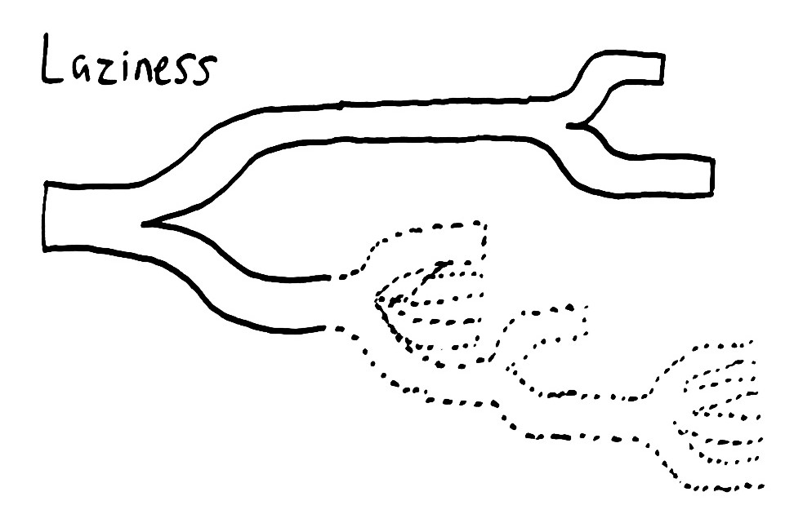

Slide 48
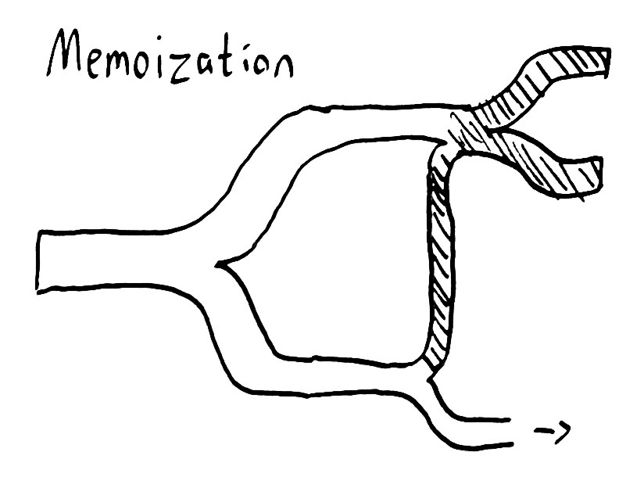

Slide 49
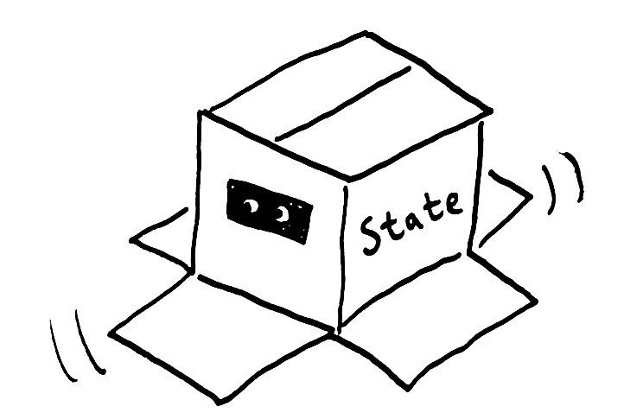

Slide 50
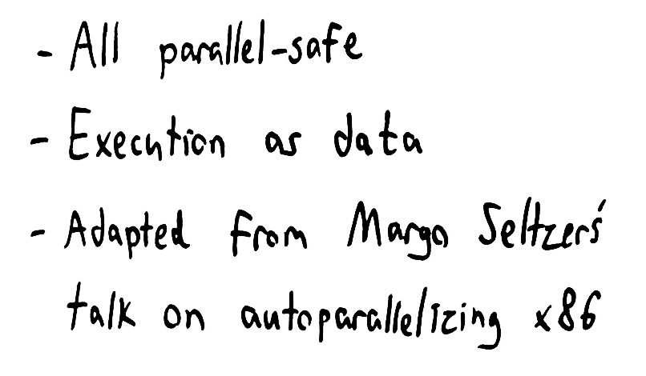

Slide 51


Slide 52
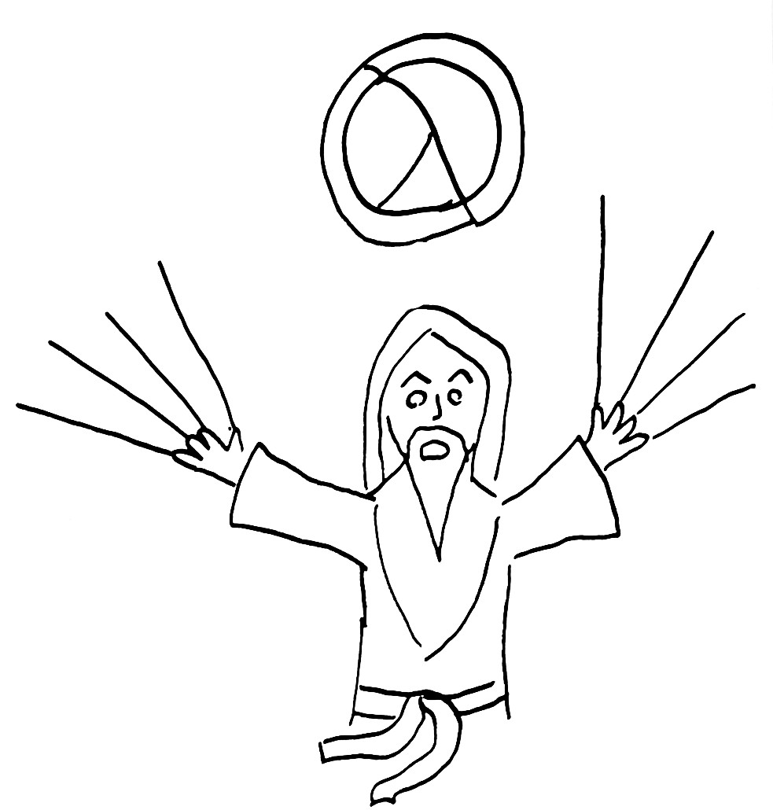

Slide 53
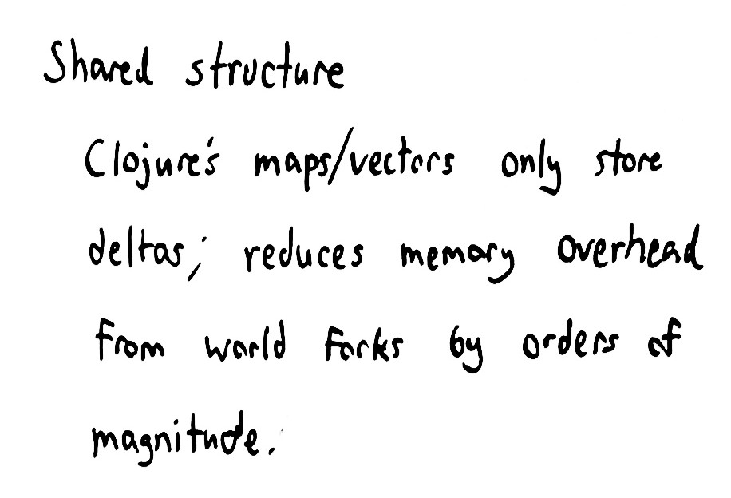

Slide 54


Slide 55
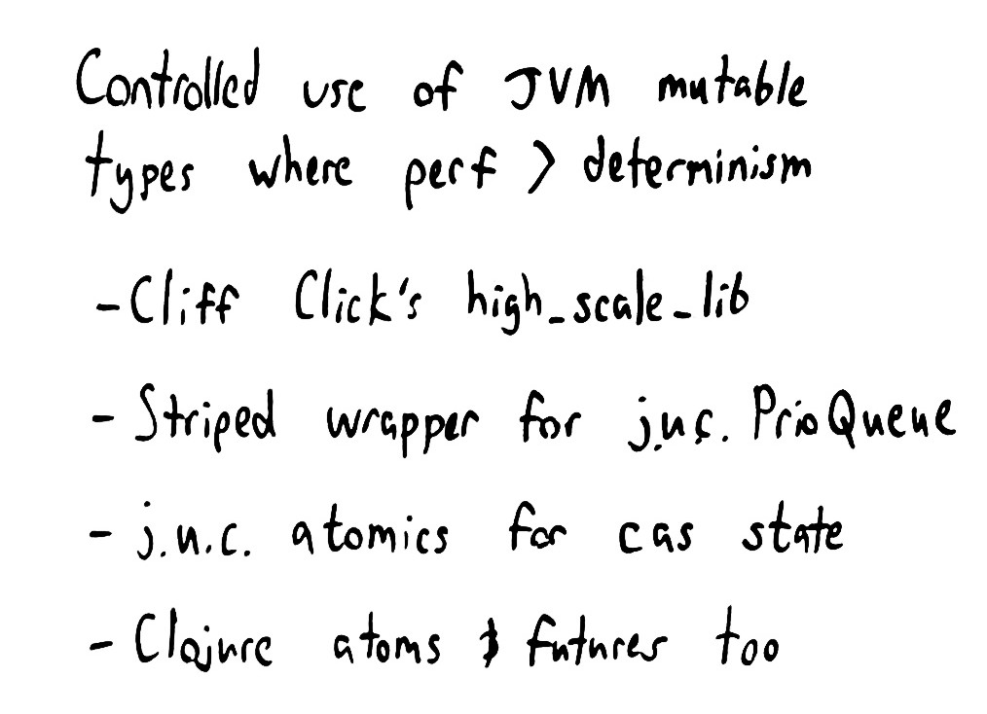

Slide 56



Slide 57


Slide 58


Slide 59


Slide 60


Slide 61


Slide 62


Slide 63


Slide 64


Slide 65


Slide 66
=ERROR REPORT==== 10-Apr-2014::13:16:08 ===
** Node rabbit@n3 not responding **
** Removing (timedout) connection **
=INFO REPORT==== 10-Apr-2014::13:16:29 ===
rabbit on node rabbit@n5 down
=ERROR REPORT==== 10-Apr-2014::13:16:45 ===
Mnesia(rabbit@n1): ** ERROR ** mnesia_event got {inconsistent_database, running_partitioned_network, rabbit@n3}

Slide 67


Slide 68


Slide 69
Not linearizable. Linearizable prefix was:
...
:nemesis :info :stop nil
:nemesis :info :stop "fully connected"
:nemesis :info :start nil
:nemesis :info :start "partitioned into [(:n1 :n4)
(:n3 :n5 :n2)]"
3 :invoke :acquire nil
2 :invoke :acquire 1
2 :ok :acquire 1
1 :invoke :acquire 2
Followed by inconsistent operation:
1 :ok :acquire 2

Slide 70
Last consistent worlds were: ----------------
World from fixed history:
1 :invoke :acquire 1
1 :invoke :release nil
2 :invoke :acquire 1
and current state #jepsen.model.Mutex{:locked true}
with pending operations:
3 :invoke :acquire nil
1 :invoke :acquire 2
0 :invoke :acquire nil
4 :invoke :acquire nil
---------------------------------------------
Inconsistent state transitions:
([{:locked true} "already held"])

Slide 71


Slide 72


Slide 73


Slide 74


Slide 75


Slide 76


Slide 77


Slide 78


Slide 79


Slide 80


Slide 81


Slide 82


Slide 83


Slide 84


Slide 85


Slide 86


Slide 87


Slide 88


Slide 89
FAIL in (register-test) (etcd_test.clj:45)
expected: (:valid? (:results test))
actual: false
Not linearizable. Linearizable prefix was:
…
:nemesis :info :start "Cut off {:n5 #{:n4 :n1}, :n2 #{:n4 :n1}, :n3 #{:n4 :n1}, :n1 #{:n3 :n2 :n5}, :n4 #{:n3 :n2 :n5}}"
2 :invoke :cas [1 4]
4 :invoke :read 1
4 :ok :read 1
2 :ok :cas [1 4]
Followed by inconsistent operation:
0 :invoke :read 1

Slide 90
World with fixed history:
...
4 :invoke :write 1
0 :invoke :read 1
3 :invoke :read 1
1 :invoke :read 1
4 :invoke :read 1
2 :invoke :cas [1 4]
led to state:
{:value 4}
with pending operations:
(and 12928 more worlds, elided here
-------------------------------------------------------
Inconsistent state transitions:
([{:value 4} "can't read 1 from register 4"])

Slide 91


Slide 92


Slide 93


Slide 94


Slide 95


Slide 96


Slide 97


Slide 98


Slide 99


Slide 100


Slide 101


Slide 102


Slide 103


Slide 104


Slide 105


Slide 106


Slide 107


Slide 108


Slide 109


Slide 110


Slide 111
{:valid? false,
:ok #{0..6 9..24 26..33 35..46 48 50..52 55..57 60..62 65
67..68 71..73 76..78 81..83 86..88 91..93 96..98
101..103 106..108 111..113 116..118 121..123
126..128 131..133 136..138 141..143 146..148
151..164 166 168..171 173..175 270..272 274},
:recovered #{50..52 55..57 60..62 65 67..68 71..73 76..78 81..83
86..88 91..93 96..98 101..103 106..108 111..113
116..118 121..123 126..128 131..133 136..138
141..143 146..147},
:lost #{176..178 250..251},
:unexpected #{},
:ok-frac 26/55,
:recovered-frac 59/275,
:lost-frac 1/55,
:unexpected-frac 0}

Slide 112


Slide 113


Slide 114


Slide 115


Slide 116
FAIL in (register-test) (elasticsearch_test.clj:49)
expected: (:valid? (:results test))
actual: false
{:valid? false,
:ok …,
:recovered #{420 438 457 475},
:lost #{418..419 421..427 429..437 439..444 446..456 458..463 465..474 476..481 483..493 495..500 502..503 505..506 509..510 514 516 520..521 524 527 529 531 534 536 539 542 544 547..548 552 554 557..558 562 564 567..568 572 574 577 579 582..583 587..588 592..593 597 599 602 604 607 609 612 614 617 619 622 624 626 629 631 634 636 638 642 644 647 649 652..653 657 659 662 664 667 669 671 674 676 679 681 684 686 689 691 694 696 698 701 704 706 709 711 715..716 720..721 725 727 730 732 735 737 741..742 746..747 749 752 754 757..758 762..763 767 769 772 775 777 779 782..783
…
1706..1707 1710 1712 1716..1717 1721..1722 1726..1727 1731..1732 1736..1737 1741..1742 1746..1747 1751..1752 1756 1761 1766 1771..1772 1776..1777 1781..1782 1786..1787 1791..1792 1796..1797 1801 1806..1807 1811..1812 1816..1817 1821 1826..1827 1831..1832 1836..1837 1841..1842 1846..1847 1851..1852 1856..1857 1861..1862 1866..1867 1871..1872 1877..1878 1882..1883 1887..1888 1892..1893 1897..1898 1902..1903 1907 1912..1913 1917..1918 1922..1923 1926 1931..1932 1936..1937 1941 1946..1947 1951 1953 1957},
:unexpected #{},
:ok-frac 1103/1961
:recovered-frac 4/1961,
:lost-frac 645/1961,
:unexpected-frac 0})

Slide 117


Slide 118
:recovered-frac 11/289,
:unexpected-frac 0,
:unexpected "#{}",
:lost-frac 688/2023,
:ok-frac 1265/2023}

Slide 119

"RemoteTransportException[[Cadaver][inet[/192.168.122.12:9300]][index]]; nested: RemoteTransportException[[Death Adder][inet[/192.168.122.11:9300]][index]]; nested: DocumentAlreadyExistsException[[jepsen-index][1] [number][EpVU56YERBOfRqyVc-_hAg]: document already exists];

Slide 120


Slide 121
:total 461,
:recovered-count 73,
:unexpected-count 0,
:lost-count 17,
:ok-count 319

Slide 122


Slide 123
:recovered-count 66,
:unexpected-count 0,
:unexpected "#{}",
:lost-count 8,
:ok-count 541}}

Slide 124


Slide 125


Slide 126


Slide 127


Slide 128


Slide 129
“We’ve had some bad networking, some Virtual Machine stalls (result of SAN issues, or VMWare doing weird stuff), or even heavy GC activity can cause enough pauses for aspects of the split brain to occur.”
--Paul Smith

Slide 130


Slide 131


Slide 132


Slide 133


Slide 134
For some reason, node A and B cannot talk to each other… but both can still talk to C and C can talk to A and B i.e. a ‘on the fence’ network partition as C can still see all…
--Mark Tinsley

Slide 135


Slide 136


Slide 137


Slide 138


Slide 139


Slide 140


Slide 141


Slide 142


Slide 143


Slide 144


Slide 145


Slide 146


Slide 147


Slide 148


Slide 149


Slide 150


Slide 151


Slide 152


Slide 153



Slide 154




