Slide 1
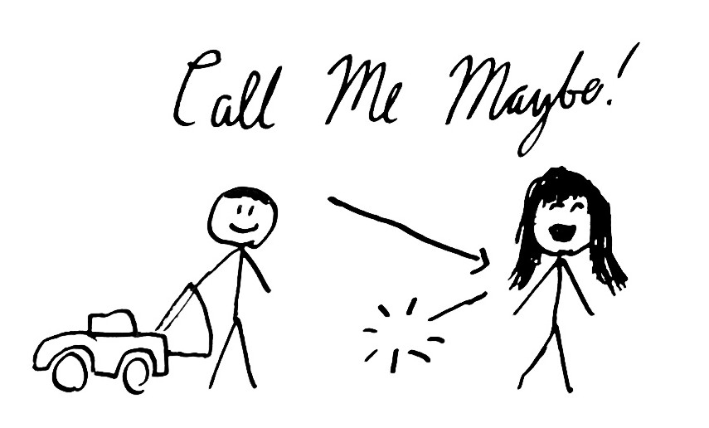

Slide 2
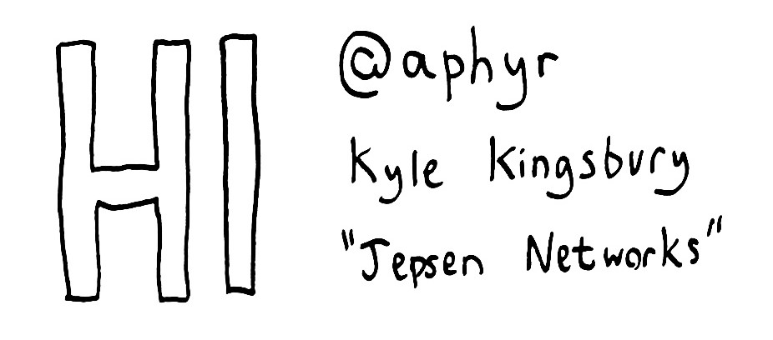

Slide 3
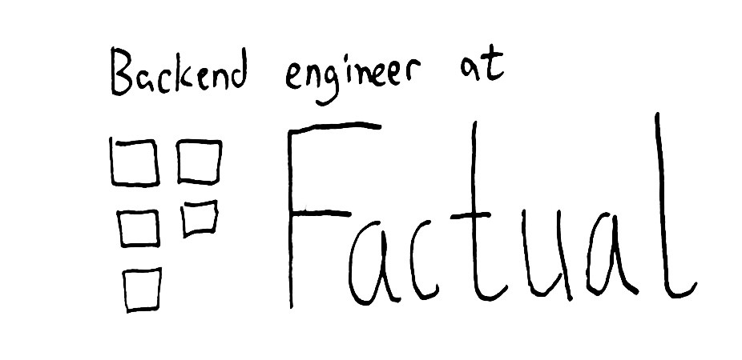

Slide 4
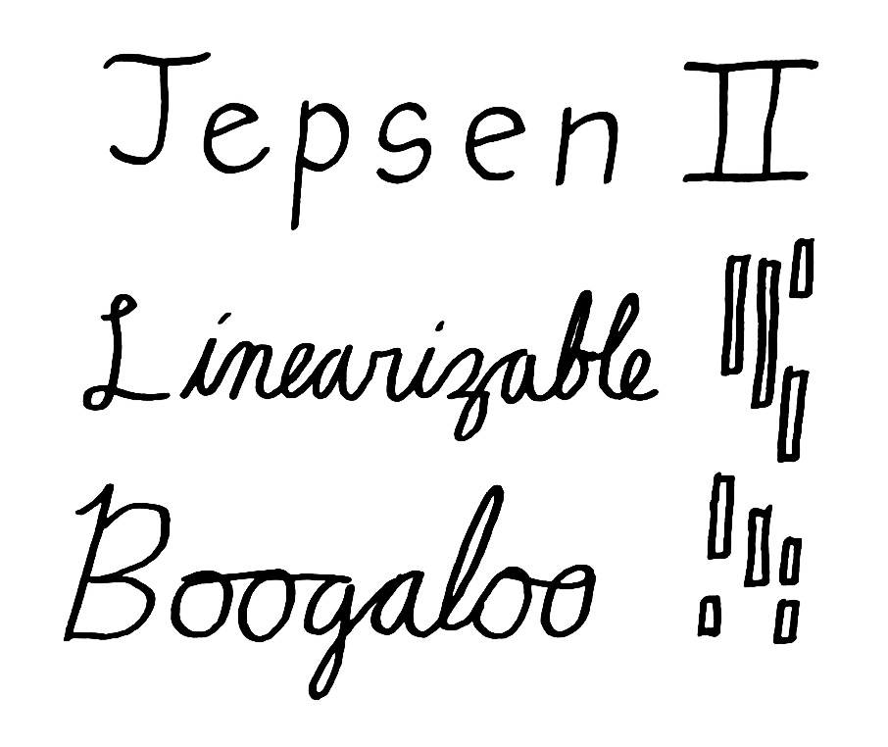

Slide 5
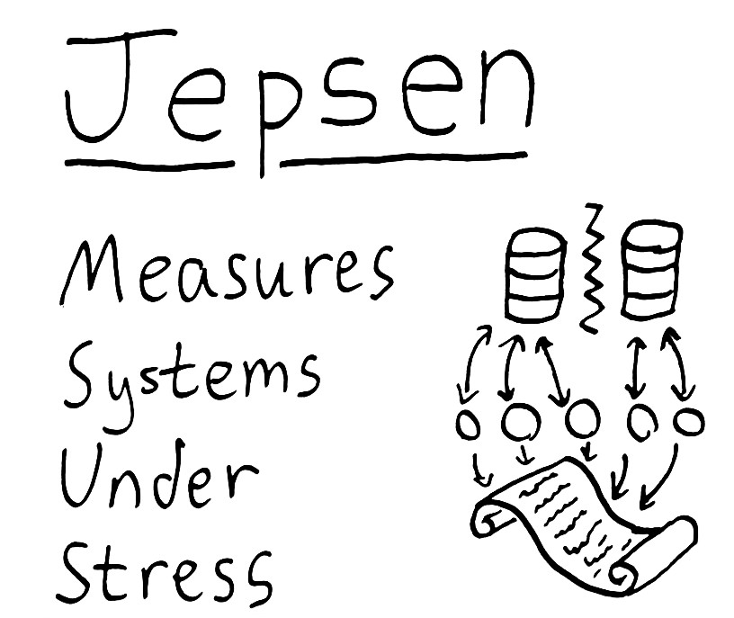

Slide 6


Slide 7
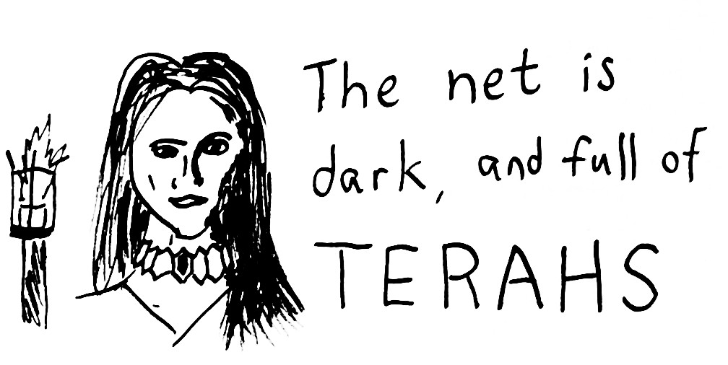

Slide 8
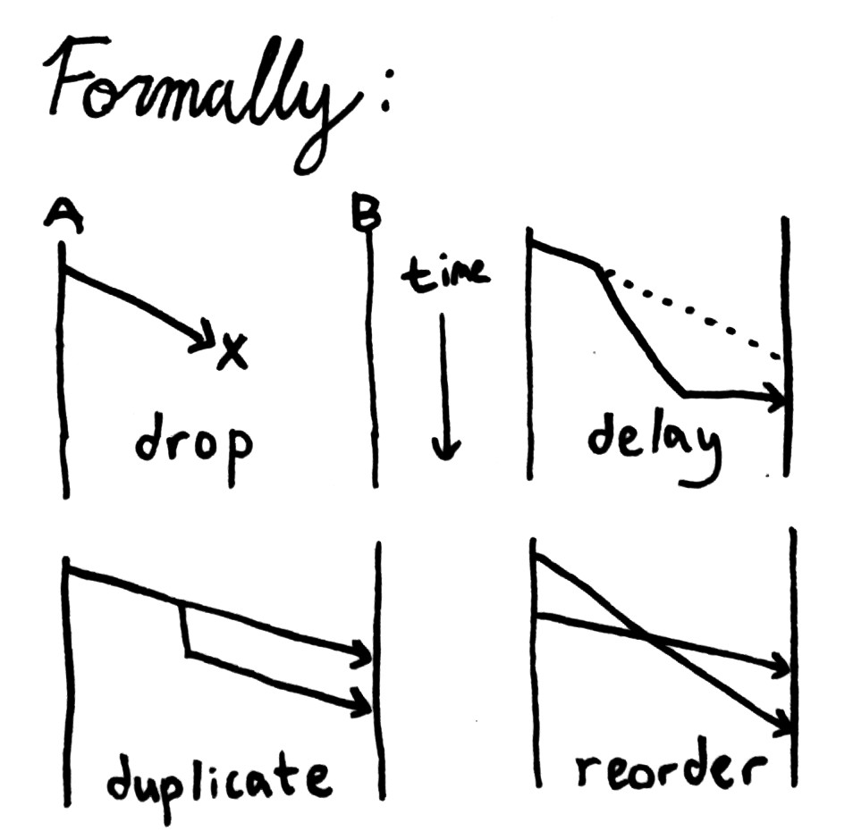

Slide 9
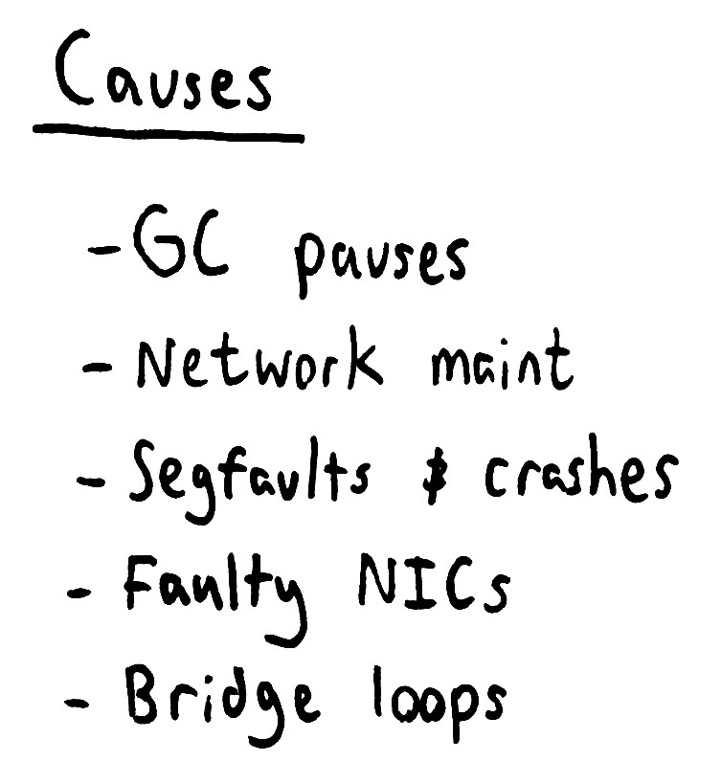

Slide 10
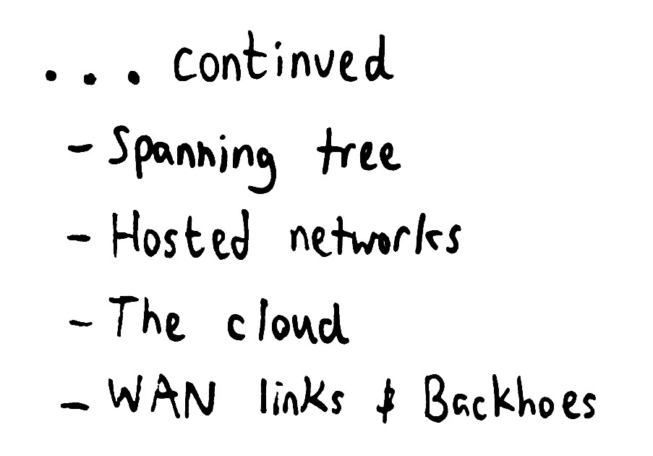

Slide 11


Slide 12
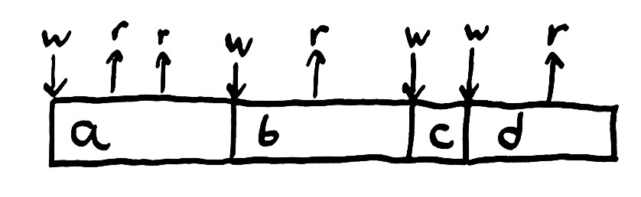

Slide 13
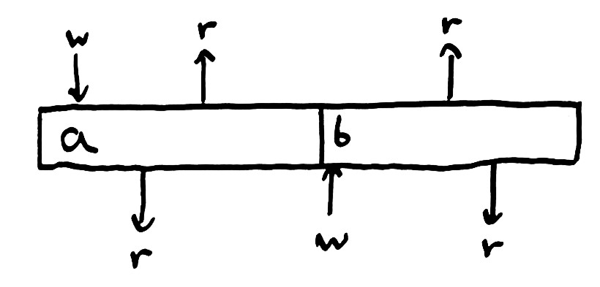

Slide 14
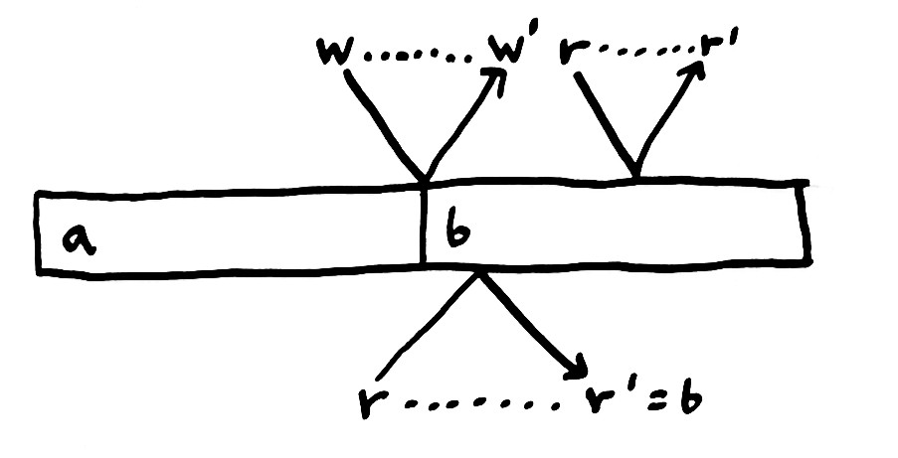

Slide 15
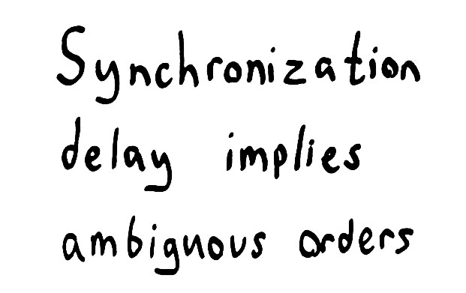

Slide 16
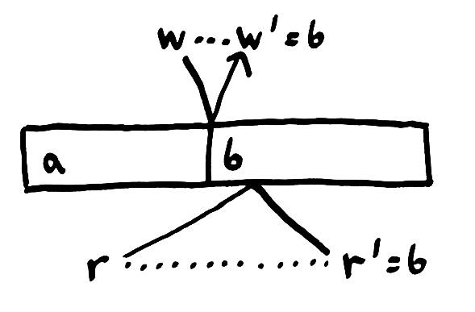

Slide 17
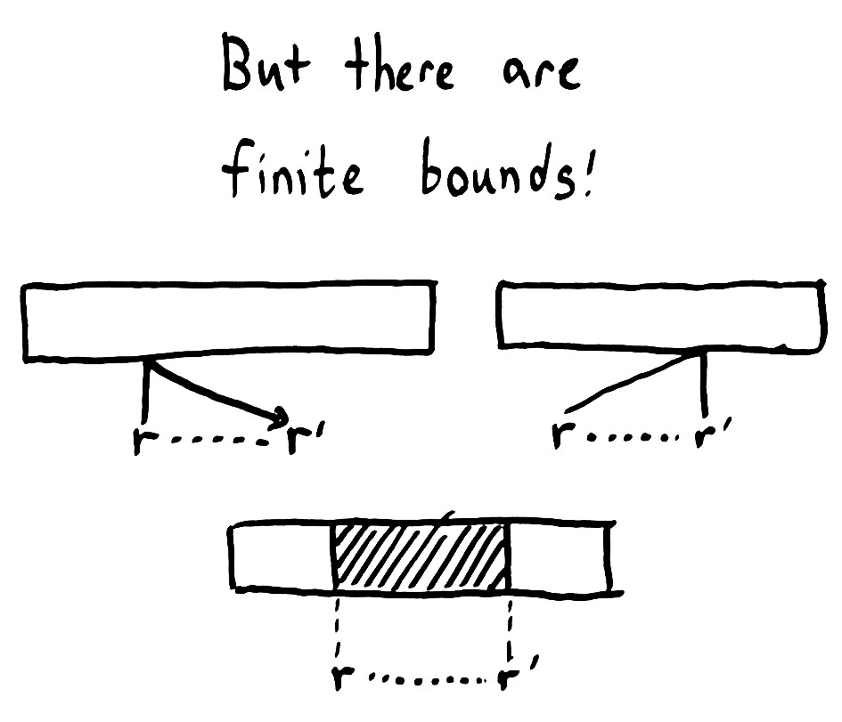

Slide 18
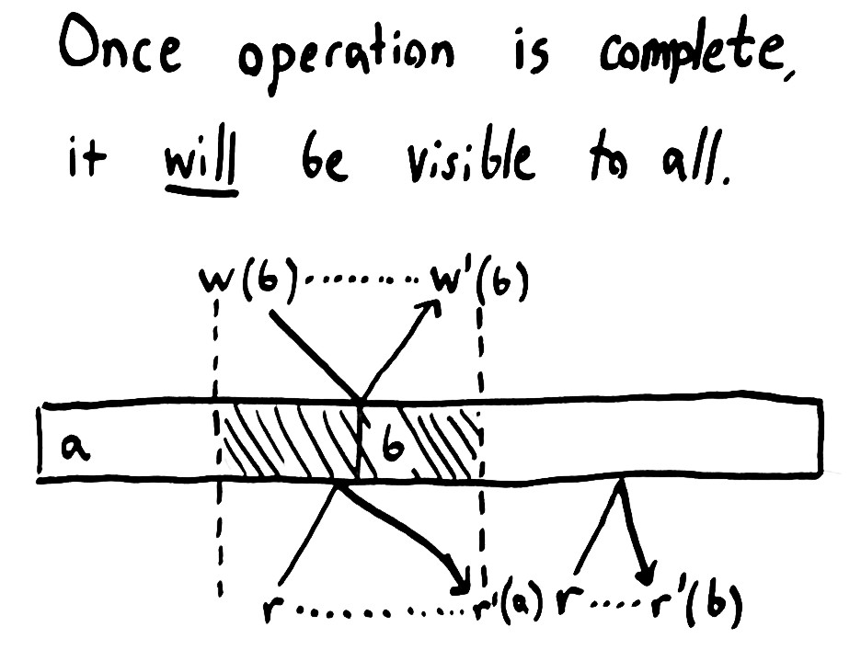

Slide 19
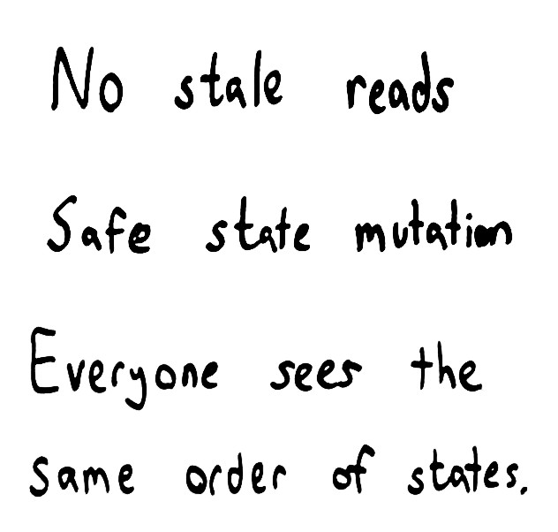

Slide 20
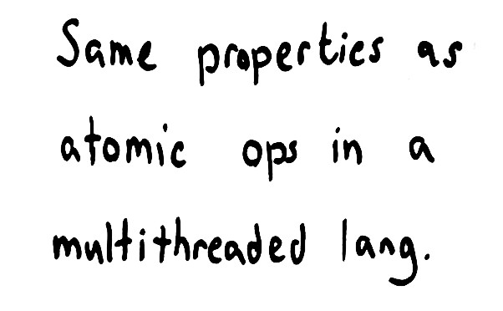

Slide 21
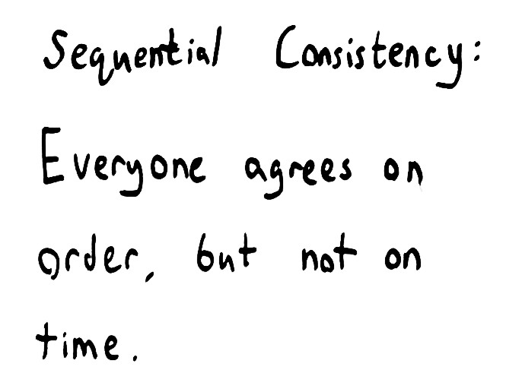

Slide 22
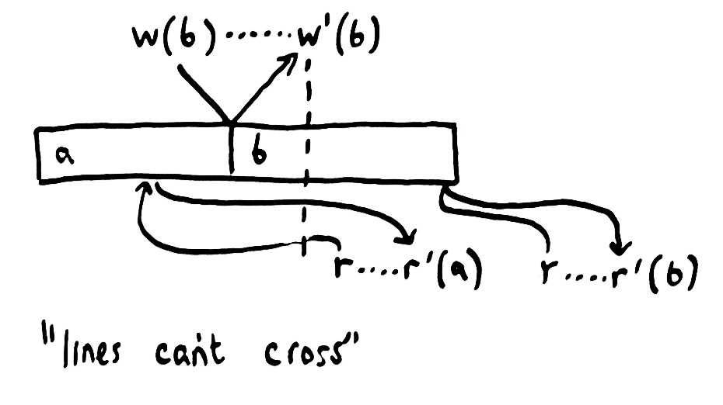

Slide 23
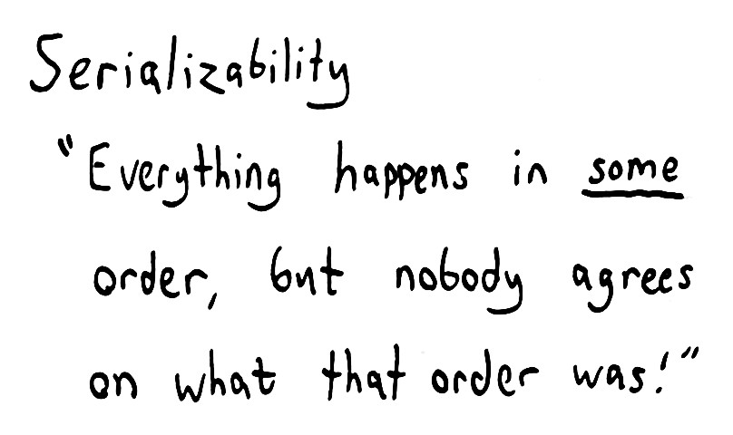

Slide 24
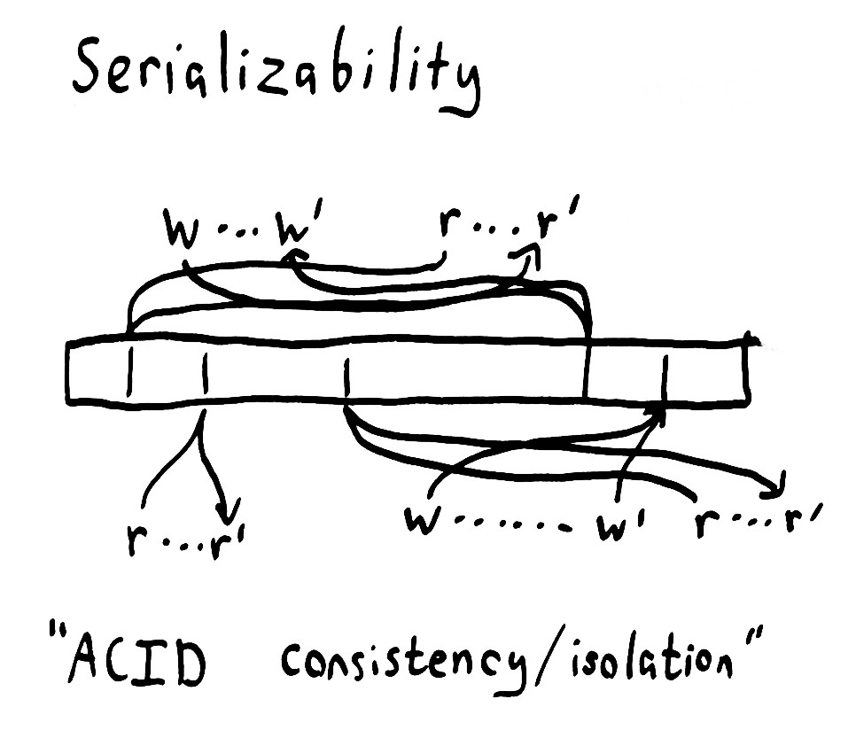

Slide 25


Slide 26
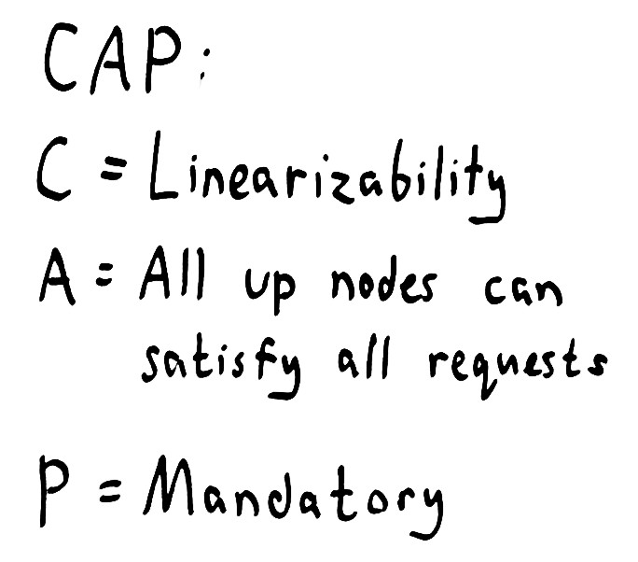

Slide 27
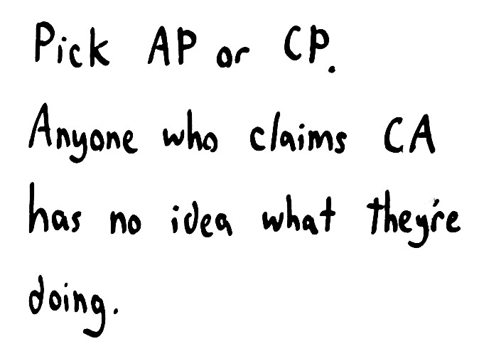

Slide 28
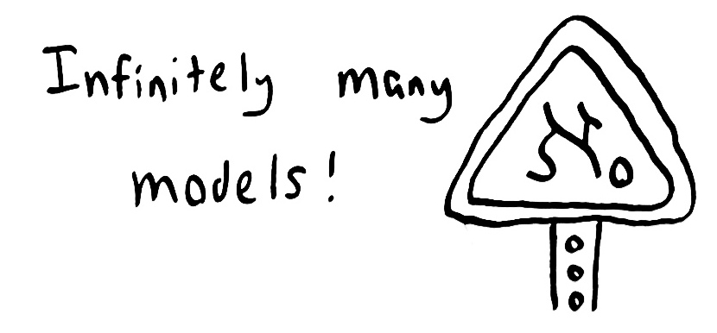

Slide 29
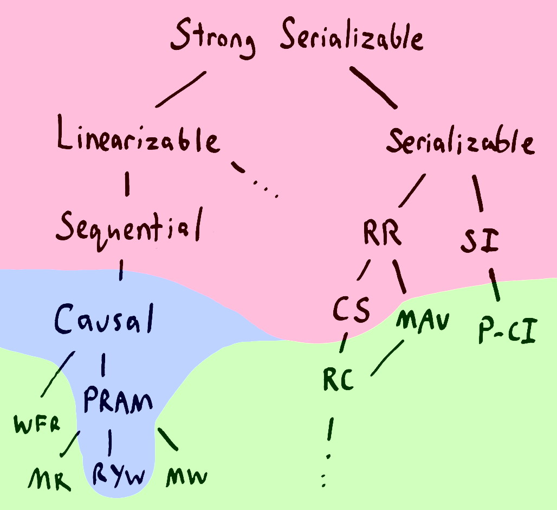

Slide 30
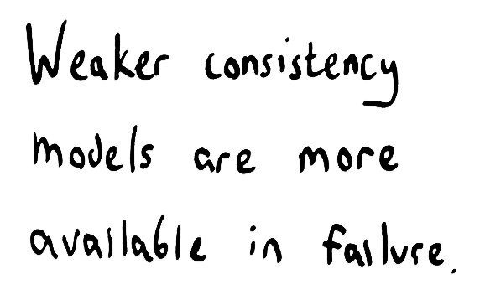

Slide 31
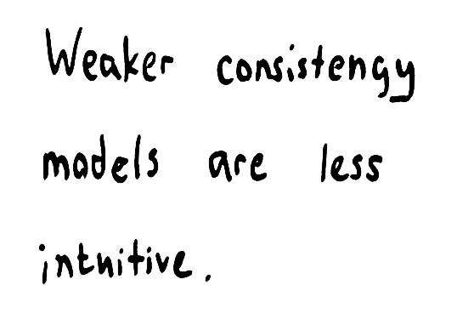

Slide 32
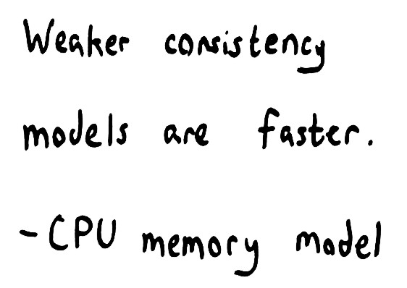

Slide 33
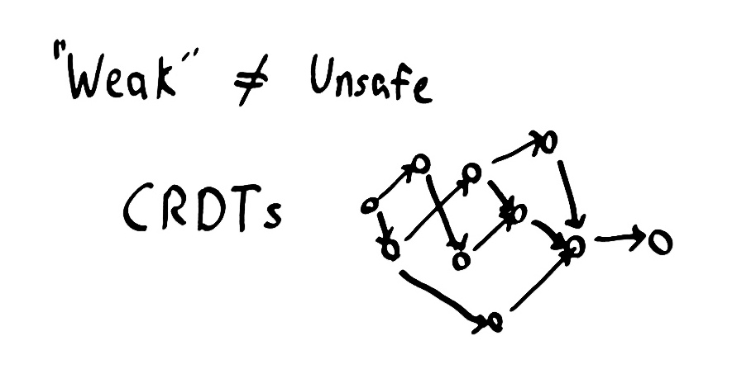

Slide 34
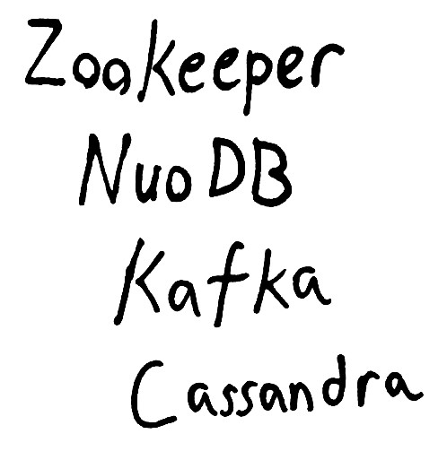

Slide 35
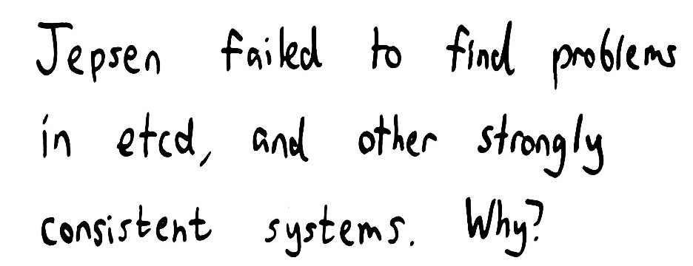

Slide 36
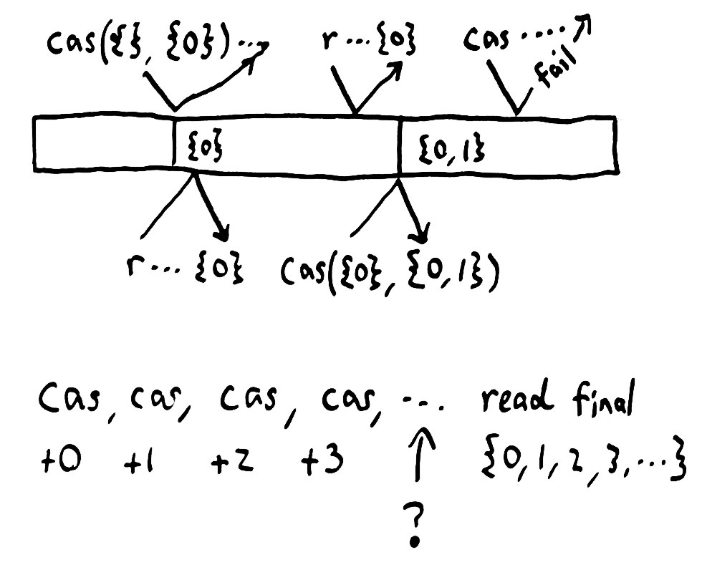

Slide 37
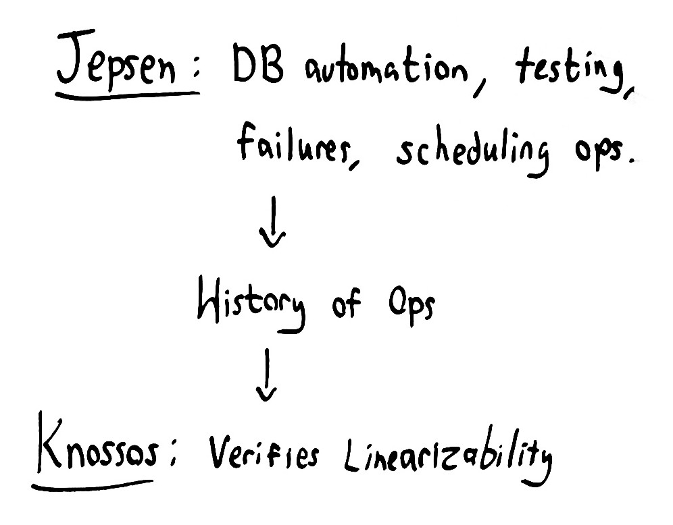

Slide 38
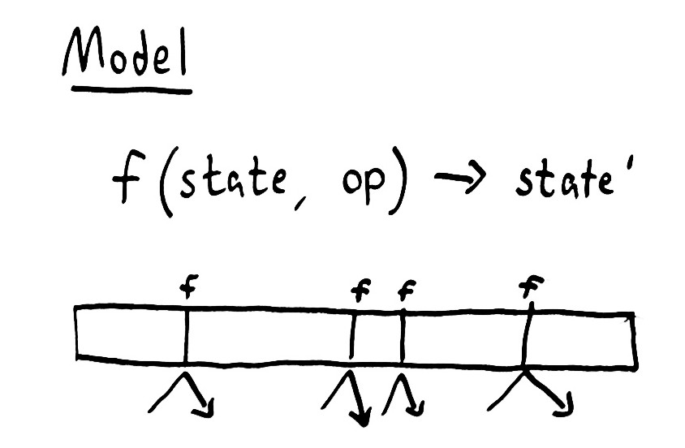

Slide 39
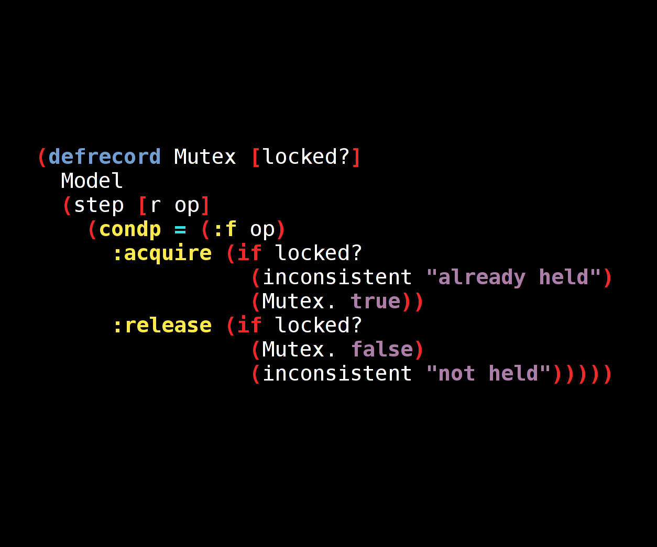

Slide 40
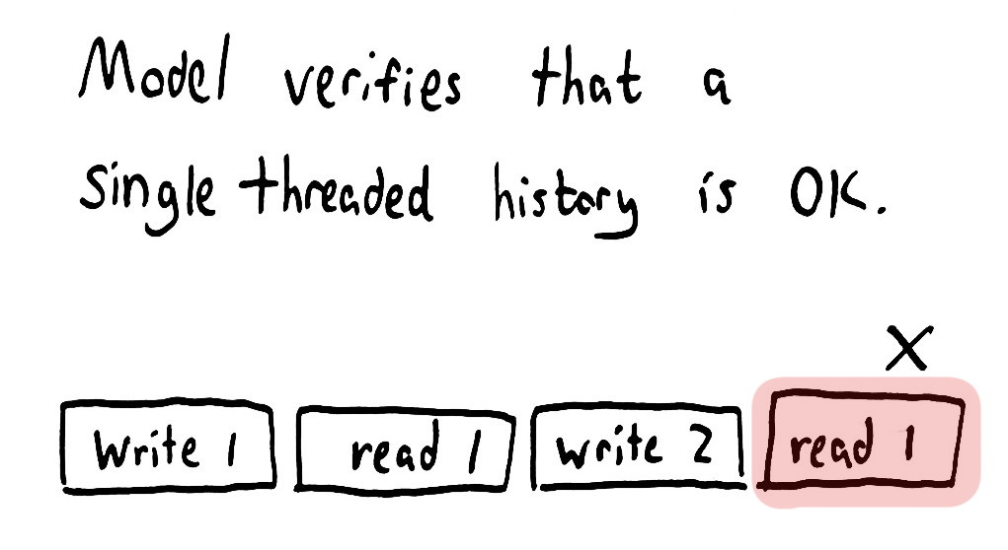

Slide 41
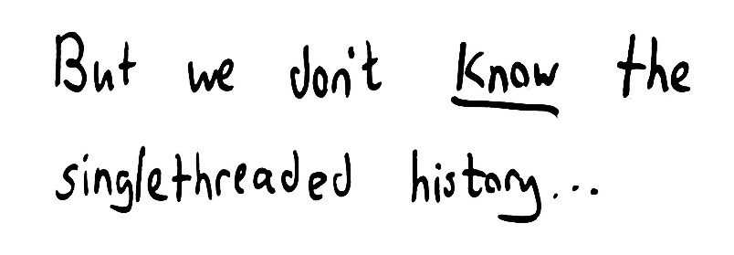

Slide 42
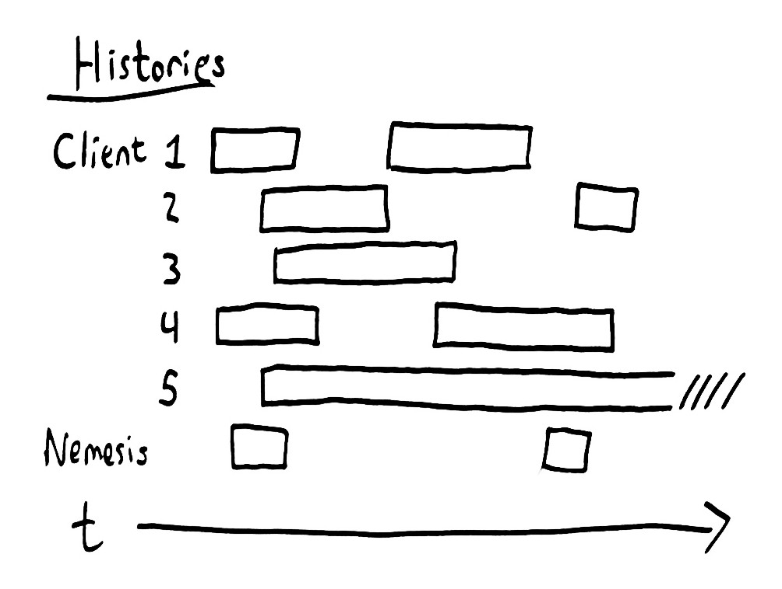

Slide 43
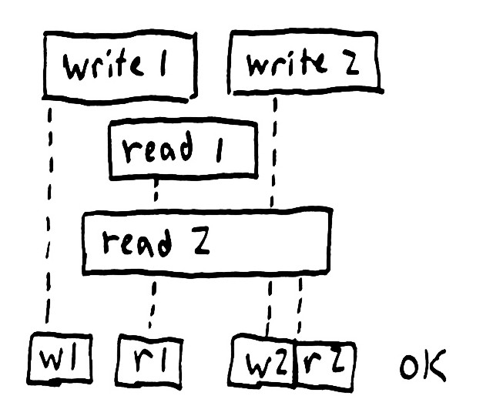
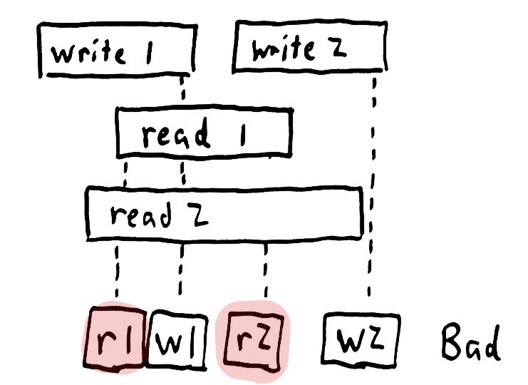

Slide 44
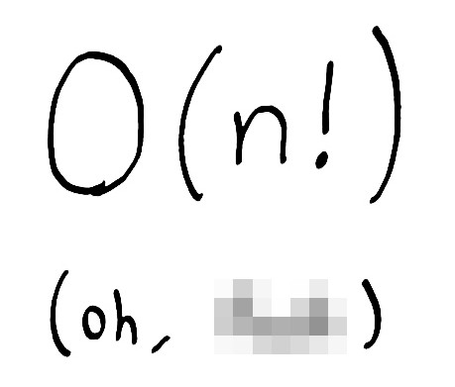

Slide 45
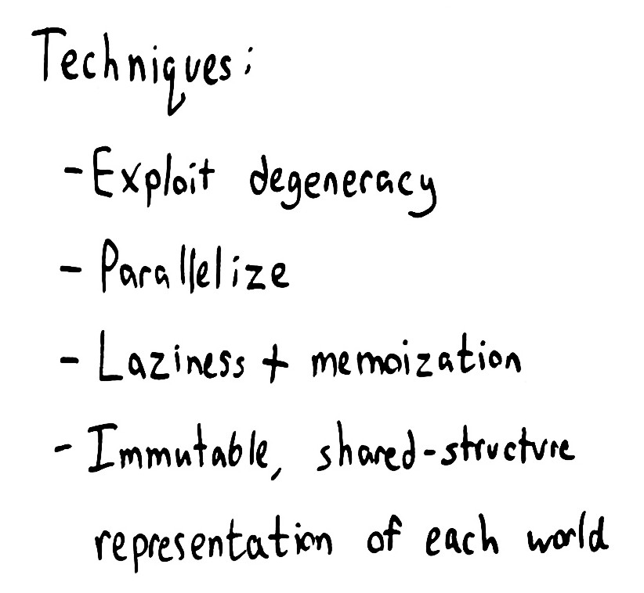

Slide 46
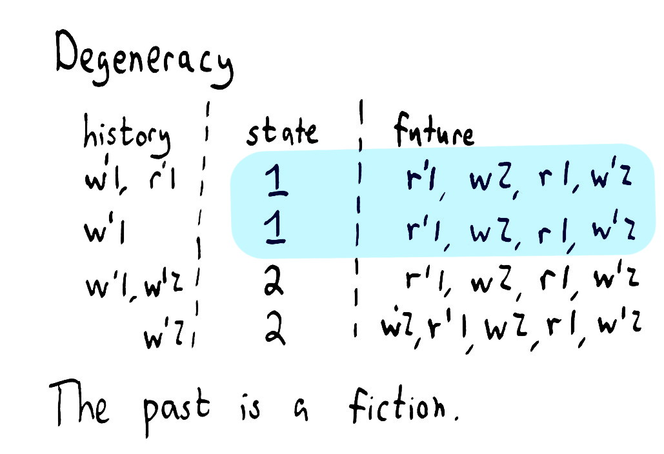

Slide 47
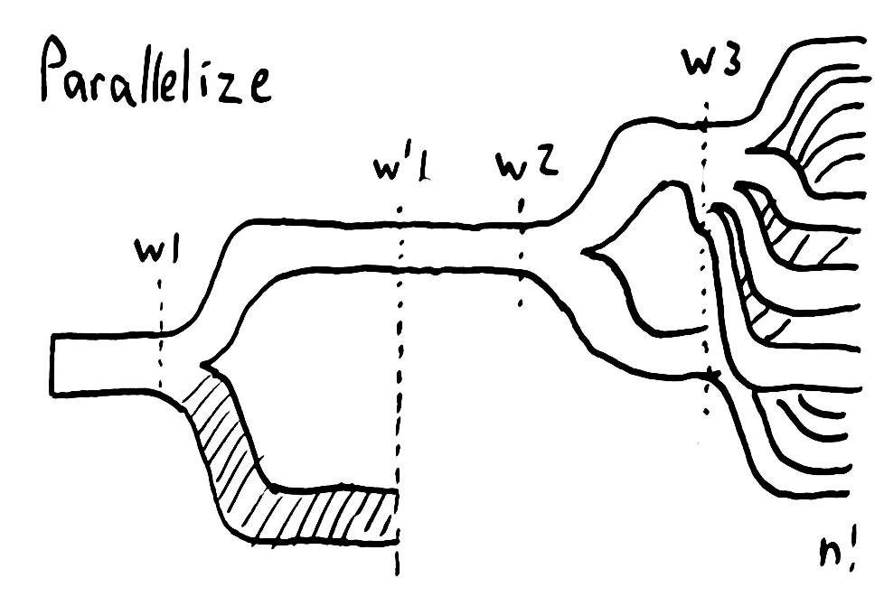

Slide 48
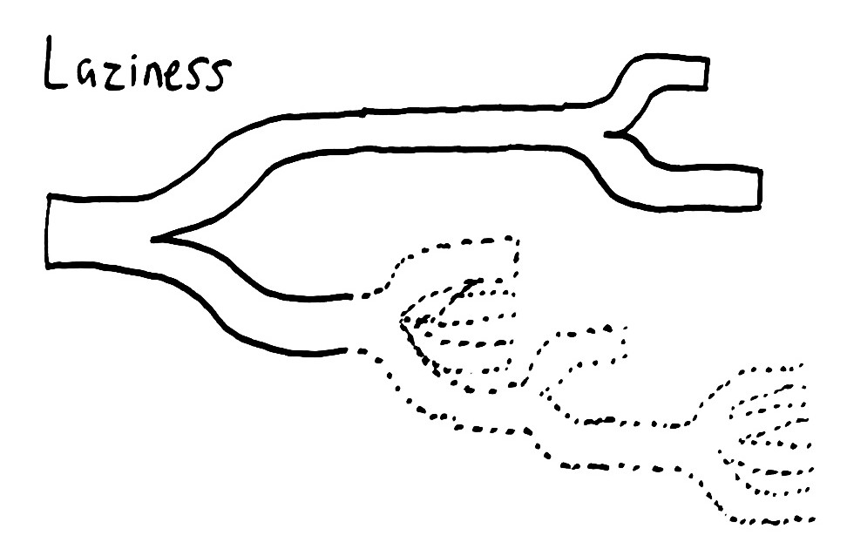

Slide 49
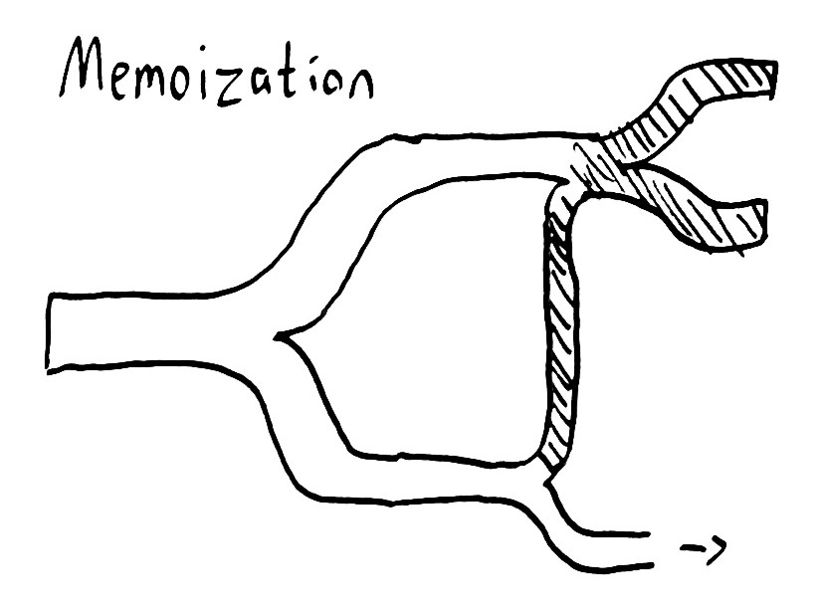

Slide 50
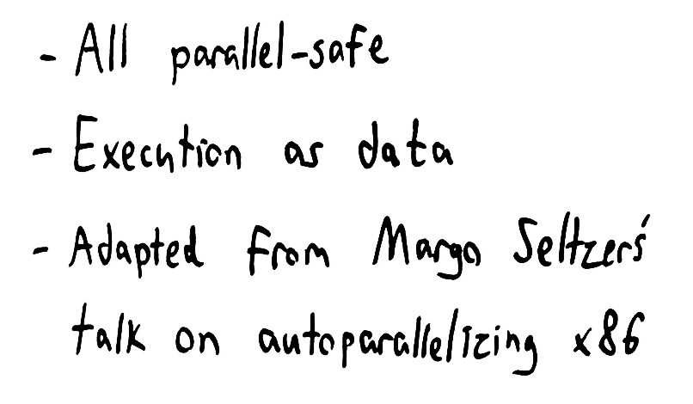

Slide 51
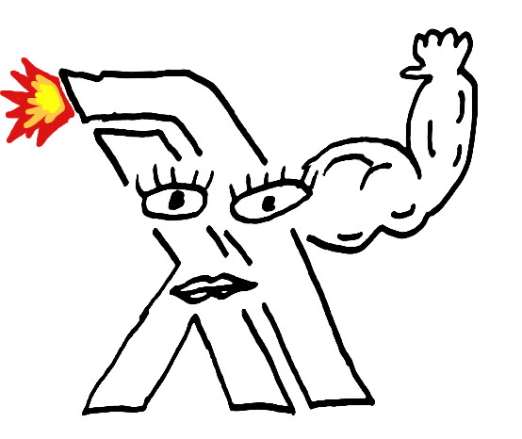

Slide 52
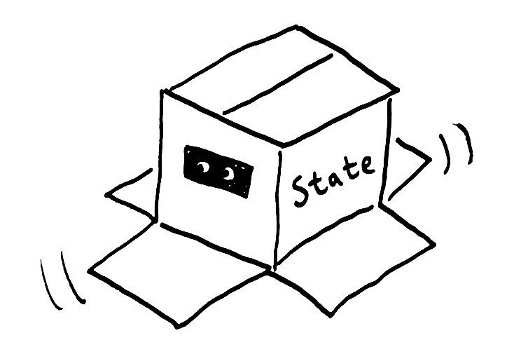

Slide 53


Slide 54


Slide 55


Slide 56


Slide 57



Slide 58


Slide 59


Slide 60


Slide 61


Slide 62
=ERROR REPORT==== 10-Apr-2014::13:16:08 ===
** Node rabbit@n3 not responding **
** Removing (timedout) connection **
=INFO REPORT==== 10-Apr-2014::13:16:29 ===
rabbit on node rabbit@n5 down
=ERROR REPORT==== 10-Apr-2014::13:16:45 ===
Mnesia(rabbit@n1): ** ERROR ** mnesia_event got {inconsistent_database, running_partitioned_network, rabbit@n3}

Slide 63


Slide 64


Slide 65


Slide 66


Slide 67


Slide 68
Not linearizable. Linearizable prefix was:
...
:nemesis :info :stop nil
:nemesis :info :stop "fully connected"
:nemesis :info :start nil
:nemesis :info :start "partitioned into [(:n1 :n4)
(:n3 :n5 :n2)]"
3 :invoke :acquire nil
2 :invoke :acquire 1
2 :ok :acquire 1
1 :invoke :acquire 2
Followed by inconsistent operation:
1 :ok :acquire 2

Slide 69
Last consistent worlds were: ----------------
World from fixed history:
1 :invoke :acquire 1
1 :invoke :release nil
2 :invoke :acquire 1
and current state #jepsen.model.Mutex{:locked true}
with pending operations:
3 :invoke :acquire nil
1 :invoke :acquire 2
0 :invoke :acquire nil
4 :invoke :acquire nil
---------------------------------------------
Inconsistent state transitions:
([{:locked true} "already held"])

Slide 70


Slide 71


Slide 72


Slide 73


Slide 74
FAIL in (register-test) (etcd_test.clj:45)
expected: (:valid? (:results test))
actual: false
Not linearizable. Linearizable prefix was:
…
:nemesis :info :start "Cut off {:n5 #{:n4 :n1}, :n2 #{:n4 :n1}, :n3 #{:n4 :n1}, :n1 #{:n3 :n2 :n5}, :n4 #{:n3 :n2 :n5}}"
2 :invoke :cas [1 4]
4 :invoke :read 1
4 :ok :read 1
2 :ok :cas [1 4]
Followed by inconsistent operation:
0 :invoke :read 1

Slide 75
World with fixed history:
...
4 :invoke :write 1
0 :invoke :read 1
3 :invoke :read 1
1 :invoke :read 1
4 :invoke :read 1
2 :invoke :cas [1 4]
led to state:
{:value 4}
with pending operations:
(and 12928 more worlds, elided here
-------------------------------------------------------
Inconsistent state transitions:
([{:value 4} "can't read 1 from register 4"])

Slide 76


Slide 77


Slide 78


Slide 79


Slide 80


Slide 81


Slide 82


Slide 83


Slide 84


Slide 85


Slide 86


Slide 87


Slide 88


Slide 89


Slide 90


Slide 91


Slide 92


Slide 93
2 :ok :add 46
1 :invoke :add 47
4 :invoke :add 48
4 :ok :add 48
0 :invoke :add 49
:nemesis :info :start "Cut off {:n5 #{:n2 :n1}, :n4 #{:n2 :n1}, :n1 #{:n4 :n5}, :n2 #{:n4 :n5}}"
3 :invoke :add 50
2 :invoke :add 51
4 :invoke :add 52
1 :info :add :timed-out
0 :info :add :timed-out
3 :info :add :timed-out
2 :info :add :timed-out
4 :info :add :timed-out
5 :invoke :add 53
6 :invoke :add 54
8 :invoke :add 55
7 :invoke :add 56
9 :invoke :add 57
5 :info :add :timed-out

Slide 94
186 :invoke :add 273
186 :fail :add 273
173 :invoke :add 274
173 :ok :add 274
185 :info :add :timed-out
:nemesis :info :stop nil
:nemesis :info :stop "fully connected"
:nemesis :info :stop nil
:nemesis :info :stop "fully connected"
174 :invoke :read nil
174 :ok :read #{0 1 2 3 4 5 6 9 10 11 12 13 14 15 16 17 18 19 20 21 22 23 24 26 27 28 29 30 31 32 33 35 36 37 38 39 40 41 42 43 44 45 46 48 50 51 52 55 56 57 60 61 62 65 67 68 71 72 73 76 77 78 81 82 83 86 87 88 91 92 93 96 97 98 101 102 103 106 107 108 111 112 113 116 117 118 121 122 123 126 127 128 131 132 133 136 137 138 141 142 143 146 147 148 151 152 153 154 155 156 157 158 159 160 161 162 163 164 166 168 169 170 171 173 174 175 270 271 272 274}

Slide 95
{:valid? false,
:ok #{0..6 9..24 26..33 35..46 48 50..52 55..57 60..62 65
67..68 71..73 76..78 81..83 86..88 91..93 96..98
101..103 106..108 111..113 116..118 121..123
126..128 131..133 136..138 141..143 146..148
151..164 166 168..171 173..175 270..272 274},
:recovered #{50..52 55..57 60..62 65 67..68 71..73 76..78 81..83
86..88 91..93 96..98 101..103 106..108 111..113
116..118 121..123 126..128 131..133 136..138
141..143 146..147},
:lost #{176..178 250..251},
:unexpected #{},
:ok-frac 26/55,
:recovered-frac 59/275,
:lost-frac 1/55,
:unexpected-frac 0}

Slide 96


Slide 97


Slide 98


Slide 99


Slide 100


Slide 101

"RemoteTransportException[[Cadaver][inet[/192.168.122.12:9300]][index]]; nested: RemoteTransportException[[Death Adder][inet[/192.168.122.11:9300]][index]]; nested: DocumentAlreadyExistsException[[jepsen-index][1] [number][EpVU56YERBOfRqyVc-_hAg]: document already exists];

Slide 102
FAIL in (register-test) (elasticsearch_test.clj:49)
expected: (:valid? (:results test))
actual: false
{:valid? false,
:ok …,
:recovered #{420 438 457 475},
:lost #{418..419 421..427 429..437 439..444 446..456 458..463 465..474 476..481 483..493 495..500 502..503 505..506 509..510 514 516 520..521 524 527 529 531 534 536 539 542 544 547..548 552 554 557..558 562 564 567..568 572 574 577 579 582..583 587..588 592..593 597 599 602 604 607 609 612 614 617 619 622 624 626 629 631 634 636 638 642 644 647 649 652..653 657 659 662 664 667 669 671 674 676 679 681 684 686 689 691 694 696 698 701 704 706 709 711 715..716 720..721 725 727 730 732 735 737 741..742 746..747 749 752 754 757..758 762..763 767 769 772 775 777 779 782..783
…
1706..1707 1710 1712 1716..1717 1721..1722 1726..1727 1731..1732 1736..1737 1741..1742 1746..1747 1751..1752 1756 1761 1766 1771..1772 1776..1777 1781..1782 1786..1787 1791..1792 1796..1797 1801 1806..1807 1811..1812 1816..1817 1821 1826..1827 1831..1832 1836..1837 1841..1842 1846..1847 1851..1852 1856..1857 1861..1862 1866..1867 1871..1872 1877..1878 1882..1883 1887..1888 1892..1893 1897..1898 1902..1903 1907 1912..1913 1917..1918 1922..1923 1926 1931..1932 1936..1937 1941 1946..1947 1951 1953 1957},
:unexpected #{},
:ok-frac 1103/1961
:recovered-frac 4/1961,
:lost-frac 645/1961,
:unexpected-frac 0})

Slide 103


Slide 104


Slide 105


Slide 106


Slide 107


Slide 108


Slide 109


Slide 110


Slide 111


Slide 112


Slide 113


Slide 114


Slide 115


Slide 116


Slide 117


Slide 118


Slide 119


Slide 120


Slide 121


Slide 122


Slide 123


Slide 124


Slide 125


Slide 126


Slide 127


Slide 128




