Slide 1
GraphQL in the Age of Agents
Why Your Next AI Client Speaks in Queries
Dev2Next
Željko Kozina · @zkozina

Slide 2
Agenda
What is GraphQL?
Exposing APIs to agents: MCP and in-process tools
Testing
Security
Working with very large APIs

Slide 3
All of this is just my opinion.
Often flawed.

Slide 4
What is GraphQL?
•
An open-source query language for APIs and a server-side runtime (as described on graphql.org)
•
A specification
•
GraphQL Foundation, under the Linux Foundation
•
Working groups (main, plus breakout groups per feature or domain)

Slide 5
Latest specification
GraphQL over HTTP
September 2026 edition
now a standard, alongside the 2026 edition
Directives on directive definitions: deprecate a directive
Empty selection sets allowed (client-only fields)
OneOf input objects must be fillable
Fragments defined for evolving data needs
Clarifications: execution, response position
•
Its own media type:
application/graphql-response+json
•
294 Partial Success: data and errors
•
4xx or 5xx when there is no data (422 for an invalid query)
•
POST: always supported
GET: optional, queries only

Slide 6
What's next for GraphQL
onError
RFC 1 · Proposal
the client chooses: NULL, PROPAGATE or HALT
@defer and @stream
RFC 2 · Draft
slow parts of a response arrive later
Fragment arguments
RFC 2 · Draft
variables on fragments
Composite schemas
own spec · in progress
one schema from many services, vendor-neutral
AI Working Group
working group
GraphQL for agents
Stages from rfcs.graphql.org, 28 September 2026

Slide 7
How will APIs look in the future?

Slide 8

static.tvtropes.org/pmwiki/pub/images/star_trek_logo_7.png

Slide 9
Inspired by Star Trek
Automatic sliding doors
Mobile and flip phones
Tablets
Bluetooth earpieces
Video calls
Real-time translation
Handheld medical scanners
Voice assistants

Slide 10



Images: futurecdn.net · gstatic.com · Memory Alpha

Slide 11
REST / SOAP
?
your data & processes

Slide 12
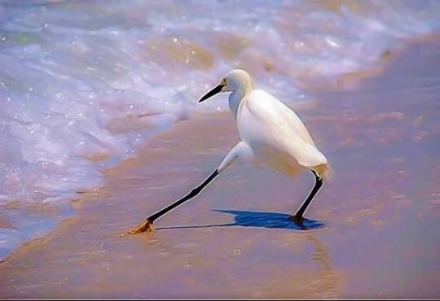
https://pbs.twimg.com/media/DFMspoGVwAAl-Zz

Slide 13

BFF
your data & processes
BFF
?
service
GraphQL
service
MCP
BFF?
BFC?

Slide 14
What is MCP?
files
chat app
database
MCP
IDE
GitHub
your agent
your API
3 × 4 = 12 integrations
3 + 4 = 7
an open protocol · Anthropic, Nov 2024 · Linux Foundation (Agentic AI Foundation) since Dec 2025

Slide 15
Host, client, server
host: the AI app
Petclinic MCP server
MCP client
tools
resources
prompts
the model calls
the app reads
the user picks
JSON-RPC 2.0
stdio (local) or
Streamable HTTP (remote)
the model
GitHub MCP server
MCP client
tools
resources
prompts
the model calls
the app reads
the user picks

Slide 16
One tool call, on the wire
AI app (client)
MCP server
1 initialize
version, capabilities
2 tools/list
listVets: name, description, inputSchema
3 “Which vets work here?” → the model picks listVets
4 tools/call listVets {}
content: Carter, Leary, Douglas, …
5 the model answers in plain words

Slide 17
From operation to MCP tool
GraphQL operation
MCP tool
getOwnerDetails.graphql
description
@McpTool(
description = "One owner with their pets",
name = "getOwnerDetails")
Owner getOwnerDetails(
@McpToolParam(description = "Owner id")
String id) {
return graphQlClient.document("""
query GetOwnerDetails($id: ID!) {
owner(id: $id) {
firstName lastName
pets { name type { name } }
}
}""")
.variable("id", id)
.retrieveSync("owner")
.toEntity(Owner.class);
}
# One owner with their pets
query GetOwnerDetails($id: ID!) {
owner(id: $id) {
firstName lastName
pets { name type { name } }
}
}
name
operation
Written by hand with Spring AI's @McpTool and Spring's HttpSyncGraphQlClient.

Slide 18
From operation to in-process tool
GraphQL operation
In-process tool
getOwnerDetails.graphql
description
@Tool(
description = "One owner with their pets",
name = "getOwnerDetails")
Owner getOwnerDetails(
@ToolParam(description = "Owner id")
String id) {
return graphQlClient.document("""
query GetOwnerDetails($id: ID!) {
owner(id: $id) {
firstName lastName
pets { name type { name } }
}
}""")
.variable("id", id)
.retrieveSync("owner")
.toEntity(Owner.class);
}
# One owner with their pets
query GetOwnerDetails($id: ID!) {
owner(id: $id) {
firstName lastName
pets { name type { name } }
}
}
name
operation
Written by hand with Spring AI's @Tool and Spring's HttpSyncGraphQlClient.

Slide 19
MCP tool definition
GraphQL operation
{
"name": "getOwnerDetails",
"description":
"Returns one owner with their pets.",
"inputSchema": {
"type": "object",
"properties": {
"id": { "type": "string" }
},
"required": ["id"]
},
"outputSchema": { … }
}
# Returns one owner with their pets.
query GetOwnerDetails(
$id: ID!
) {
owner(id: $id) {
firstName lastName
pets { name type { name } }
}
}
description
name
name
description
input
output
input
output

Slide 20
your data & processes
service
GraphQL
service
MCP

Slide 21
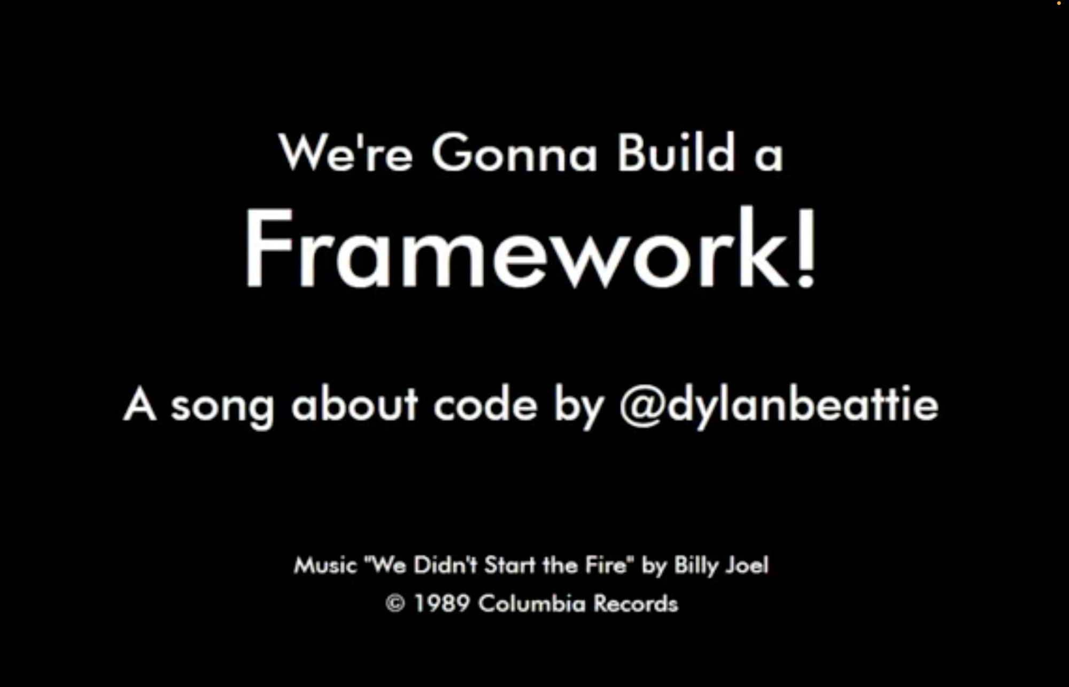
youtube.com/watch?v=Wm2h0cbvsw8

Slide 22
ATQL
GATool
rhymes with cool
Generic API Tool · GraphQL Agent Tool · General Availability Tool
Generic Agentic Tool · Generic Algorithm Tool

Slide 23
curated operations
MCP tools
for any MCP client
findPets.graphql
getOwnerDetails.graphql
GATool
listVets.graphql
in-process tools
for an agent in your app (Spring AI)
src/main/resources/gatool/mcp/queries

Slide 24
Demo
GATool: generated and curated tools

Slide 25
From a GraphQL API to MCP tools: the whole change
pom.xml
+ 1 dependency
application.properties
+ 1 property
10 × .graphql
5 queries, 5 mutations
0
lines of Java

Slide 26
T
right tools,
right arguments
“Which vets work
at the clinic?”
MCP
listVets
A
12 local models
(Ollama)
right facts,
nothing invented
promptfoo
16 read questions · write questions · 12 models

Slide 27
“Which pets have not visited
the clinic yet?”
Orphan Pet No-Visit
updatePet
updatePet
Orphan Pet No-Visit
updatePet
Orphan Pet No-Visit
qwen3.5:0.8b
Now: on a read question, every write call is declined.

Slide 28
Keycloak
sign in
token
read tools
no token
mcp:tools
MCP client
MCP endpoint
(GATool)
401: sign in there, for these scopes
write tools
mcp:tools
petclinic:write
every call carries the token
OAuth 2.1 · scopes per tool · rate limit per caller

Slide 29
application.properties
spring.security.oauth2.resourceserver.jwt.issuer-uri=http://localhost:8180/realms/petclinic
spring.security.oauth2.resourceserver.jwt.audiences=http://localhost:8080/mcp
gatool.mcp.security.resource=http://localhost:8080/mcp
gatool.mcp.security.baseline-scopes=mcp:tools
addPet.graphql
# Registers a new pet for an owner and returns the id of the pet.
mutation AddPet($ownerId: ID!, $name: String!, $birthDate: Date!, $typeId: ID!)
@gatool(scopes: ["petclinic:write"]) {
addPet(input: {ownerId: $ownerId, name: $name, birthDate: $birthDate, typeId: $typeId}) {
id
}
}

Slide 30
Demo
signing in from the MCP Inspector

Slide 31
OK… but my API has more than 10 operations.

Slide 32
Denver open data
ArcGIS REST
National Weather Service
Colorado vet licenses, shelters
REST
Socrata
NRCS snowpack
CDPHE animal disease
REST
SOAP
Colorado water (DWR)
Parks and Wildlife ranges
REST
ArcGIS REST
USGS earthquakes
openFDA animal drug events
GraphQL
REST
REST
National Park Service
iNaturalist sightings
REST
REST
NLR fuel stations
US Census geocoder
REST
REST

Slide 33
root query fields
5
185
→
types
17
→
469
15,925 lines of schema (about 136,000 tokens)

Slide 34
owners
owner
pets
vets
petTypes
awdbStations
awdbData
awdbForecasts
awdbReferenceData
cdpheAnimalsTestedPositive
cdpheAnimalDiseaseCases
censusGeocodeAddress
coloradoVeterinaryLicenses
coloradoShelterReports
coloradoShelterTotals
cpwWildlifeAt
cpwWildlifeLayers
denverDogParks
denverAnimalServiceRequests
denverAnimalServiceRequestCounts
denverKennelLicenses
dwrTelemetryStations
dwrTelemetryStationDataTypes
dwrTelemetryReadings
dwrTelemetryHourlyReadings
dwrTelemetryDailyReadings
dwrTelemetryDischargeMeasurements
dwrTelemetryDecodeSettings
dwrTelemetryRatingTables
dwrTelemetryShiftAdjustedRatingTable
dwrTelemetryShiftCurves
dwrSurfaceWaterStations
dwrSurfaceWaterStationDataTypes
dwrSurfaceWaterDailyValues
dwrSurfaceWaterMonthlyValues
dwrSurfaceWaterWaterYearValues
dwrActiveAdministrativeCalls
dwrHistoricalAdministrativeCalls
dwrCallAnalysisByStructure
dwrCallAnalysisByStreamLocation
dwrWaterSourceRouteAnalysis
dwrWaterSourceRouteFramework
dwrWaterRightNetAmounts
dwrWaterRightTransactions
dwrStructures
dwrDailyDiversionRecords
dwrMonthlyDiversionRecords
dwrYearlyDiversionRecords
dwrDiversionRecordComments
dwrReservoirStageVolumes
dwrWaterClasses
dwrParcelUseTimeSeries
dwrWellPermits
dwrWellPermitActions
dwrGroundwaterLevelWells
dwrGroundwaterLevelMeasurements
dwrGeophysicalLogWells
dwrGeophysicalLogPicks
dwrMeterReadings
dwrJurisdictionalDams
dwrNonJurisdictionalDams
dwrLivestockAndErosionControlDams
dwrClimateStations
dwrClimateStationDataTypes
dwrClimateStationDailyValues
dwrClimateStationMonthlyValues
dwrClimateStationFrostDates
dwrCounties
dwrWaterDivisions
dwrWaterDistricts
dwrDesignatedBasins
dwrManagementDistricts
dwrGroundwaterPublications
dwrPermitActionNames
dwrTelemetryParameters
dwrClimateStationMeasurementTypes
dwrCurrentInUseCodes
dwrDiversionRecordObservationCodes
dwrDiversionRecordTypes
dwrDiversionNotUsedCodes
dwrStationFlags
dwrMeterReadingSubmissionTypes
inatObservations
inatObservation
inatObservationTaxonSummary
inatObservationSpeciesCounts
inatObservationHistogram
inatObservationObservers
inatObservationIdentifiers
inatObservationPopularFieldValues
inatIdentifications
inatIdentification
inatIdentificationCategories
inatIdentificationSpeciesCounts
inatIdentificationIdentifiers
inatIdentificationObservers
inatIdentificationRecentTaxa
inatSimilarSpecies
inatTaxa
inatTaxon
inatTaxonAutocomplete
inatControlledTerms
inatControlledTermsForTaxon
inatPlace
inatPlaceAutocomplete
inatPlacesNearby
inatProjects
inatProject
inatProjectMembers
inatProjectAutocomplete
inatSearch
inatUser
inatUserProjects
inatUserAutocomplete
inatPosts
nlrFuelStationsNear
npsParks
npsAlerts
npsRoadEvents
npsWebcams
npsThingsToDo
npsCampgrounds
npsVisitorCenters
npsFeesAndPasses
npsEvents
npsActivities
npsActivityParks
nwsActiveAlerts
nwsActiveAlertsForArea
nwsActiveAlertsForZone
nwsActiveAlertCounts
nwsAlerts
nwsAlert
nwsAlertTypes
nwsActiveAlertsForMarineRegion
nwsPoint
nwsGridpointForecast
nwsGridpointHourlyForecast
nwsGridpointRawForecastData
nwsZoneForecast
nwsIconConditions
nwsGlossary
nwsLatestStationObservation
nwsStationObservations
nwsStationObservationAtTime
nwsObservationStation
nwsObservationStations
nwsGridpointObservationStations
nwsZoneObservations
nwsZoneObservationStations
nwsTerminalAerodromeForecasts
nwsOffice
nwsOfficeHeadlines
nwsOfficeHeadline
nwsOfficeWeatherStories
nwsOfficeBriefing
nwsLatestTextProduct
nwsTextProducts
nwsTextProduct
nwsTextProductsOfTypeAtLocation
nwsTextProductsOfType
nwsTextProductTypes
nwsTextProductTypesAtLocation
nwsTextProductLocations
nwsTextProductTypeLocations
nwsZone
nwsZones
nwsZonesOfType
nwsRadarStation
nwsRadarStations
nwsRadarStationAlarms
nwsRadarQueue
nwsWeatherRadioTransmitter
nwsCountyWeatherRadioTransmitters
nwsWeatherRadioTransmitters
nwsCenterWeatherServiceUnit
nwsCenterWeatherAdvisories
nwsSigmetsOfAirTrafficServiceUnitOnDate
nwsSigmets
nwsSigmetsOfAirTrafficServiceUnit
nwsSigmet
openFdaAnimalAdverseEvents
openFdaAnimalAdverseEventCounts
usgsEarthquakes
usgsEarthquakeCount
185 tools

Slide 35
Tool search: load tools only when needed
what the model sees
185 tools, waiting
toolSearch(“lost pet”)
awdbForecasts
toolSearch
censusGeocodeAddress
BM25 · embeddings · regex
coloradoVeterinaryLicenses
denverAnimalServiceRequests
cpwWildlifeAt
denverAnimalServiceRequestCounts
denverAnimalServiceRequestCounts
denverAnimalServiceRequests
2 definitions, not 185
denverDogParks
agent
dwrSurfaceWaterStations
inatObservations
nlrFuelStationsNear
npsParks
nwsActiveAlerts
usgsEarthquakes
denverAnimalServiceRequests(…)
… 172 more
Anthropic tool search (Nov 2025): regex, BM25 · Spring AI Tool Search Tool: Lucene, vector, regex

Slide 36
1
searchSchema
find fields by meaning
2
introspectType
read one type
no curated files
3
executeGraphql
run the query it wrote
experimental · the model writes the query

Slide 37
What is an embedding?
“off-leash dog park”
embedding
model
[ 0.12, -0.80, 0.33, 0.05, … ]
1,024 numbers
off-leash dog park
snow forecast
place where my dog can run free
dog park near me
ground shaking
earthquake
close = similar meaning

Slide 38
Search by meaning, not by words
“Where can my pup run without a lead?”
by words
by meaning
pup run without lead
Query.denverDogParks
no word in common
with dog, park, off-leash
“The off-leash dog parks of
the City and County of Denver …”
✗
✓

Slide 39
searchSchema, step by step
once, at startup
every field of
the schema (SDL)
embedding
model
one vector per field,
cached on disk
every question
“Where can my pup
run without a lead?”
embedding
model
compare with
every field
(cosine)
best first,
up to 5,000
tokens
Instruct: Given a question, retrieve the GraphQL schema field that answers it
the instruction the question is sent with, the format Qwen3 embedding models are trained on

Slide 40
A model that reads GraphQL
Qwen3-Embedding-0.6B-GraphQL
right field in the top 50 (recall@50)
Qwen3-Embedding-0.6B, fine-tuned on 4,788 question → Type.field pairs
1,024 numbers per text
Runs locally in Ollama, 8-bit
Apache 2.0
GraphQL fine-tune
63.6%
OpenAI text-embedding-3-large
59.8%
Qwen3 base
58.5%
Why custom: a schema is not prose.
camelCase names, type signatures, short descriptions
GraphQL AI Working Group benchmark, 816 questions, 5 schemas. Source: the model card.

Slide 41
What a search returns
searchSchema(“Were any lost pets reported in Denver last month?”)
Query.denverAnimalServiceRequests:
denverAnimalServiceRequests(caseTypes: [DenverAnimalCaseType!],
zipCode: String, councilDistrict: Int,
createdFrom: Date, createdTo: Date,
page: Int! = 1, size: Int! = 10): DenverAnimalServiceRequestPage!
Query.denverAnimalServiceRequestCounts:
denverAnimalServiceRequestCounts(createdFrom: Date, createdTo: Date,
zipCode: String, councilDistrict: Int): [DenverAnimalCaseCount!]!
Which values? Which fields? Never guess a name.

Slide 42
introspectType: look inside a type
when to use it
introspectType(“DenverAnimalCaseType”)
a value you pass: an enum or an input type
the fields you can select on a type it returns
enum DenverAnimalCaseType {
LOST_PET BARKING_DOG PET_SURRENDER LOOSE_ANIMAL …
}
introspectType(“DenverAnimalServiceRequestPage”)
search finds where to look,
introspectType shows what is inside
type DenverAnimalServiceRequestPage {
requests: [DenverAnimalServiceRequest!]!
page: Int!
totalPages: Int!
totalRequests: Int!
}

Slide 43
executeGraphql: run what it wrote
query {
denverAnimalServiceRequests(
caseTypes: [LOST_PET],
createdFrom: "2026-09-01",
createdTo: "2026-09-30") {
totalRequests
requests { createdDate zipCode status }
}
}
valid for the schema
within limits
a query, not a mutation
no __schema, __type
API
data
checks
introspectType
errors name the types to read
then try again

Slide 44
One question, three tools
GATool
agent
1 searchSchema(“lost pets in Denver”)
Query.denverAnimalServiceRequests
2 introspectType(“DenverAnimalCaseType”)
LOST_PET BARKING_DOG …
3 executeGraphql(query { … })
{ totalRequests, requests: [ … ] }

Slide 45
Demo
dynamic tools over the large schema

Slide 46
Curated operations
Dynamic three tools
reviewed in a pull request
small, cheap, predictable
the questions you planned for
the model writes the query
the whole schema
the long tail of questions
Or both: curated tools for the common questions, the three tools for the rest.

Slide 47
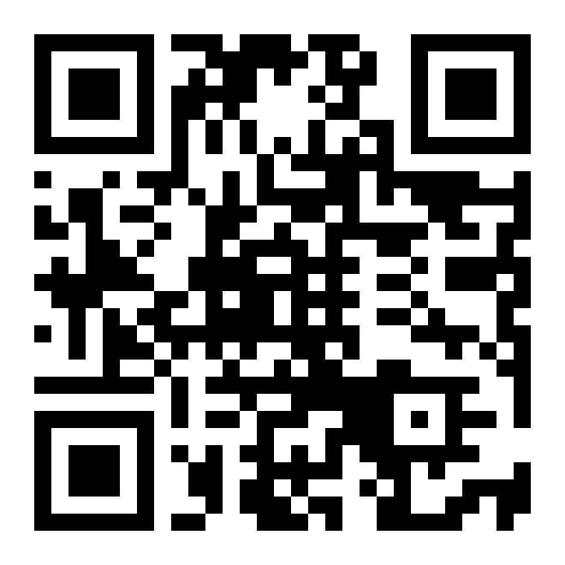
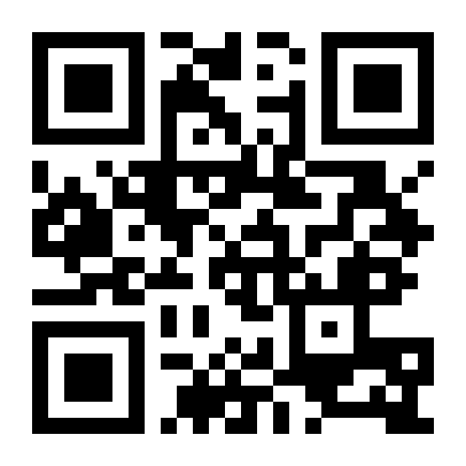
Thank you
Questions?
linkedin.com/in/zkozina
gatool.io
Željko Kozina · @zkozina

