Slide 1
Hypermedia APIs

Slide 2

HTTP APIs - The Shared Story

Slide 3

RESTful Web Services - 2007
"Our ultimate goal in this book is to reunite the programmable web with the human web. We envision a single interconnected network: a World Wide Web that runs on one set of servers, uses one set of protocols, and obeys one set of design principles."
- Richardson & Ruby, 2008
Notes:
http://shop.oreilly.com/product/9780596529260.do
Quote from the Preface.
Focus on HTTP, describes Resource-Oriented Architecture pattern (ROA) also called Create-Read-Update-Delete or CRUD

Slide 4
Richardson Maturity Model (RMM)
Notes:
(pacing slide)

Slide 5
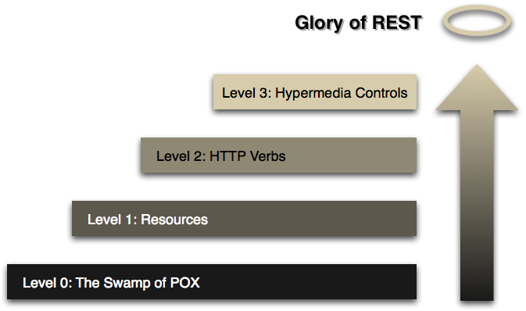
Richardson Maturity Model (RMM)
Notes:
Leonard Richardson's Maturity Hueristic: http://www.crummy.com/writing/speaking/2008-QCon/act3.html
This is based on the MArtin Fowler explanation:

Slide 6
Richardson Maturity Model (RMM)

Slide 7
Richardson Maturity Model (RMM)

Slide 8
Richardson Maturity Model (RMM)

Slide 9
Richardson Maturity Model (RMM)

Slide 10
Richardson Maturity Model (RMM)

Slide 11
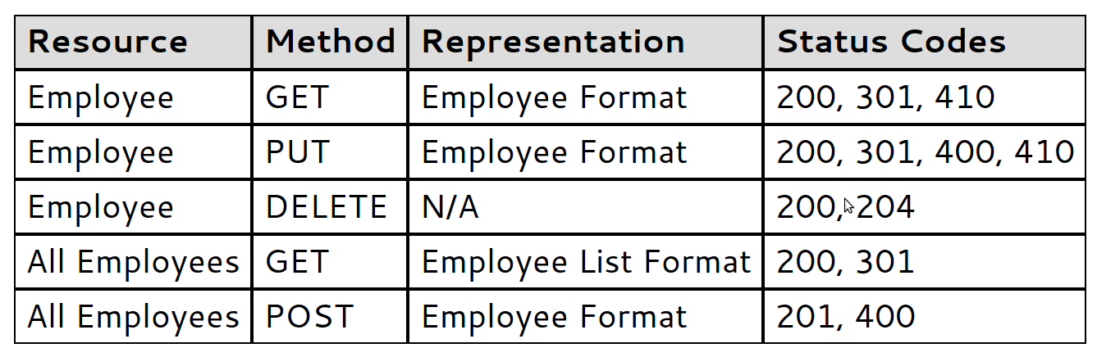
CRUD in one slide
Notes:
This is from a 2006 blog post by Joe Gregorio (from 2004 XML.com).
http://bitworking.org/news/How_to_create_a_REST_Protocol
Note that "RESTful Web Services" is released in 2007 and Rails switches from SOAP to REST support in 2007
http://en.wikipedia.org/wiki/Ruby_on_Rails
(DHH writes the foreward for RWS).

Slide 12
Gregorio's Four Questions (2006)
What are the URIs?
What are the formats?
What methods are supported at each URI?
What status codes could be returned?
Notes:
Also from the same blog post.

Slide 13
Common CRUD Guidance
URI design is the primary taskhttp://{server}/{collection}/{id}
Focus on serializing domain objects{customer: {name:"mike",...}}
Use URIs to express object relationshipshttp://example.com/users/abc/friends/xyz
Use controller URIs to handle service taskshttp://example.com/reports/1
Notes:
Additional common guidance on ROA/CRUD implementation.

Slide 14
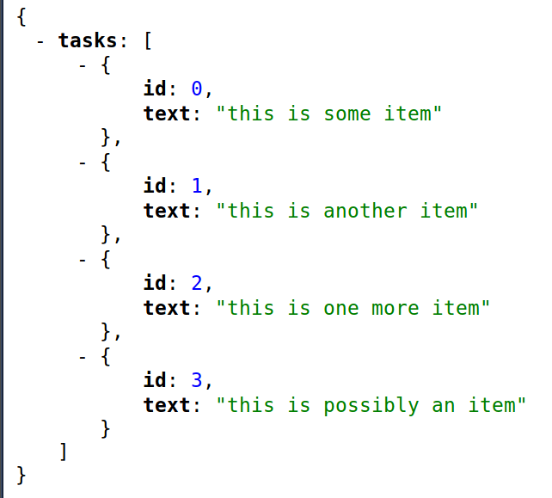
To-Do CRUD App Demo
Notes:
running code: http://protected-mesa-6779.herokuapp.com/
source code: https://github.com/apiacademy/tasks-crud

Slide 15
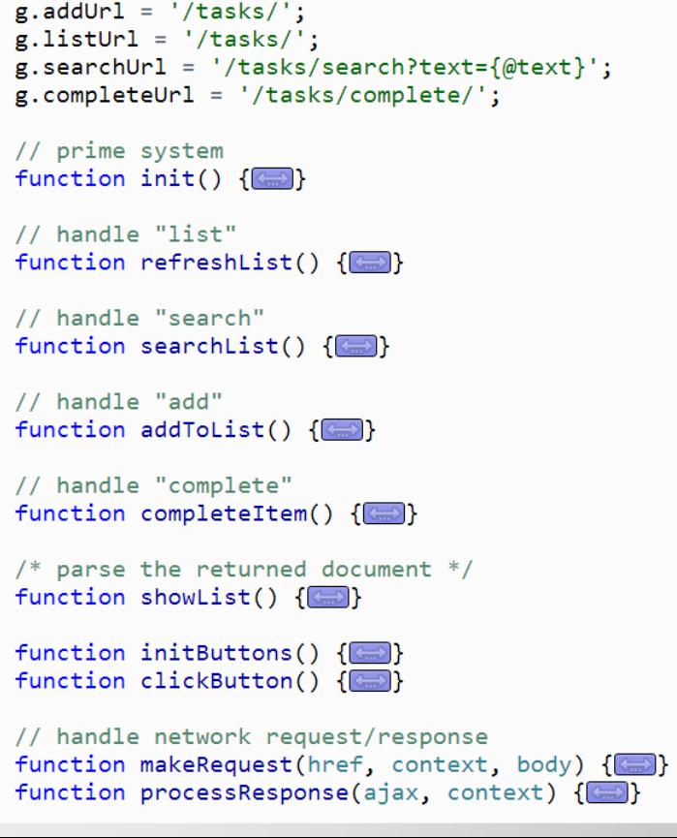
To-Do CRUD App Demo
Notes:
running code: http://protected-mesa-6779.herokuapp.com/
source code: https://github.com/apiacademy/tasks-crud

Slide 16

Hypermedia APIs - The Linked Story

Slide 17
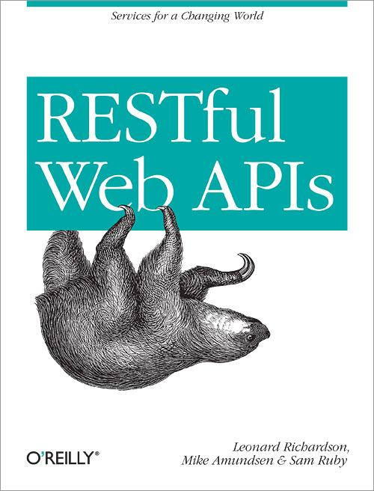
RESTful Web APIs - 2013
"RESTful Web Services covered hypermedia, but it wasn’t central to the book. It was possible to skip the hypermedia parts of the book and still design a functioning API. By contrast, RESTful Web APIs is effectively a book about hypermedia." - Richardson & Amundsen
Notes:
http://shop.oreilly.com/product/0636920028468.do
Quote from the Introduction.
Hypermedia is central to the style advocated in this book.

Slide 18
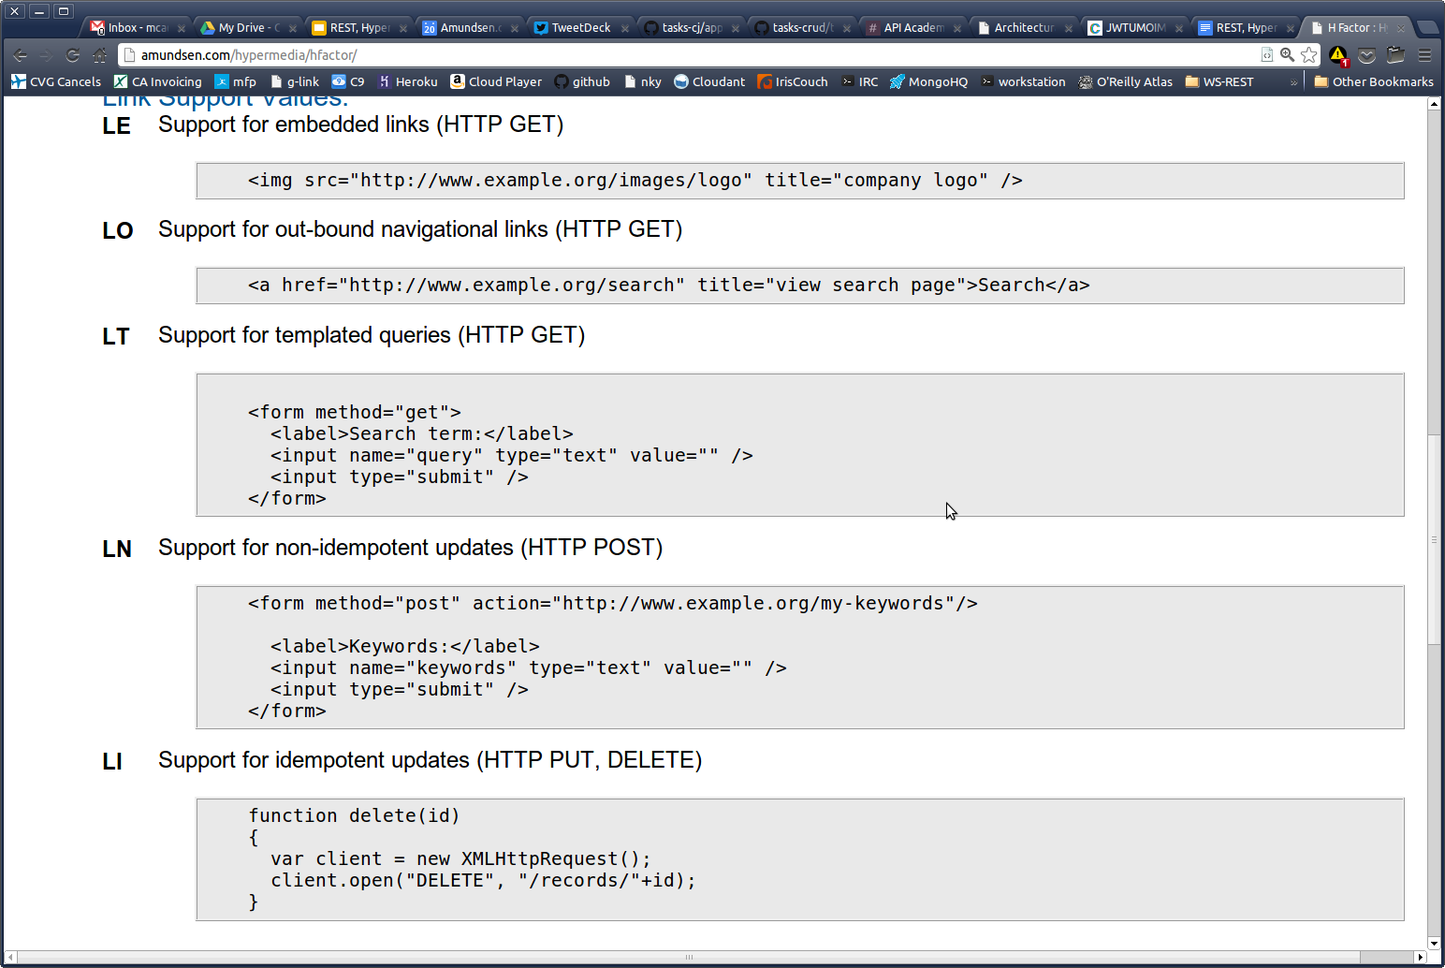
H-Factors (2010)
Link Factors
LO
LE
LT
LN
LI
Notes:
The H Factor of a media-type is a measurement of the level of hypermedia support and sophistication of a media-type. H Factor values can be used to compare and contrast media types in order to aid in selecting the proper media-type(s) for your implementation.
http://amundsen.com/hypermedia/hfactor/

Slide 19
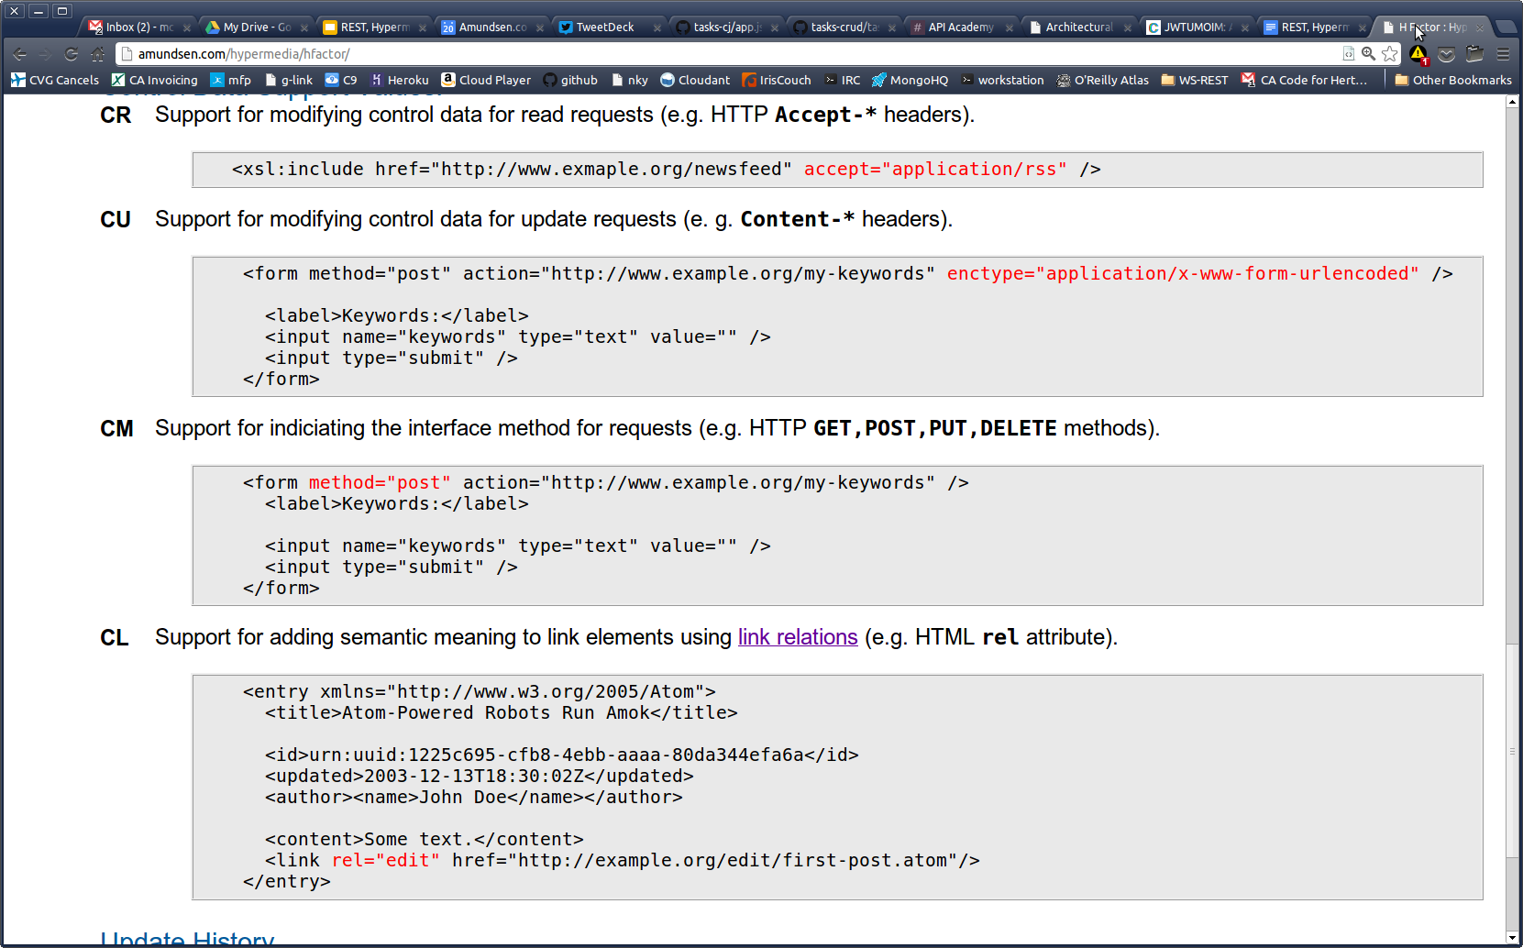
H-Factors
Control Factors
CR
CU
CM
CL

Slide 20
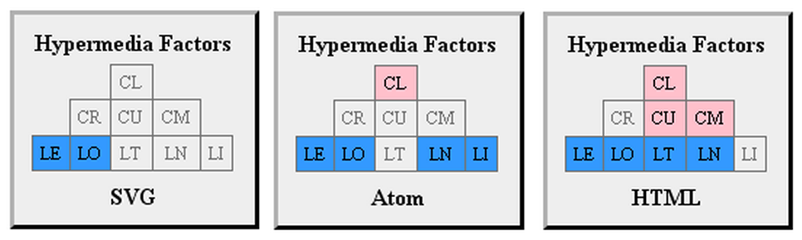
H-Factors
Notes:
You can use H-Factors to analyze existing formats for support of inline protocol expression

Slide 21
Hypermedia in one slide
{"link" : {"rel" : "help", "href" : "..."} }
{"image" : {"rel" : "logo", "href" : "..."} }
{"form" : {"rel" : "edit", "href" : "...", "method" : "put", "data" : [{"name":"...","value":"..."}] } }
Notes:
The essence of hypermedia-oriented implementations is to express protocol semantics for
- links (navigation)
- transclusions (img, iframe)
- forms (query & body)
Note that the URL is no longer "interesting" to the client, only the server. Now the "rel" is what clients are about.

Slide 22
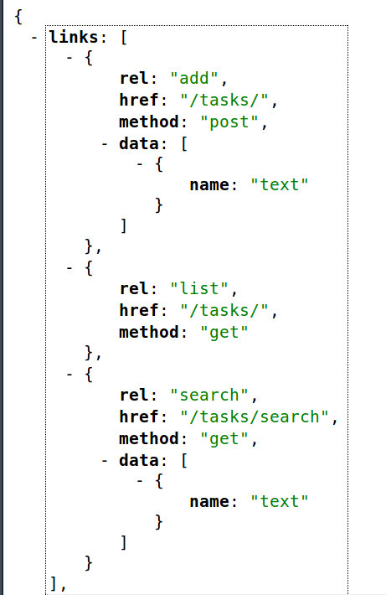
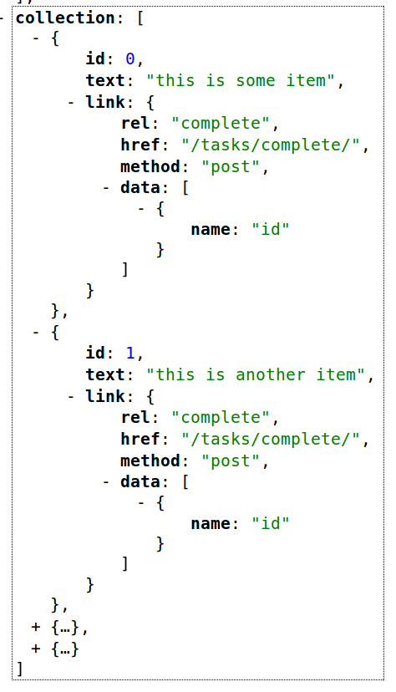
To-Do Hypermedia Demo App
Notes:
running code: http://mighty-retreat-8867.herokuapp.com/
source code: https://github.com/apiacademy/tasks-hypermedia

Slide 23
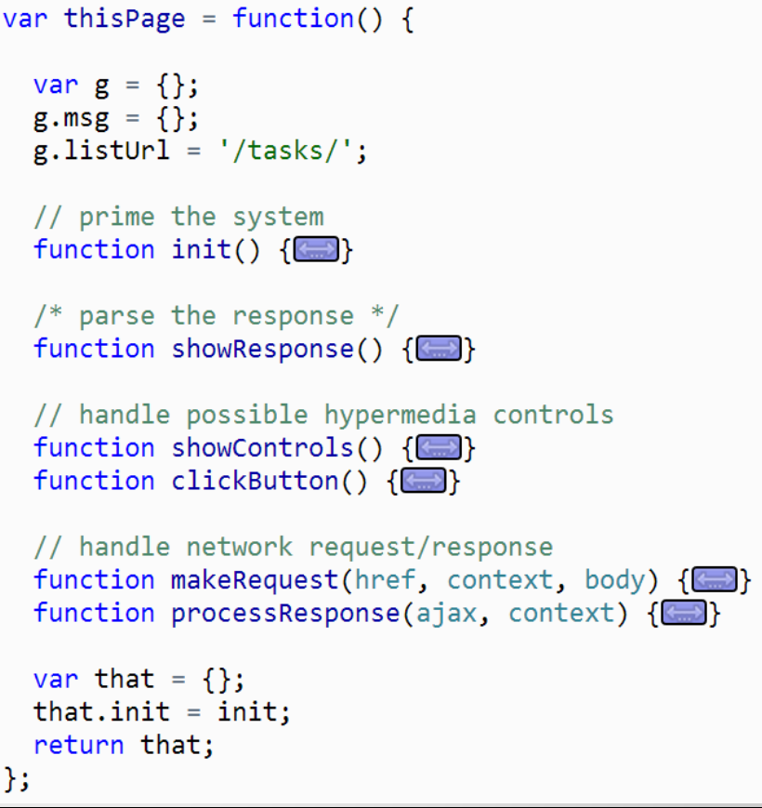
To-Do Hypermedia Demo App
Notes:
running code: http://mighty-retreat-8867.herokuapp.com/
source code: https://github.com/apiacademy/tasks-hypermedia

