Slide 1

The Representor Pattern
Mike Amundsen API Academy @mamund

Slide 2
Highlights
XML or JSON: Pick a Side!
When Formats are Negotiable
The Representor Pattern
Server-Side Representor
Summary

Slide 3
XML or JSON: Pick a Side!

Slide 4
XML or JSON: Pick a Side!
XML is Dead, long live XML?
The New kids in town
Atom (2006)
HAL (2011)
Collection+JSON (2011)
Siren (2012)
UBER (2014)
Mason, JSON API, CPHL, etc.

Slide 5
Negotiating
The Fallacy of “The Right Format”
Reasons for “Just One”
Cheaper
Easier
Controlled

Slide 6
Negotiating
The Fallacy of “The Right Format”
Reasons for “Just One”
Cheaper
Easier
Controlled
What if we could make supporting multiple formats:
Cheaper
Easier
Controlled

Slide 7
The Representor Pattern

Slide 8
Implementing Representor Pattern
Separate Form(at) from Function
Use a Selecting Algorithm
Implement a Dispatch Routine
Create Transformers for Each Format
Rely on Shared Model for All Transformers

Slide 9
Separate Format from Function
DORR (again)
Data
Object
Resource
Representation
What you send vs. How you “package” it

Slide 10
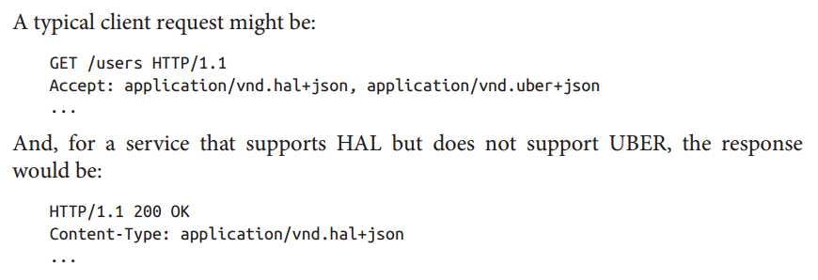
Selection Algorithm (context)
HTTP Accept
HTTP Content-Type

Slide 11
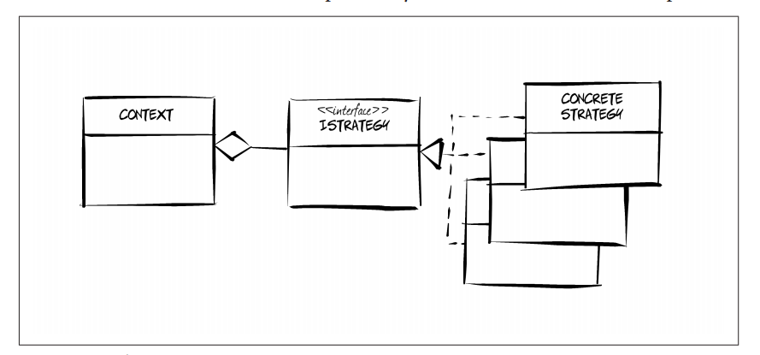
Strategy Pattern (GoF)

Slide 12
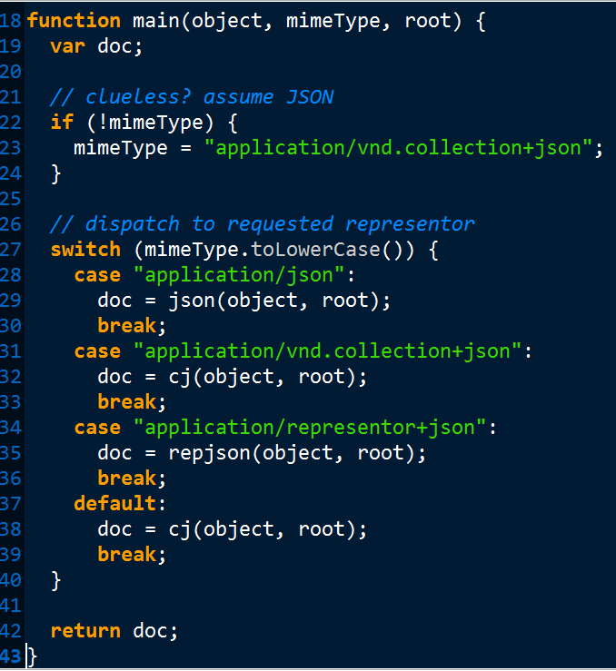
Dispatch (IStrategy)

Slide 13
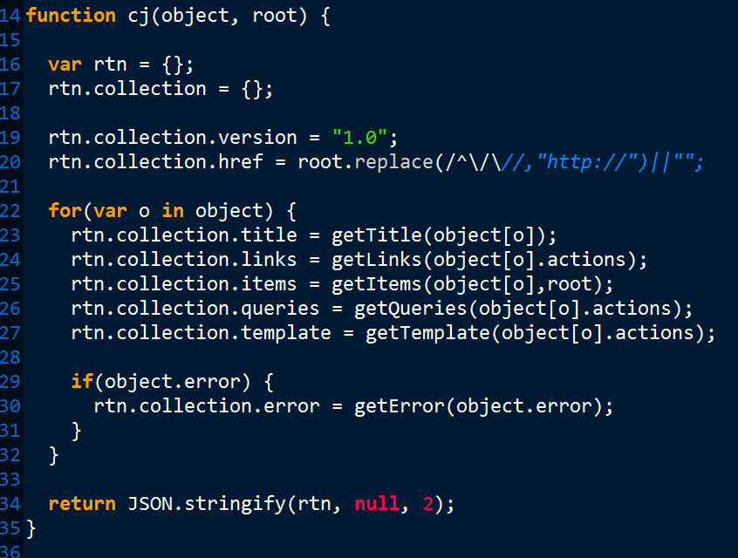
Cj Representor (ConcreteStrategy)

Slide 14
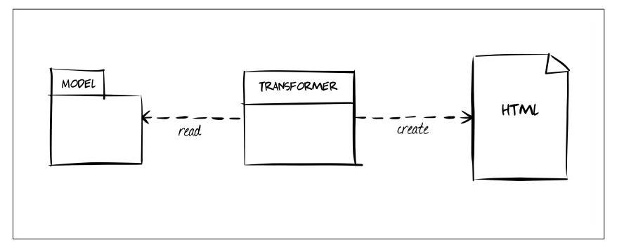
Transform View Pattern (Fowler)

Slide 15
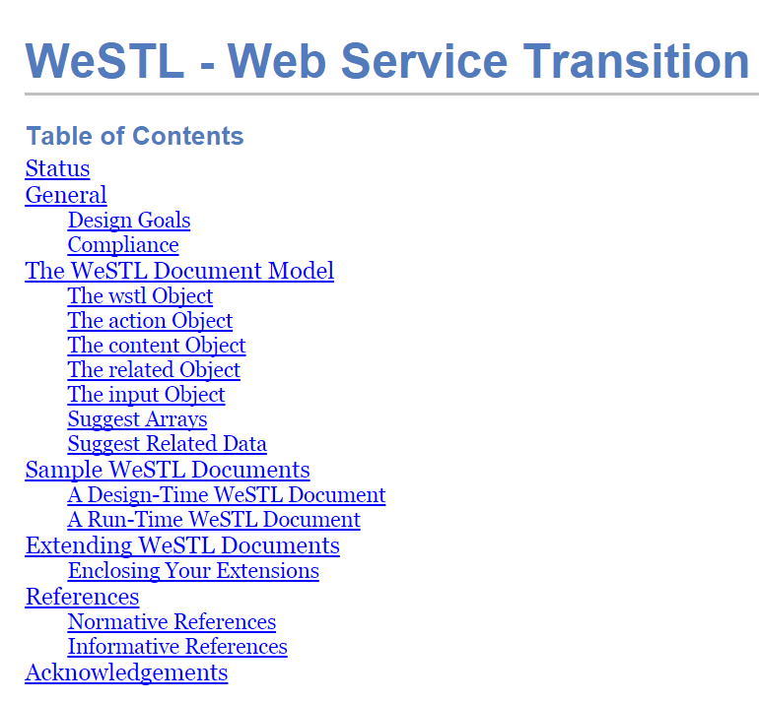
Web Service Transition Language (WeSTL)

Slide 16
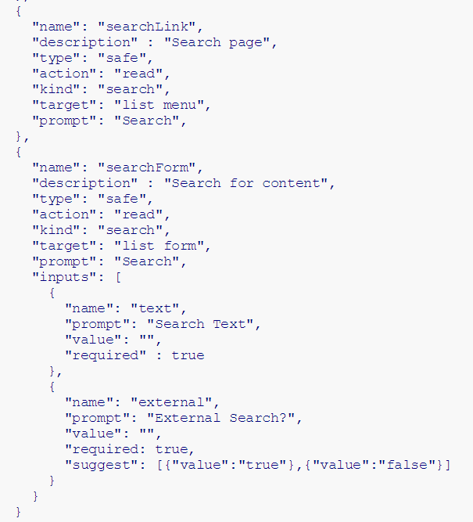
WeSTL

Slide 17
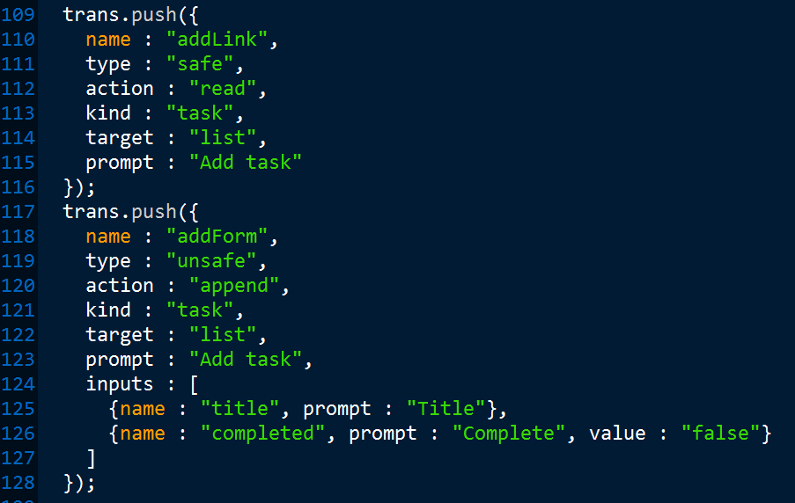
Transitions.js

Slide 18
Transform View Pattern (Fowler)

Slide 19
XML or JSON?
Many options available today
Atom (2006)
HAL (2011)
Collection+JSON (2011)
Siren (2012)
UBER (2014)
Mason, JSON API, CPHL, etc.
Expect more to come, esp. due to IoT

Slide 20
Negotiating is the Key
The Fallacy of “The Right Format”
Make supporting multiple formats:
Cheaper
Easier
Controlled

Slide 21
Implementing Representor Pattern
Separate Form(at) from Function
Use a Selecting Algorithm (accept & content-type)
Implement a Dispatch Routine (representor.js)
Create Transformers for Each Format (cj.js)
Rely on Shared Model for All Transformers (wstl.js)

Slide 22
The Representor Pattern
Mike Amundsen API Academy @mamund

