Slide 1

Exercise: DORR Part #2

Slide 2
Add PUT and Cj Queries
Implement PUT for the Task Resource
Implement Queries for the Cj Representor

Slide 3
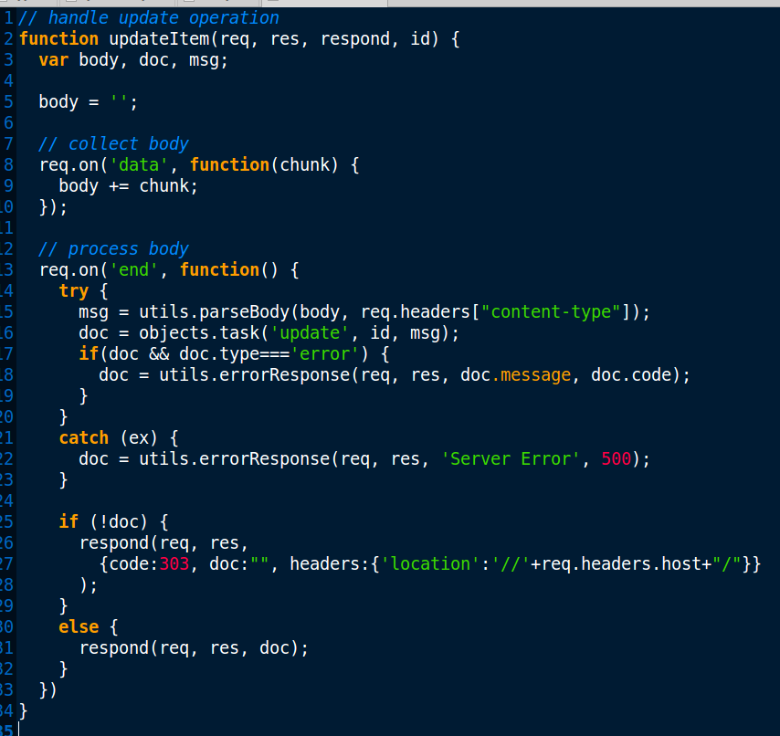
Add PUT and Cj Queries
Implement PUT for the Task Resource

Slide 4
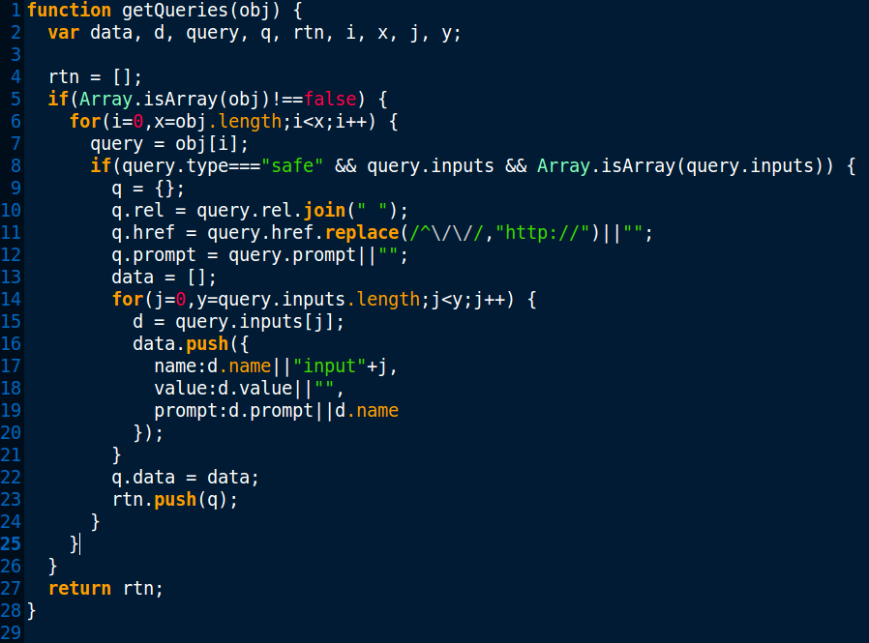
Add PUT and Cj Queries
Implement Queries for the Cj Representor

