Slide 1

DORR Architecture for Hypermedia Services
Mike Amundsen API Academy @mamund

Slide 2
Highlights
Evolvability
Loosely Coupled
DORR Pattern
Conway

Slide 3
Evolvability

Slide 4

Evolvability
evolution: “the gradual development of something, especially from simple to a more complex form”

Slide 5
Evolvability
evolution: “the gradual development of something, especially from simple to a more complex form”

Slide 6

Evolvability
Refactoring: “the process of restructuring existing computer code without changing its external behavior.”

Slide 7
Evolvability
Refactoring: “the process of restructuring existing computer code without changing its external behavior.”

Slide 8
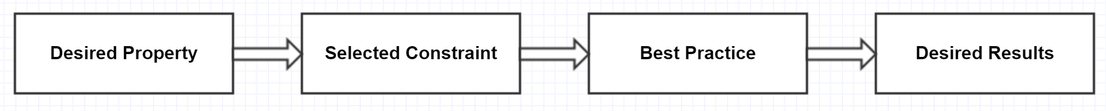
Evolvability is a System Property

Slide 9
Loosely-Coupled

Slide 10
Loosely-Coupled
“A system in which each of its components has little or no knowledge of the [internal] definitions of other separate components.”

Slide 11

Loosely-Coupled
“Program to an interface, not an implementation.” -GoF

Slide 12
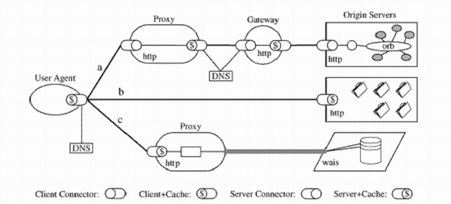
Loosely-Coupled
“Your system is not loosely-coupled if deploying component A means you MUST also deploy component B.”

Slide 13

Loosely-Coupled
“Embrace independent evolvability.” – Darrel Miller, Runscope

Slide 14
Loosely-Coupled as a Constraint

Slide 15
D.O.R.R.

Slide 16
D.O.R.R
Data Model (storage)
Object Model (functionality)
Resource Model (interface)
Representation Model (message)

Slide 17
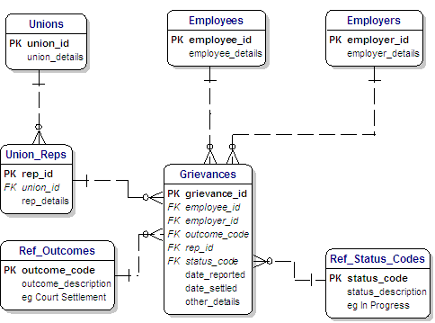
D.O.R.R
“Data Model”

Slide 18
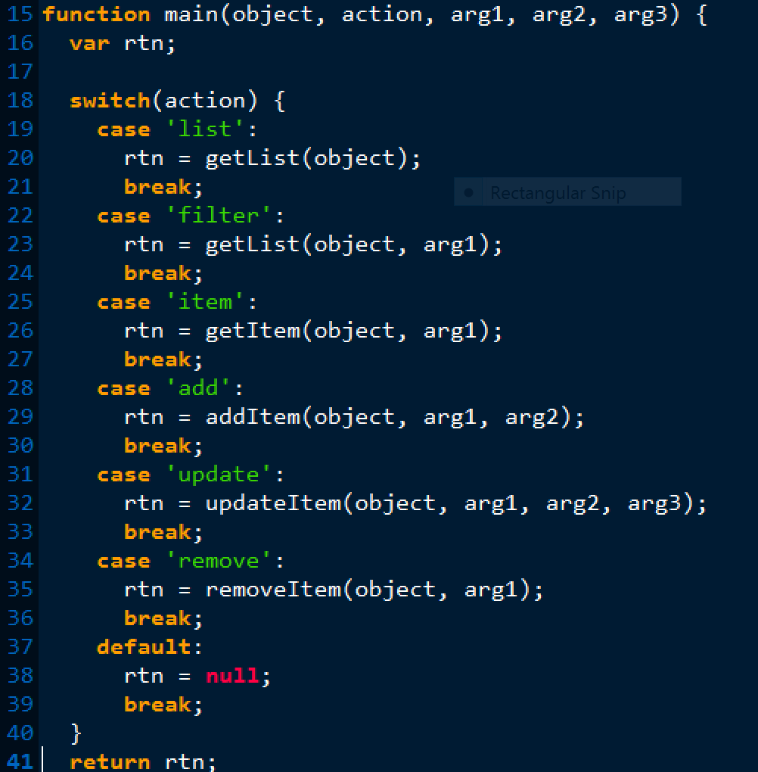

Slide 19
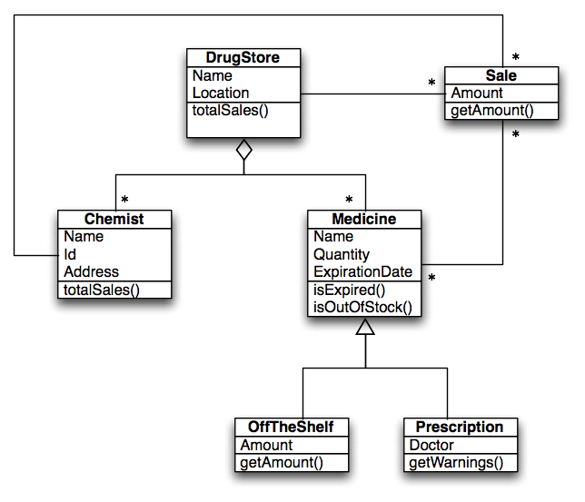
D.O.R.R
“Object Model”

Slide 20
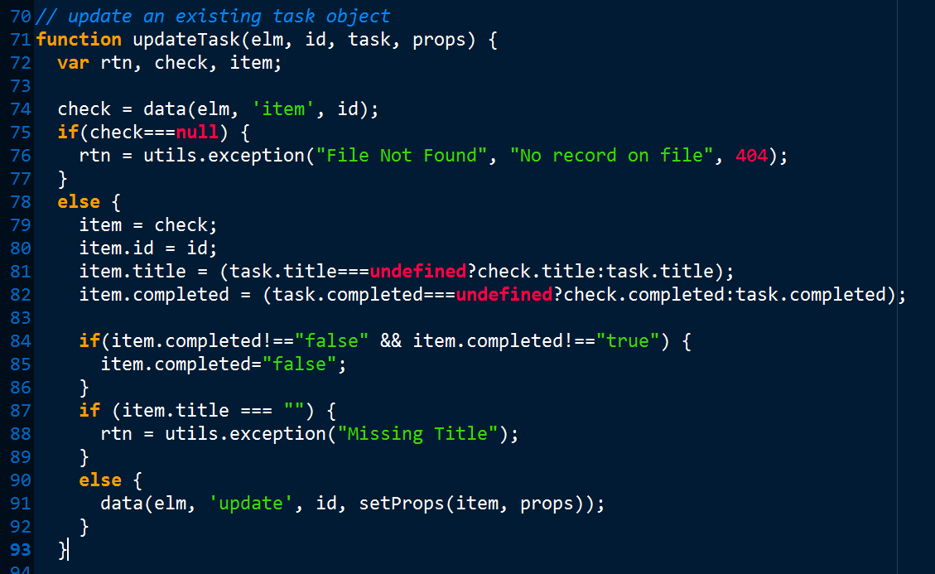

Slide 21
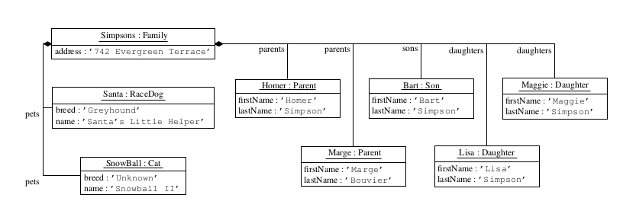
D.O.R.R
“Resource Model”

Slide 22
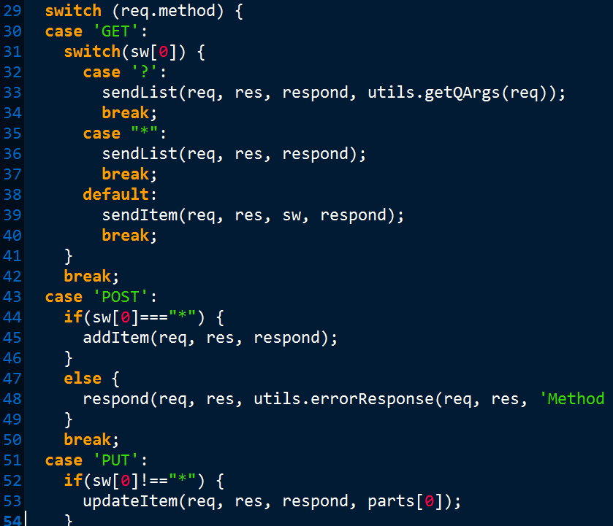

Slide 23
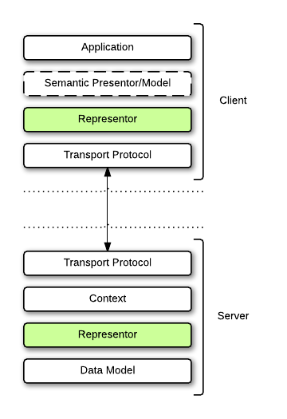
D.O.R.R
“Representor Model”

Slide 24
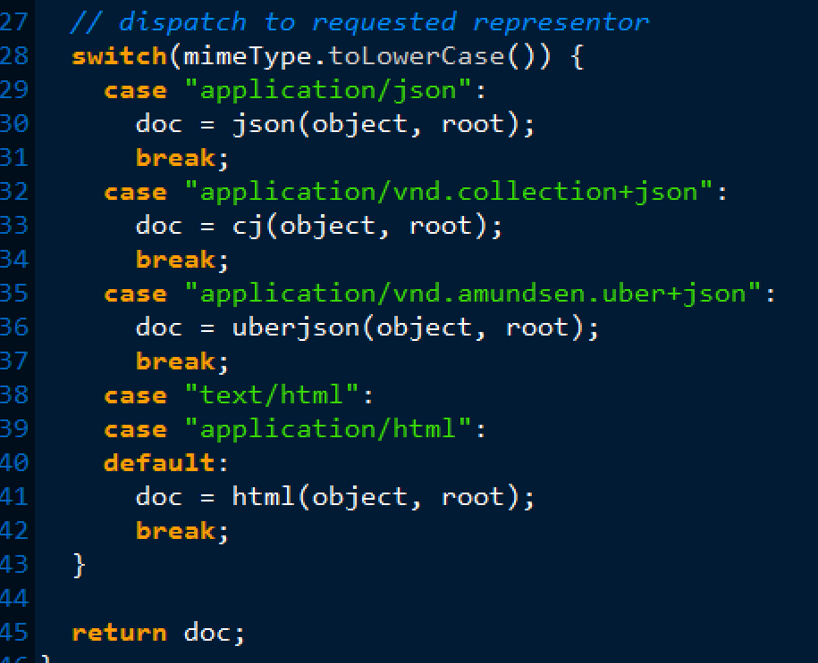

Slide 25
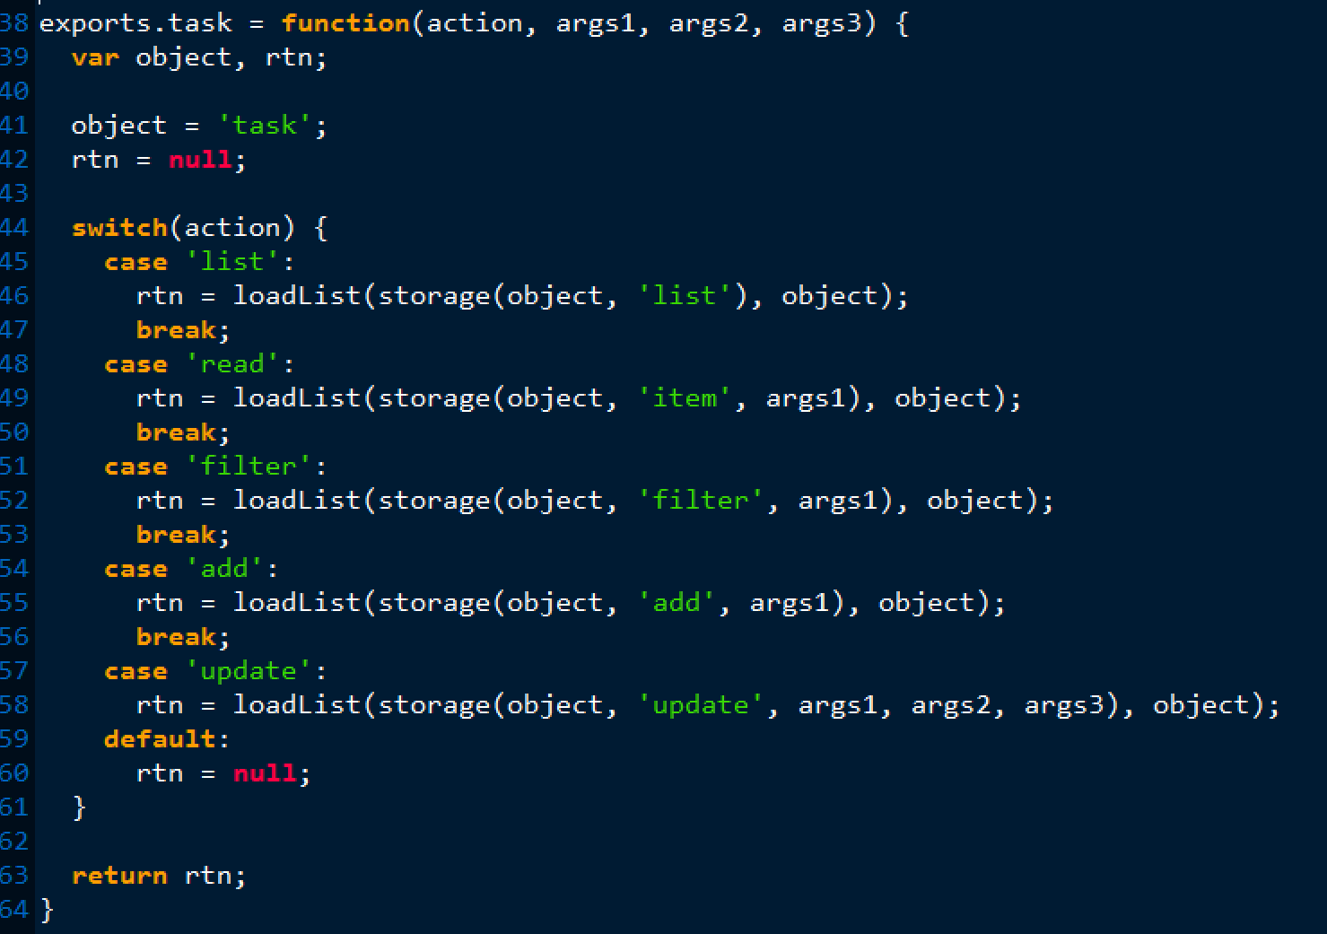
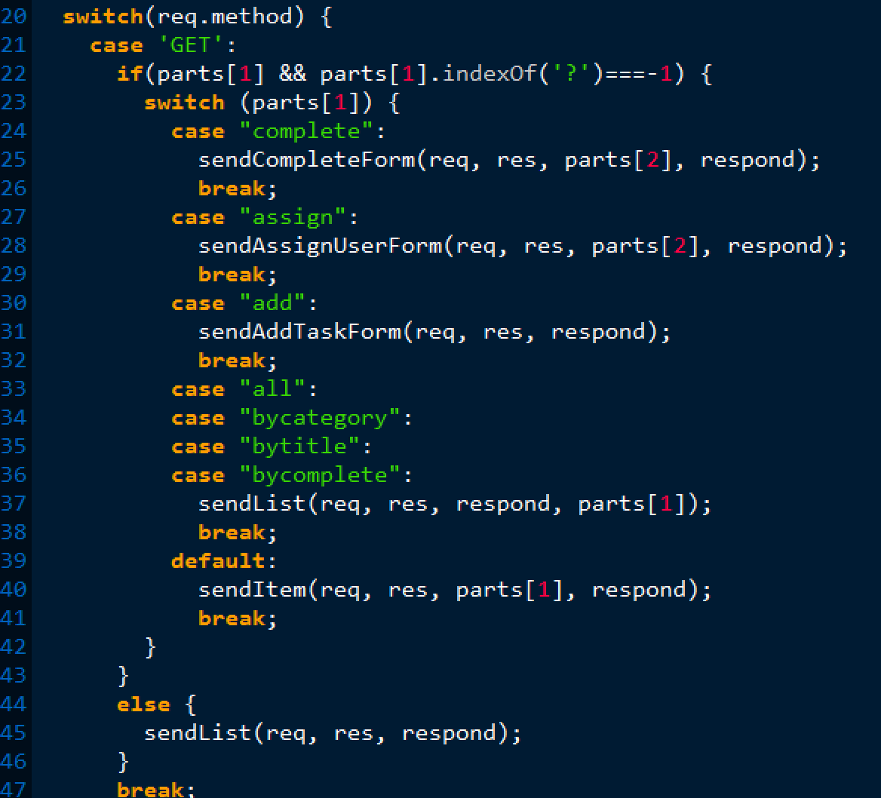
D.O.R.R
“Embrace independent evolvability.”

Slide 26
D.O.R.R. as a Best Practice

Slide 27
Conway’s Law

Slide 28

Conway’s Law
“Organizations produce systems which are copies of their communication structures.” – Mel Conway, 1968

Slide 29
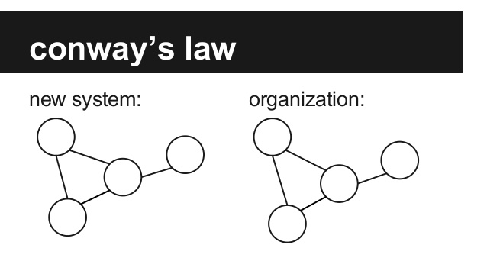
Conway’s Law

Slide 30
Conway’s Law

Slide 31

Conway’s Law
“If you have four teams working on a compiler project, you gat a four-pass compiler” – Eric S. Raymond

Slide 32
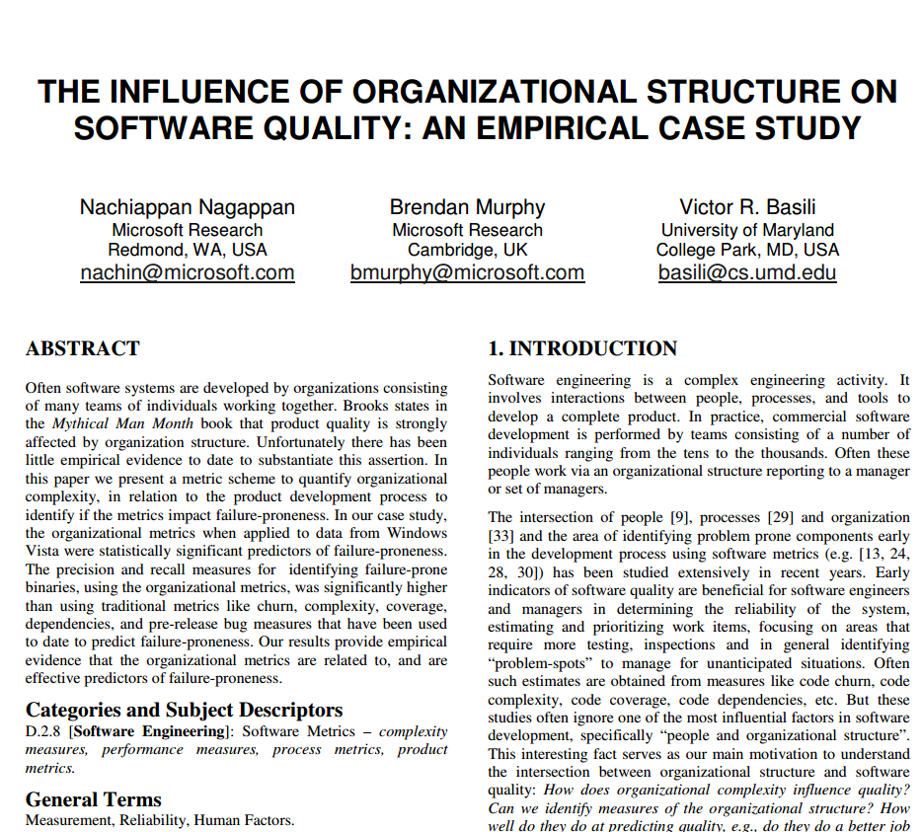
Conway’s Law
“Organizational metrics can predict software failure-proneness with a precision and recall of 85 percent.” – Microsoft Research

Slide 33
Conway’s Law is Inevitable

Slide 34
Summary

Slide 35

Continuous Deployment
“Every day you don’t release to production is another day you risk falling behind.”

Slide 36
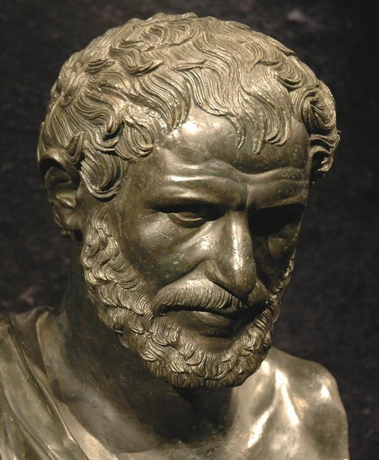
Change
“The only thing that is constant is change.” -- Heraclitus

Slide 37
Highlights
Evolvability
Loosely Coupled
DORR Pattern
Conway

Slide 38
DORR Architecture for Hypermedia Services
Mike Amundsen API Academy @mamund

