Slide 1

Exercise: DORR Part #1

Slide 2
Implement the UPDATE (Data & Objects)
Modify data.js to support “update”
Modify objects.js to support “updateTask”

Slide 3
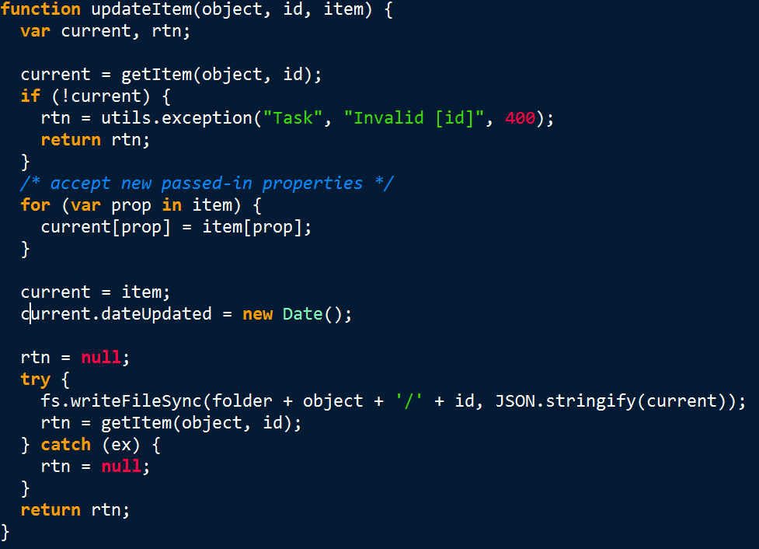
data.js updateItem()

Slide 4
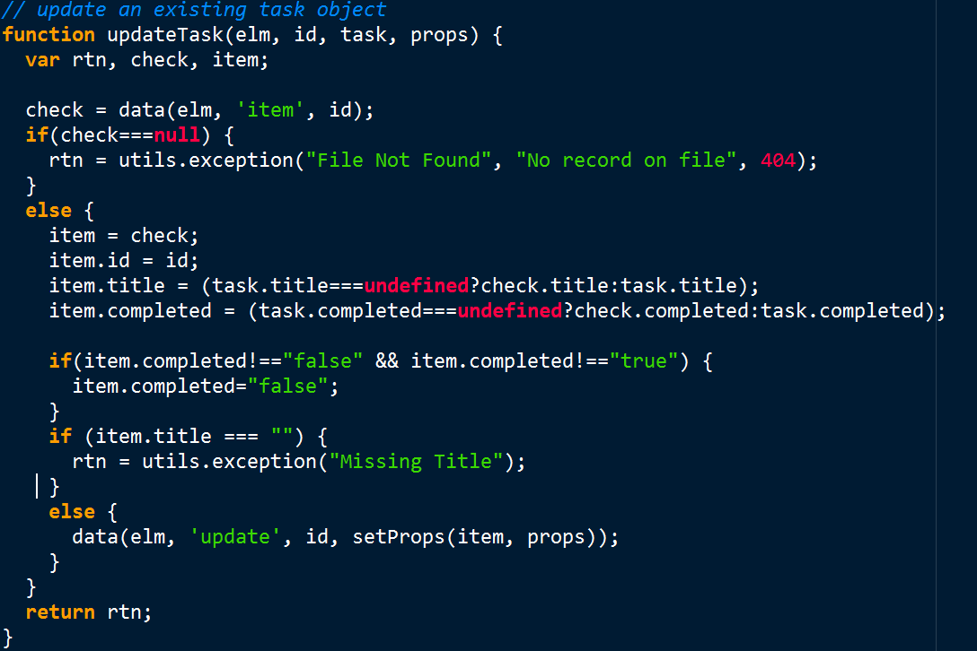
objects.js updateTask()

