Slide 1
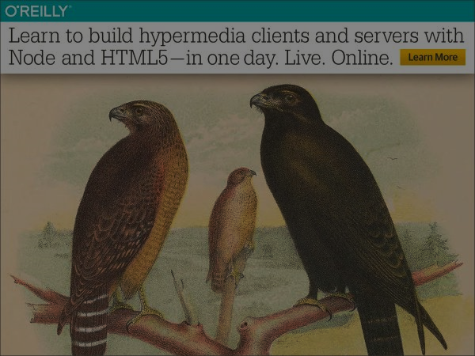
Implementing Hypermedia with NodeJS and HTML5
Mike Amundsen API Academy @mamund

Slide 2
Introduction

Slide 3
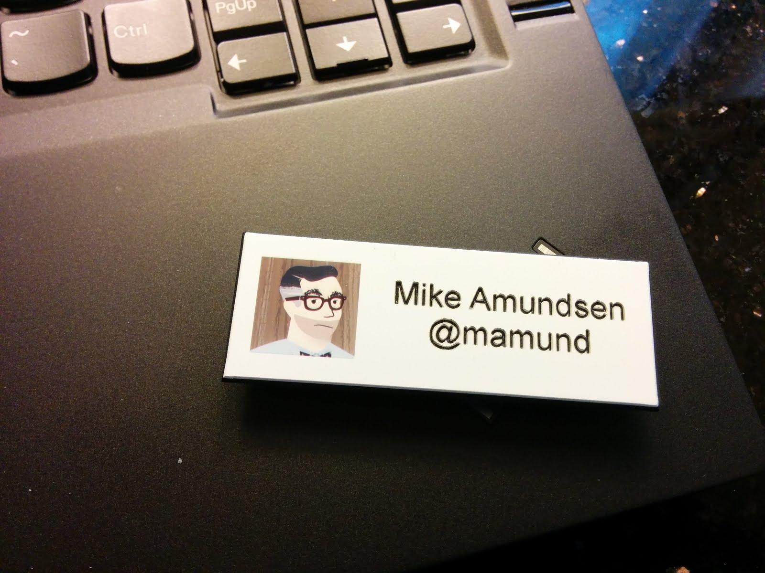

Slide 4
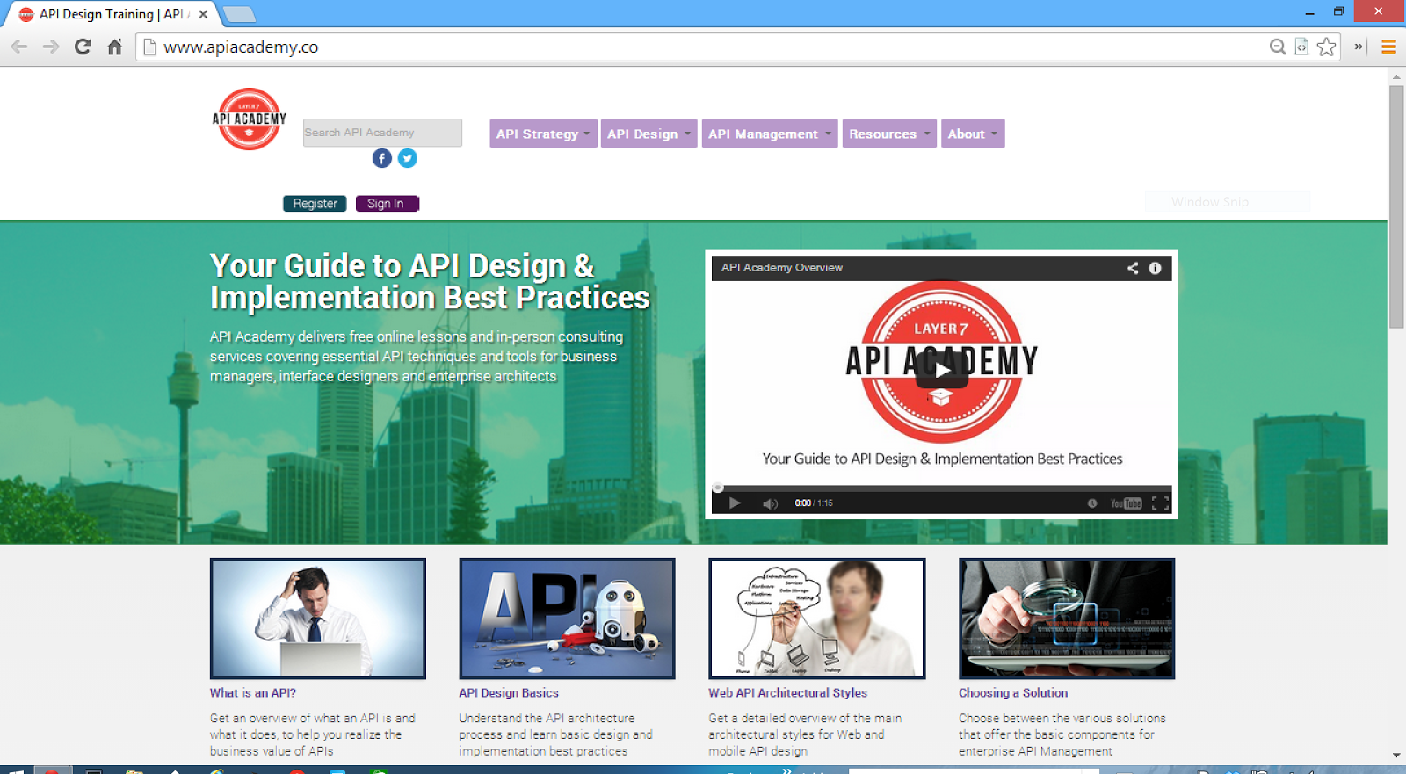

Slide 5


Slide 6


Slide 7


Slide 8

RESTful Web Clients
Focus on the client side code
Covers human-driven SPAs
Lots of code (15+ projects)!
Due in spring 2016
@RWCBook (@LCHBook)

Slide 9

Equipment Check
NodeJS installed
https://nodejs.org/en/
Code editor ready
Browser ready
Github account
https://github.com/apiacademy/oreilly-hypermedia-training
Dropbox account
http://g.mamund.com/dropbox-hypertut

Slide 10
The Plan for the Day – AM Server-Side
15min What are Hypermedia APIs?
30min Exercise: Map out the Task Service API
15min The DORR Architecture for Hypermedia Services
30min Exercise: Begin Implementing Your API Service w/ NodeJS
(Data & Objects)
15min The Strategy Pattern for Representors
45min Exercise: Complete Implementing Your API Service
(Resource & Representation)
15min Question Time
Follow up on any of the material in the first half of the day

Slide 11
Resources
On site
Slides
Code Reviews
Github
Examples
Slides
DropBox
ZIPs (for those w/o Github)
Email
mca@mamund.com

Slide 12
Ground Rules
Lecture + Code
I’ll introduce basic terms/concepts
I’ll do a code review
We’ll work through the exercises together
Lots of Qs
Ask lots of Qs
I might temporarily “ignore” Qs to get through a topic
Follow-Ups
We’ll have “follow-up” time as needed
Planned Break (30min)
You can take a break during the exercise blocks
Feel free to step away any time and pick up later

Slide 13
Let’s get started…

