Slide 1

Wrapping it up

Slide 2
Implementing Hypermedia w/ Node & HTML5
Hypermedia Services (APIs)
API Design Methodology
DORR Architecture for Hypermedia Services
Strategy Pattern for Representors

Slide 3
Follow-up Resources
Github
Examples
Slides
DropBox
ZIPs (for those w/o Github)
Email
mca@mamund.com

Slide 4
Let’s keep it going…

Slide 5
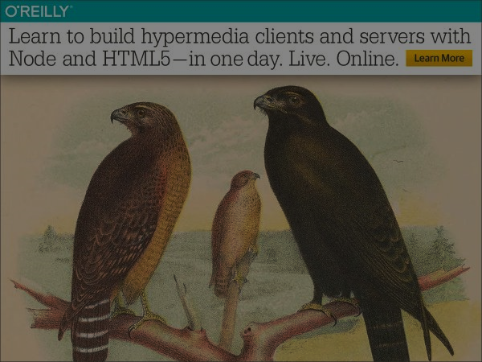
Implementing Hypermedia with NodeJS and HTML5
Mike Amundsen API Academy @mamund

