Slide 1
Microservices

Slide 2
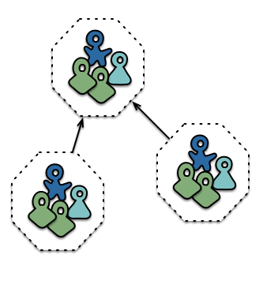
Martin Fowler sez…
“An approach to developing a single application as a suite of small services, each running in its own process and communicating with lightweight mechanisms, often an HTTP resource API. These services are built around business capabilities and independently deployable by fully automated deployment machinery.”
http://martinfowler.com/articles/microservices.html

Slide 3
Martin Fowler sez…
“An approach to developing a single application as a suite of small services, each running in its own process and communicating with lightweight mechanisms, often an HTTP resource API. These services are built around business capabilities and independently deployable by fully automated deployment machinery.”
http://martinfowler.com/articles/microservices.html

Slide 4
Martin Fowler sez…
“An approach to developing a single application as a suite of small services, each running in its own process and communicating with lightweight mechanisms, often an HTTP resource API. These services are built around business capabilities and independently deployable by fully automated deployment machinery.”
http://martinfowler.com/articles/microservices.html

Slide 5
Martin Fowler sez…
“An approach to developing a single application as a suite of small services, each running in its own process and communicating with lightweight mechanisms, often an HTTP resource API. These services are built around business capabilities and independently deployable by fully automated deployment machinery.”
http://martinfowler.com/articles/microservices.html

Slide 6
Martin Fowler sez…
“An approach to developing a single application as a suite of small services, each running in its own process and communicating with lightweight mechanisms, often an HTTP resource API. These services are built around business capabilities and independently deployable by fully automated deployment machinery.”
http://martinfowler.com/articles/microservices.html

Slide 7
Martin Fowler sez…
“An approach to developing a single application as a suite of small services, each running in its own process and communicating with lightweight mechanisms, often an HTTP resource API. These services are built around business capabilities and independently deployable by fully automated deployment machinery.”
http://martinfowler.com/articles/microservices.html

Slide 8
Martin Fowler sez…
“An approach to developing a single application as a suite of small services, each running in its own process and communicating with lightweight mechanisms, often an HTTP resource API. These services are built around business capabilities and independently deployable by fully automated deployment machinery.”
http://martinfowler.com/articles/microservices.html

Slide 9
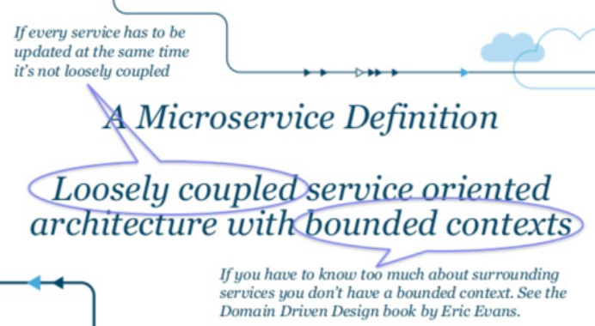
Adrian Cockcroft sez…
http://www.slideshare.net/adriancockcroft/innovation-and-architecture

Slide 10
Mike sez…
Make each microservice do one thing well. To do a new job, build afresh rather than complicate old microservices by adding new features.
Expect the output of every microservice to become the input to another, as yet unknown, microservice. Don't clutter output with extraneous information. Avoid strongly-typed or binary input formats. Don't insist on object trees as input.
Design and build microservices to be created and deployed early, ideally within weeks. Don't hesitate to throw away the clumsy parts and rebuild them.
Use testing and deployment tooling (in preference to manual efforts) to lighten a programming task, even if you have to detour to build the tools and expect to throw some of them out after you've finished using them.

Slide 11
Mike sez…
Make each microservice do one thing well. To do a new job, build afresh rather than complicate old microservices by adding new features.
Expect the output of every microservice to become the input to another, as yet unknown, microservice. Don't clutter output with extraneous information. Avoid strongly-typed or binary input formats. Don't insist on object trees as input.
Design and build microservices to be created and deployed early, ideally within weeks. Don't hesitate to throw away the clumsy parts and rebuild them.
Use testing and deployment tooling (in preference to manual efforts) to lighten a programming task, even if you have to detour to build the tools and expect to throw some of them out after you've finished using them.

Slide 12
Mike sez…
Make each microservice do one thing well. To do a new job, build afresh rather than complicate old microservices by adding new features.
Expect the output of every microservice to become the input to another, as yet unknown, microservice. Don't clutter output with extraneous information. Avoid strongly-typed or binary input formats. Don't insist on object trees as input.
Design and build microservices to be created and deployed early, ideally within weeks. Don't hesitate to throw away the clumsy parts and rebuild them.
Use testing and deployment tooling (in preference to manual efforts) to lighten a programming task, even if you have to detour to build the tools and expect to throw some of them out after you've finished using them.

Slide 13
Mike sez…
Make each microservice do one thing well. To do a new job, build afresh rather than complicate old microservices by adding new features.
Expect the output of every microservice to become the input to another, as yet unknown, microservice. Don't clutter output with extraneous information. Avoid strongly-typed or binary input formats. Don't insist on object trees as input.
Design and build microservices to be created and deployed early, ideally within weeks. Don't hesitate to throw away the clumsy parts and rebuild them.
Use testing and deployment tooling (in preference to manual efforts) to lighten a programming task, even if you have to detour to build the tools and expect to throw some of them out after you've finished using them.

Slide 14
Mike sez…
Make each microservice do one thing well. To do a new job, build afresh rather than complicate old microservices by adding new features.
Expect the output of every microservice to become the input to another, as yet unknown, microservice. Don't clutter output with extraneous information. Avoid strongly-typed or binary input formats. Don't insist on object trees as input.
Design and build microservices to be created and deployed early, ideally within weeks. Don't hesitate to throw away the clumsy parts and rebuild them.
Use testing and deployment tooling (in preference to manual efforts) to lighten a programming task, even if you have to detour to build the tools and expect to throw some of them out after you've finished using them.

Slide 15
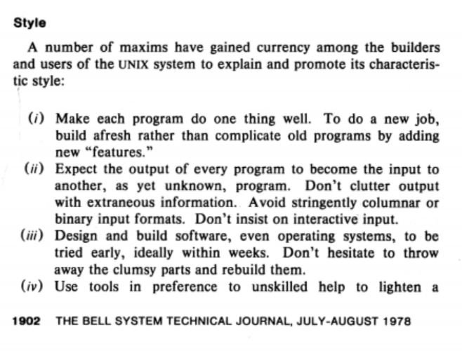
Unix Time-Sharing System : Foreword (1978)

Slide 16
Microservices

