Slide 1
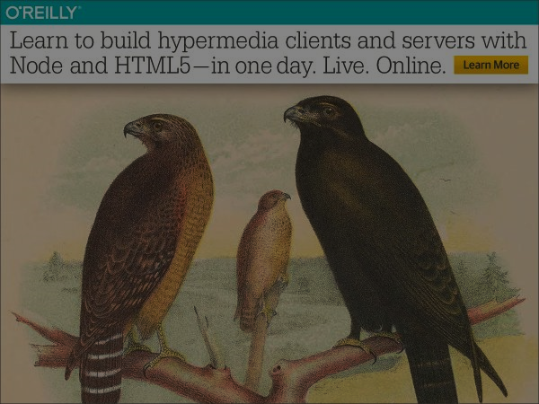
From Goals to Deployment: Building Hypermedia Services with NodeJS
Mike Amundsen API Academy @mamund Eder Ignatowicz Red hat @ederign

Slide 2
Introduction

Slide 3
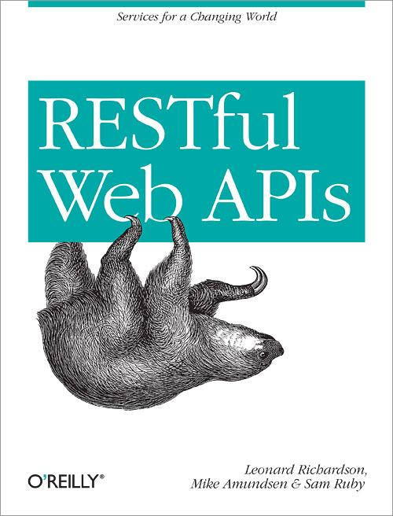

Slide 4
Equipment Check
NodeJS installed
https://nodejs.org/en/
Code editor ready
Browser ready
Curl installed
https://curl.haxx.se/
Github account
https://github.com/apiacademy/2016-04-qcon-sao-paulo
Gitter chat channel (click icon in repo)
https://gitter.im/apiacademy/2016-04-qcon-sao-paulo

Slide 5
The Plan for the Day – AM Design and DORR
API Design
Slides (15min)
API Design Exercise (30min)
BREAK (30min)
DORR Implementation, part 1
Slides (15min)
Data Model Exercise (30min)
Slides (15min)
Object Model Exercise (30min)

Slide 6
The Plan for the Day – PM DORR and Demo
DORR Implementation, part 2
Slides (15min)
Resource Model Exercise (30min)
Slides (15min)
Representation Model Exercise (30min)
BREAK (30min)
Putting it All Together
Teams Show Working Demos (30min)
Wrap-up Slides (15min)

Slide 7
Ground Rules
Lecture + Code
I’ll introduce basic terms/concepts
I’ll do a code review
We’ll work through the exercises together
Lots of Qs
Ask lots of Qs
Use chat window (or Slack)
I might temporarily “ignore” Qs to get through a topic
Follow-Ups
We’ll have “follow-up” time in AM and PM as needed
Planned Breaks
You can take a break during the exercise blocks
Feel free to step away any time and pick up later

Slide 8
Let’s get started…

