Slide 1
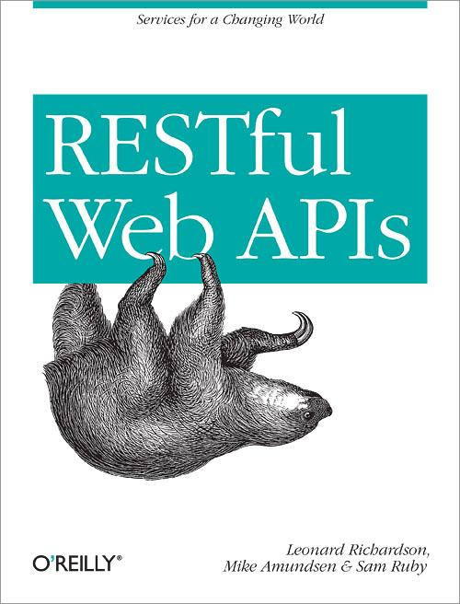
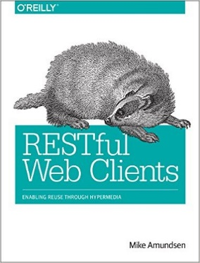
DORR Architecture for Hypermedia Services
Mike Amundsen API Academy @mamund

Slide 2
Highlights
Evolvability
Loosely Coupled
DORR Pattern
Conway

Slide 3
Evolvability

Slide 4
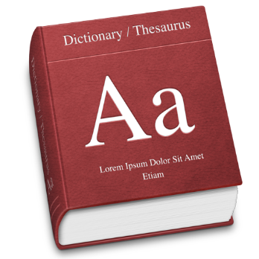
Evolvability
evolution: “the gradual development of something, especially from simple to a more complex form”

Slide 5
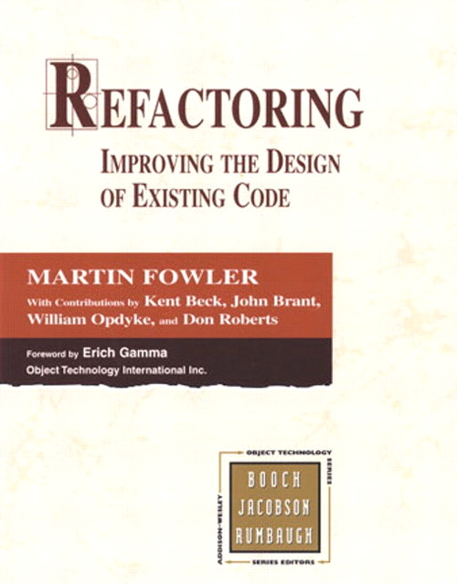
Evolvability
Refactoring: “the process of restructuring existing computer code without changing its external behavior.”

Slide 6
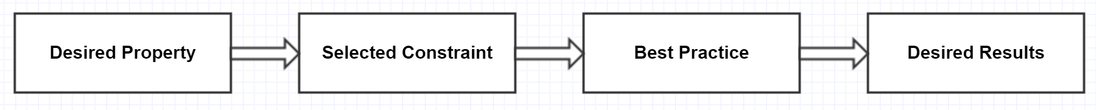
Evolvability is a System Property

Slide 7
Loosely-Coupled

Slide 8
Loosely-Coupled
“A system in which each of its components has little or no knowledge of the [internal] definitions of other separate components.”

Slide 9
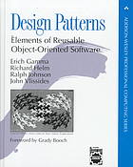
Loosely-Coupled
“Program to an interface, not an implementation.” -GoF

Slide 10
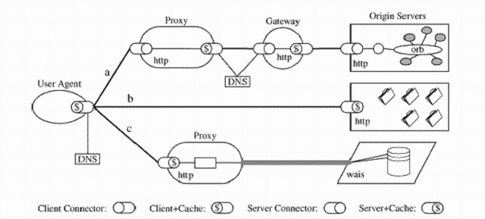
Loosely-Coupled
“Your system is not loosely-coupled if deploying component A means you MUST also deploy component B.”

Slide 11

Loosely-Coupled
“Embrace independent evolvability.” – Darrel Miller, Runscope

Slide 12
Loosely-Coupled as a Constraint

Slide 13
D.O.R.R.

Slide 14
D.O.R.R
Data Model (storage)
Object Model (functionality)
Resource Model (interface)
Representation Model (message)

Slide 15
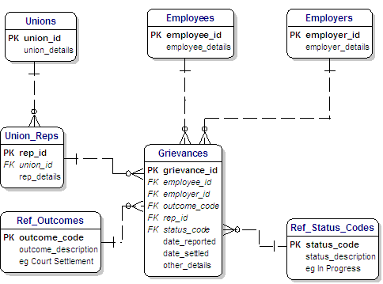
D.O.R.R
“Data Model”

Slide 16
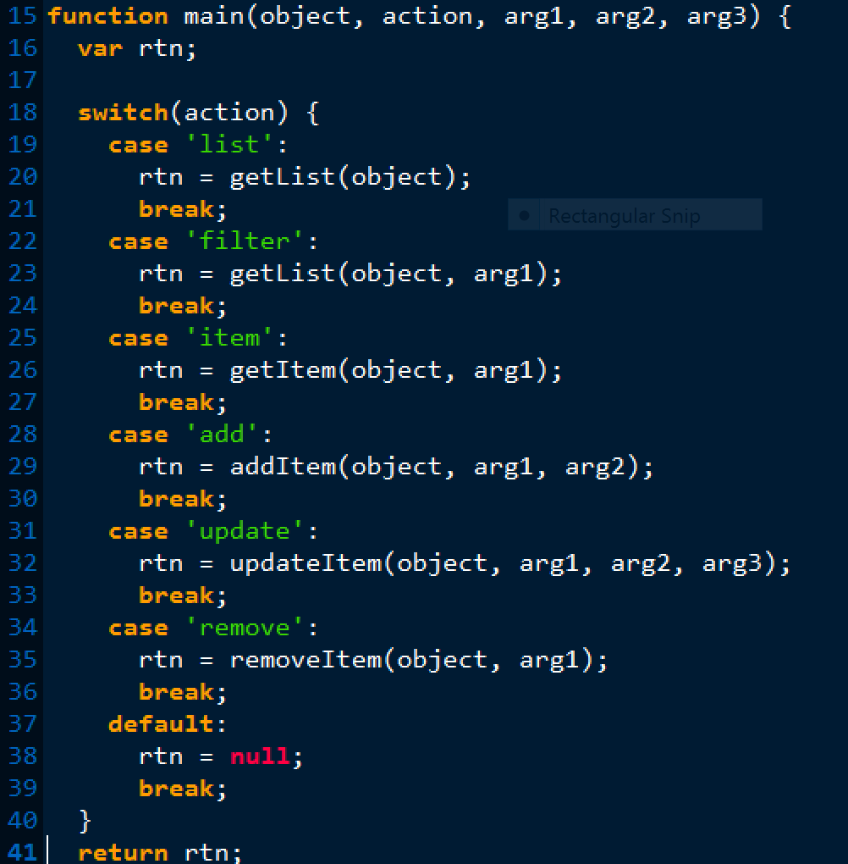

Slide 17
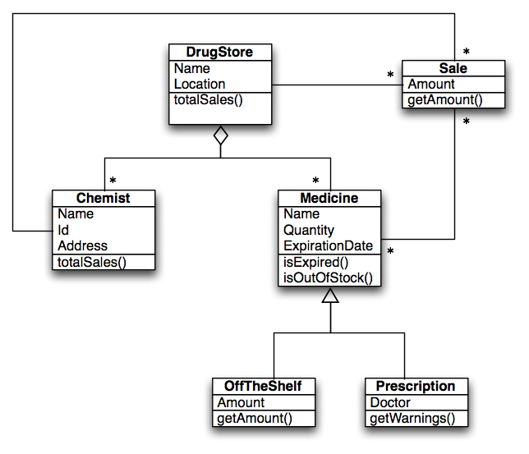
D.O.R.R
“Object Model”

Slide 18
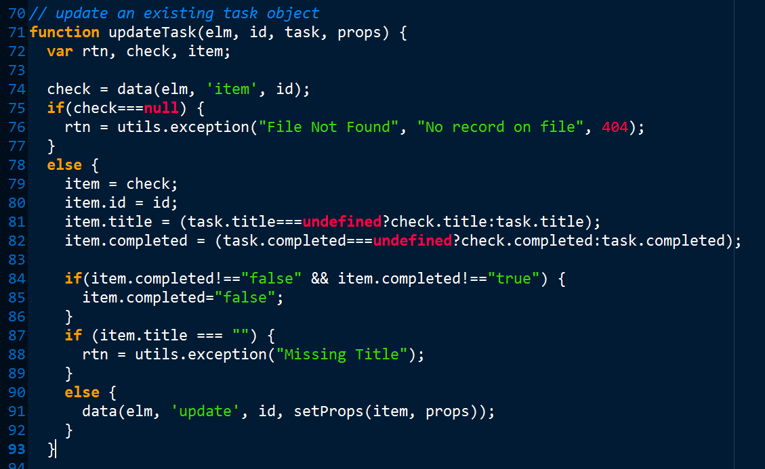

Slide 19
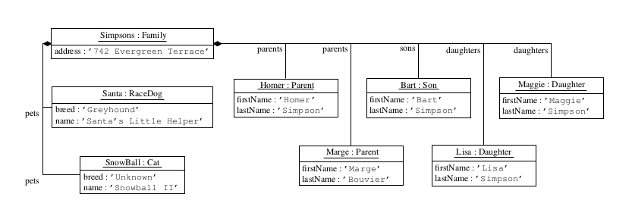
D.O.R.R
“Resource Model”

Slide 20
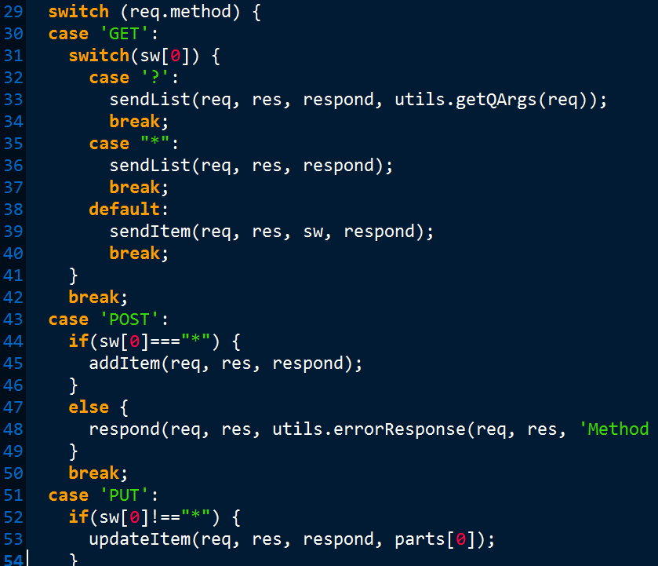

Slide 21
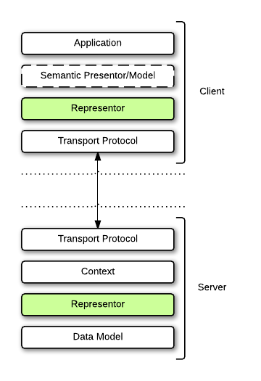
D.O.R.R
“Representor Model”

Slide 22
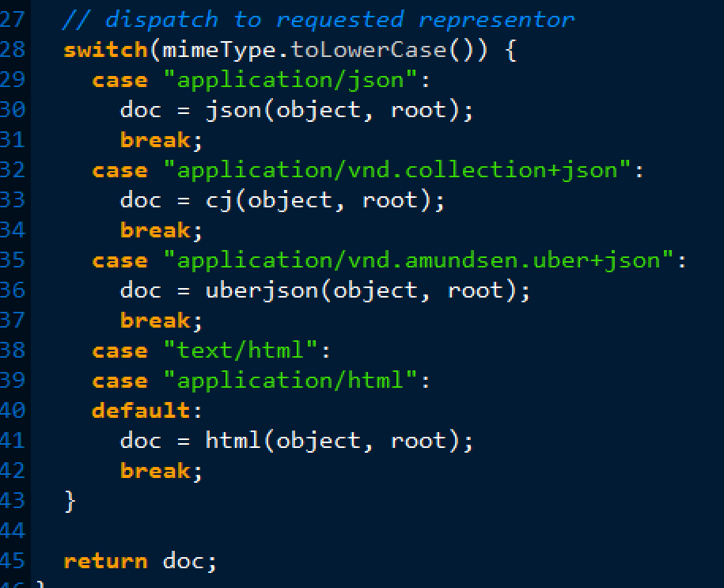

Slide 23
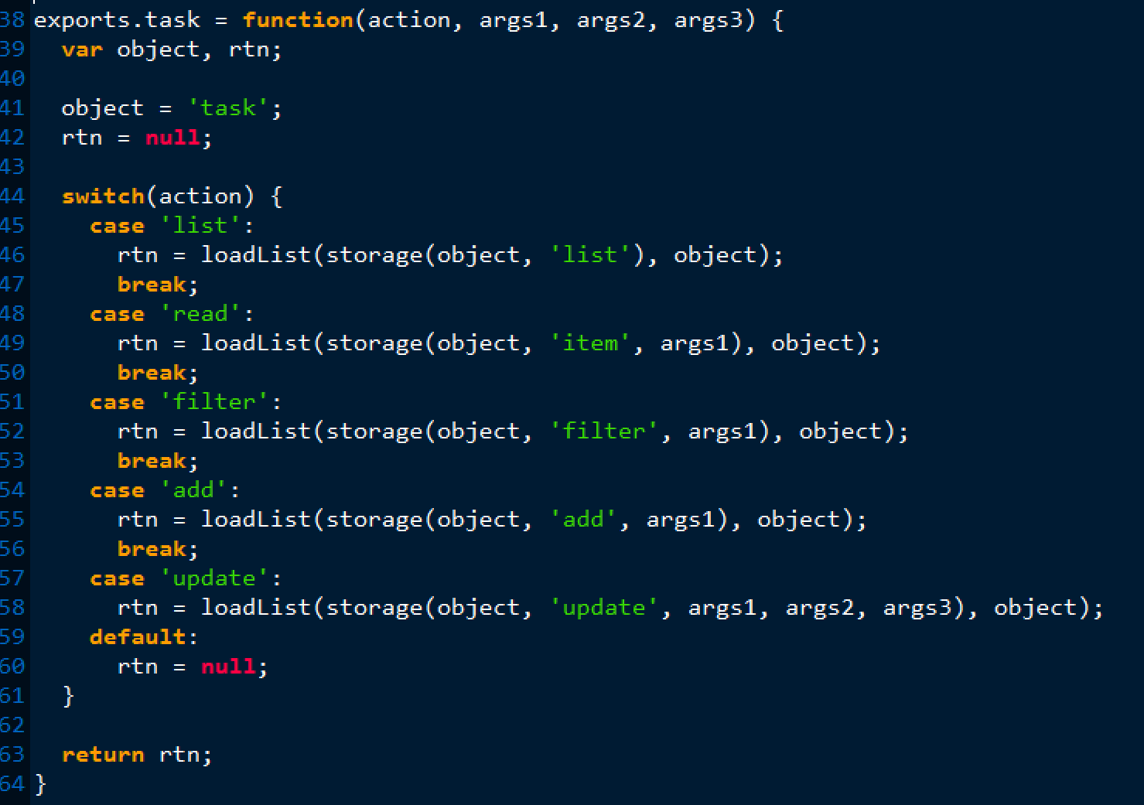
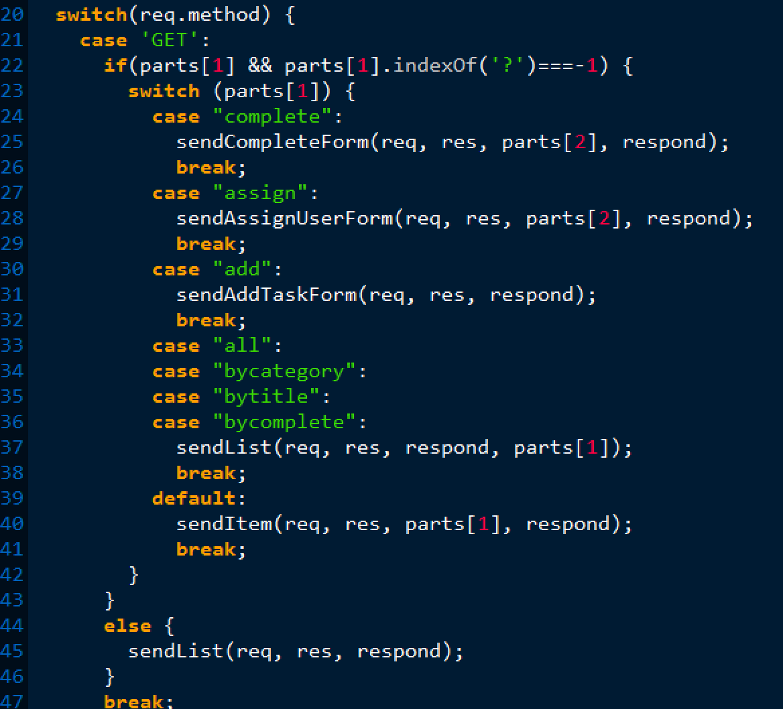
D.O.R.R
“Embrace independent evolvability.”

Slide 24
D.O.R.R. as a Best Practice

Slide 25
Conway’s Law

Slide 26
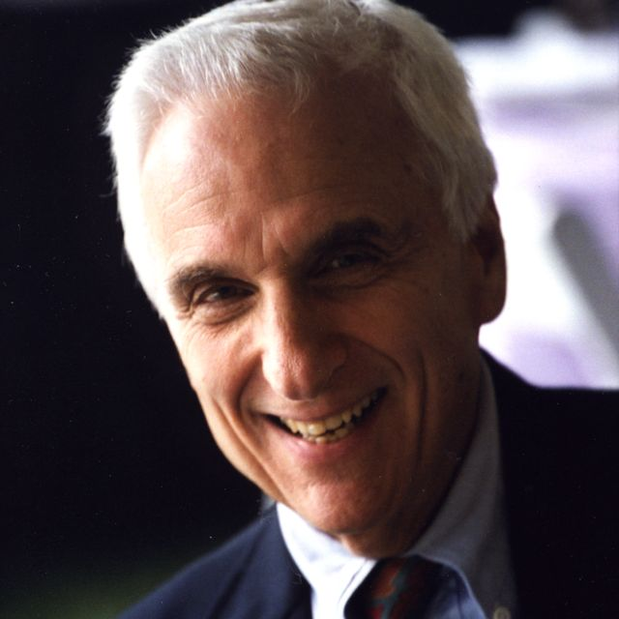
Conway’s Law
“Organizations produce systems which are copies of their communication structures.” – Mel Conway, 1968

Slide 27
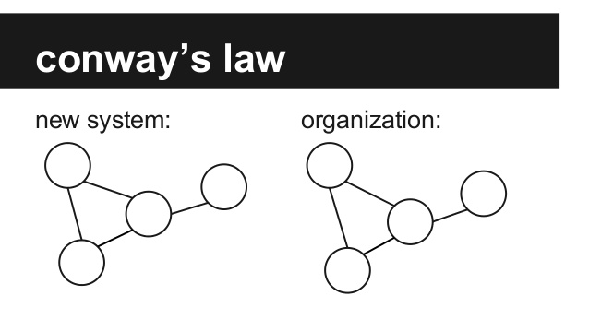
Conway’s Law

Slide 28
Conway’s Law

Slide 29
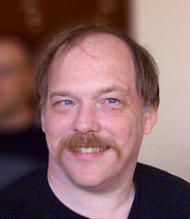
Conway’s Law
“If you have four teams working on a compiler project, you gat a four-pass compiler” – Eric S. Raymond

Slide 30
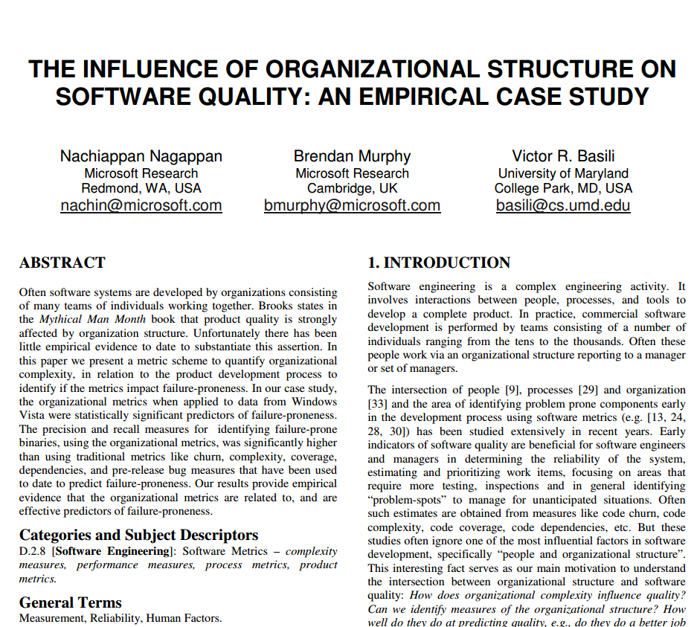
Conway’s Law
“Organizational metrics can predict software failure-proneness with a precision and recall of 85 percent.” – Microsoft Research

Slide 31
Conway’s Law is Inevitable

Slide 32
Summary

Slide 33
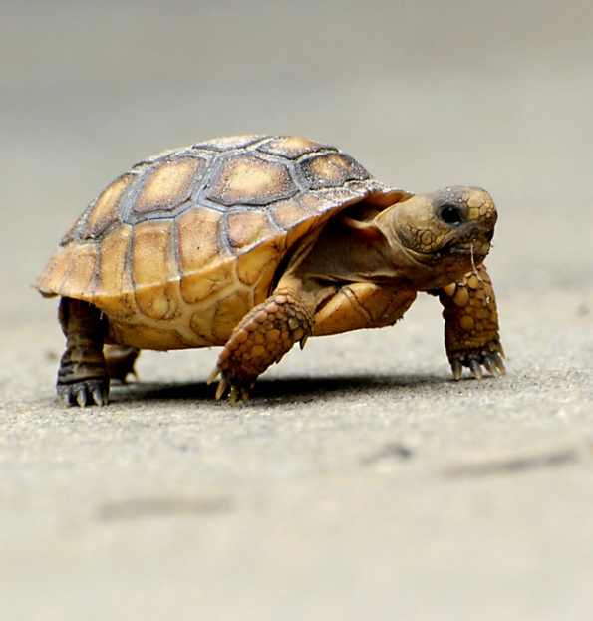
Continuous Deployment
“Every day you don’t release to production is another day you risk falling behind.”

Slide 34
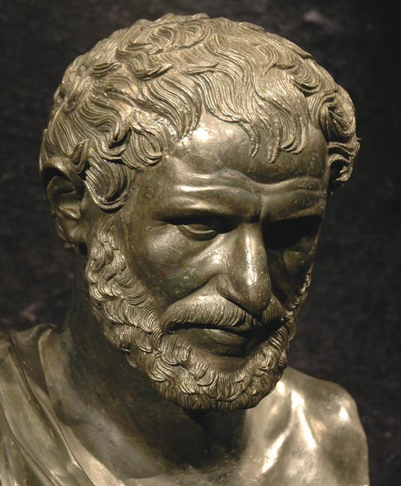
Change
“The only thing that is constant is change.” -- Heraclitus

Slide 35
Highlights
Evolvability
Loosely Coupled
DORR Pattern
Conway

Slide 36
DORR Architecture for Hypermedia Services
Mike Amundsen API Academy @mamund

