Slide 1
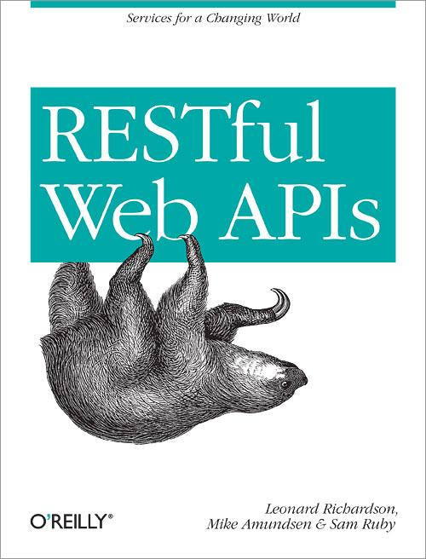

Exercise: DORR Part #1

Slide 2
Data-Layer Services
Direct connection between data-storage and the public resources (Web API)
Resource Layer
Data Layer

Slide 3
Implement the UPDATE (Data & Objects)
Modify data.js to support “removeItem”
Modify task.js to support “removeItem”

Slide 4
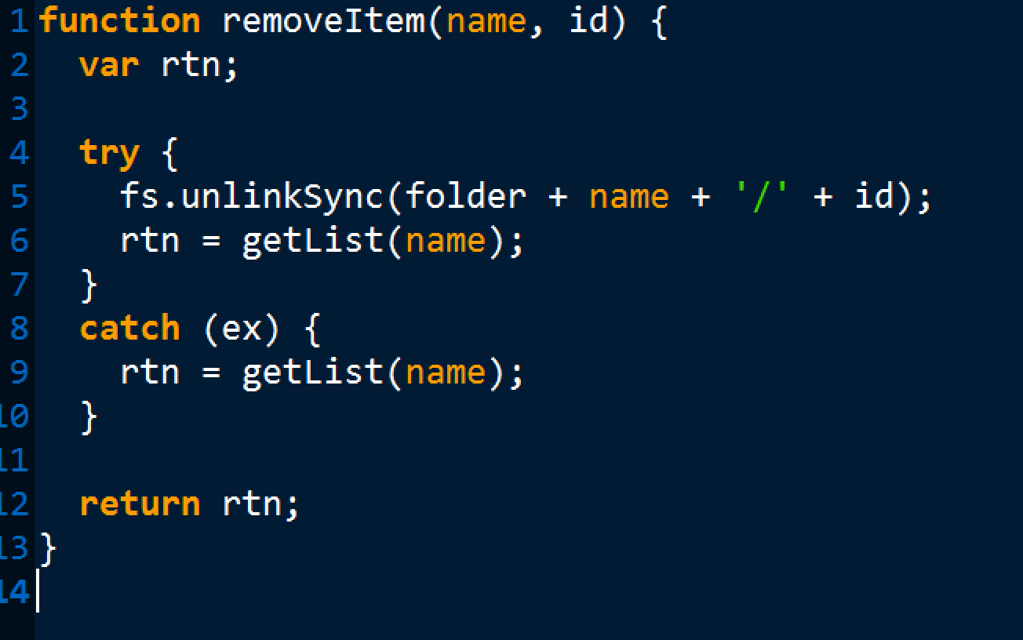
data.js removeItem()

Slide 5
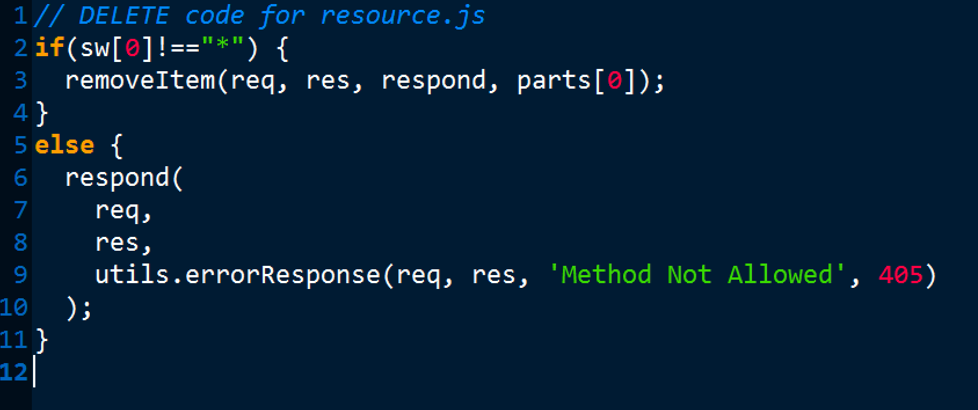
task.js DELETE

