Slide 1
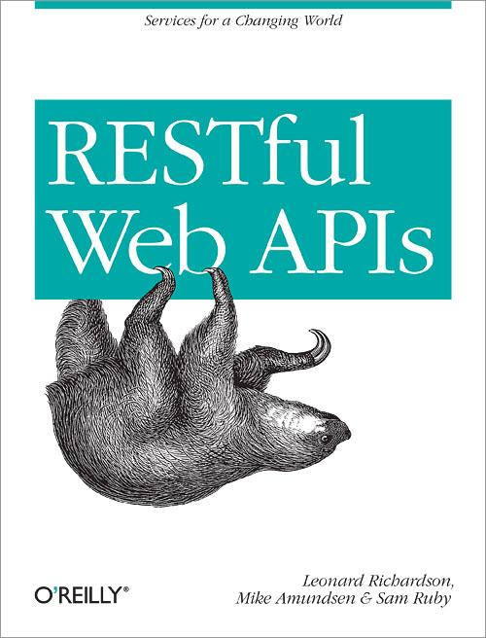
Exercise: DORR Part #2

Slide 2
Object-Layer Services
Loosely-coupled to Data-Storage. Direct connection between internal object model and the public resources (Web API)
Resource Layer
Object Layer
Data Layer

Slide 3
Implement the UpdateTask (Object Model)
Modify object.js to support “updateTask”

Slide 4
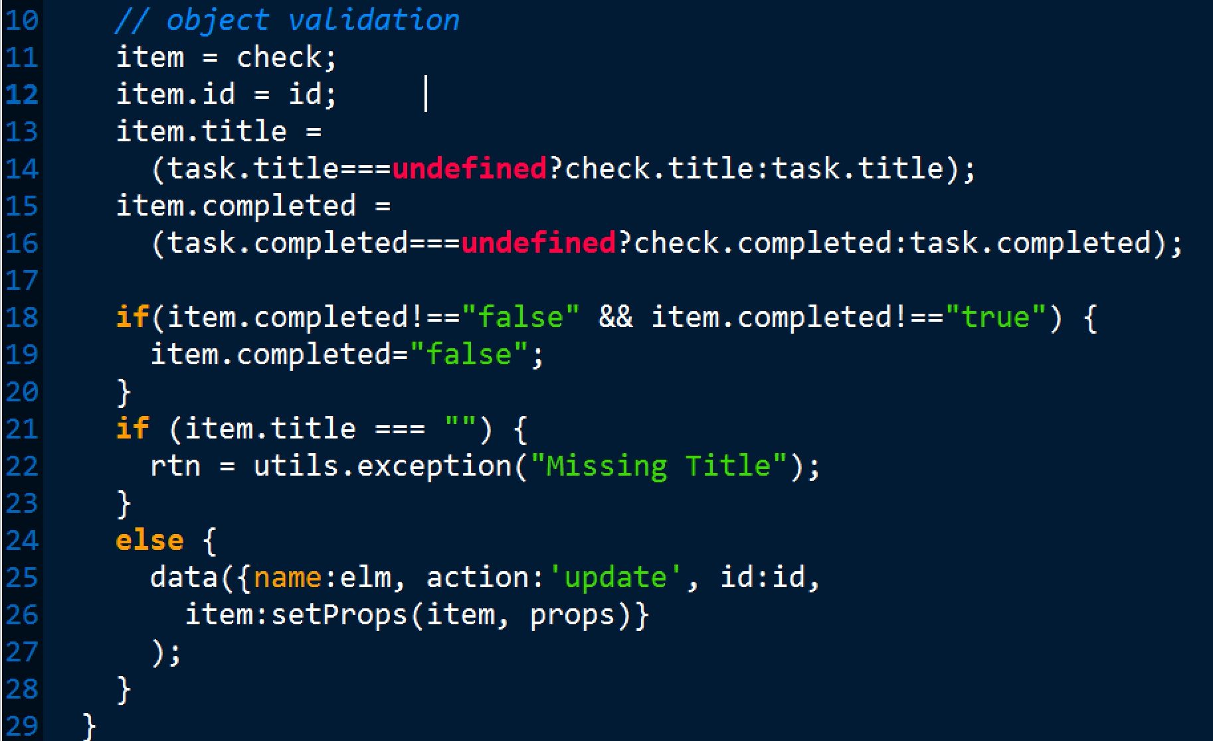
Object.js updateTask()

