Slide 1
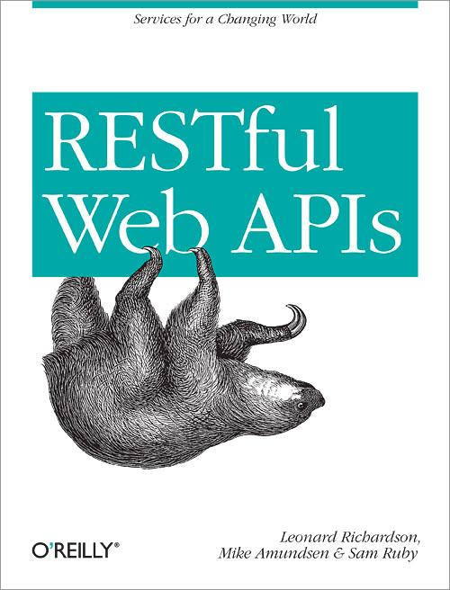
Exercise: DORR Part #4

Slide 2
Representation-Layer Services
Expand responses to include transitions (links & forms)
Loosely-coupled to Resource Model Loosely-coupled to Object Model Loosely-coupled to Data Model
Representation Layer
completeItem()
Resource Layer
Object Layer
Data Layer

Slide 3
Resource-Layer Services
Expand responses to include transitions (links & forms)
Loosely-coupled to Resource Model Loosely-coupled to Object Model Loosely-coupled to Data Model
completeForm()
Representation Layer
incompleteForm()
completeItem()
Resource Layer
Object Layer
Data Layer

Slide 4
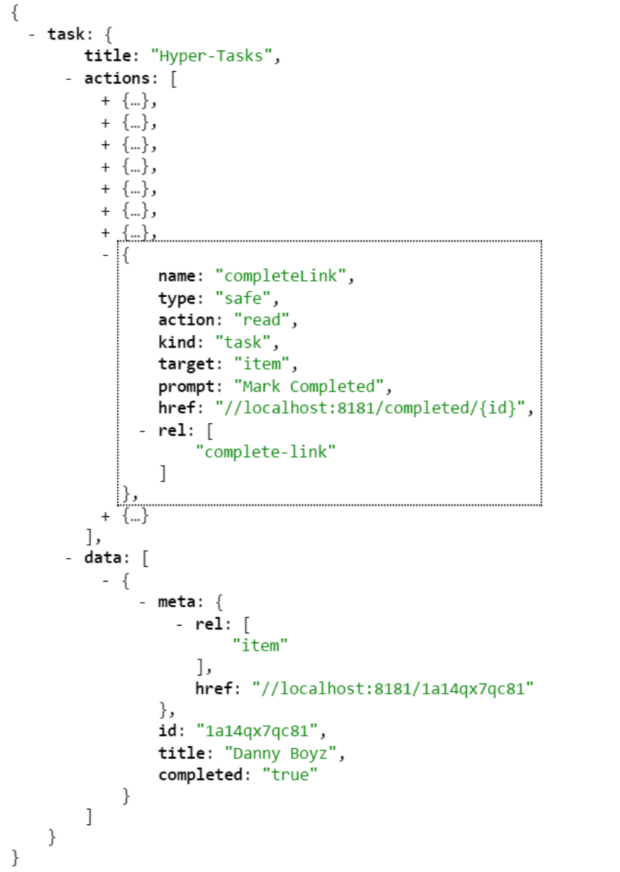
Step 1: View WeSTL

Slide 5
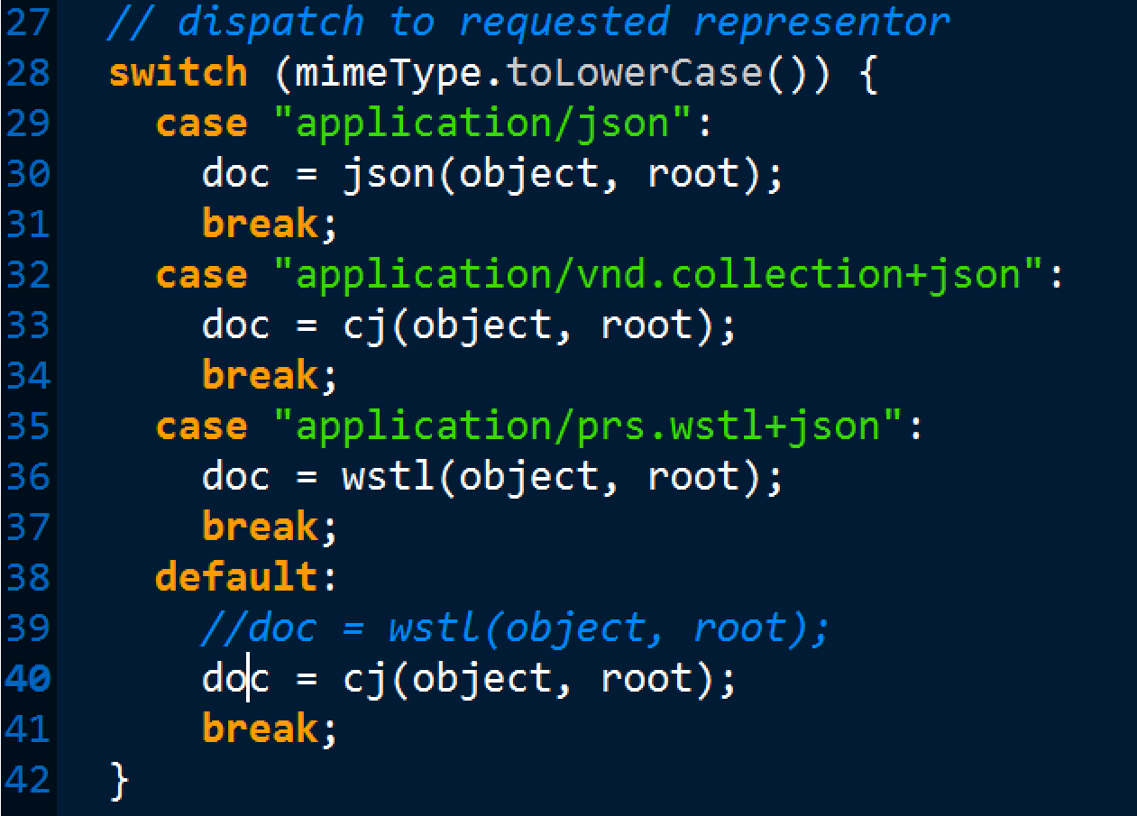
Step 2: Modify representor.js to emit Cj

Slide 6
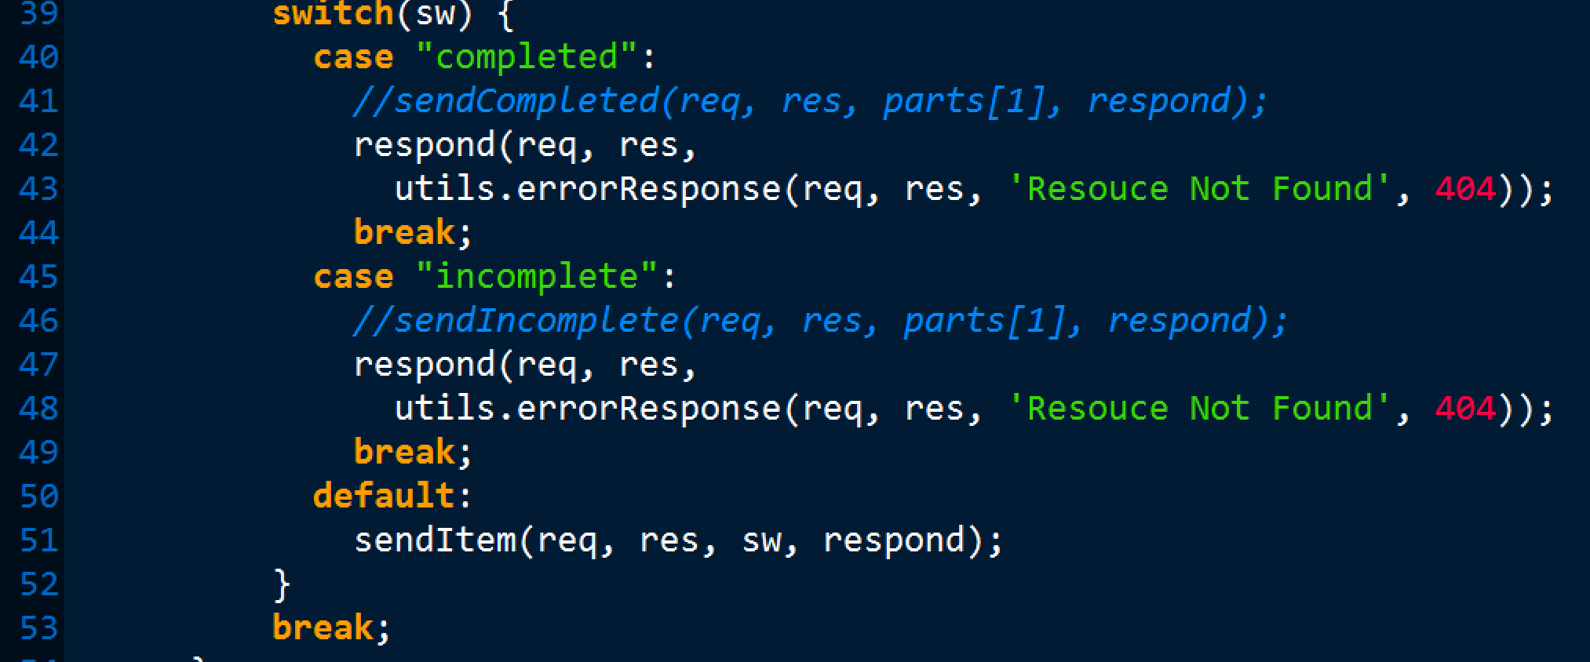
Step 3: Modify task.js to emit form resouces

Slide 7
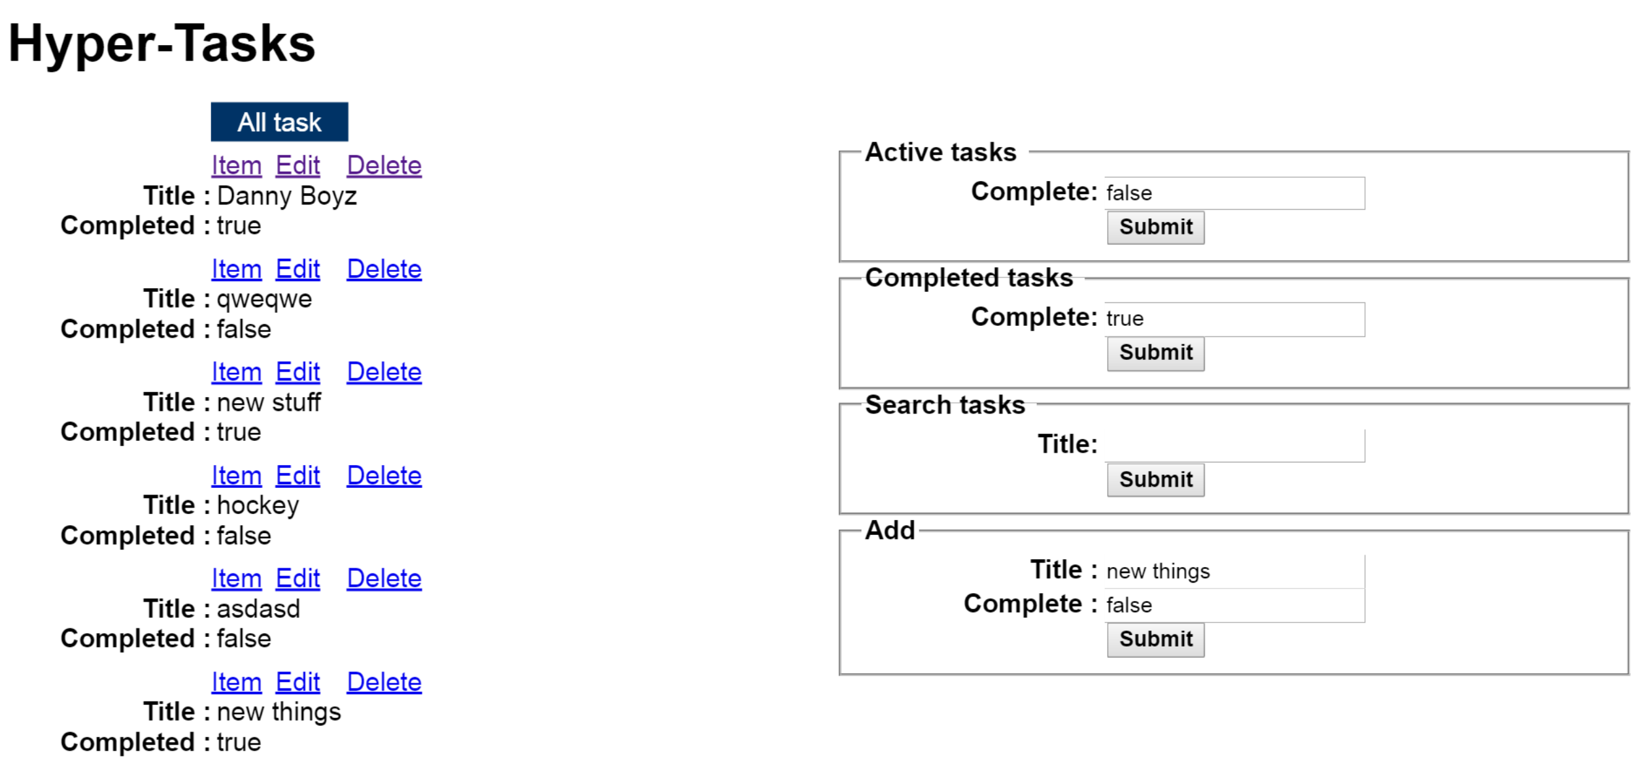
Step 4: View API using Cj Client
http://localhost:8181/files/index.html

