Slide 1
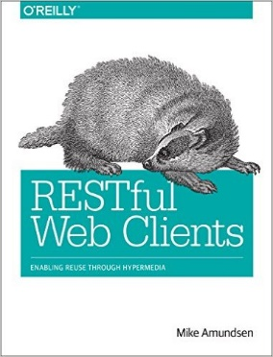
Wrapping it up

Slide 2
Implementing Hypermedia Services w/ NodeJS
Hypermedia Services (APIs)
API Design Methodology
Design the API without implementing it
Use ALPS to document the design
DORR Architecture for Hypermedia Services
Data Model
Object Model
Resource Model
Representation Model
Strategy Pattern for Representors
Decouple representation from resource
Use WeSTL to describe a representation-free resource

Slide 3
Follow-up Resources
Github
Examples
Slides
Gitter chat room
Convo starts today – will continue, too
Email
mca@mamund.com

Slide 4
Let’s keep it going…

Slide 5
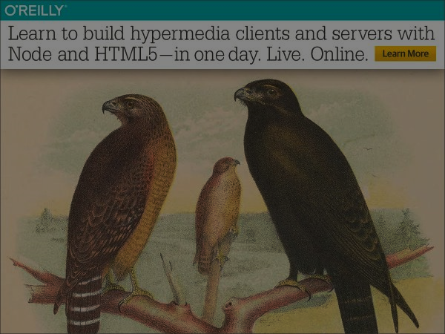
From Goals to Deployment: Building Hypermedia Services with NodeJS
Mike Amundsen API Academy @mamund Eder Ignatowicz Red hat @ederign

