Slide 1

Exercise: Map Out the TASK API

Slide 2

API Design Methodology
Collect Semantic Descriptors
Draw a Diagram
Reconcile Names
Write A Profile (ALPS)
Select a Media Type (Cj)

Slide 3
Step #1: Collect Task API elements
Data:
id, title, completed
Actions:
createTask, readTask, updateTask, removeTask
listAll, listActive, listCompleted, findByName

Slide 4
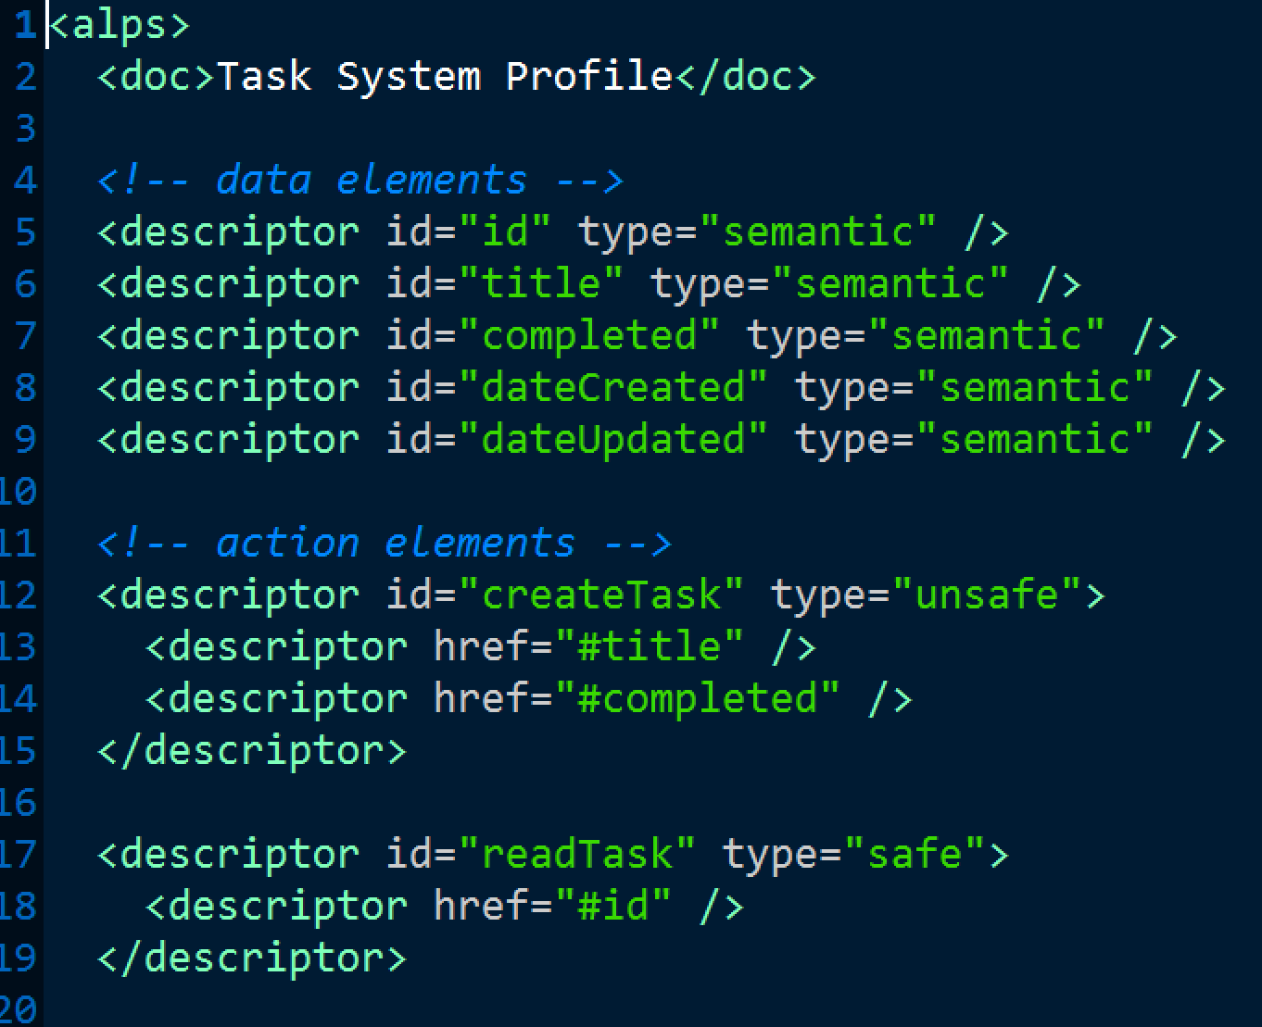
Step #2: Document Task API with ALPS

