Slide 1
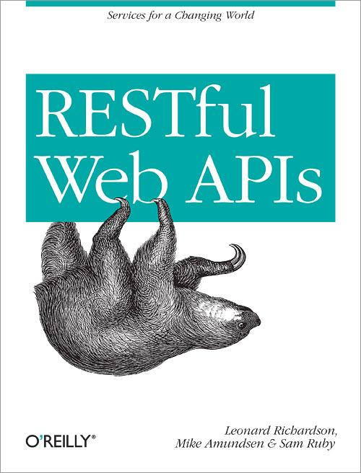

Exercise: DORR Part #1

Slide 2
Data-Layer Services
Direct connection between data-storage and the public resources (Web API)
Resource Layer
Data Layer

Slide 3
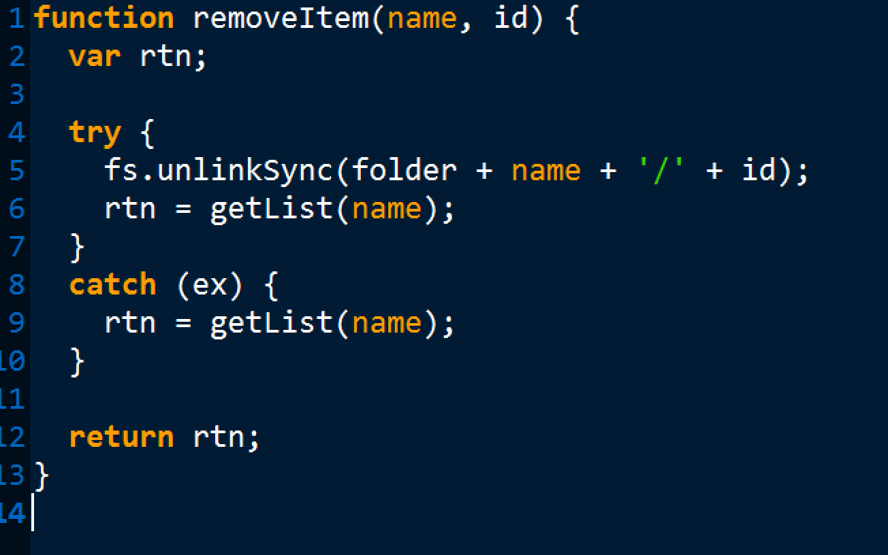
Step #1: add data.js removeItem()

Slide 4
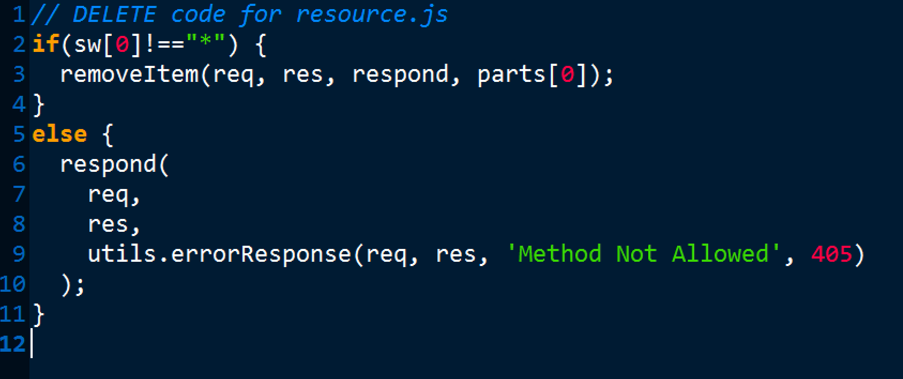
Step #2: add task.js DELETE

