Slide 1
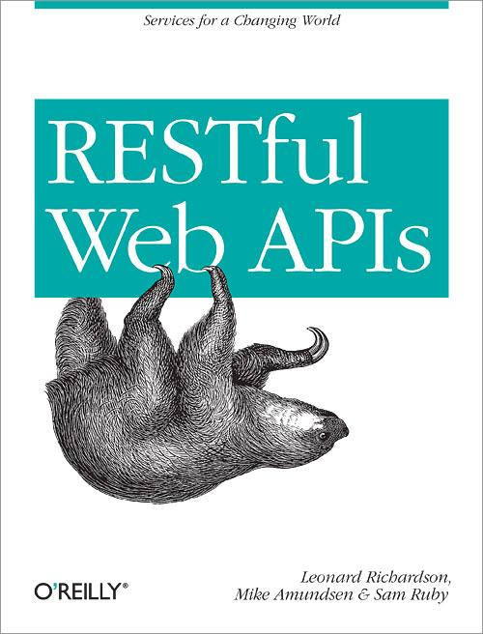
Exercise: DORR Part #3

Slide 2
Resource-Layer Services
Expand internal object model to support new API resources Loosely-coupled to Object Model Loosely-coupled to Data-Storage
Resource Layer
Object Layer
Data Layer

Slide 3
Resource-Layer Services
Expand internal object model to support new API resources Loosely-coupled to Object Model Loosely-coupled to Data-Storage
completeItem()
Resource Layer
Object Layer
Data Layer

Slide 4
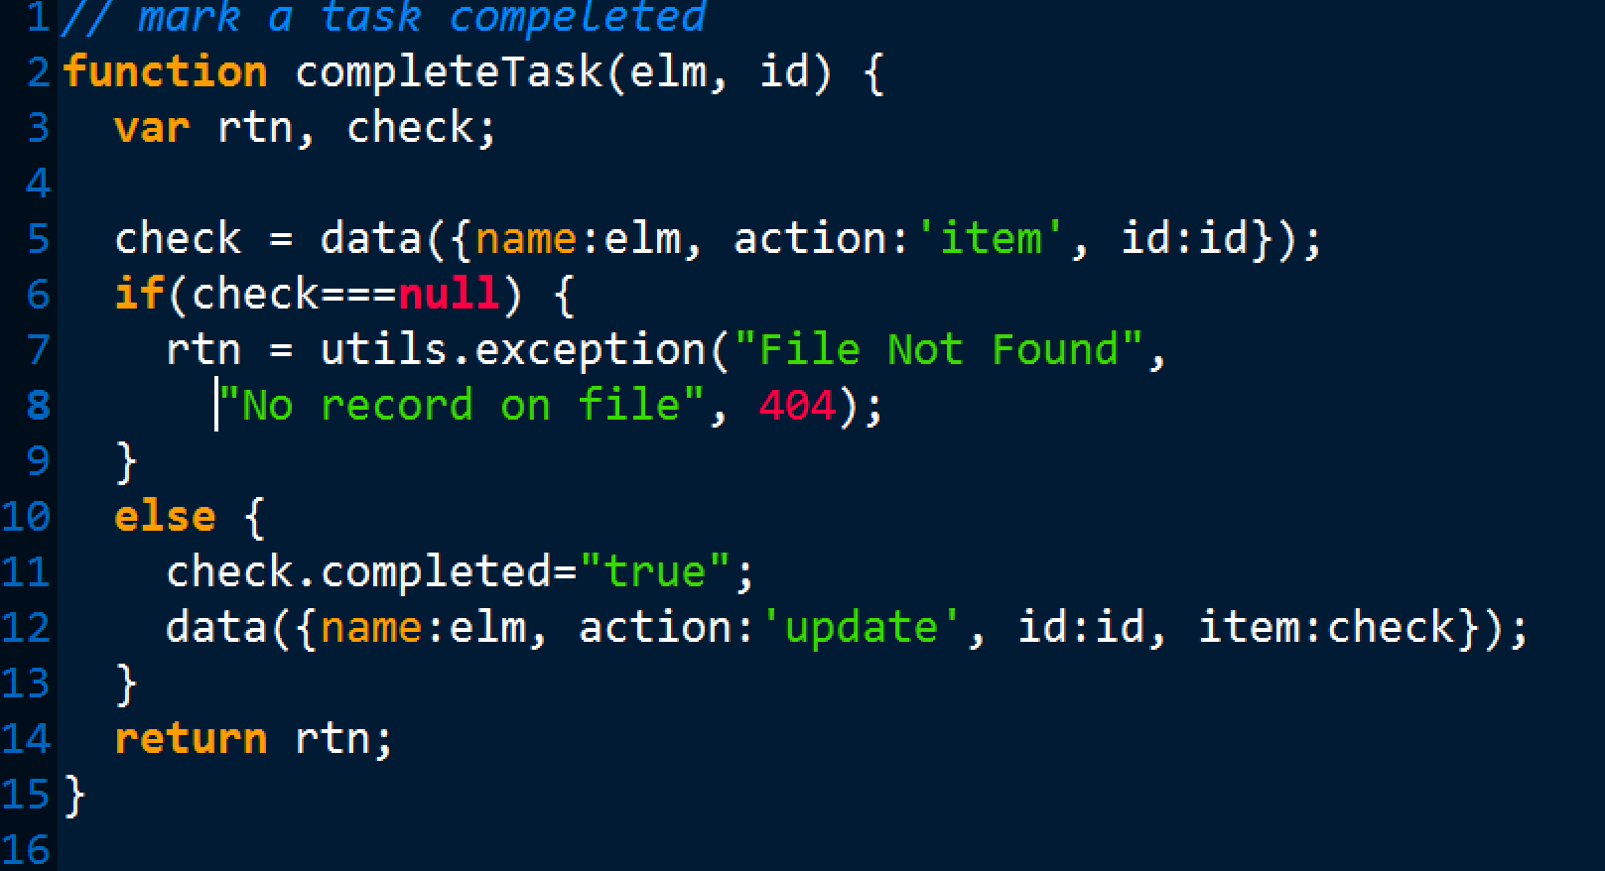
Step #1: add completeTask (Object Model)
Modify object.js to support “completeTask”

Slide 5
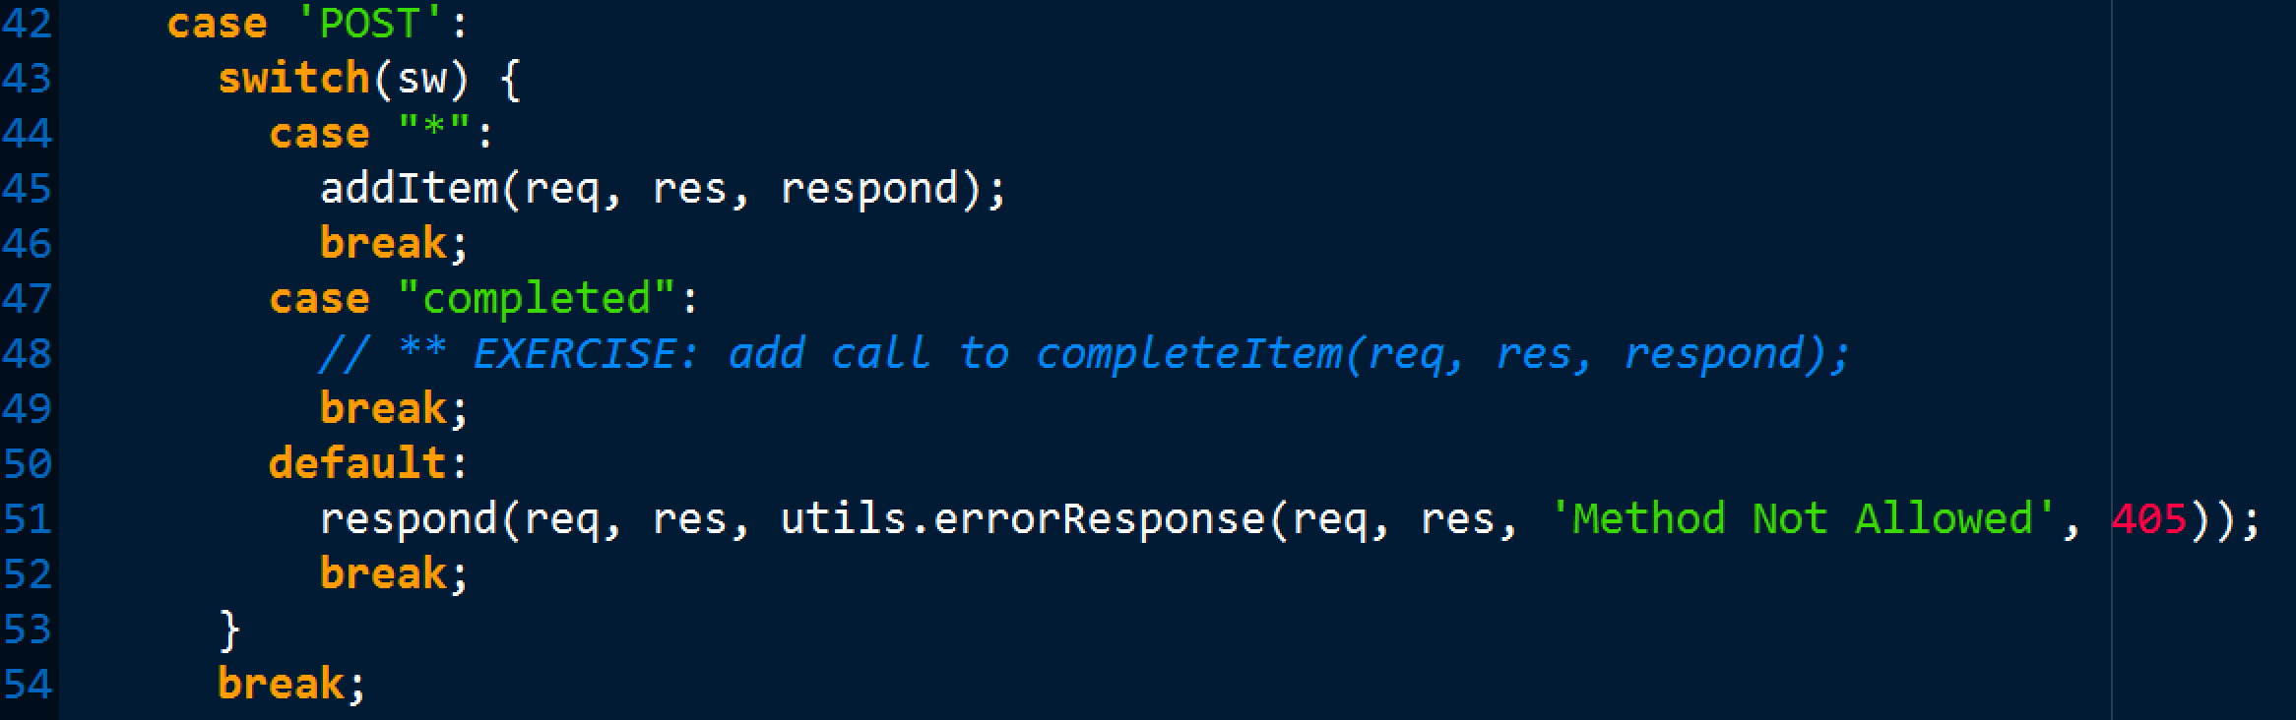
Step #2: Task.js add call to completeItem()

