Slide 1
@ManfredBo

Slide 2
APIs are still very new for businesses.
Many struggle finding strategies to leverage APIs.
@ManfredBo

Slide 3
We introduce the API Model Canvas.
@ManfredBo

Slide 4
The API Model Canvas
is a methodology
for defining and executing API strategies.
@ManfredBo

Slide 5
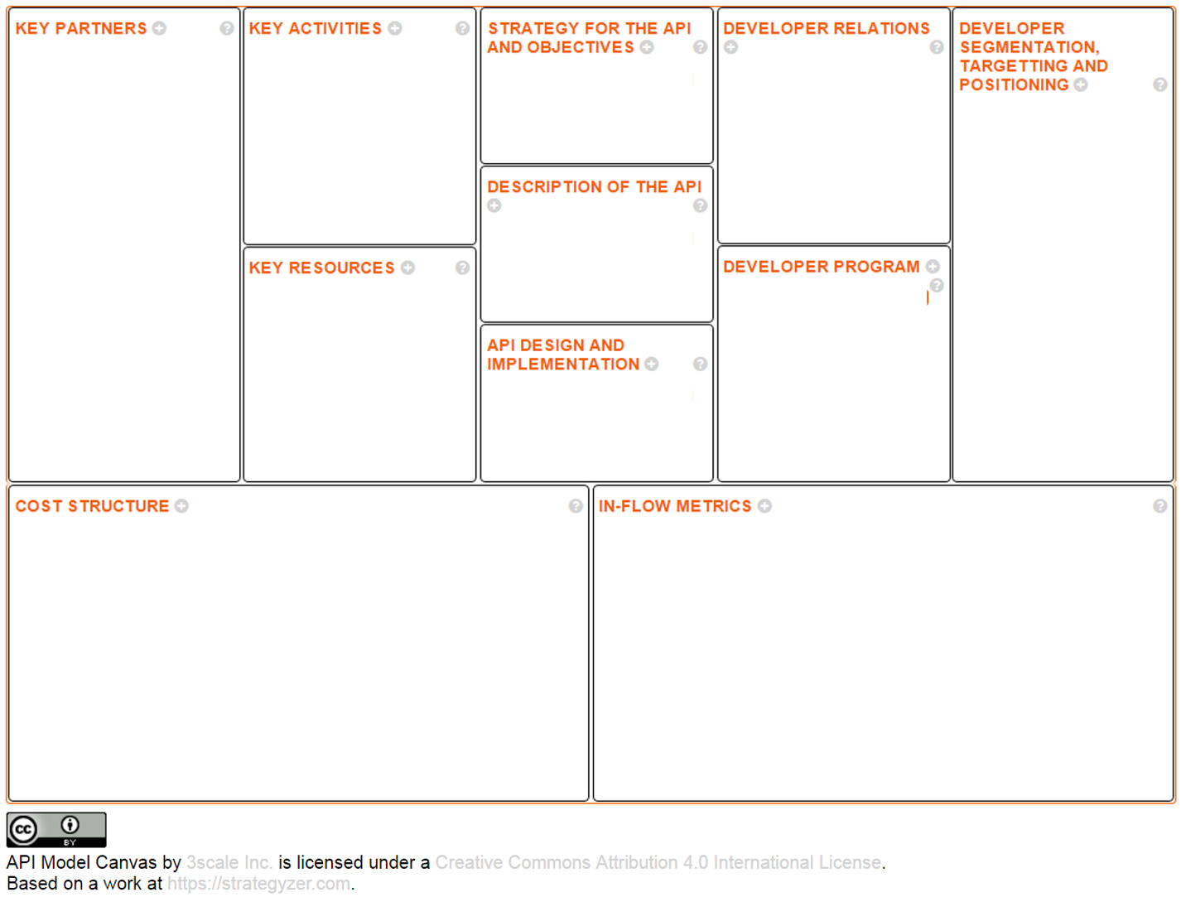

Slide 6
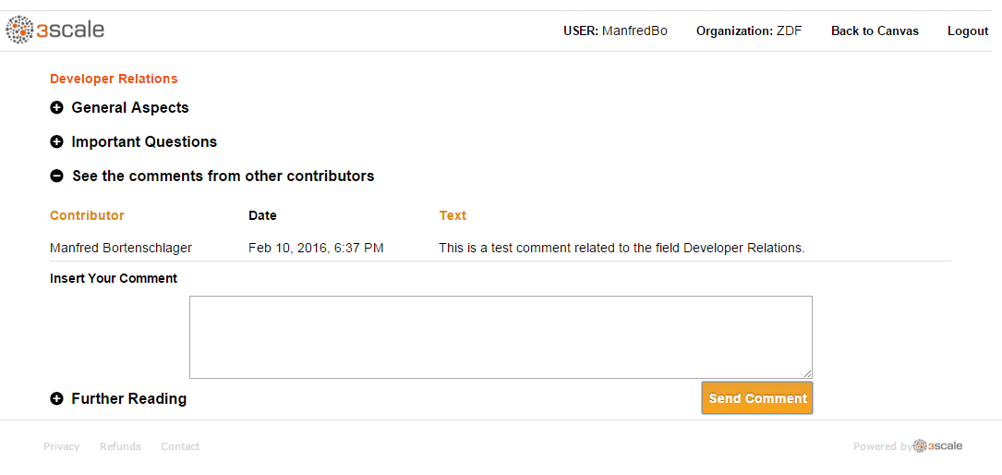
Example: Developer Relations field

Slide 7
We offer the API Model Canvas methodology in three forms:
Open-source
Self-service (Freemium)
Dedicated consulting
@ManfredBo

Slide 8
apicanvas.io
@ManfredBo

