Slide 1
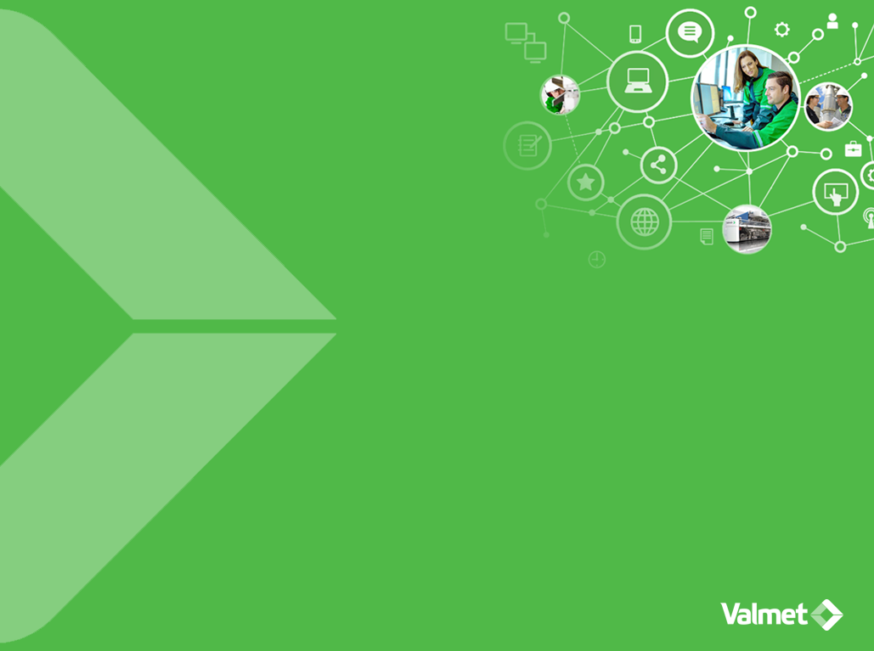
API Days Nordic 2016 Tampere
Mika Karaila
Research manager
Valmet Automation

Slide 2
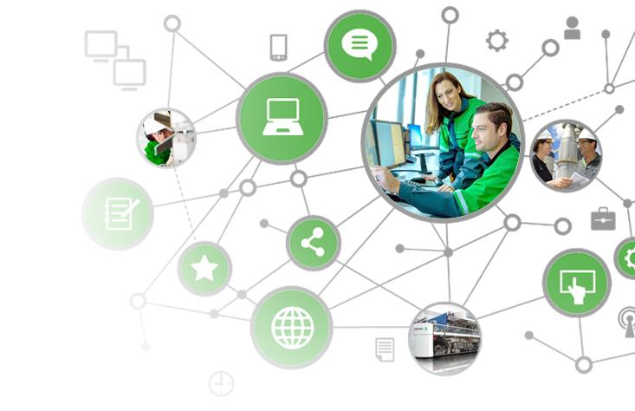
Contents
1
Importance of APIs for Industrial Internet
2
Visual flow programming: node-red
3
Using REST APIs and Swagger
4
Node-red meta programming
5
Summary

Slide 3

Importance of APIs for Industrial Internet

Slide 4
Evolution to Industrial Internet
Cross system impact
Cross-system optimization
Network of systems
Internet wide, deep analytics and business processes
Remote control and operations
System of systems
Data sharing and analytics between systems
Monitoring and Control
Product systems
Plant-wide data collection and control
Smart components
Connectivity and intelligence
Industrial Internet
Components
Mechanical function
Impact on work
Impact on industry
Impact on society
Notes:
If you believe what is published today on industrial internet, you could think that the industrial internet is something totally new and revolutionary. However, if you look at it from the digitalization viewpoint, you can see that what has been surfacing the last few years is only one step of many in the increasing digitalization of the industry.
Industries have step by step moved first from monitoring and controlling separate production process components to plant wide data collection and control. Now the following step is taking us towards cross system optimization, but we already know that the development will continue. The networks will grow bigger, eventually crossing over the industry boundaries.
Today, enabled by advanced communication technology and big data analysis, industrial internet is already moving to the next level– outside the production facilities. We believe that in the future we will see networks of different systems impacting each other, connecting different value chains, and thus changing the whole society in ways that we can hardly envision today.

Slide 5
Visual flow programming

Slide 6
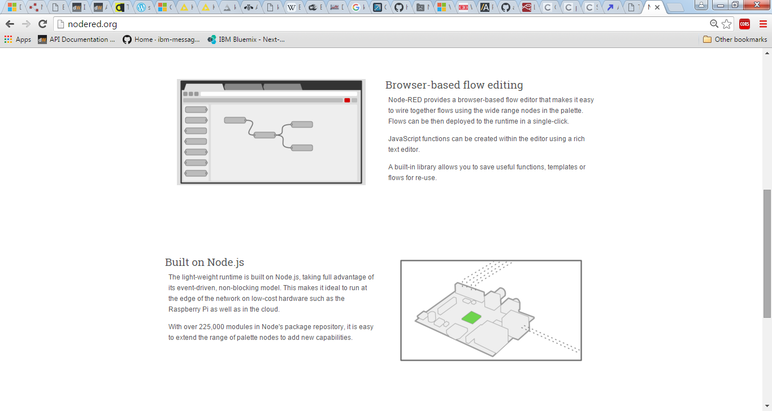
Node-red
Visual programming
http://nodered.org/

Slide 7
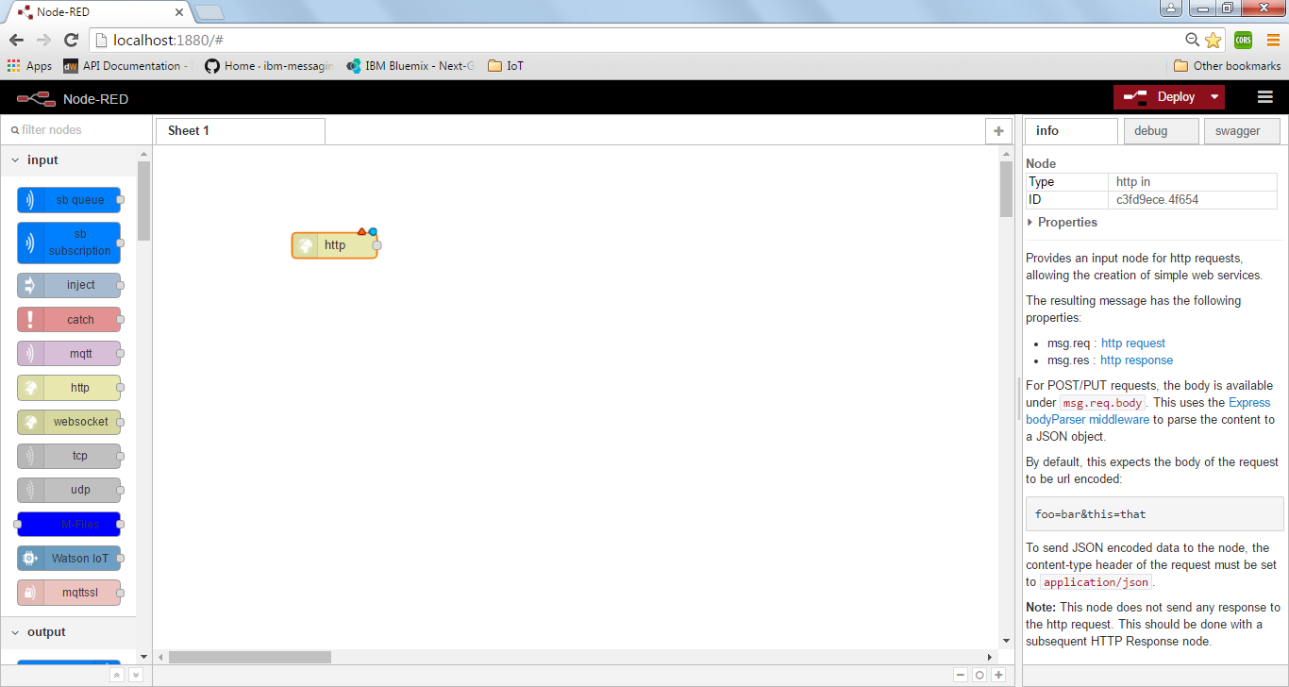
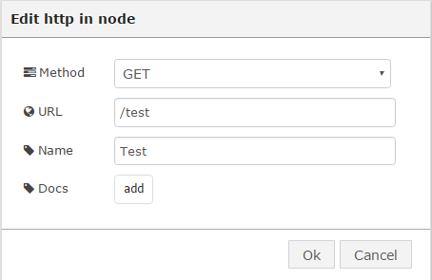
Node-red principles
Add node, edit parameters
Blue dot: not yet deployed
Red triangle: check parameters
Info: description

Slide 8
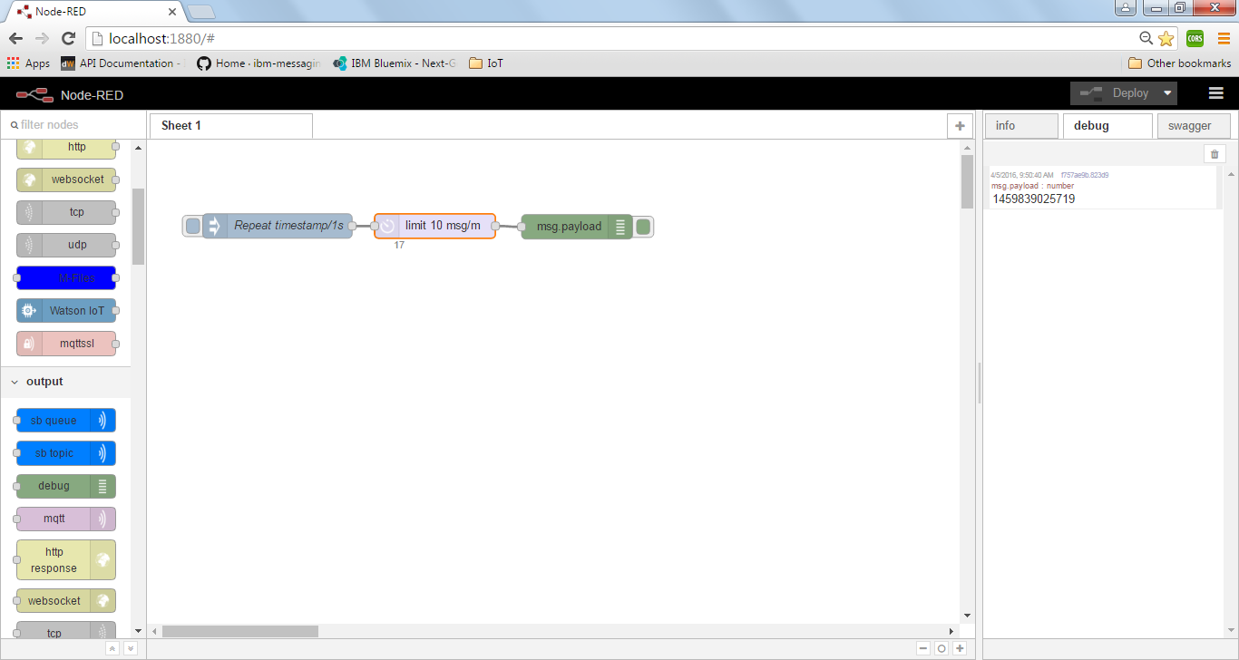
Node-red example
Nodes: Inject, limit, debug
Debug: timestamp value
Status: msg counter value

Slide 9
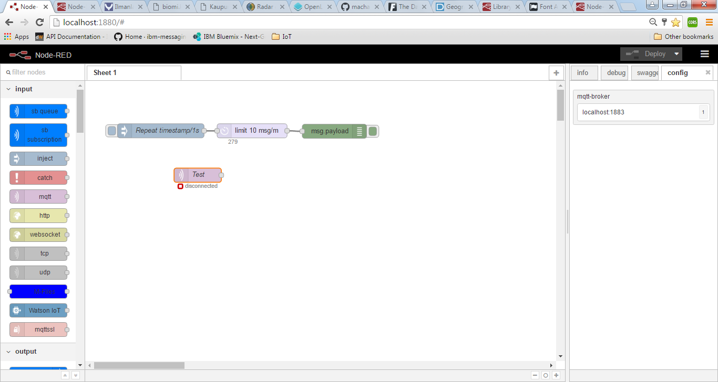
Server parameters in one node
Config: keeps all parameters in one node like server IP-address & user/passwd

Slide 10
Using REST APIs and Swagger

Slide 11
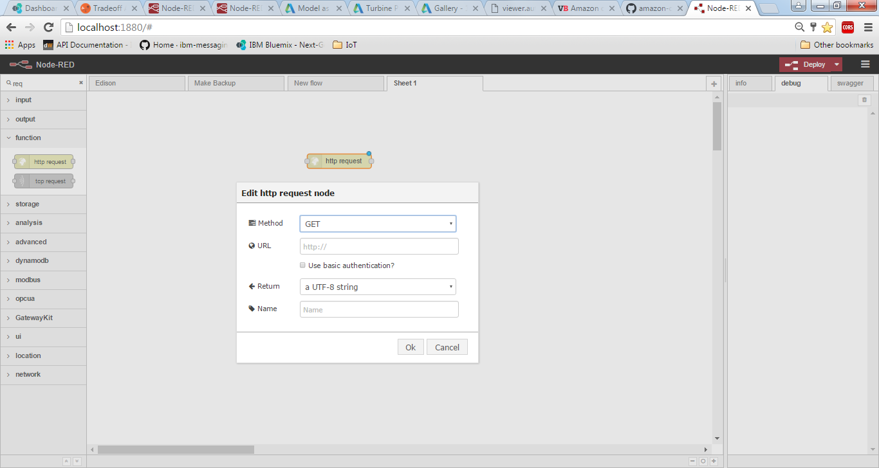
Creating REST API
http request node

Slide 12
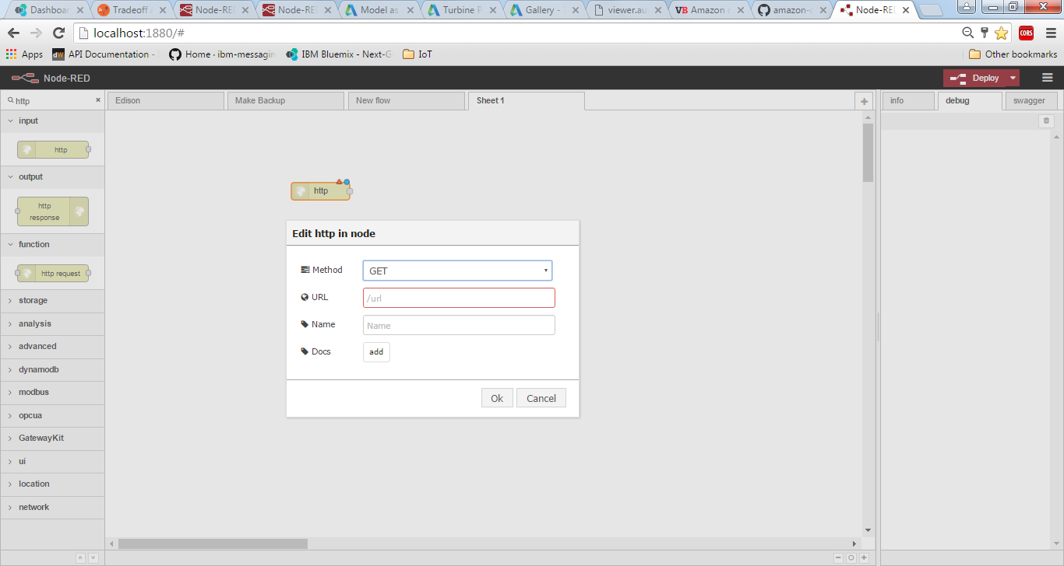
HTTP GET
Defining endpoint

Slide 13
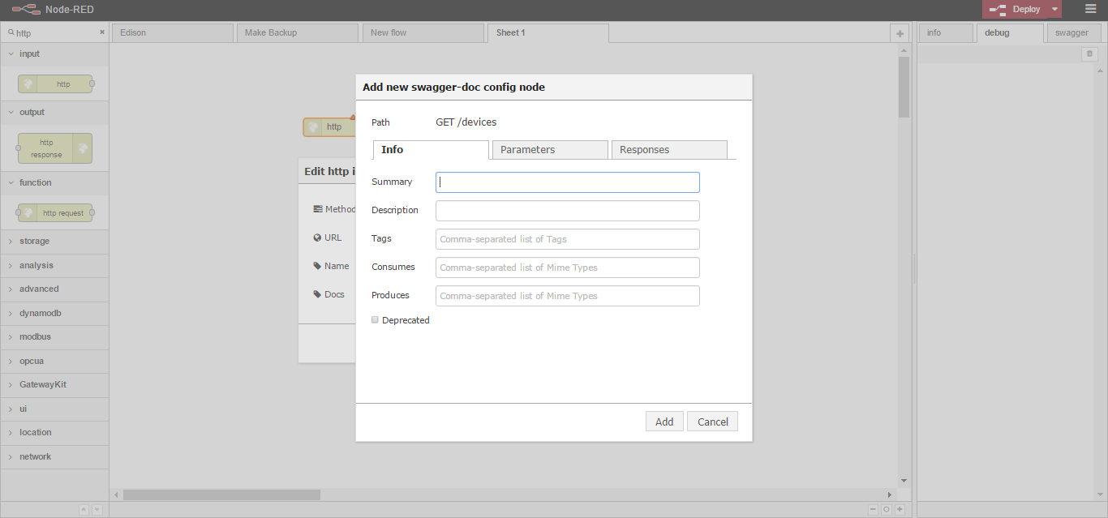
Documenting endpoint
Description

Slide 14
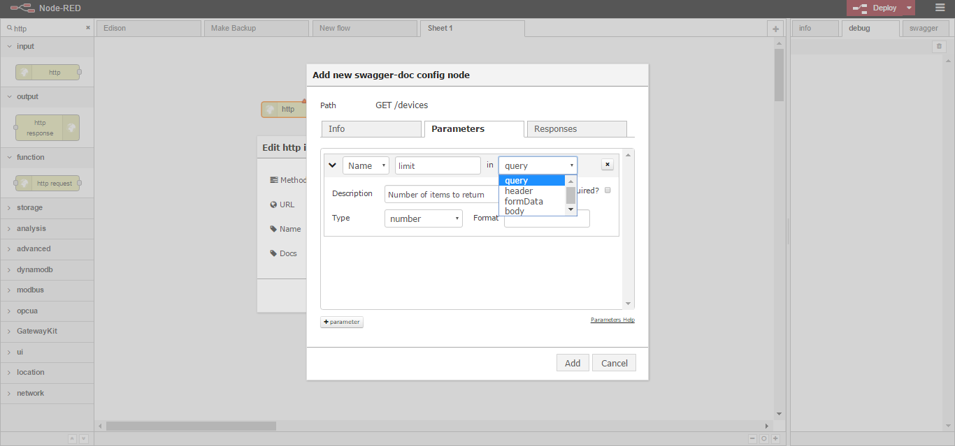
Parameters for endpoint

Slide 15
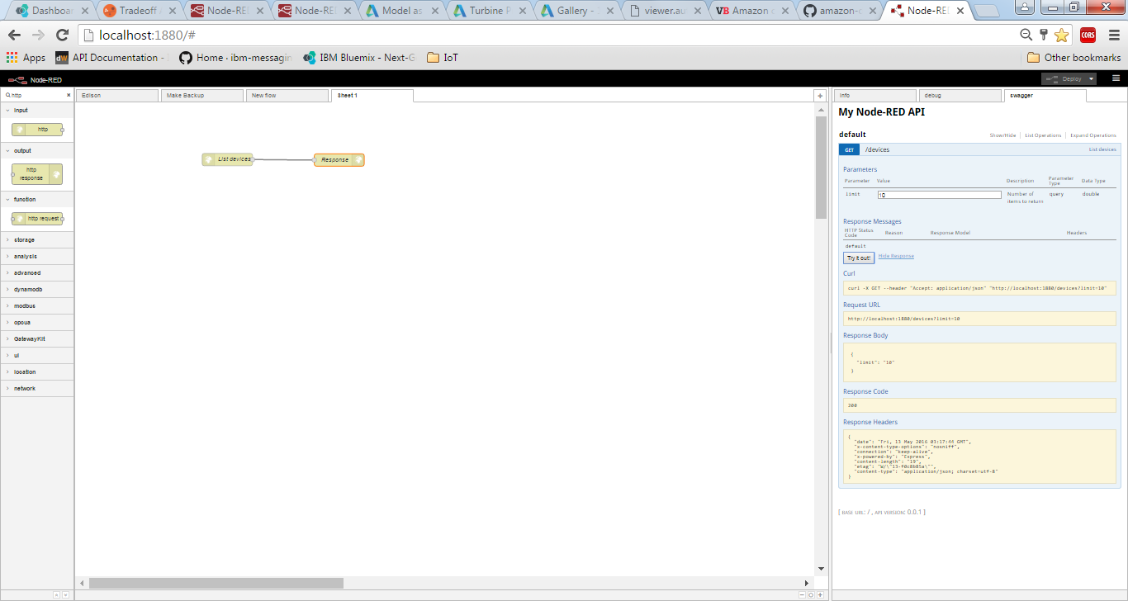
Deploy & use Swagger
Swagger integrated

Slide 16
Ready to use & test

Slide 17
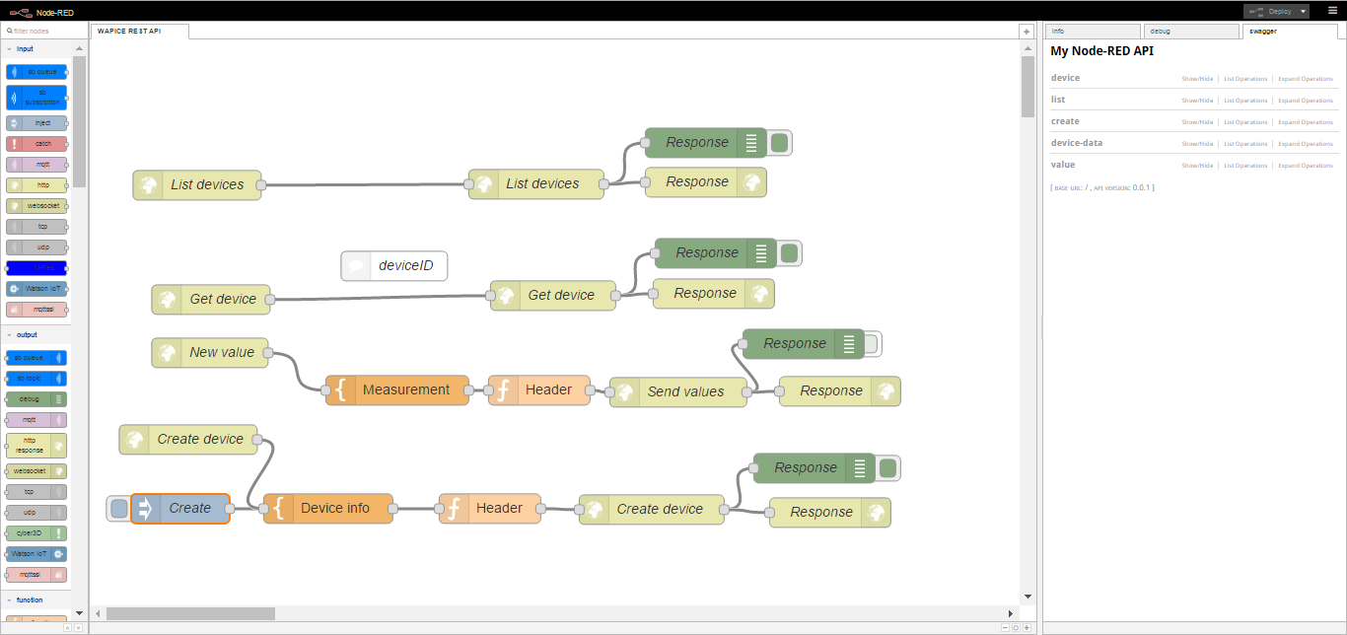
DEMO
Live demo with Wapice IoT-Ticket: swagger.json
Demonstrates how to use node-red with swagger to simplify and effective use REST interfaces

Slide 18
Node-red meta programming

Slide 19
Meta-programming
Program that creates a program
Node-red supports admin level REST interface
Endpoint to GET / POST to access flows
Ideal for managing & testing larger amount of nodes

Slide 20
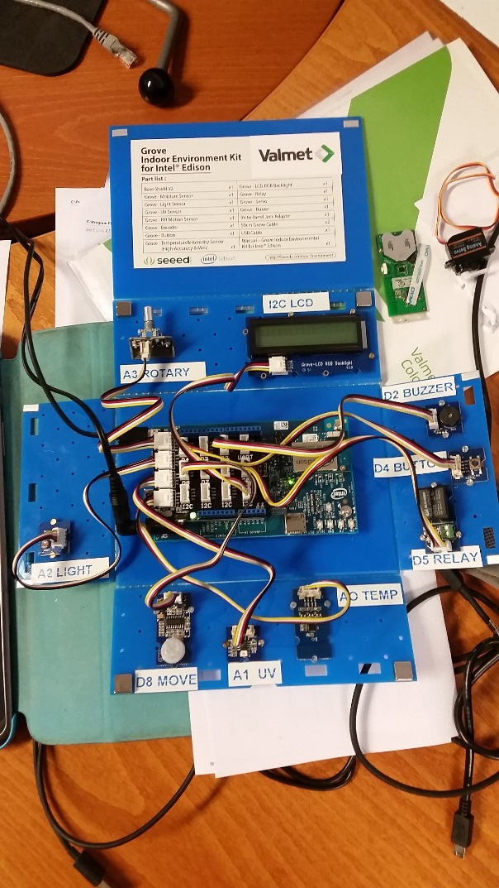
Demo hardware: Intel Edison + Groove kit
Intel Edison into base board
Base board into enclosure: 4 x metal lifters + 8 x screws
Arduino sensor adapter
Sensors: 2 x screws + 2 x nuts 4 x washers
Leave space for connectors: Power line + USB-debug

Slide 21
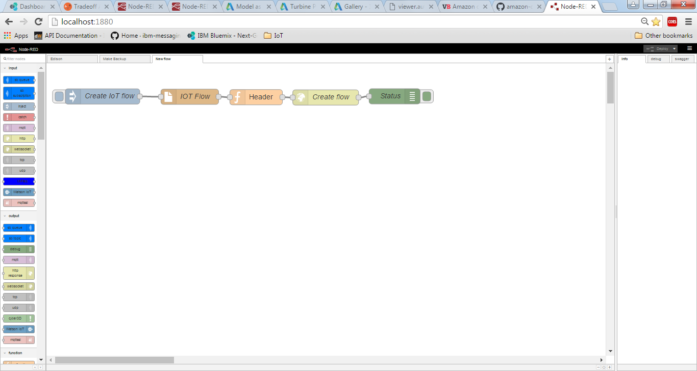
Simple flow that will send “program” to Edison

Slide 22
Demo summary
Same programming environment
Simple REST APIs
Effective and very easy to reuse => high productivity

Slide 23
Summary

Slide 24
Highlights
Document as you program
Test immediately
Easiness & productivity
Have fun !
Questions & discussion

