Slide 1

Securing Public Services with Blockchain
Ivo Lõhmus Program Manager

Slide 2

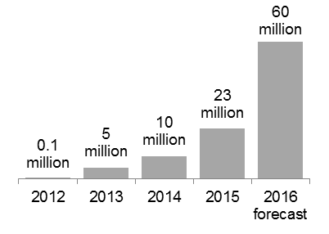



Guardtime at Glance
Tallinn, Estonia
Systems engineering company, fundamental & applied research into cryptographic applications
Founded in 2007 in Tallinn, Estonia
130 Full-time employees
30+ Global Patent Portfolio (8 issued)
Employee Owned, Customer Financed
Alexandria, VA
Amsterdam
Irvine, CA
Revenues, license + product, in USD
Customers
Thesis: the root cause for ineffective cybersecurity today is the lack of integrity of systems, networks, processes and data.
Technological Advantage: The KSI Blockchain is the only blockchain today that can be used for enterprise-scale data governance.

Slide 3

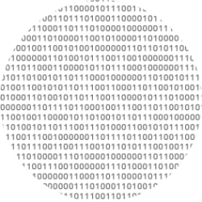

Traditional Approach to security
Build a fence around the data. This approach has fundamental flaws…
You can’t be 100% sure the fence is working (no instrumentation).
Supervisors, courts and the public have no transparency.
Cloud computing blurs the perimeter.
Over 50% of electronic fraud is conducted by insiders.
PERIMETER
ATTACKER
INSIDER

Slide 4
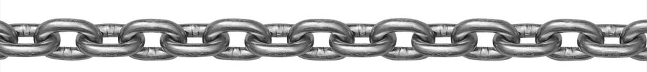

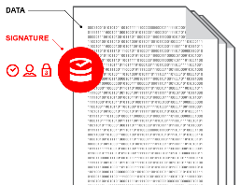
Solution to the Integrity Problem: Register Digital Assets in the Blockchain
Keyless Signature Infrastructure (KSI) enable the properties of siged data to be verified without the need for trusted third parties, keys or credentials that can be compromised.

Slide 5
Keyless Signature Infrastructure - KSI®
A blockchain technology
for verifying the integrity of systems and data at unprecedented scale.

Slide 6




KSI blockchain based asset authentication uses formal mathematical methods only, there are no secrets that can be compromised and conclusive proof of asset integrity is independent of any insiders or third parties.
The massive scale of the KSI enables authentication of billions of data items every second.
The KSI does not ingest any customer data – complete data privacy is guaranteed at all times.
KSI is quantum immune, meaning it’s security is not vulnerable to quantum algorithms run in existing or upcoming quantum computers, unlike i.e. RSA algorithm commonly used in PKI implementations.

Slide 7
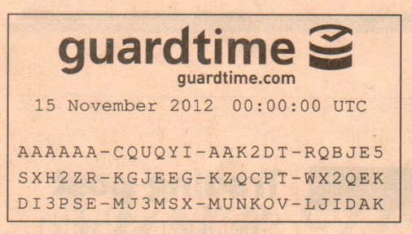
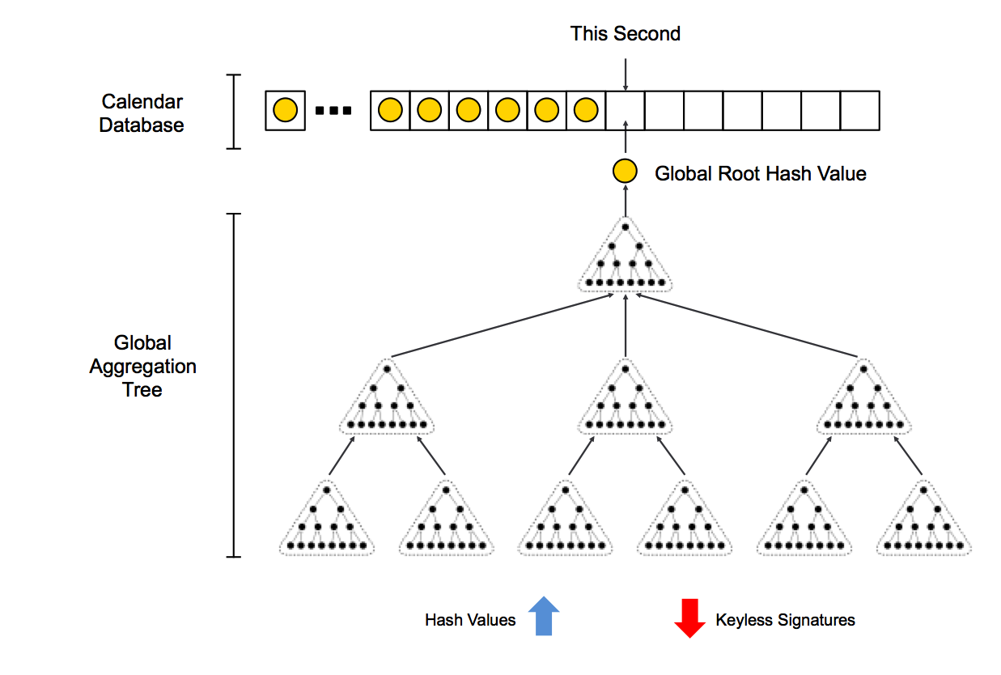
KSI Launched in April 2008 Global Blockchain Infrastructure
A global asynchronous Aggregation Tree summarizing all submitted Hash Values is built every second and destroyed after all clients have received their KSI Signatures.
Only the Global Root Hash Values of the Aggregation Tree are kept in a public Calendar Blockchain.
The Calendar Blockchain has exactly one entry for each second since 1970-01-01 00:00:00 UTC
Periodically, Calendar Blockchain is published in physical newspapers.
Calendar
Blockchain
Global
Aggregation
Tree
Hash Values
KSI Signature
Notes:
Change to hash chains

Slide 8
KSI Case Studies
Public Sector

Slide 9


Information System Authority Riigi Infosüsteemi Amet
KSI user since 2011
Access point to Government Institutions
Knowledge Centre for Integrations
Internal use-case: KSI provides tamper-proof audit/access logs
RIA Gateway Cluster
Government Institution
X-Road
Government Institution
Government Institution
Government Institution

Slide 10
Centre of Registers and Information Systems Registrite ja Infosüsteemide Keskus
KSI user since 2013
Business Registry
Property Registry
Succession Registry
Riigi Teataja
Official Announcements
Digital Court Files
…
Database Integrity
Transparency
Accountability
Forensic Proof
Fully Digital Governance

Slide 11
E-Health Foundation E-Tervise Sihtasutus
Implementation ongoing
Securing:
Medical records
Digital Prescriptions
Access Logs
Database Integrity
Liability
Regulatory Compliance
Forensic Proof
Prove record’s integrity in isolation!

Slide 12
KSI APIs
Native and Web-based

Slide 13
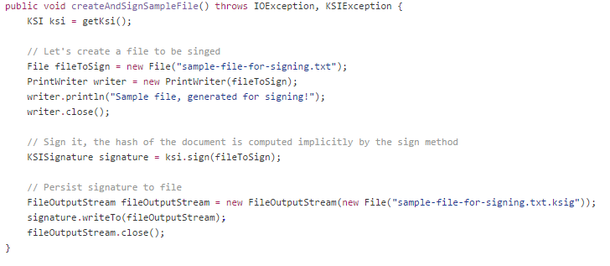
Native APIs
https://github.com/GuardTime
C
Java
.net
Full flexibility
Offline Verification

Slide 14
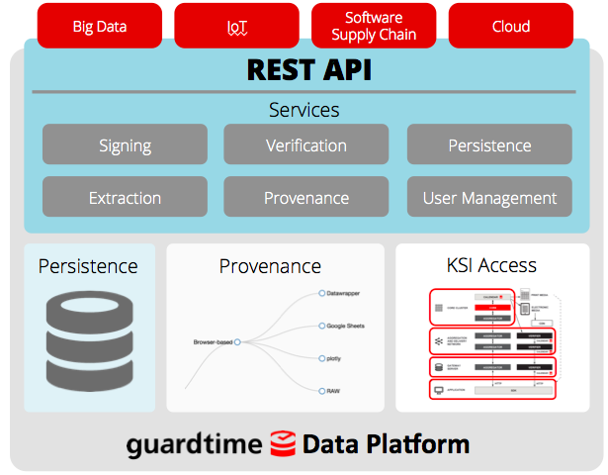
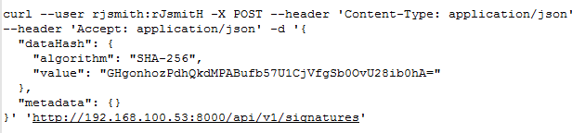
KSI Middleware Service

Slide 15
Developer Program
https://guardtime.com/blockchain-developers
Free fully functional service access, command-line utilities and documentation!

Slide 16
Thank you!
Ivo Lõhmus
Ivo.lohmus@guardtime.com

