Slide 1


Know-how materials related to X-Road
Heiko Vainsalu
X-tee Area Manager
18-May-2016
Notes:
Data exchange platform X-Road
I’m going to tell you about the data exchange platform X-Road

Slide 2
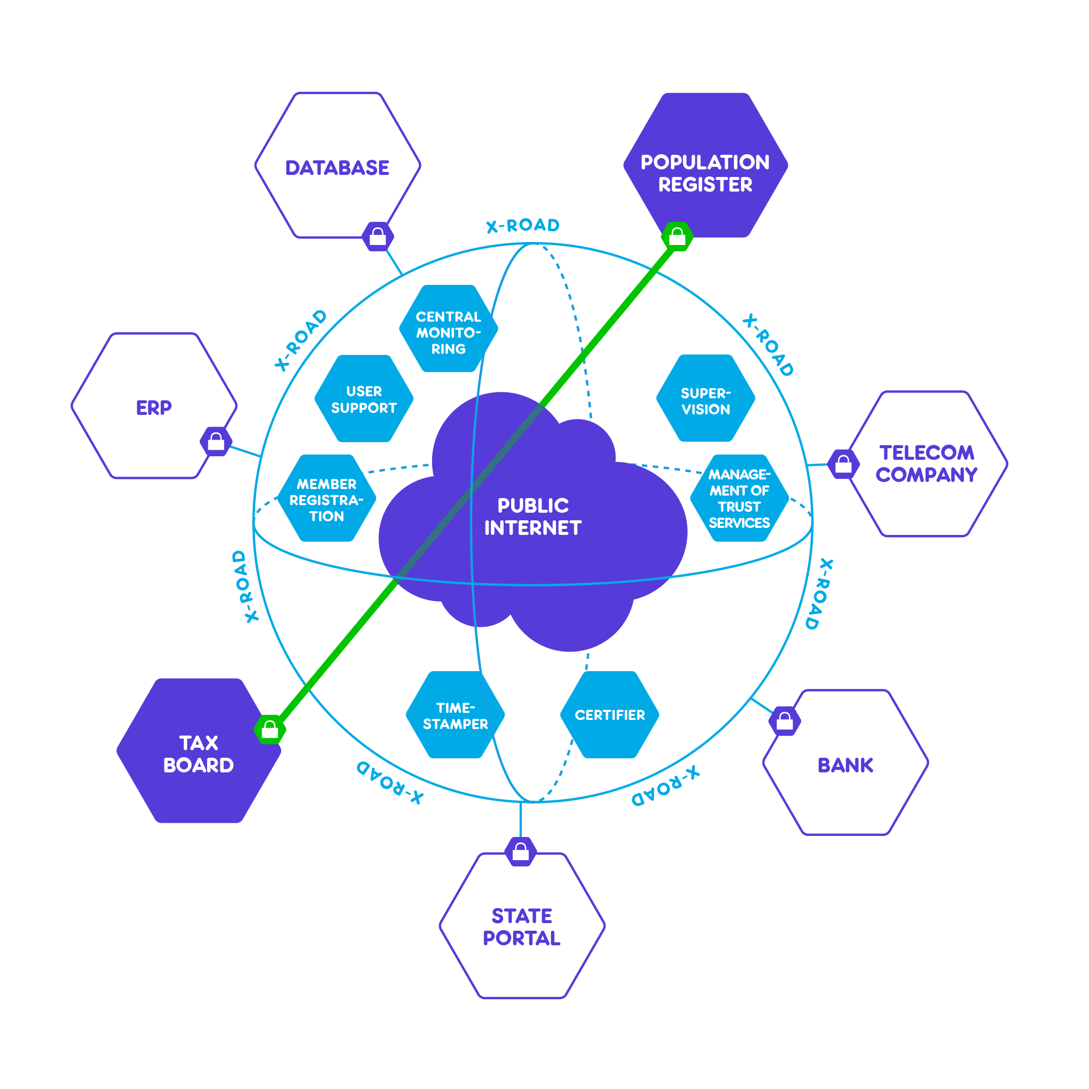
It’s So Simple.
It needs nothing to know about
only stateless web-services!
How complex could that be?
3000 services defined, ca 1600 used
Notes:
X-Road makes the distributed state information system manageable
On a wider scale, such distributes data exchange provides:
- Overview and control concerning the participants of the ecosystem and the kind of functions/services offered there. However, no party of the ecosystem has too much strength.
Overview of activity between parties: central monitoring concerning meta data of services provides an overview of the connections between parties/members (who is connected to whom and to what extent data is exchanged)
Interoperability
Universal interoperability is ensured between different members of the X-Road
Improving the ecosystem
- Provides an opportunity to implement other support systems that help improve the ecosystem (security measures, catalogue of business services and data, etc.)
Resource efficiency
There is no need to create separate data exchange platforms in different fields, the X-Road can be used across all fields of activity.

Slide 3
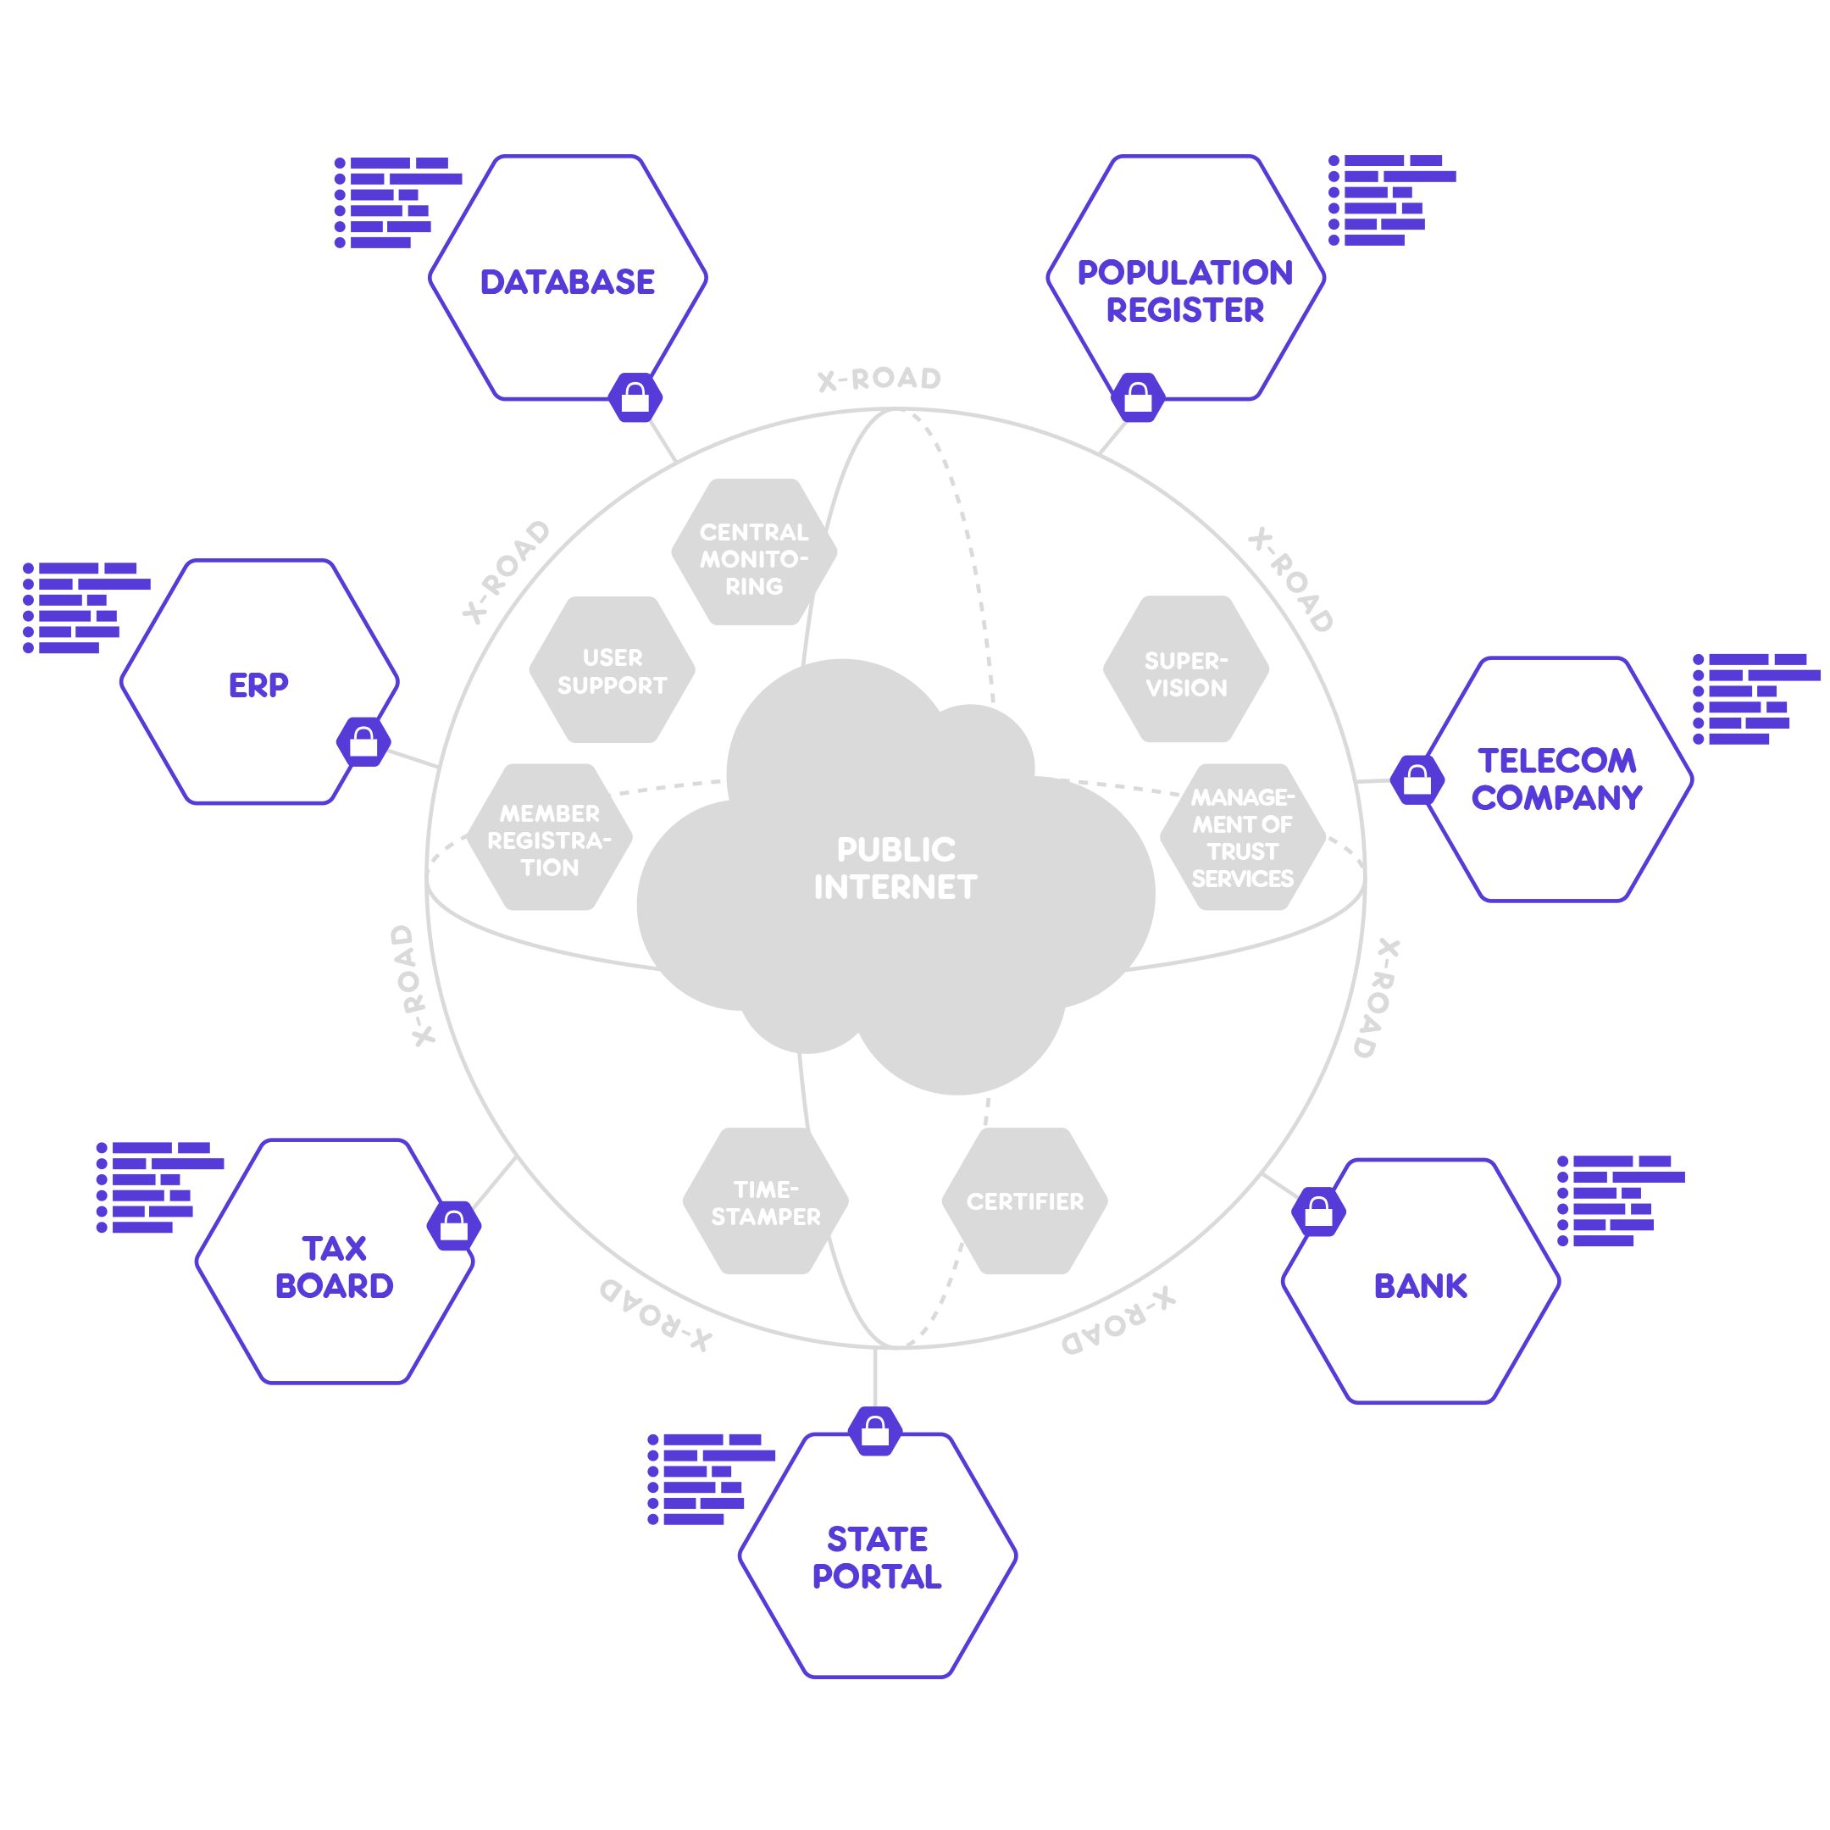
How To Make Best Use Of Freedom?
Notes:
Administration System for the State Information System
Complete picture of members and services
A regulation and overview tool for the ENTIRE state information system. In addition, there is also an overview of what kind of internal information systems (beside those connected to X-Road) members use.
Avoids double solutions and data collection
The overview about what/where/by whom has been done already eliminates the possibility of creating services that have the same content or collecting data that is already accessible.
Control over compliance with the law
Provides an overview of which members, and to what extent, comply with statutory requirements that are applicable to state information systems.

Slide 4
CEO
Promotional materials
Applicability Guide
Business process owner
Architect/developer
Administrator
Administrator training
X-Road protocol stack
Catalogue of interaction patterns
Developer training
Guide for joining X-tee
Developer
Catalogue of reusable components
X-Road web-service descriptions
X-Road SS user guide
Requirements for installation
X-Road knowledge-base
Why?
What?
How to make use of?
How to develop?
How to deploy?
Performance indicators
Notes:
Different parties
– The state/domain contains a lot of parties.
Each party (organisation/company) offers business services.
Data exchange
Each party processes some data. In order to create better services, it is necessary to reuse the data that other parties have obtained.
Interoperability
The need to find a universal solution to the data exchange problem – how to ensure interoperability and information security during data exchange between different parties?

Slide 5
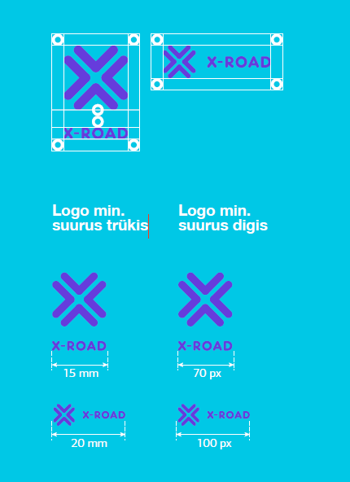

Promotion and mini CVI
http://ria.ee/x-tee/fact
Notes:
Different parties
– The state/domain contains a lot of parties.
Each party (organisation/company) offers business services.
Data exchange
Each party processes some data. In order to create better services, it is necessary to reuse the data that other parties have obtained.
Interoperability
The need to find a universal solution to the data exchange problem – how to ensure interoperability and information security during data exchange between different parties?

Slide 6
X-Road Applicability Guide and
Catalogue of Interaction Patterns
X-Road applicability guide (what X-Road is good for) introduces different options for using X-Road from business perspective.
X-Road Catalogue of Interaction Patterns (how to used X-Road).
Optimize the learning curve of X-Road service development cycle and improve quality of services.
Notes:
Different parties
– The state/domain contains a lot of parties.
Each party (organisation/company) offers business services.
Data exchange
Each party processes some data. In order to create better services, it is necessary to reuse the data that other parties have obtained.
Interoperability
The need to find a universal solution to the data exchange problem – how to ensure interoperability and information security during data exchange between different parties?

Slide 7
Catalogue of Reusable Components
…overview of components and applications that work on top of X-Road protocol stack.
Phase 1 – study, component discovery and analysis.
Phase 2 – building the catalogue:
- review discovered components
- describe the components
- publish
- set references how link/upload additional stuff
https://github.com/jointxroad/components
Notes:
Different parties
– The state/domain contains a lot of parties.
Each party (organisation/company) offers business services.
Data exchange
Each party processes some data. In order to create better services, it is necessary to reuse the data that other parties have obtained.
Interoperability
The need to find a universal solution to the data exchange problem – how to ensure interoperability and information security during data exchange between different parties?

Slide 8
X-Road Security Server Adminsitrator Learning Materials And Pilot Trainings
Partner: JukuLab OÜ
Output: Estonian and English version of individual tutoring (may 2016)
Pilot Trainings – to test the output
- Tallinn and Helsinki (June, August 2016)
- a 10-20 persons
Published in moodle.ria.ee environment.
Notes:
Different parties
– The state/domain contains a lot of parties.
Each party (organisation/company) offers business services.
Data exchange
Each party processes some data. In order to create better services, it is necessary to reuse the data that other parties have obtained.
Interoperability
The need to find a universal solution to the data exchange problem – how to ensure interoperability and information security during data exchange between different parties?

Slide 9
X-Road Webservice Developer Trainings
Traditional developer training .
Oriented for class room trainings.
X-Road relevant approach.
6 trainings in Estonia.
Translated to English.
Active procurement.
Notes:
Different parties
– The state/domain contains a lot of parties.
Each party (organisation/company) offers business services.
Data exchange
Each party processes some data. In order to create better services, it is necessary to reuse the data that other parties have obtained.
Interoperability
The need to find a universal solution to the data exchange problem – how to ensure interoperability and information security during data exchange between different parties?

Slide 10
Thank You!
Heiko Vainsalu
http://ria.ee/x-tee/fact
The introductory materials of the X-Road have been compiled with funding from the structural funds support scheme “Raising Public Awareness about the Information Society” of the European Regional Development Fund.

