Slide 1




Heavy Industry and APIs &
Government Driven API Platforms
Organizers
APIOps (APIs, DevOps, containers, testing, micro services and monitoring)
18.-19.5.3016
Organized at Nordic API Capitol –
City of Tampere, Finland
Sponsors

Slide 2
Super API Spring 2016
January - X-Road in production in Finland
January – API Manifesto in Finnish
February - Finna API metadata for almost 9 million entries of the Finnish cultural heritage
March – “Digi dating” event (APIs in major role)
April - The API Stack Conference – Nordic APIs
June – API Days Nordic
18.-19.5.2016
Tampere
Finland

Slide 3
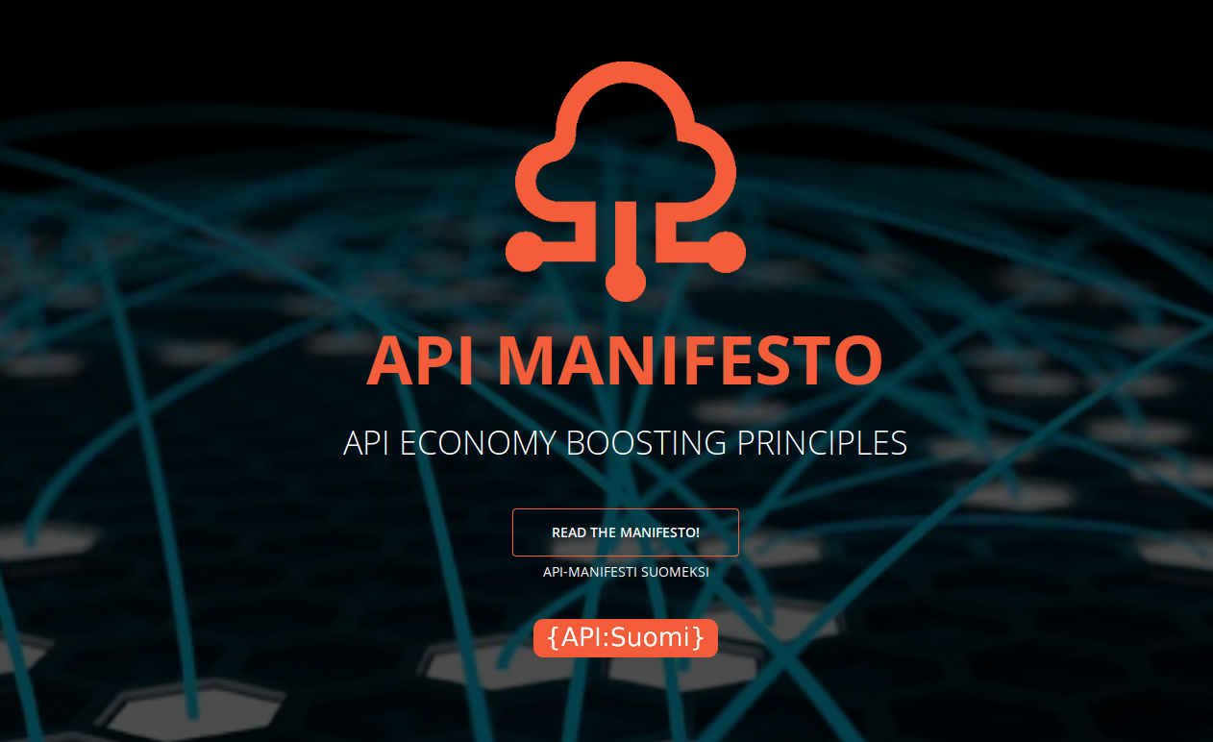
apimanifesti.fi/en

Slide 4
Program
3 keynotes
Change to different building (Pinni B)
  Lunch
18.-19.5.2016
Tampere
Finland

Slide 5
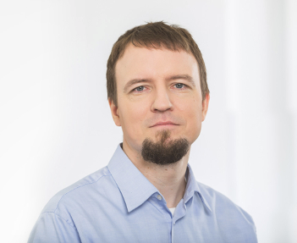
Architecting a Country
Andres Kütt
Estonian information system architect
18.-19.5.2016
Tampere
Finland

