Slide 1
Final Project: Sodium Data Levels in hospital Patients
Arianna Pierre, Tai Polur

Slide 2
Introduction
Our general research topic is to determine the level of sodium in admitted patients. Throughout the data, the sodium level is either flagged or not, further variables would describe the admitted patients' sodium level as low, normal, or high.
Based on the data provided, the purpose of our research is to determine the median age of each level of sodium.

Slide 3
Prerequistes
The following packages need to be downloaded from the library
library(tidyverse)
library(ggplot2)
library(pivottabler)

Slide 4

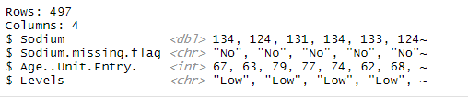
Data description
- We created this data from the original csv. It contains Sodium points, Sodium Missing flags, Age at the Entry, and Levels.

Slide 5

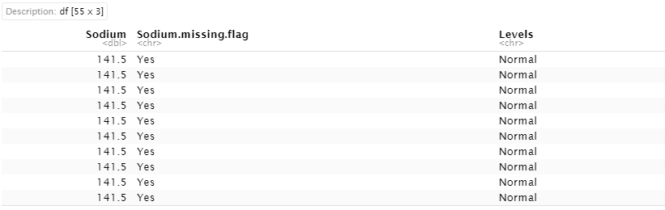
Sodium Missing
Missing sodium means when the patient has enough sodium in their body to show they did not set off a test that could mean they are critically ill.

Slide 6
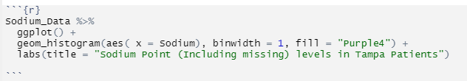
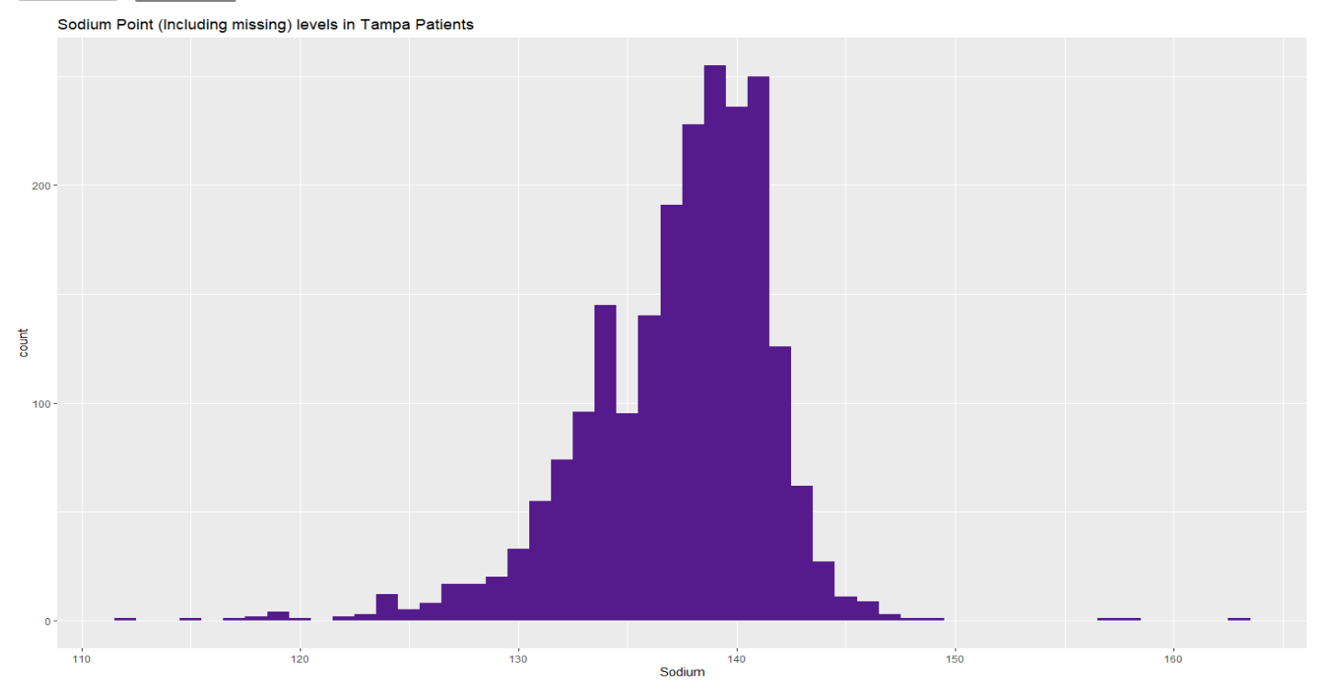
Data Analysis
In this data we made a histogram of all the sodium points including the missing points.
This ranged between 112 and 163

Slide 7
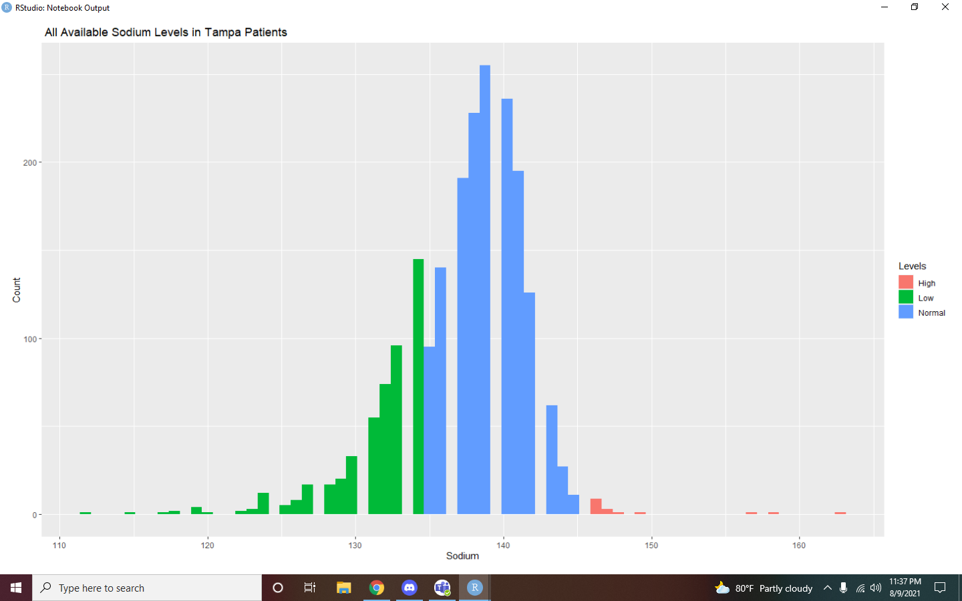
Sodium Level
When sodium levels in the blood are lower than 135 meq/l, it is a condition called Hyponatremia.
Sodium levels between 135 and 145meq/l are within the normal range.
When sodium levels in the blood are higher than 145 meq/l, it is a condition called Hypernatremia.

Slide 8
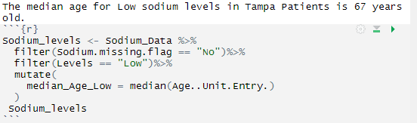
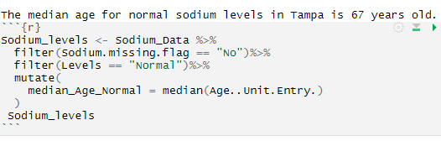
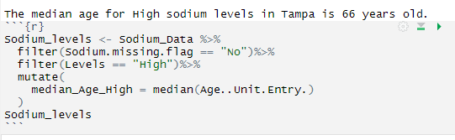

Slide 9
Conclusion
In conclusion, based on our data analysis and our research question provided us the answer that there was a median age level that corresponded with a specific sodium level group.
This means that there was a common age that was found in a respective sodium level group, despite there being a few outliers. We learned that these sodium levels are result of underlying health conditions.

Slide 10
Citations
Mayo Clinic:
https://www.mayoclinic.org/diseases-conditions/hyponatremia/symptoms-causes/syc-20373711
Annals of intensive care
https://annalsofintensivecare.springeropen.com/articles/10.1186/s13613-018-0442-2

