Slide 1
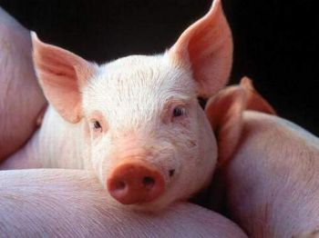
Self parameterizing tools and subsystems in animal genetic evaluation
Ulf Müller, Ralf Fischer, Eildert Groeneveld

Slide 2
outline
- introduction
- problems / objectivs
- general output format
- self parameterizing
- applications
- summary

Slide 3
stages of animal breeding
performance testing
selection
mating
necessary information
- animal
- performances
- breeding program
- heritabilities
- genetic variances
- grouping, basis
- breedings values
- total breeding values
- standard errors
- breeding values
- change of inbreeding
- change of population parameters
actions
variance
components
estimation
breeding
value
estimation
total
breeding
values
storage
controlling
publication
applications
postgres
oracle
...
VCE
ASReml
...
PEST
PigBlup
...
individual Software

Slide 4
problems
1. The whole process of breeding value estimation is very
expensive so it is not done very often
2. A lot of specialized knowledge is necessary, therefore
these steps were usually developed through projects in
universities. However the universities are not interested
in continuing with these projects.
3. There are a lot of applications for each single action -
scientific software or applications created by individuals.

Slide 5
objectivs
- combine different applications
- automize the whole process of breeding value estimation
- use standard software instead individual software

Slide 6
hierachical structure of information
variance
components
estimation
breeding
value
estimation
total
breeding
values
storage
controlling
publication
- type of information are known
- conditions between information are known
- structure of results are known
- configuration parameters are known
using of previous configuration and currently results to create the following configuration

Slide 7
general output format
data
configuration
breeding value estimation
method
output
A1
A2
A3
applications
parser
for A3
for A2
for A1
new applications with new aggregations

Slide 8
self parameterizing
data
configuration
total breeding values
method
output
A1
A2
A3
B1
B2
applications
parser
for A3
for B1
for A2
for B2
for A1

Slide 9
applications
PopulationReport
- reports on population structure under biodiversity aspects
- support for small and endangered populations
arroundVCE
- parser for vce-runs
- produce parameterfile for vce runs
- format matrices
postEST
- detect weak spots and systematic problems
- change of BLUP were observed over time
- genetic trend can be computed
- produce parameterfile for calcTBV
calcTBV
- aggregate breeding values are computed
- produce parameterfile for ZwISSS

Slide 10
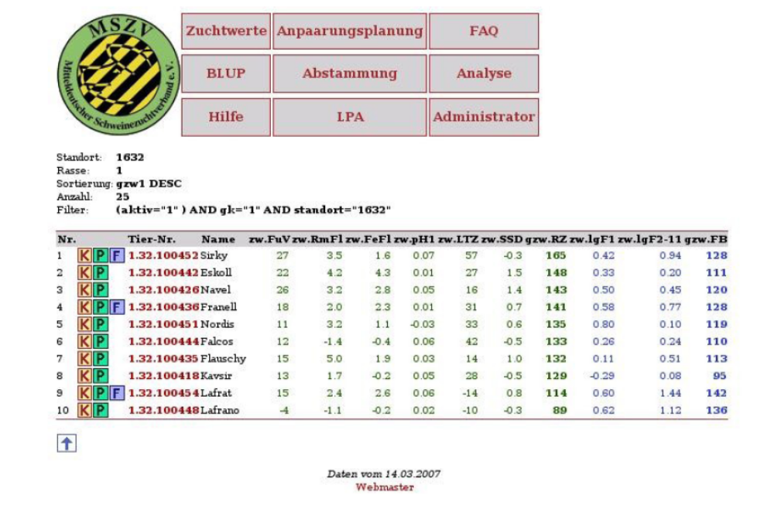
ZwISSS

Slide 11
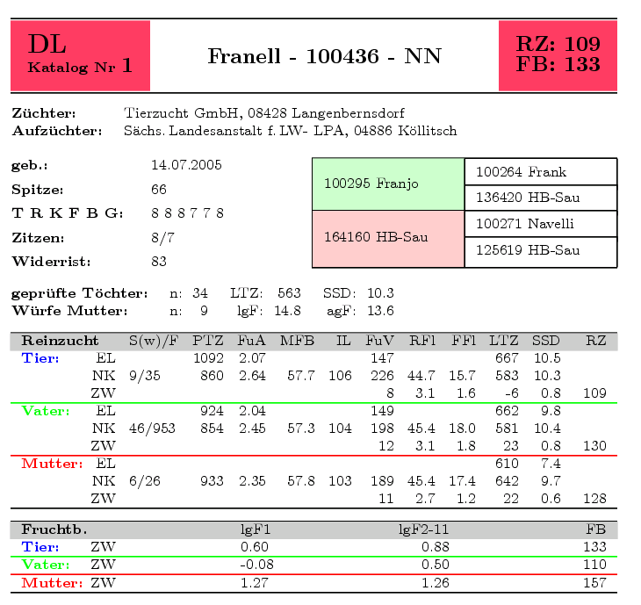
ZwISSS

Slide 12
summary
performance testing
selection
mating
variance
components
estimation
breeding
value
estimation
total
breeding
values
storage
controlling
publication

Slide 13
summary
Parsers were developed to put results into a general
structure in a database by using the extracted information
about configuration and results from a given application.
Configurable and general software is developed to publish
breeding values via webaccess and to control the whole
continous process of breeding value estimation.

